Slide 1

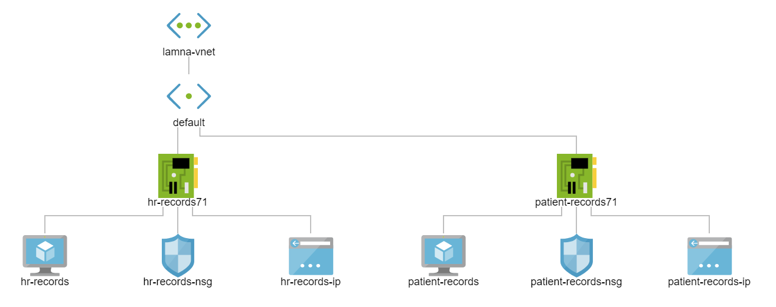
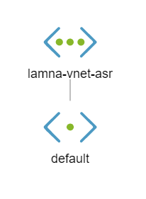
Azure Site
Recovery
Primary region
(West US 2)
Recovery region
(East US 2)

