Slide 1
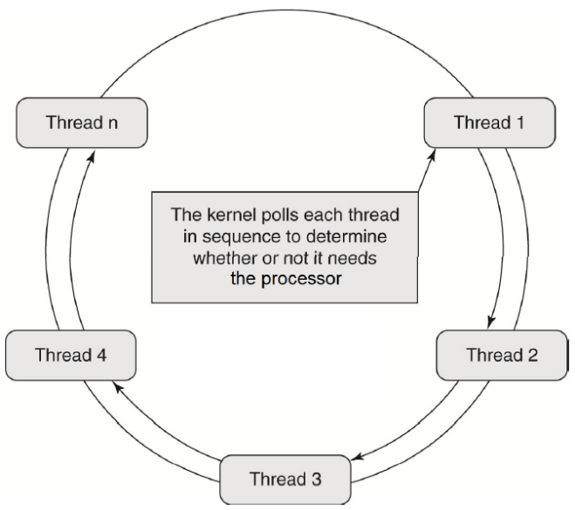
Figure 1
Thread n
Thread 1
The kernel polls each thread in sequence to determine whether or not it needs the processor
Thread 4
Thread 2
Figure 1. Big Loop Scheduling
Thread 3

Slide 2
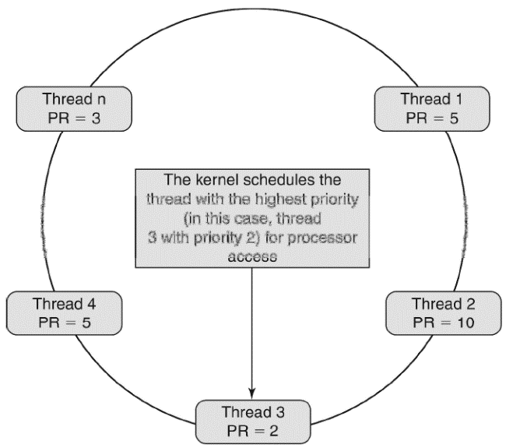
Figure 2
Thread n PR = 3
Thread 1 PR = 5
The kernel schedules the thread with the highest priority (in this case, thread 3 with priority 2) for processor access
Thread 4 PR = 5
Thread 2 PR = 10
Figure 2. RTOS Scheduling
Thread 3 PR = 2

Slide 3
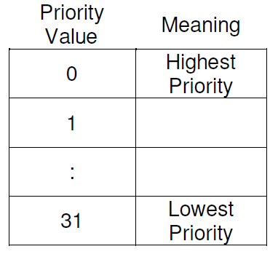
Figure 4
Priority Value
Meaning
0 | Highest Priority
1
:
31 | Lowest Priority
To export this as a Picture, you need to select the Table and Grouped background BOTH … then right-click, Save As Picture (tables can’t be grouped in PowerPoint)

Slide 4
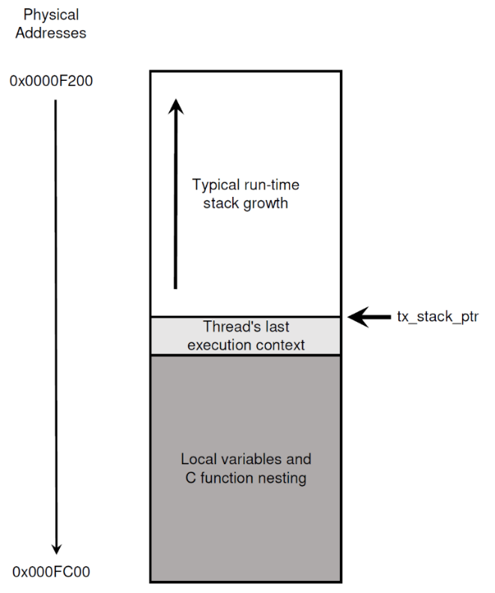
Figure 5
Physical Addresses
0x0000F200
Typical run-time stack growth
tx_stack_ptr
Thread’s last execution context
Local variables and C function nesting
0x000FC00
Figure 5. Example of a Thread Stack

Slide 5
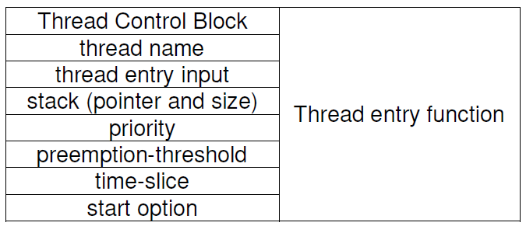
Figure 6
Thread Control Block | Thread entry function
thread name
thread entry input
stack (pointer and size)
priority
preemption-threshold
time-slice
start option
Figure 6. Attribures of a Thread
To export this as a Picture, you need to select the Table and Grouped background BOTH … then right-click, Save As Picture (tables can’t be grouped in PowerPoint)

Slide 6
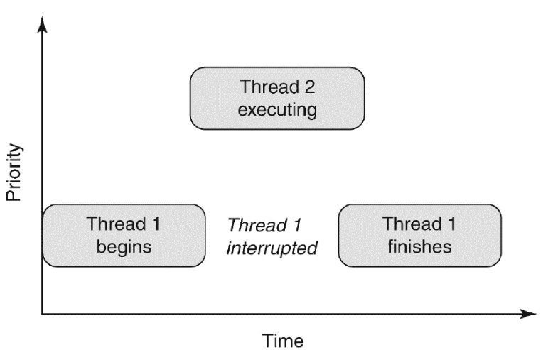
Figure 7
Thread 2 executing
PRIORITY
Thread 1 begins
Thread 1 interrupted
Thread 1 finishes
Figure 7. Priority-Based Preemption
TIME

Slide 7
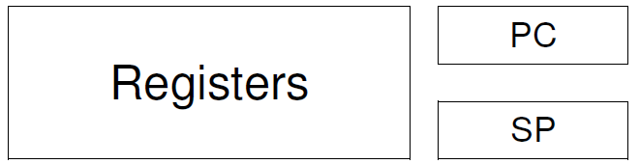
Figure 8
Registers
PC
SP
Figure 8. Example of Thread Context

