Slide 1
Resources
Kubernetes icon set: https://github.com/kubernetes/community/tree/master/icons
License
The Kubernetes Icons Set is licensed under a choice of either Apache-2.0 or CC-BY-4.0 (Creative Commons Attribution 4.0 International). The Kubernetes logo is a registered trademark of The Linux Foundation, and use of it as a trademark is subject to The Linux Foundation's Trademark Usage Guidelines at https://www.linuxfoundation.org/trademark-usage/.

Slide 2

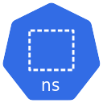
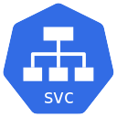

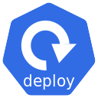



Azure Kubernetes Service
ratingsapp
Type: ClusterIP
ratings-mongodb
mongosecret
ratings-mongodb.ratingsapp.svc.cluster.local

Slide 3
Azure Kubernetes Service
ratingsapp
Type: ClusterIP
ratings-mongodb
mongosecret
ratings-mongodb.ratingsapp.svc.cluster.local
MongoDB traffic
ratings-api
Type: ClusterIP
ratings-api.ratingsapp.svc.cluster.local

Slide 4


Azure Kubernetes Service
ratingsapp
Type: ClusterIP
ratings-mongodb
mongosecret
ratings-mongodb.ratingsapp.svc.cluster.local
MongoDB traffic
ratings-api
Type: ClusterIP
ratings-api.ratingsapp.svc.cluster.local
API traffic
Public IP
Azure Load Balancer
HTTP traffic from internet
Type: LoadBalancer
ratings-web
Public IP: 10.23.22.11

Slide 5
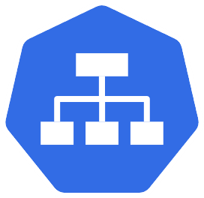
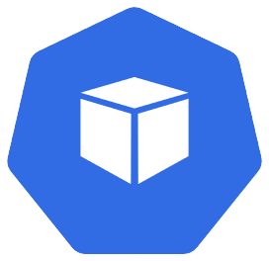




Deploy the Order Capture API – Architecture
Azure
Kubernetes
orders-mongo-mongodb
Service (ClusterIP)
orders-mongo-mongodb.default.svc.cluster.local
pods
MongoDB connection/traffic
Service (LoadBalancer)
Load Balancer
deployment
port:80
Public IP for
captureorder
captureorder
captureorder
HTTP traffic from internet
port:8080
secret
mongodb

Slide 6

Deploy the Frontend Using Ingress – Architecture
Azure
Kubernetes
secret
orders-mongo-mongodb
mongodb
Public IP for
captureorder service
HTTP traffic from internet
pods
deployment
Load Balancer
service
captureorder
HTTP traffic from internet via ingress
frontend.12.34.56.78.nip.io
Public IP for
Ingress controller
service
ingress
service
deployment
ingress controller
serviceName:frontend
frontend
frontend

Slide 7


Enable SSL/TLS on Ingress – Architecture
Azure
secret
Kubernetes
orders-mongo-mongodb
clusterissuer
mongodb
tls-secret
cert
serviceName:captureorder
pods
frontend.12.34.56.78.nip.io
deployment
orders.12.34.56.78.nip.io
ingress
Load Balancer
service
service
captureorder
Public IP for
Ingress controller
ingress controller
ingress
service
deployment
HTTP traffic from internet via ingress
serviceName:frontend
frontend
frontend

Slide 8

Kubernetes Ingress – Simple Architecture
Azure
Kubernetes
rules:
- host: foo.example.net
Foo
pods
Type: LoadBalancer
ingress
service
Load Balancer
service
Type: ClusterIP
Public IP for
Ingress controller
ingress controller
Bar
ingress
pods
Public DNS
bar.example.net
foo.example.net
Both point to public IP
of the ingress controller
rules:
- host: bar.example.net
service
Type: ClusterIP

