Slide 1




Unit 2
2-other-big-data-engines.png
Hive
LLAP
Spark
Presto
Common Hive
Metastore
Azure Storage

Slide 2

Unit 3
3-hive-architecture.png
OCBC or JDBC client tool
Data Analytics Studio
Zepplin Notebook
Visual Studio Code
Visual Studio
HiveView 2.0
HiveQL Queries
SELECT * FROM … WHERE …;
Metastore
HiveServer Interactive
Interactive Query cluster
Cluster node [LLAP Daemon]
Cluster node [LLAP Daemon]
Cluster node [LLAP Daemon]
SSD + Shared in-memory cache
Business data storage
Azure Storage Blobs
Azure Data Lake Storage Gen1 or Gen2

Slide 3



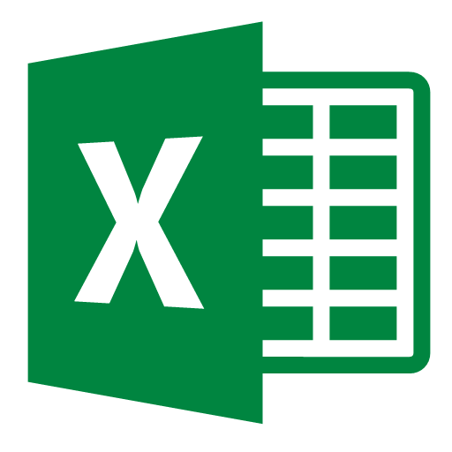












Solution Architecture on HDInsight
Unit 3
3-solution-architecture.png
Cold path
Serving-layer
Streaming/Real-Time/
Application
Corporate Data
ETL
Ingest batch data
Spark, Hive, Pig on Azure HDInsight
AdHoc Query
Analytics
Data Exploration
Corporate
Reporting
Self-Service BI
Interactive Query (Hive LLAP) or Spark on Azure HDInsight
HDFS Compatible Storage
(Data Lake)
Store real-time data
for long term analysis
Azure Blob Storage
Azure Data Lake Storage
Azure Cosmos DB
Advanced Analytics & Data Science
Machine Learning
R, Python, APIs
Hot path
Devices & Sensors
HBase on Azure HDInsight
Kafka on Azure HDInsight
Spark Streaming on Azure HDInsight
Downstream applications
access the structured low
latency storage
Ingest real-time data
Real Time NoSQL Store
Azure IoT Hub
Governance
AZURE DATA FACTORY
AZURE
ACTIVE DIRECTORY
AZURE NETWORK
SECURITY GROUPS
AZURE KEY
MANAGEMENT SERVICE
AZURE LOG ANALYTICS

