Slide 1



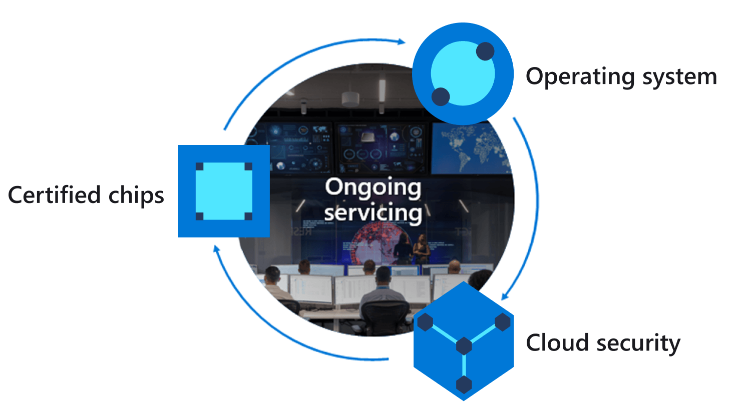
Azure IoT Explorer
Azure IoT Hub
Azure Sphere
1
2
Invoke device restart command
Restart device handler
Direct method
Device twin
3
Query and display restart date and time
property
Properties.Reported
Report restart Time (UTC)
JSON
5
Restart device
4
Notes:
Change the rate the sensor os measured

