Slide 1
VNet
On-premises
VNet
VNet
Azure
VNet
VNet
VNet
VNet
VNet

Slide 2


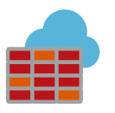






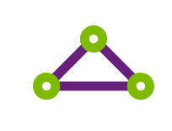



Public Internet
VNet Peering
Spoke 1
Spoke 2
Hub
Azure Firewall
DDOS protection
On-Premises
NSG
NSG
Load Balancer
Load Balancer
VPN
Satellite Offices
IIS
IIS
IIS
IIS
Active Directory
ExpressRoute
HQ
DB
DB
VNet
VNet
VNet

Slide 3
Virtual Network
Subnet
NSG
NSG

