Slide 1
Capstone Project
Finding a suitable neighborhood for opening a bar in Cologne, Germany

Slide 2
Introduction
Research Question
Which neighborhood in Cologne is best suitable for opening a bar in Cologne, Germany?
Available data about Coogne, that could be interesting for the resarch:
Population density in each neigbborhood („population per square kilometers“)
Prpprotion of young people in each neigbborhood, („percentage 18-34“)
Availabe data via Foursquare API
Number of Bars in each neigbourhood („Bar/Pup Count“)
Number of Tips for each Bar („Tip Count“)

Slide 3
Data-Model
Hypotheses: A neighborhood with a high population density, a high proportion of young people and many bars in the surrounding will bring more customers.
Estimator for visitor-Count = “Tip-Count” of each bar= Dependent Variable
Independent Variables:
„Bar/Pup Count“ of each NB
„population per square kilometers“ of eqach NB
„percentage 18-34“ of each NB

Slide 4
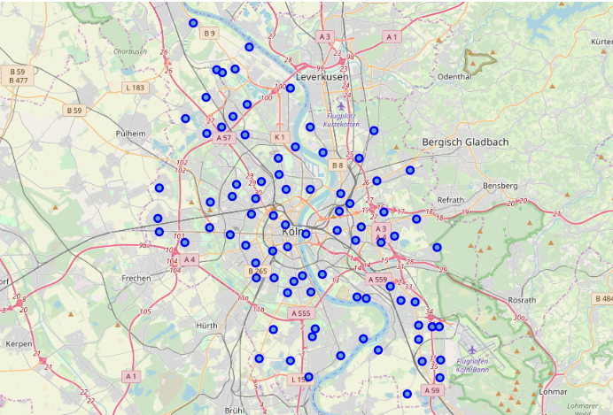
Map of Cologne Neighborhoods (n=83)

Slide 5
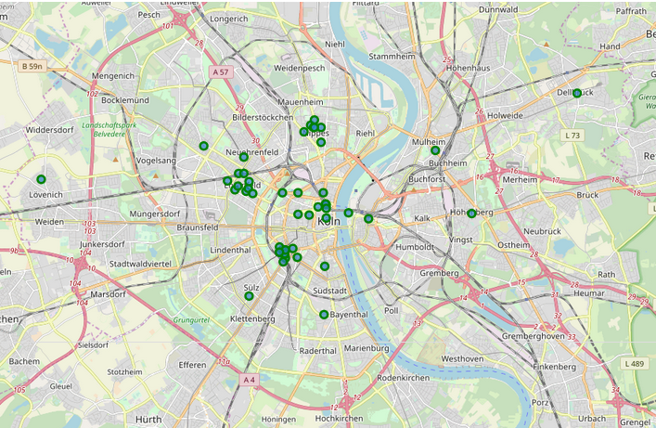
Map of Cologne Bars (N=50)

Slide 6
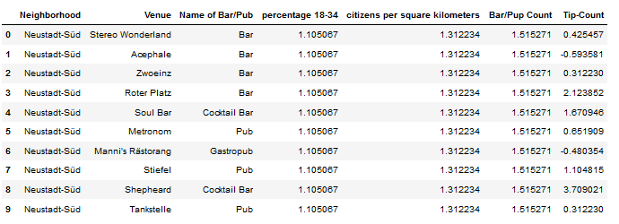
DataBASe for the regression Analysis
N (number of bars) = 50

Slide 7
Correlation-Analysis
“percentage 18-34” and “tip-Count” = r = 0.40, p= 0.00
“citizens per square kilometers” and “tip-Count” = r = 0.51, p= 0.03
”Bar/Pub” and ”tip-Count” = r = 0.52, p= 0.00

Slide 8
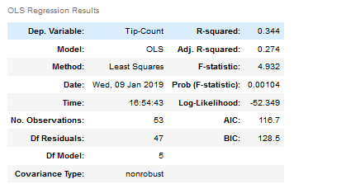
Regression-Analysis
A Polynomial regression-model (degree =2) with „percentage 18-34” “citizens per square kilometers” as independent variables could best account for the variance in Tip-Count.

Slide 9
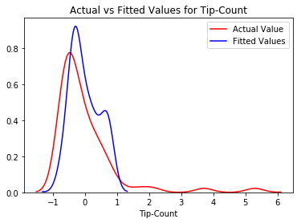
Distribution Plot

Slide 10
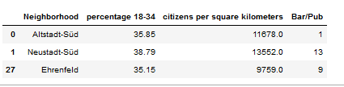
Results
Selection of neighborhoods that have a high Value for “percentage of young people” and “citizens per square kilometers” (percentile =0.9)

