Slide 1

AI FLOODSHIELD PAK
Chenab River · Marala Headworks · Pakistan
What if the river hasn’t crossed
the danger threshold yet…
but tomorrow’s forecast already has?
Turning official river intelligence into an early, bilingual warning.
Official FFD observations
Next-day ML prediction
English + Urdu alerts
NOW
TOMORROW
ACTION
A decision-support system. Official PMD / FFD / PDMA warnings always take precedence.
AI FloodShield PAK · Chenab River @ Marala · Decision-support only
1 / 23

Slide 2
THE INFORMATION GAP
The warning already exists.
The problem is turning it into action.
PAKISTAN METEOROLOGICAL DEPARTMENT
TODAY
Flood Forecasting Division · Daily flood bulletin · 4 Sep 2026
What is happening now?
RIVER
STATION
INFLOW
OUTFLOW
24H FORECAST
Current official inflow
CHENAB
Marala
51.9
26.1
100–120
TOMORROW
What is likely next?
Units: thousand cusecs · Live FFD table excerpt (saved engine run)
FFD already publishes inflow, outflow and a 24-hour outlook.
Communities still have to translate a technical table into a next-day decision — in a language they can act on.
FFD 24h + ML next day
ACTION
What should people understand?
One bilingual alert
AI FloodShield PAK · Chenab River @ Marala · Decision-support only
2 / 23

Slide 3
WHY THIS STATION
Why Chenab at Marala?
01
02
03
04
PAKISTAN
PUNJAB
CHENAB
MARALA
National river network
Indus basin headworks
Gauged at FFD stations
Our live focus
Official FFD
gauging station
1,100 thousand cusecs
Operational headworks
Chenab @ Marala appears in daily quantitative flood-forecast tables.
Design capacity used in the engine and the trained model — not an alert class.
A control point on the Chenab. We do not claim downstream population counts.
AI FloodShield PAK · Chenab River @ Marala · Decision-support only
3 / 23

Slide 4
FLOODSHIELD INSIGHT
Three signals. One safer decision.
Final risk = the highest credible signal. Official danger is never downgraded.
01
02
03
NOW
NEXT 24H
TOMORROW
Current official inflow
FFD official forecast
ML next-day prediction
Threshold engine
Upper end of the band
39-feature classifier
FINAL RISK
Highest credible risk among the three signals
ENGLISH ALERT
اردو الرٹ
Official danger is never downgraded.
AI FloodShield PAK · Chenab River @ Marala · Decision-support only
4 / 23

Slide 5

OFFICIAL RISK LEVELS
Risk levels come from official Marala thresholds — not invented AI scores.
Units: thousand cusecs. Design capacity is context — not a seventh alert class.
Normal
Low
Medium
High
Very High
Exceptional
< 100
100
150
200
400
600+
thousand
cusecs
thousand
cusecs
thousand
cusecs
thousand
cusecs
thousand
cusecs
thousand
cusecs
Design capacity = 1,100 thousand cusecs
Shown as an engineering reference only. FloodShield does not create an extra alert class at design capacity.
AI FloodShield PAK · Chenab River @ Marala · Decision-support only
5 / 23

Slide 6
THE ML QUESTION
We don’t teach AI to recognize today’s flood level.
We predict tomorrow.
TODAY’S INFORMATION
Current inflow
TARGET
Current outflow
ML
MODEL
Next calendar day’s official flood class
Trend / lags
Random Forest
39 features
FFD 24h forecast
Normal → Exceptional
Rolling statistics
Seasonal signals
Given information available today, predict the official flood class tomorrow.
TRAINING
HELD-OUT EVALUATION
2024–2025
2026 · not randomly split
AI FloodShield PAK · Chenab River @ Marala · Decision-support only
6 / 23

Slide 7
AUTHENTIC DATA
Built from official Pakistani flood data — not synthetic data.
Pakistan Meteorological Department
Flood Forecasting Division
PDMA Punjab
(product context, not ML features)
Daily bulletins and advisories
Marala inflow / outflow
24-hour quantitative forecasts
Historical bulletin PDFs
Gauge reports cited on the dashboard
Rainfall reports cited as situational context
Not used as trained model inputs
6,610
315
294
26
Extracted station-days
FFD bulletin PDFs
Chenab @ Marala days
Gauging stations in extract
Official PDFs → extraction → Chenab @ Marala → features → next-day labels → model
Processed file date range: 16 Jun 2024 – 3 Sep 2026. Primary training source: FFD bulletins.
AI FloodShield PAK · Chenab River @ Marala · Decision-support only
7 / 23

Slide 8
DATA PIPELINE
From messy government PDFs to a machine-learning dataset.
RAW
BULLETINS
EXTRACT
NORMALIZE
MARALA
FEATURES
NEXT-DAY
TARGET
TIME-AWARE
TRAINING
FFD PDFs
extract_data.py
dates + stations
build_dataset.py
final_dataset.py
train_model.py
2024–25 / 2026
SOURCE REALITY
STRUCTURED MARALA ROW
Belolewve Ll Ow
River / station
CHENAB · Marala
Exception Ally High
Inflow / outflow
thousand cusecs
Hig H
24h forecast
parsed numeric band
Lo W
Next-day label
official threshold class
1100.0 in flood_level
Keep rule
only consecutive calendar days
AI FloodShield PAK · Chenab River @ Marala · Decision-support only
8 / 23

Slide 9
MODEL DEVELOPMENT
Designed for time-series data, not random test splits.
CANDIDATES
SELECTION
SELECTED
Random Forest
Extra Trees
TimeSeriesSplit
Macro F1
Random
Forest
Same median imputer.
Trees chosen for mixed-scale hydro features.
2026 stays untouched until the final test.
Saved in the model package
Why macro F1?
Rare severe flood classes must not disappear behind abundant normal days.
Accuracy alone would reward a model that only predicts Normal.
AI FloodShield PAK · Chenab River @ Marala · Decision-support only
9 / 23

Slide 10
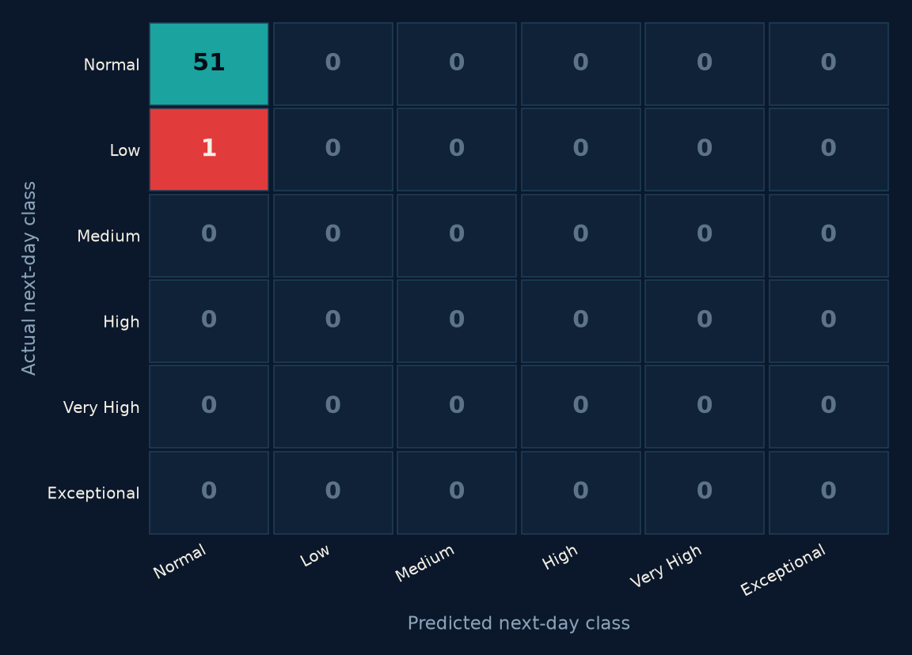
HELD-OUT 2026 TEST
Does it actually work?
Training 2024–2025 · Test 2026 · 52 next-day cases · Random Forest
98.1%
50.0%
49.5%
97.1%
Accuracy
Balanced accuracy
Macro F1
Weighted F1
READ THE HARD NUMBER
51 of 52 held-out days were Normal.
Accuracy is high because the test year was quiet.
The one Low next-day case was predicted Normal.
That is why FloodShield never lets ML override official FFD danger.
AI FloodShield PAK · Chenab River @ Marala · Decision-support only
10 / 23

Slide 11
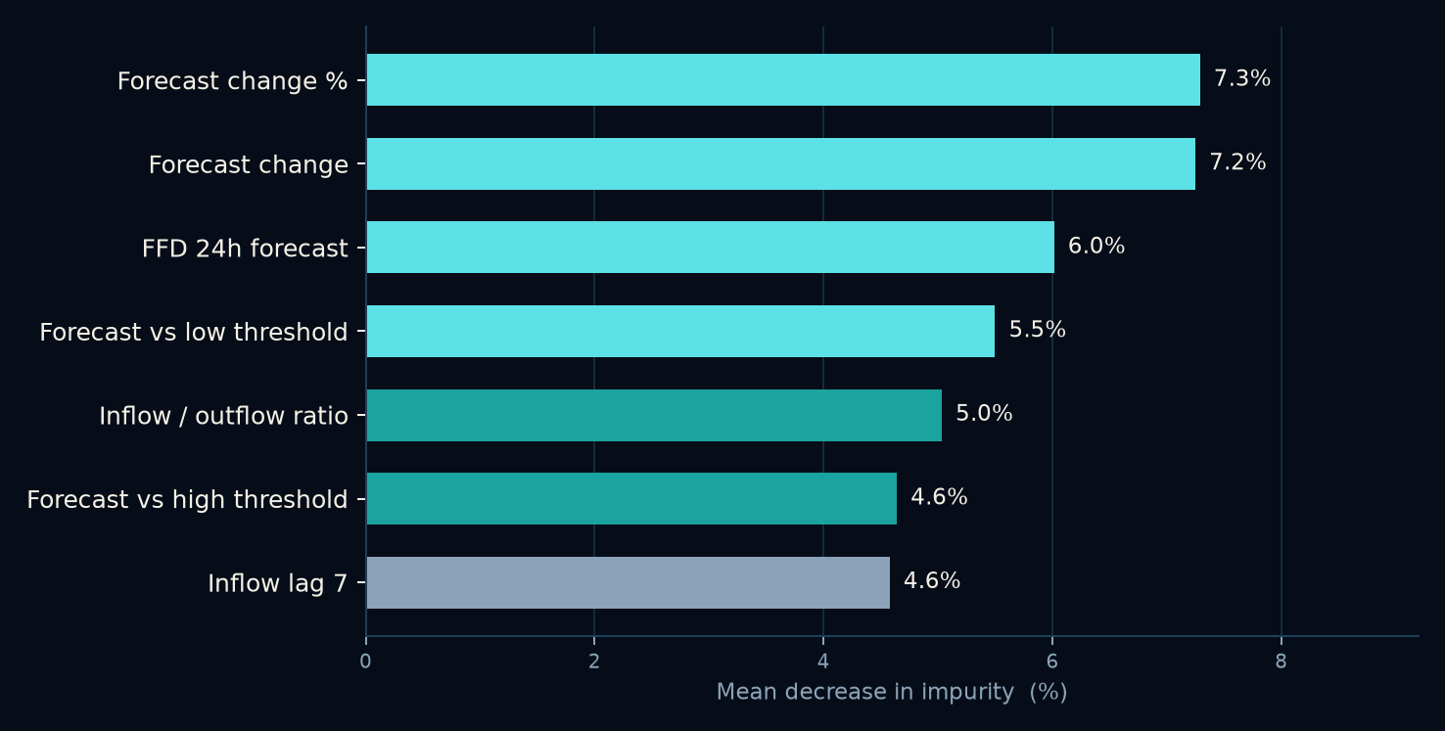
WHAT THE MODEL LISTENS TO
What does the model actually listen to?
Feature importance shows association, not causation. Six FFD-forecast features account for 34% of total importance.
MAIN PATTERN
Forecast change and FFD’s 24-hour outlook dominate the learned signal.
Top values are mean-decrease-in-impurity from the saved Random Forest in floodshield_feature_importance.csv.
AI FloodShield PAK · Chenab River @ Marala · Decision-support only
11 / 23

Slide 12
RESPONSIBLE AI
We deliberately took AI away from the most dangerous decision.
OFFICIAL DATA
THRESHOLD + ML
MAX-RISK FUSION
RISK LEVEL LOCKED
QWEN / TEMPLATES
EN + URDU
QWEN CAN
QWEN CANNOT
Phrase the already-decided alert
Change the risk level
Invent measurements
Explain the three signals simply
Invent evacuation orders
Translate into Urdu
Override official danger
If Qwen is unavailable, deterministic English + Urdu templates still fire. The risk level stays locked.
AI FloodShield PAK · Chenab River @ Marala · Decision-support only
12 / 23

Slide 13
LIVE DEMO
Let’s watch FloodShield make a decision.
Worked example from the saved live engine run · 4 September 2026 · Chenab @ Marala
AI FLOODSHIELD PAK
LIVE · 04 Sep 2026
ENGLISH · generated by Qwen
Flood risk is currently Low on the Chenab River at Marala. Water inflow is 51.9 thousand cusecs and outflow is 26.1 thousand cusecs. The forecast for the next 24 hours shows inflow rising to 100–120 thousand cusecs, but the overall risk remains Low. The machine-learning model predicts Normal conditions for tomorrow. Follow official government instructions.
FINAL ALERT LEVEL
LOW
51.9k
26.1k
100–120
Inflow
Outflow
FFD 24h
اردو · Qwen
NOW
FFD 24H
ML NEXT DAY
چناب ندی مارالہ پر فلڈ کا خطرہ ابھی کم ہے۔ آب کا داخلہ 51.9 ہزار کیوسکس ہے اور باہر جانے والا آب 26.1 ہزار کیوسکس ہے۔ اگلے 24 گھنٹوں کے لیے توقع ہے کہ داخلہ 100-120 ہزار کیوسکس تک بڑھ جائے۔ حکومتی ہدایات کی پیروی کریں۔
NORMAL
LOW
NORMAL
ML said Normal. FFD said Low. Final = Low.
Official danger is never downgraded.
AI FloodShield PAK · Chenab River @ Marala · Decision-support only
13 / 23

Slide 14
SYSTEM ARCHITECTURE
Train once. Infer continuously.
TRAINING PATH
LIVE PATH
Official historical bulletins
FFD bulletin · HTML or local CSV
PDF extraction · extract_data.py
Current risk + forecast risk + ML
Feature engineering
Max-risk fusion
Temporal training · 2024–2025
Qwen phrasing / deterministic templates
Model artifact · floodshield_marala_model.pkl
FastAPI → Next.js dashboard
Python · pandas · scikit-learn · pdfplumber · BeautifulSoup · FastAPI · Next.js · Qwen / DashScope
AI FloodShield PAK · Chenab River @ Marala · Decision-support only
14 / 23

Slide 15
IMPACT + SCALE
Marala is the beginning — not the endpoint.
FFD bulletins already include these Chenab stations. Expansion is a next-phase filter, not a new data invention.
IMPLEMENTED
NEXT PHASE
NEXT PHASE
NEXT PHASE
NEXT PHASE
Marala
Khanki
Qadirabad
Trimmu
Panjnad
Then the broader FFD river network already present in the 6,610-row extract.
COMMUNICATION · NEXT PHASE
WHAT THIS IS NOT
Dashboard
Implemented
Not a national deployment.
Not a government endorsement.
Not a replacement for PMD, FFD, PDMA or NDMA.
SMS
Next phase
WhatsApp
Next phase
IVR
Next phase
Mobile
Next phase
AI FloodShield PAK · Chenab River @ Marala · Decision-support only
15 / 23

Slide 16
The goal isn’t to predict the flood perfectly.
The goal is to give people a better chance to act before it arrives.
AI FloodShield PAK
Chenab River · Marala · Pakistan
Official warnings always take precedence.
AI FloodShield PAK · Chenab River @ Marala · Decision-support only
16 / 23

Slide 17
APPENDIX A1 · FEATURE GROUPS
39 features — resolved. Not 40.
Current hydro (3)
Season / calendar (8)
Lags (4)
Change (5)
inflow_current
capacity_utilization
distance_from_low_flood
month, day_of_year
day_of_week, flood_season
month_sin/cos, doy_sin/cos
inflow_lag_1
inflow_lag_2
inflow_lag_3
inflow_lag_7
inflow_change_1 / 3 / 7
inflow_pct_change_1
inflow_pct_change_3
Rolling (8)
Outflow (5)
FFD forecast (6)
mean/max/std 3d & 7d
inflow_vs_3d_mean
inflow_vs_7d_mean
outflow_current
outflow_lag_1 / 3
inflow−outflow
inflow/outflow ratio
forecast_24h
forecast_change / %
low & high margins
forecast_risk_numeric
Count confirmed from model package features[] and n_features_in_ = 39. Rainfall is not among them.
AI FloodShield PAK · Chenab River @ Marala · Decision-support only
17 / 23

Slide 18
APPENDIX A2 · HYPERPARAMETERS
Selected model: Random Forest
Chosen over Extra Trees by TimeSeriesSplit macro F1 on 2024–2025 only.
n_estimators
max_depth
min_samples_split
min_samples_leaf
400
None
4
2
max_features
class_weight
random_state
imputer
sqrt
balanced_subsample
42
median
EXTRA TREES CANDIDATE · not selected
Same 400 trees, same splits, class_weight = balanced instead of balanced_subsample.
StandardScaler is not used — tree models do not require it.
AI FloodShield PAK · Chenab River @ Marala · Decision-support only
18 / 23

Slide 19
APPENDIX A3 · CLASSIFICATION DETAIL
2026 test: almost a single-class year.
FROM floodshield_2026_predictions.csv
HOW TO READ THE METRICS
Normal
51 actual
51 predicted correctly
Accuracy 98.1% and weighted F1 97.1% are majority-class numbers.
Balanced accuracy 50.0% and macro F1 49.5% are the rare-class numbers.
Trained classes_ : Exceptional, High, Low, Medium, Normal. Very High is absent.
*Train-class counts are reconstructed from the current CSV with the training script’s next-day filter — not stored inside the pickle.
Low
1 actual
0 predicted correctly
Medium
0 actual
—
High
0 actual
—
Very High
0 actual
unseen in training
Exceptional
0 actual
1 train example only*
AI FloodShield PAK · Chenab River @ Marala · Decision-support only
19 / 23

Slide 20
APPENDIX A4 · API
Four dashboard endpoints. Two run modes.
GET /
Health message
FLOODSHIELD_MODE
GET /api/health
CSV + model present
local (default)
CSV + trained model
live
FFD scrape, fallback to local
GET /api/status
Fused alert + ML + bilingual text
GET /api/history
Recent Marala observations
GET /api/model-info
Metadata + stored 2026 metrics
Deployed API:
sardar19-floodshield-api.hf.space
AI FloodShield PAK · Chenab River @ Marala · Decision-support only
20 / 23

Slide 21
APPENDIX A5 · LANGUAGE MODEL CONSTRAINTS
Qwen writes. It does not decide.
PROMPT CONSTRAINTS · qwen-flash, temperature 0.2
DETERMINISTIC FALLBACK
▸ Keep FINAL ALERT LEVEL exactly as provided
If DASHSCOPE_API_KEY is missing, the quota fails, or JSON parsing fails, create_template_alert() still emits English + Urdu from locked risk + numbers.
The engine continues. Wording degrades. The risk level does not.
▸ Do not recalculate or change the category
▸ Do not invent weather, locations, or measurements
▸ Do not invent evacuation orders
▸ State that official instructions take priority
▸ Do not claim the ML prediction is certain
▸ Return JSON only: english + urdu
AI FloodShield PAK · Chenab River @ Marala · Decision-support only
21 / 23

Slide 22
APPENDIX A6 · REPOSITORY
Three folders. One decision engine.
frontend/
backend/
ml/
Next.js dashboard
FloodAlertHero, fusion, bilingual alerts
Reads FastAPI or HF Space
FastAPI + floodshield_engine.py
Live FFD scrape or local CSV
Qwen phrasing + templates
extract / final / build / train
processed CSVs
floodshield_marala_model.pkl
Root app.py wraps the same service for Hugging Face Spaces (Gradio). Raw bulletin PDFs are not in git (too large). Processed CSVs and the trained model are.
AI FloodShield PAK · Chenab River @ Marala · Decision-support only
22 / 23

Slide 23
APPENDIX A7 · LIMITS AND NEXT WORK
What we will not over-claim.
2026 test year is class-imbalanced (51 Normal / 1 Low)
NEXT PHASE
Khanki → Qadirabad → Trimmu → Panjnad
Very High never appears in training classes_
High and Exceptional are extremely rare
NEXT PHASE
SMS / WhatsApp / IVR / mobile
Observation gaps: next-day pairs need consecutive dates
NEXT PHASE
PDF extraction is noisy (garbled flood-level text)
Richer evaluation on high-flood years
Classifier confidence ≠ calibrated flood probability
NEXT PHASE
Rainfall as a researched, not claimed, input
Rainfall is not a deployed ML feature
ALWAYS
Single-station scope: Marala only, today
Official warnings take precedence
AI FloodShield PAK · Chenab River @ Marala · Decision-support only
23 / 23

