Slide 1
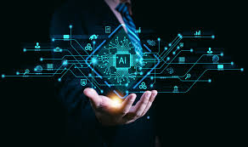
The History of Artificial Intelligence from Early Dreams to Agentic AI

Slide 2
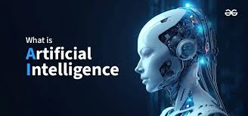
Introduction Artificial Intelligence Understanding AI, LLMs, Generative AI & Agentic AI
What is Artificial Intelligence?
The quest to build machines that can “think”
Evolution shaped by philosophy, mathematics, and computing

Slide 3
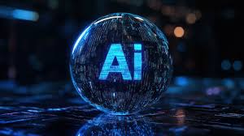
History of AI
• 1950s: Alan Turing introduces AI concepts
• 1956: Dartmouth Conference coined 'Artificial Intelligence'
• 1980s: Expert systems revolution
• 2000s+: Rise of Machine Learning & Deep Learning

Slide 4
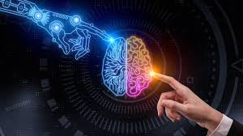
Different Transitions of AI
• Rule-based AI → Simple decision-making
• Machine Learning → Learning from data
• Deep Learning → Neural networks
• Generative AI → Creating new data & content

Slide 5
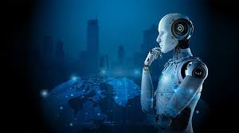
What are LLMs? (Large Language Models)
• LLMs process huge datasets to understand human language
• Examples: GPT, Gemini, Claude
• Applications: Chatbots, summarization, coding assistance

Slide 6
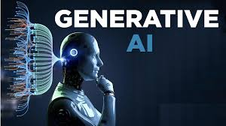
What is Generative AI?
• Generates new content like text, images, videos, and code
• Examples: ChatGPT, DALL·E, MidJourney
• Applications: Marketing, design, education, content creation

Slide 7
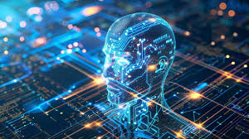
What is Agentic AI?
• Agentic AI refers to systems that make independent decisions
• Uses planning, reasoning, and memory to achieve goals
• Examples: AutoGPT, Lang Chain agents

Slide 8
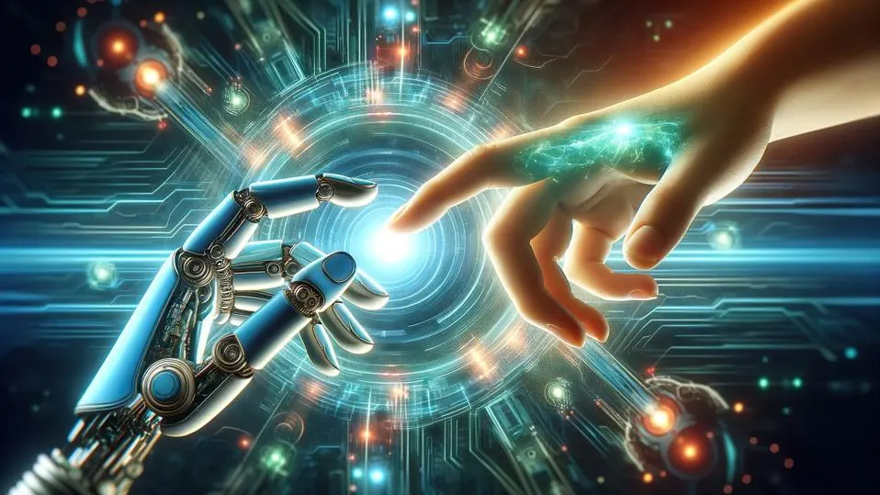
Agentic AI (Present & Future)
AI systems acting as autonomous agents
Capable of planning, reasoning, and executing tasks
Moving toward general-purpose AI assistants

Slide 9
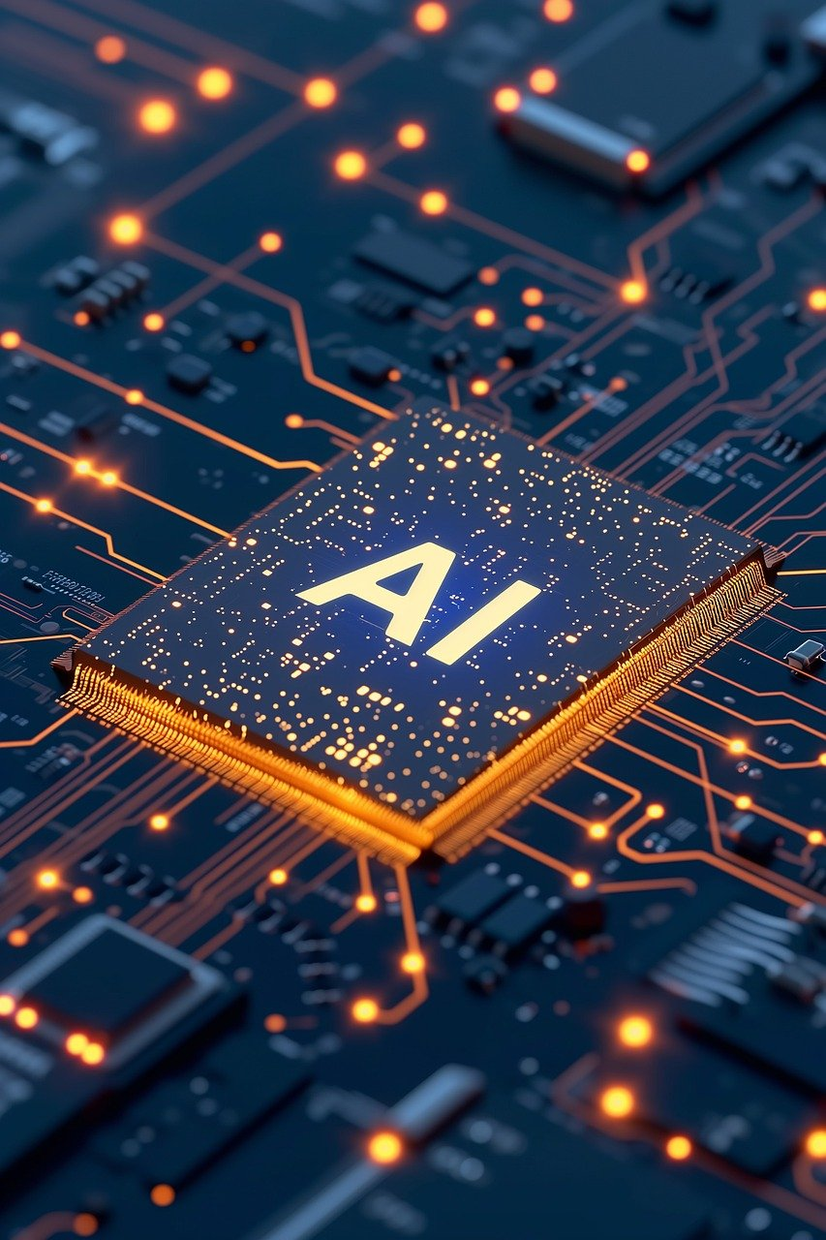
Looking Ahead
Potential benefits: healthcare, science, creativity
Ethical challenges: bias, privacy, alignment
The journey continues toward safe & powerful AI

Slide 10
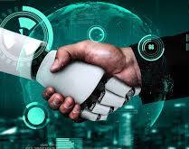
Conclusion
AI is transforming industries and daily life
• LLMs and Generative AI are shaping future innovations
• Agentic AI represents the next step in AI evolution
• "The future belongs to those who shape it with AI."

