Slide 1


Slide 2
PHASE ONE PROJECT
Student name: BUSHRA MOHAMED
Student pace: PART TIME
Instructor name: STELLA WAITHERA

Slide 3

Project Overview
The objective of this project is to explore movie data and generate insights to assist Microsoft's new movie studio in making informed decisions about the types of films to create. By conducting exploratory data analysis (EDA) on various movie datasets, we aim to identify key trends, successful genres, and potential profit opportunities in the movie industry.

Slide 4

Business Problem
Microsoft sees all the big companies creating original video content and they want to get in on the fun. They have decided to create a new movie studio, but they don’t know anything about creating movies. You are charged with exploring what types of films are currently doing the best at the box office. You must then translate those findings into actionable insights that the head of Microsoft's new movie studio can use to help decide what type of films to create.

Slide 5
The Data
For this project, we will be analyzing data from the following movie websites:
imdb.title.basics
Imdb.title.ratings
title.akas
tn.movie_budgets
bom.movie_gross

Slide 6
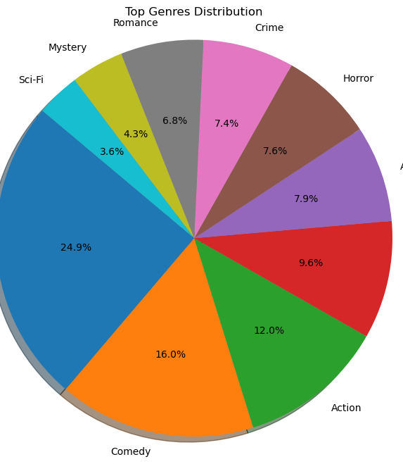
Which specific genre of movie should Microsoft prioritize for production?

Slide 7
Observation
Genre Performance: Drama, comedy, action, thriller, adventure and horror are the top-performing genres based on ratings and audience votes.

Slide 8
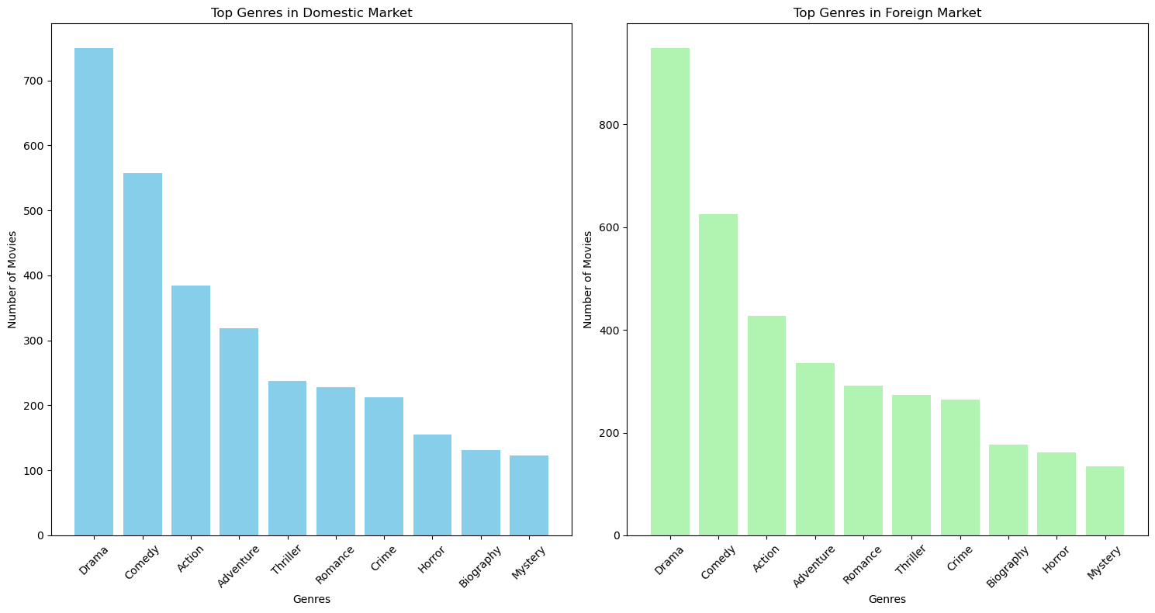
Which genres of movies have demonstrated the highest performance in terms of ratings and audience votes?

Slide 9
Observation
Domestic vs. Foreign Market: The top genres in both markets are Drama, Comedy, Action and Adventure, this shows their global popularity.

Slide 10
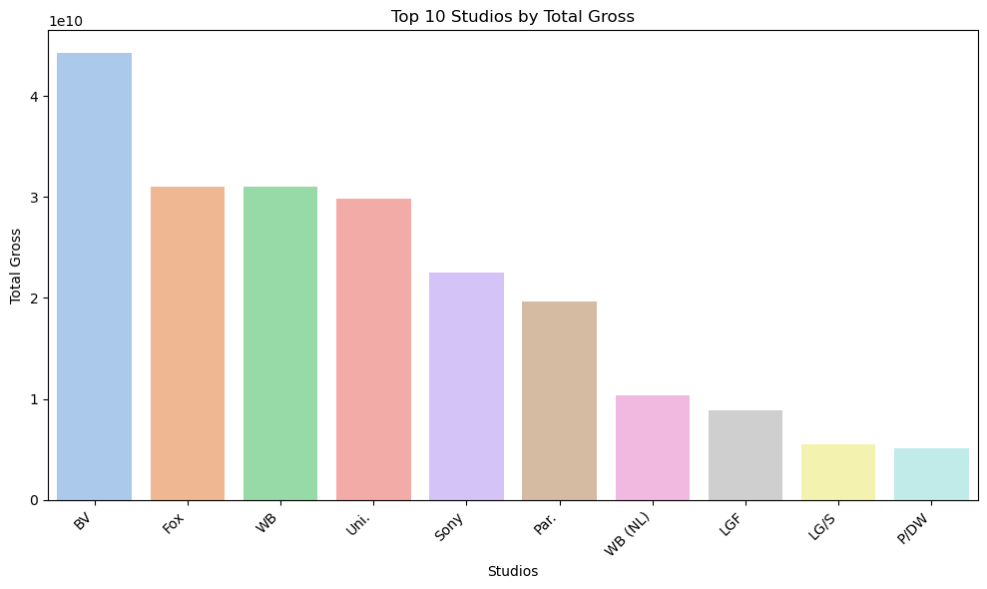
What is the total gross revenue for each movie studio?

Slide 11
Observation
Total Gross Revenue: Studios like BV, Fox, WB, Uni., and Sony have recorded the highest total gross revenues, making them potential partners for Microsoft's new movie studio.

Slide 12
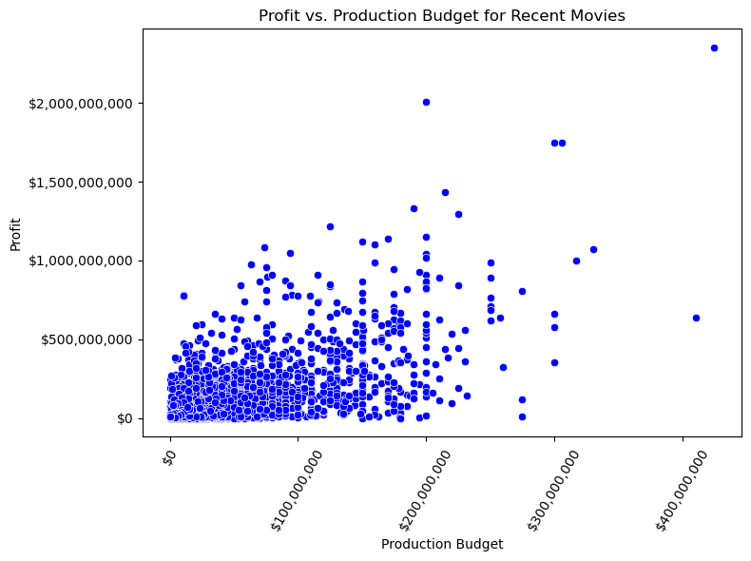
What is the optimal budget amount to be allocated?

Slide 13
Observation
There is a positive relationship between production budgets and profits, suggesting that allocating a reasonable budget, around the median of $200 million, can lead to profitable outcomes.

Slide 14
Recommendation
1. Genre Selection: Drama, Comedy, Action, Thriller, Adventure, Horror, and other genres have demonstrated high performance based on the number of movies produced and their ratings and votes. Microsoft should prioritize producing movies in these genres as they have proven to be popular among audiences.
2. Market Focus: The top four genres in both the domestic and foreign markets include Drama, Comedy, Action and Adventure. These genres have a wide appeal in both markets, and Microsoft should focus on producing movies in these genres to target a global audience.
3. Studio Partnerships: Microsoft should consider forming partnerships with successful movie studios like BV, Fox, WB, Uni., and Sony, as they have recorded the highest total gross revenues. Collaborating with established studios can help Microsoft leverage their expertise and resources to ensure successful movie productions.
4. Budget Allocation: While there are movies with low production budgets and low profits, there is a positive relationship between the production budget and profit. Microsoft should aim to allocate a reasonable budget, around the median of $200 million, for its movie productions. This will increase the chances of achieving profitable outcomes while minimizing the risk of producing low-budget movies with limited potential for profit.

Slide 15
Conclusion
Through extensive exploratory data analysis, we have identified key trends and insights in the movie industry. The recommended genres for Microsoft's new movie studio are Drama, Comedy, Action, Thriller, Adventure, Horror and other genres which have demonstrated high performance in terms of ratings and votes. To target a global audience, Microsoft should focus on producing movies in these genres.
Furthermore, Microsoft should consider forming partnerships with successful studios like BV, Fox, WB, Uni., and Sony to leverage their expertise and resources for successful movie productions. Allocating a reasonable budget, around the median of $200 million, can lead to profitable outcomes while minimizing risks.
By following these recommendations and utilizing the insights from our data analysis, Microsoft's new movie studio can position itself for success in the competitive movie industry and create a diverse and captivating portfolio of films that resonate with audiences worldwide.

Slide 16


