Slide 1
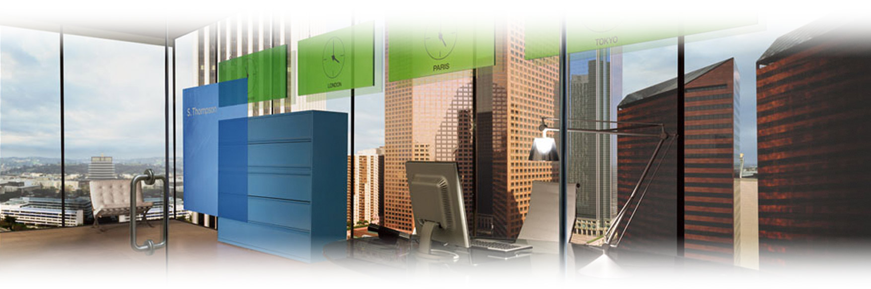
iShares ETF Lending
Keshava Shastry, CFA
Director, Head of Markets

Slide 2
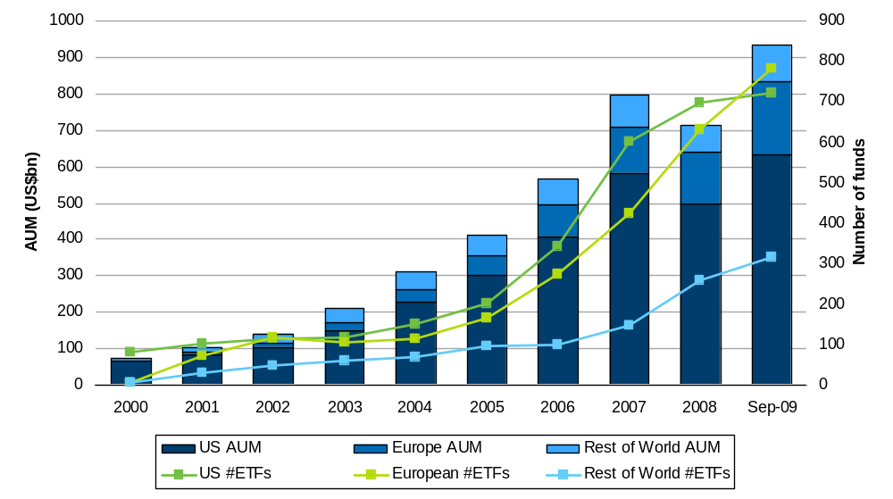
Global ETF market growth
The global ETF market has experienced strong growth since 2000
Global ETF market growth (AUM and number of funds)
Global annual growth rate
(2000 - 2008) = 28%
Europe annual growth rate
(2000 – 2008) = 82%
US annual growth rate
(2000 – 2008) = 25%
Global ETF AUM is forecasted to reach US$2tn by 2011
Source: ETF Research and Implementation Strategy Team, Barclays Global Investors, Bloomberg. As at end September 2009
General_ETF market growth_SNUIF_3006_EN_730640

Slide 3
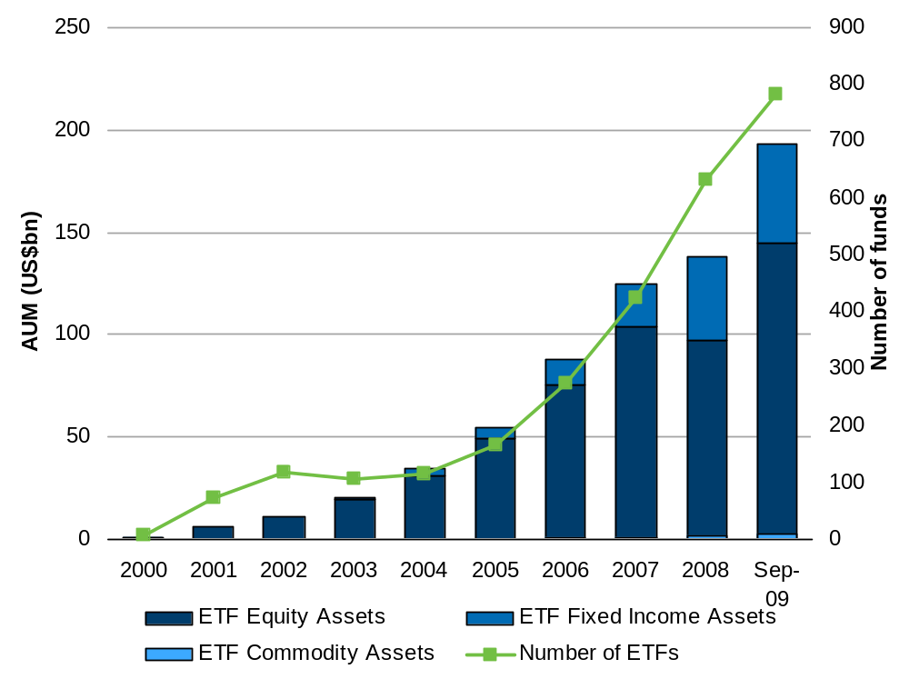
European ETF growth
European ETF market has experienced strong growth since 2003
European ETF market growth (AUM and number of funds)
 | ETF assets (US$bn) | ETF Equity assets (US$bn) | ETF Fixed Income assets (US$bn) | ETF Commodity assets (US$bn) | Number of ETFs
2000 | 0.68 | 0.68 |  |  | 6
2001 | 5.66 | 5.66 |  |  | 71
2002 | 10.69 | 10.69 |  |  | 118
2003 | 20.44 | 19.41 | 1.03 |  | 104
2004 | 33.97 | 31.04 | 2.93 |  | 114
2005 | 54.92 | 49.33 | 5.16 | 0.43 | 165
2006 | 89.70 | 75.65 | 12.06 | 1.98 | 273
2007 | 128.46 | 103.55 | 21.03 | 3.33 | 423
2008 | 142.82 | 96.70 | 41.10 | 4.81 | 632
Sep 2009 | 204.22 | 144.81 | 48.74 | 10.34 | 783
Source: ETF Research and Implementation Strategy Team, Barclays Global Investors, Bloomberg. As at end September 2009
General_ETF market growth_SNUIF_3006_EN_730640

Slide 4
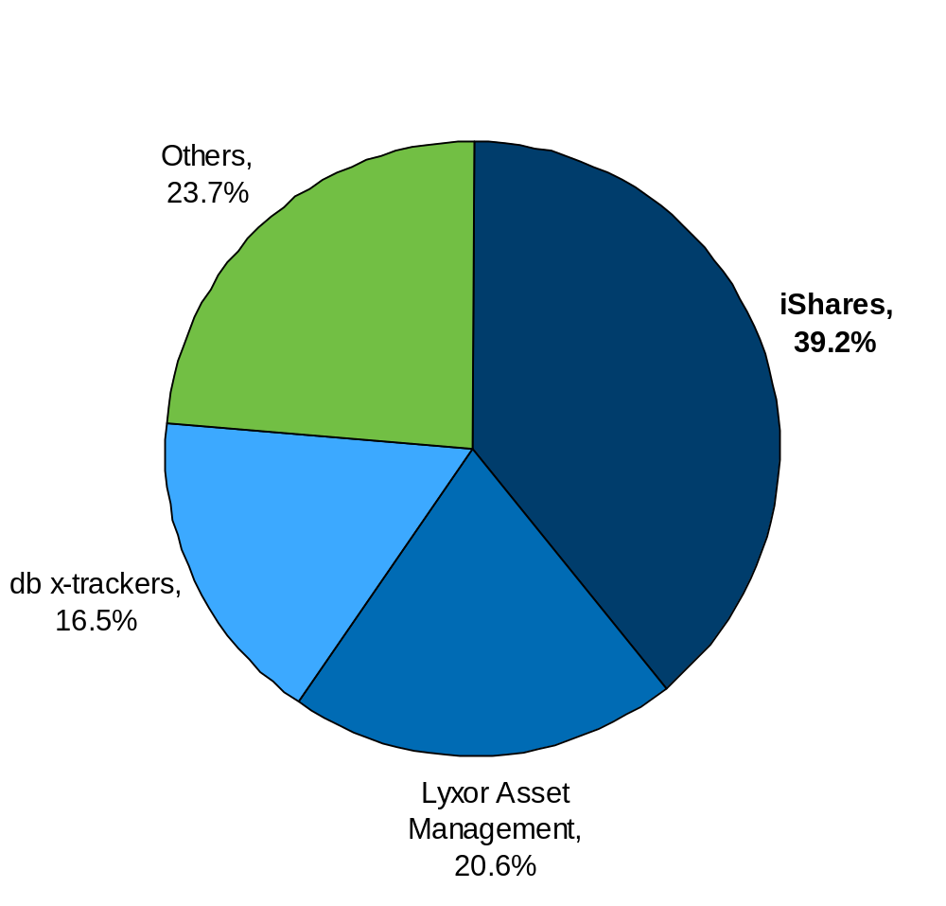
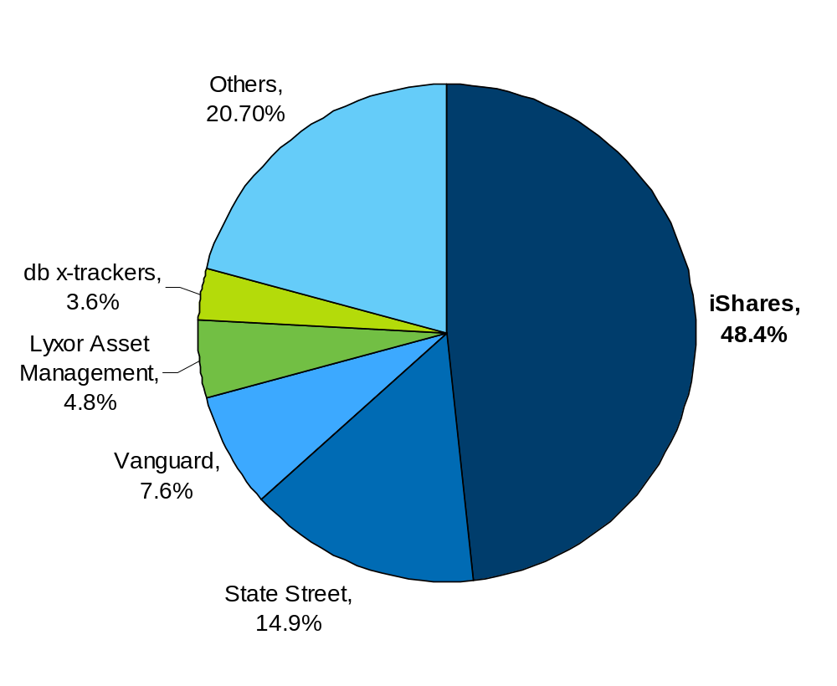
ETF providers worldwide and in Europe (AUM)
ETF managers Globally by AUM
ETF managers in Europe by AUM
Source: ETF Research and Implementation Strategy Team, Barclays Global Investors, Bloomberg. As at 30 September 2009
General_ETF market growth_SNUIF_3006_EN_730640

Slide 5
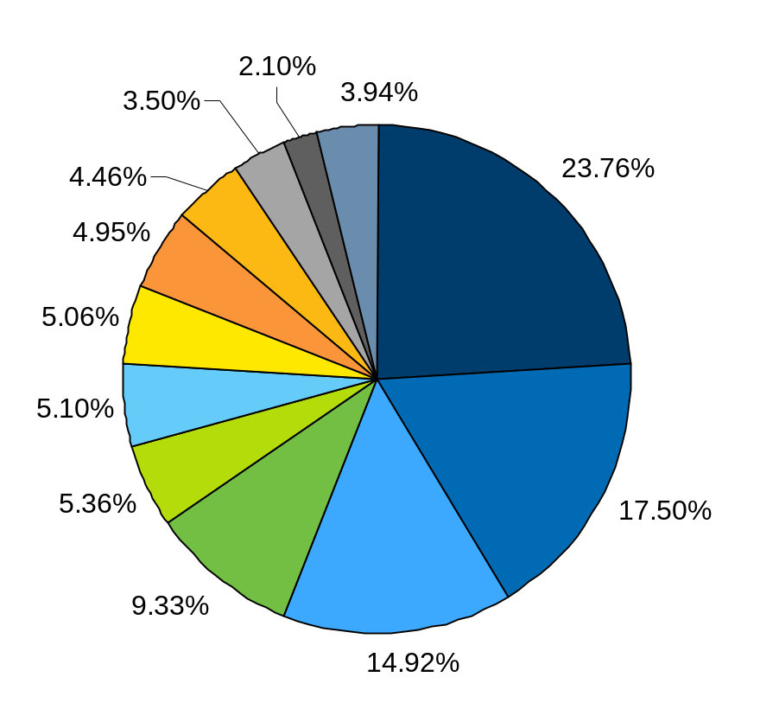
European usage of ETFs by type of exposure
Exposure | # ETFs | AUM (US$ BN) | % TOTAL
Fixed Income | 135 | 48.53 | 23.76%
Country Exposure Europe - Equity | 86 | 35.74 | 17.50%
Regional Exposure Eurozone - Equity | 32 | 30.47 | 14.92%
Emerging Markets - Equity | 85 | 19.06 | 9.33%
Country Exposure United States - Equity | 36 | 10.95 | 5.36%
Regional Exposure Europe - Equity | 46 | 10.42 | 5.10%
Commodities | 26 | 10.33 | 5.06%
International - Equity | 52 | 10.11 | 4.95%
European Sector Exposure - Equity | 126 | 9.11 | 4.46%
Global Exposure - Equity | 45 | 7.14 | 3.50%
Style - Equity | 40 | 4.30 | 2.10%
Others | 74 | 8.05 | 3.94%
ETFs today provide a broad range of potential exposures
Source: ETF Research and Implementation Strategy Team, Barclays Global Investors, Bloomberg. As at 30 September 2009
Note: Others include: Inverse, Euro zone Sector exposure, Leveraged inverse, Leveraged, Currency, Alternatives, Mixed (Equity and Fixed Income), US Sector exposure
General_ETF market growth_SNUIF_3006_EN_730640

Slide 6
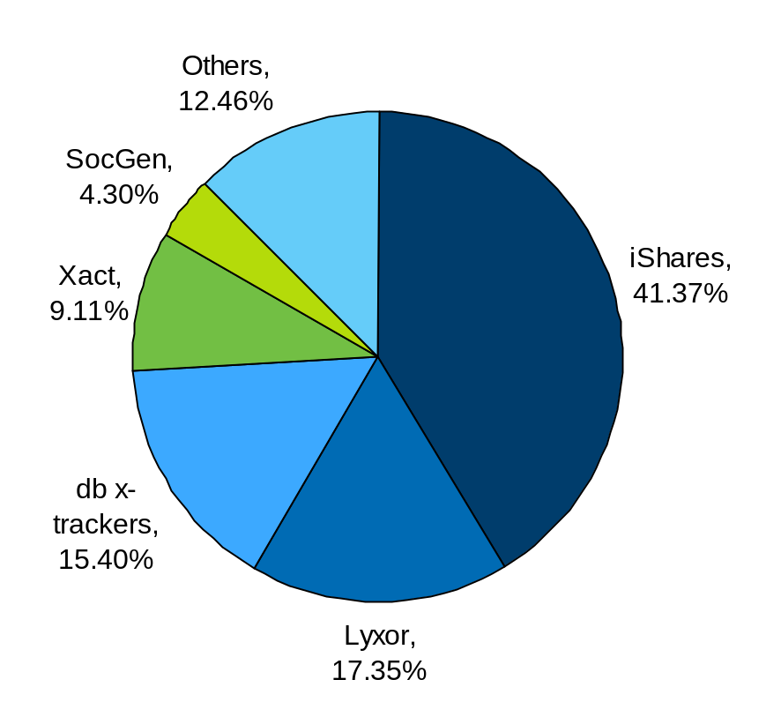
Largest European ETF providers by secondary market volume
H1 2009 secondary market trading volumes
Name | Weight (%)
iShares | 41.37%
Lyxor | 17.35%
db x-trackers | 15.40%
Xact | 9.11%
SocGen | 4.30%
Others | 12.46%
Source: BGI, Bloomberg, as at 30 June 2009
General_ETF market growth_SNUIF_3006_EN_730640

Slide 7
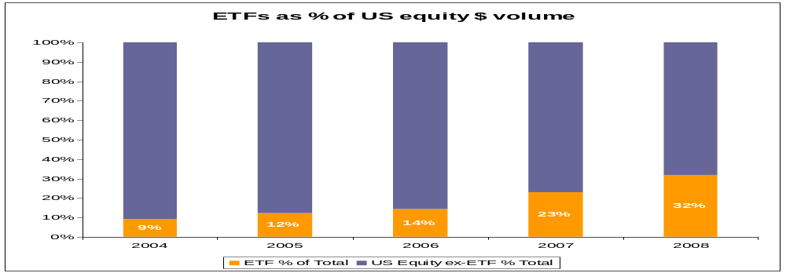
US ETF secondary market
  In 2008 the 4 most actively traded U.S. equities are ETFs⁽¹⁾
  In 2008 8 of the10 most actively traded U.S. equities are ETFs ⁽¹⁾
  In 2008 the iShares Russell 2000 Fund (IWM) is the 3rd most actively traded US equity ⁽¹⁾
  ETFs represented apprx. 32% of total U.S. equity dollar volume in 2008 ⁽¹⁾
  iShares ETFs represented apprx. 7% of total U.S. equity dollar volume in 2008 ⁽¹⁾
  iShares ETFs trading volume in 2000 was 69 million shares / $18.5 billion ⁽¹⁾
  iShares ETFs trading volume 2008 was 94 billion shares / $5.1 trillion ⁽¹⁾
  Creation/redemption orders in 2000 equaled (net) $7.3 billion ⁽²⁾
  Creation/redemption orders in 2008 equaled (net) $53 billion ⁽²⁾
(1) Source: NYSEArca, Bloomberg.
(2) Source: BGI Dixie database (BGI internal system to track iShares authorized participant activity).

Slide 8
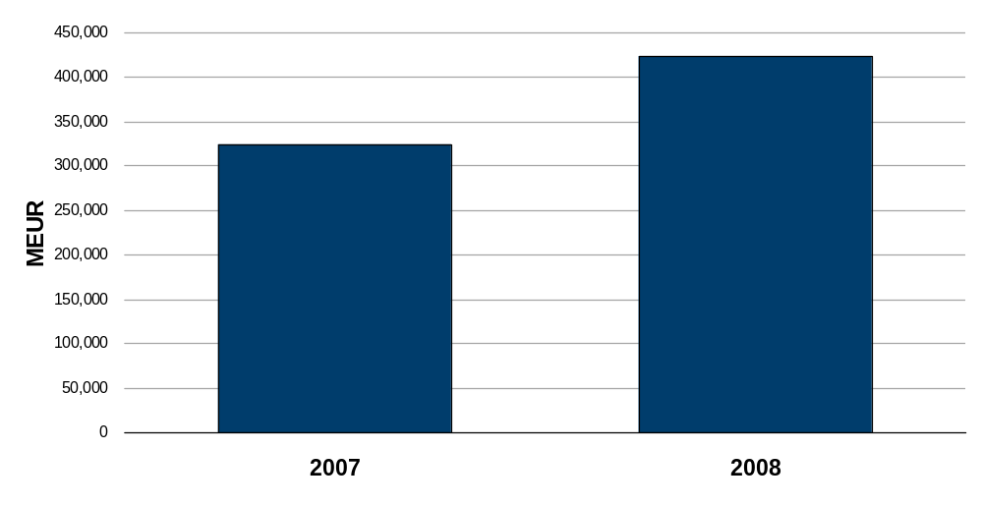
2007 vs 2008 - All recorded volumes
2008 MEUR volume > 20% increase YoY despite Equity market crash
Source: Bloomberg, FESE
Confidential - professional investors only

Slide 9
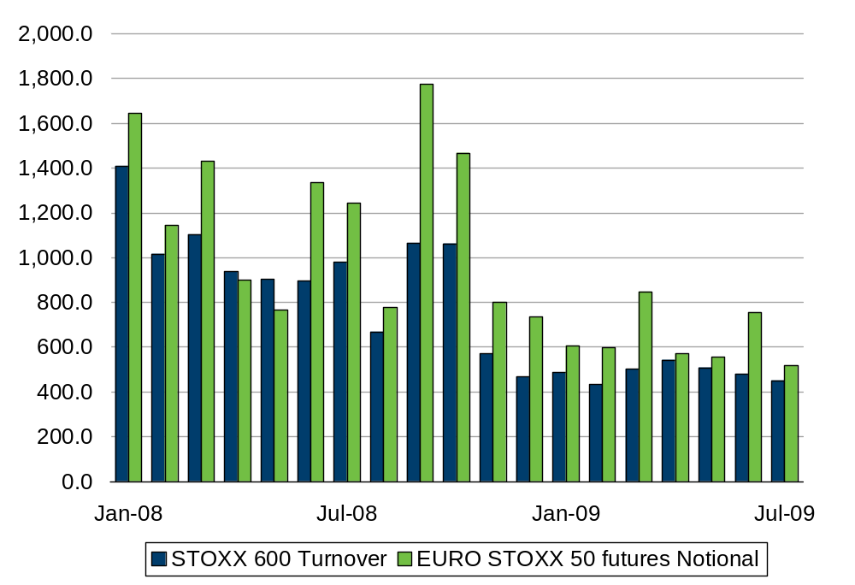
Equity and Futures Turnover shows a sharp decrease
European equity and futures turnover (€m)
Source: Bloomberg, Barclays Global Investors

Slide 10
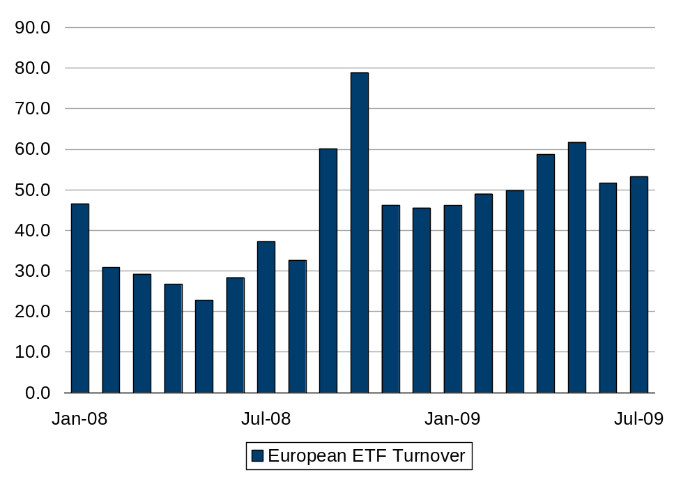
European Turnover – on Exchange & OTC (€bn)
Source: Bloomberg, Barclays Global Investors

Slide 11
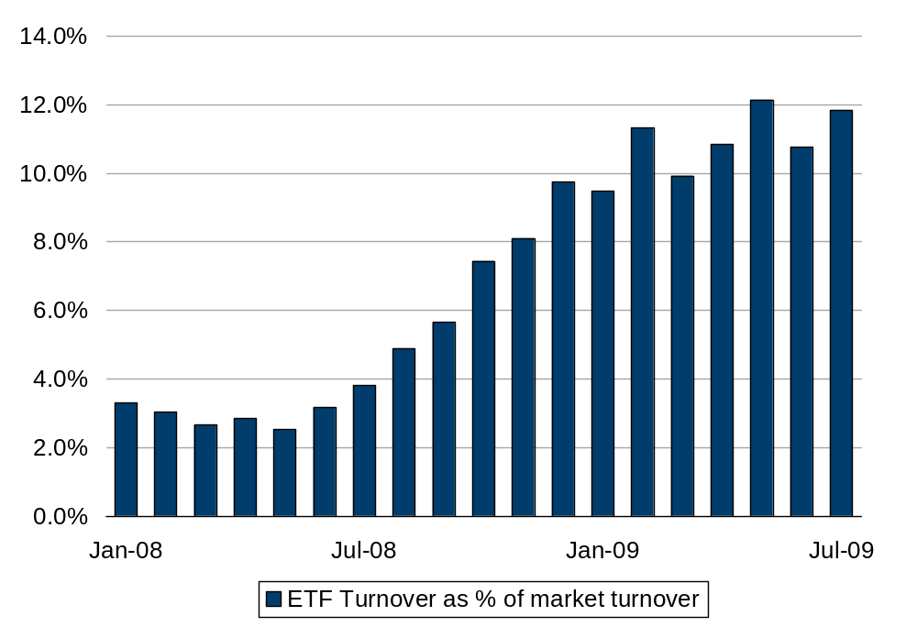
The Growth in ETP share continues
European ETP market share
Source: Bloomberg, Barclays Global Investors

Slide 12
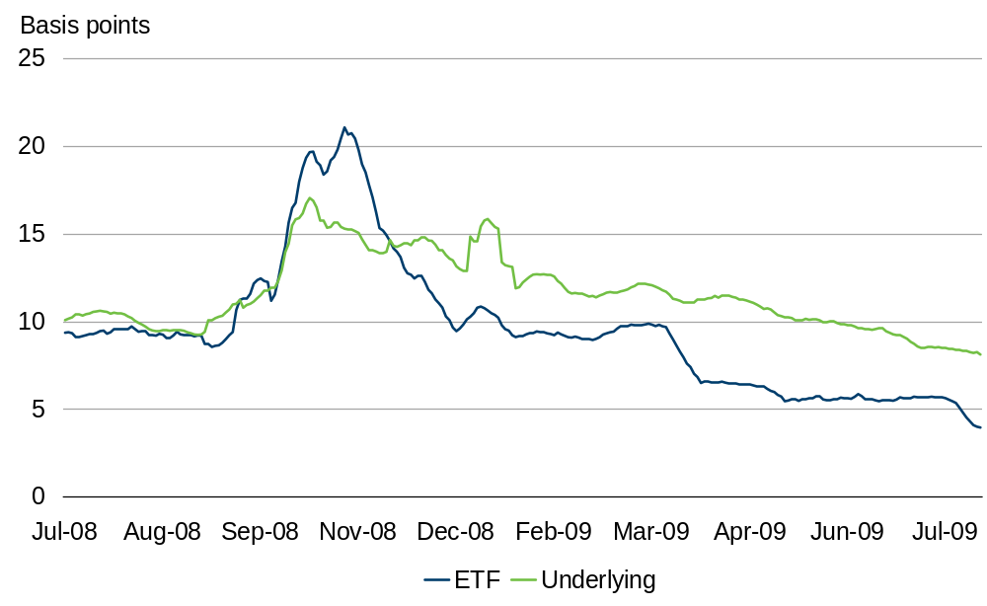
Secondary market efficiencies
iShares FTSE 100 – LSE Spreads
Source: Bloomberg, Barclays Global Investors, Citigroup

Slide 13
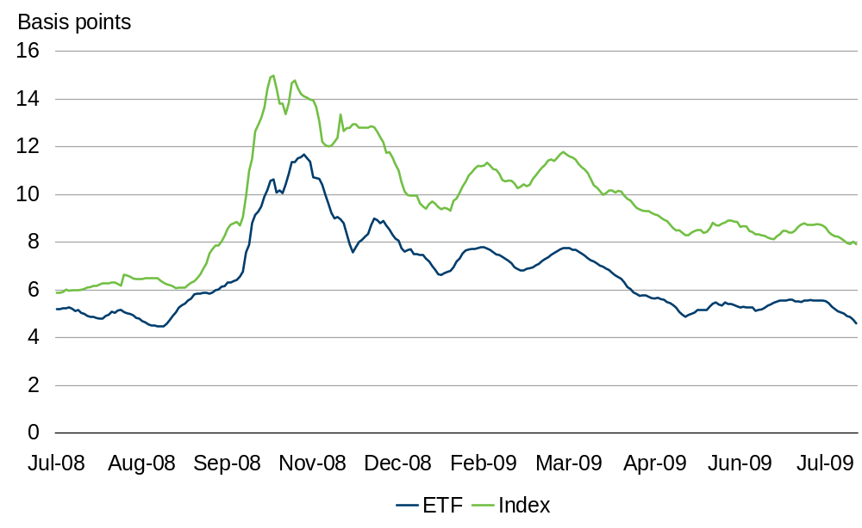
Secondary market efficiencies
iShares DAX® - Xetra Spreads
Source: Bloomberg, Barclays Global Investors, Citigroup

Slide 14
Markets Team
Main Responsibilities
  Central point of contact for buy side sales teams to facilitate their client flows, providing trading, broker and execution expertise, accompanying them to buy-side meetings –
    Facilitated $3.4b of client deals – upto 2009 Q3
  Relationship Managers for the trading community. This can be split into four main categories
    Trading desks
      ETF Trading
      Delta 1 Trading
      Securities Lending
      Prime Brokerage
      Structured products
      Fund derivatives
      Buy side execution desks
    - Inter-Dealer flow matching
      Equities - matched $3.8b of notional deals
  Team has over 30 permanent chat rooms with key brokers to facilitate liquidity and end-client best execution
    Exchanges
      6 Traditional exchanges – LSE, Deutsche Boerse etc
      5+ Mutlilateral Trading Facilities (MTFs)
    Platforms
      National dealing platforms – SelfTrade (UK), ALEX (Neth), Pershing
      Algorithmic platforms
      Lending platforms – Quadriserv, Secfinex
      Fixed Income trading – MarketAxess, tradeweb
    Vendors
      Markit, Bloomberg, Reuters, Telekurs, Lipper
  Monitoring, management and analysis of on-exchange ETF activity across 2000+ lines – this includes the entire European ETP community
  Pre-trade analysis and broker introductions for clients
  Production of trading and liquidity reports and analysis for sales and marketing functions

Slide 15
Matching Service adds Real Value
iShares is the only ETF provider to “match” AP/MM flow
Why is this important?
        “For creation/redemption purposes, iShares will try to help by locating the other side of the trade. Saving creation/redemption fees on these occasions is a very positive feature for us.”
Leading ETF Trader
        “Some clients don’t know that Net Asset Value (NAV) might be a few basis points away from the final execution price because the ETF creation and redemption process is not an entirely frictionless one. iShares service is useful in this regard because it helps to reduce creation/redemption costs, allowing ETFs to trade more tightly.”
Ex-Head of Sales for leading ETF provider
Source: Multi Dealer Model – www.iShares.com

Slide 16
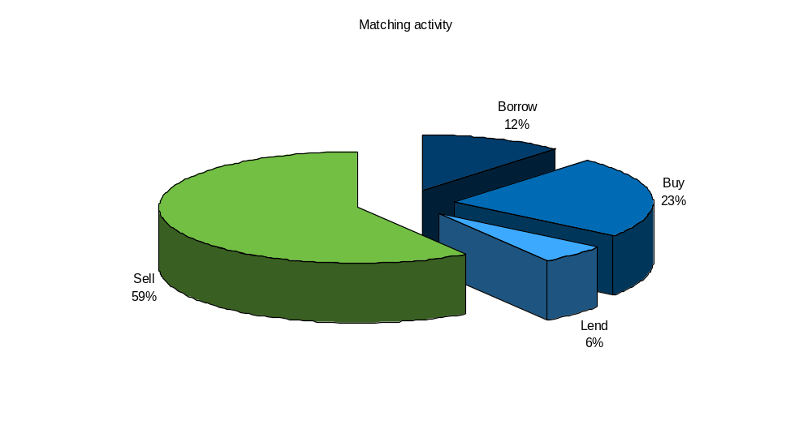
Matching activity 2008: $6.34 bn, 37 counterparties

Slide 17
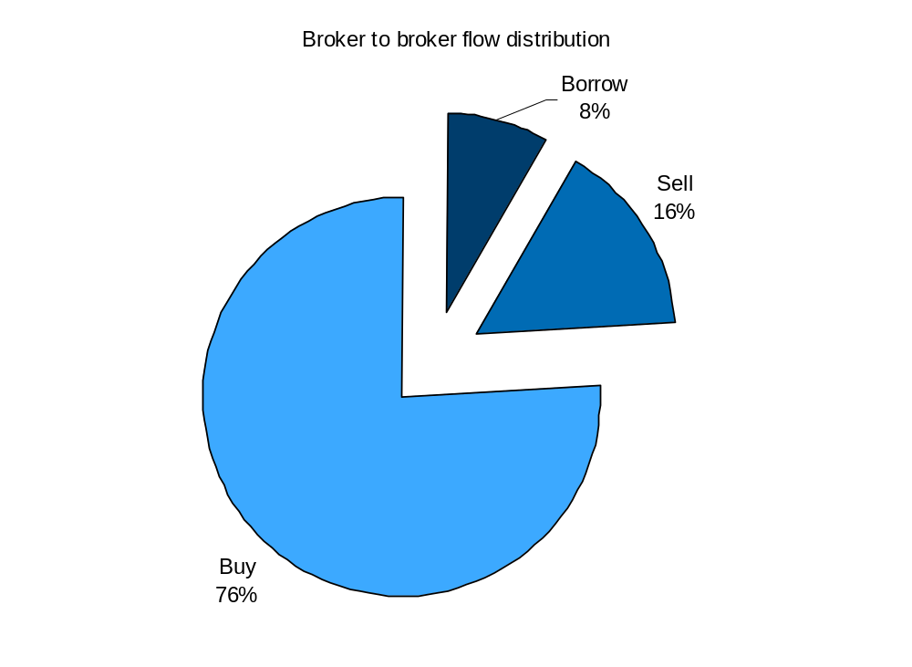
2009 matching and client flow activity
  In excess of $7.2 billion in deals matched 2009 YTD
  36 brokers
  22 active sec lending counterparties
  Brokers saving ca. $3.2 mln in trade commissions, taxes and fees to each side of the trade
  Average save rate $40.5k

Slide 18
2009 Headline figures
140 deals matched YTD
22 active counterparties
Average deal size: $2.2m in a range between $92k to $23.5m
Rates between 1.5% and 10%

Slide 19
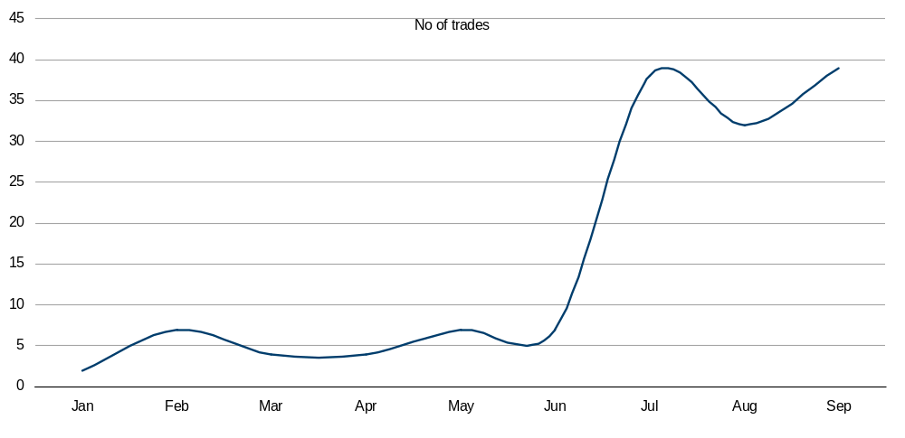
iShares matching flow 2009 YTD – number of trades

Slide 20
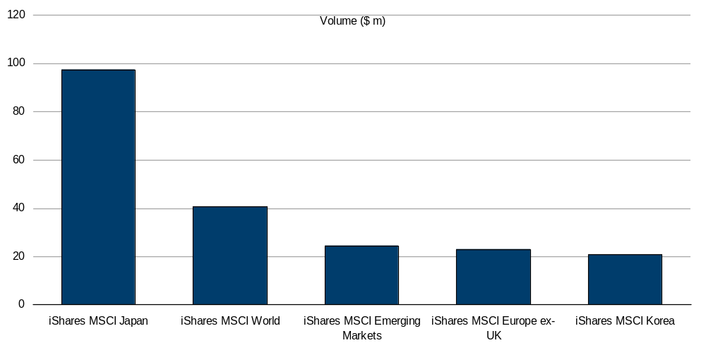
Most Wanted: Top 5 iShares by Sec Lending Volume

Slide 21

Regulatory Information
Barclays Global Investors Limited ('BGIL'), which is authorised and regulated by the Financial Services Authority ('FSA'), has issued this document for access by Professional Clients in the UK only and no other person should rely upon the information contained within it.
iShares plc, iShares II plc and iShares III plc (together 'the Companies') are open-ended investment companies with variable capital having segregated liability between their funds organised under the laws of Ireland and authorised by the Financial Regulator. Shares in the Companies may or may not be suitable for all investors. Barclays Global Investors Limited does not guarantee the performance of the shares or funds. The price of the investments (which may trade in limited markets) may go up or down and the investor may not get back the amount invested.
This activity does not constitute “investment advice” as defined in the Financial Services and Markets Act 2000 (Regulated Activities) Order 2001 (“RAO”) Article 53. Neither does it constitute “making arrangements with a view to a person who participated in the arrangement buying, selling, subscribing for or underwriting investments” under the RAO Article 25(2) – by virtue of the exemption in Article 27 of the RAO.
Affiliated companies of Barclays Global Investors Limited may make markets in the securities mentioned in this document. Further, Barclays Global Investors Limited and/or its affiliated companies and/or their employees from time to time may hold shares or holdings in the underlying shares of, or options on, any security included in this document and may as principal or agent buy or sell securities.
iShares funds are not sponsored, endorsed, or promoted by MSCI, and MSCI bears no liability with respect to any such funds or any index on which such funds are based. The Prospectus contains a more detailed description of the limited relationship that MSCI has with Barclays Global Investors and any related funds.
iShares' is a registered trademark of Barclays Global Investors, N.A. All other trademarks, servicemarks or registered trademarks are the property of their respective owners.
© 2009 Barclays Global Investors Limited. Registered Company No. 00796793. All rights reserved. Calls may be monitored or recorded.

Slide 22
Regulatory information
Regulatory Information
Barclays Global Investors Limited ('BGIL'), which is authorised and regulated by the Financial Services Authority ('FSA'), has issued this document for access by Professional Clients in Switzerland and the UK only and no other person should rely upon the information contained within it. iShares plc, iShares II plc and iShares III plc (together 'the Companies') are open-ended investment companies with variable capital having segregated liability between their funds organised under the laws of Ireland and authorised by the Financial Regulator. The German domiciled funds are "undertakings for collective investment in conformity with the directives" within the meaning of the German Law on the investments. These funds are managed by Barclays Global Investors Deutschland AG which authorised and regulated by the Bundesanstalt fuer Finanzdienstleistungsaufsicht.
For investors in Switzerland
This document is directed at 'qualified investors' only, as defined by Clause 10 (3) of the Swiss Act on Collective Investment Schemes ('CISA') and Clause 6 of the Swiss Ordinance on Collective Investment Schemes ('CISO'). Certain of the funds are not registered with the Federal Banking Commission which acts as supervisory authority in investment fund matters. In respect of these funds, the shares or units of these funds may not be offered or distributed in or from Switzerland unless they are placed without 'public solicitation' as such term is defined under the practice of the Federal Banking Commission from time to time. With respect to those funds that are registered, the Federal Banking Commission has authorised Barclays Bank (Suisse) SA, 8-10 rue d’Italie, case postale 3941, 1211 Genève 3, to act as Swiss Representative and Paying Agent of the Companies. The prospectus, complete and simplified, the Articles of Incorporation, the latest and any previous annual and semi-annual reports of the Companies as well as a list of purchases and sales undertaken on behalf of the Companies are available free of charge from the Swiss representative. Before investing please read the prospectus, complete and simplified, copies of which can be obtained from the Swiss representative.
For investors in the UK
This document is directed at 'Professional Clients' only within the meaning of the rules of the FSA. Certain of the funds mentioned in this document are not registered for public distribution in the UK. In respect of these funds, this document is intended for information purposes only and does not constitute investment advice or an offer to sell or a solicitation of an offer to buy the funds described within and no steps may be taken which would constitute or result in a public offering of the funds in the UK. This document is strictly confidential and may not be distributed without authorisation from BGIL. With respect to the funds that are registered for public distribution in the UK, most of the protections provided by the UK regulatory system do not apply to the operation of the Companies, and compensation will not be available under the UK Financial Services Compensation Scheme on its default. The Companies are recognised schemes for the purposes of the Financial Services and Markets Act 2000. Important information is contained in the relevant prospectus, the simplified prospectus and other documents, copies of which can be obtained by calling 0845 357 7000, from your broker or financial adviser, by writing to Barclays Global Investors Limited, iShares Business Development, Murray House, 1 Royal Mint Court, London EC3N 4HH or by writing to the Manager of the Companies: Barclays Global Investors Ireland Limited, New Century House, International Financial Services Centre, Mayor Street Lower, Dublin 1, Ireland.
Restricted Investors
This document is not, and under no circumstances is to be construed as, an advertisement, or any other step in furtherance of a public offering of shares in the United States or Canada. This document is not aimed at persons who are resident in the United States, Canada or any province or territory thereof, where the Companies are not authorised or registered for distribution and where no prospectus for the Companies has been filed with any securities commission or regulatory authority. The Companies may not be acquired or owned by, or acquired with the assets of, an ERISA Plan.
Risk Warnings
Shares in the Companies may or may not be suitable for all investors. Barclays Global Investors Limited does not guarantee the performance of the shares or funds. The price of the investments (which may trade in limited markets) may go up or down and the investor may not get back the amount invested. Your income is not fixed and may fluctuate. Past performance is not a reliable indicator of future results. The value of the investment involving exposure to foreign currencies can be affected by exchange rate movements. We remind you that the levels and bases of, and reliefs from, taxation can change. Affiliated companies of Barclays Global Investors Limited may make markets in the securities mentioned in this document. Further, Barclays Global Investors Limited and/or its affiliated companies and/or their employees from time to time may hold shares or holdings in the underlying shares of, or options on, any security included in this document and may as principal or agent buy or sell securities.

Slide 23
European iShares index disclaimers continued
Risk Warnings
Shares in the Companies may or may not be suitable for all investors. Barclays Global Investors Limited does not guarantee the performance of the shares or funds. The price of the investments (which may trade in limited markets) may go up or down and the investor may not get back the amount invested. Your income is not fixed and may fluctuate. Past performance is not a reliable indicator of future results. The value of the investment involving exposure to foreign currencies can be affected by exchange rate movements. We remind you that the levels and bases of, and reliefs from, taxation can change. Affiliated companies of Barclays Global Investors Limited may make markets in the securities mentioned in this document. Further, Barclays Global Investors Limited and/or its affiliated companies and/or their employees from time to time may hold shares or holdings in the underlying shares of, or options on, any security included in this document and may as principal or agent buy or sell securities.
Index Disclaimers
'Barclays Capital' is a trade mark of Barclays Capital, the investment banking division of Barclays Bank PLC ('Barclays Capital'), and is used by Barclays Global Investors under licence. With a distinctive business model, Barclays Capital provides corporates, financial institutions, governments and supranational organisations with solutions to their financing and risk management needs. Barclays Capital compiles, maintains and owns rights in and to the Barclays World Government Inflation-Linked Bond Index, the Barclays US Government Inflation-Linked Bond Index, Barclays US Treasury 1-3 yr Term Index, Barclays US Treasury 10 Year Term Index, Barclays UK Government Inflation-Linked Bond Index, Barclays Euro Government Bond 1-3yr Term Index, Barclays Euro Government Bond 30 Year Term Index, Barclays Euro Government Bond 5 Year Term Index, Barclays Euro Government Bond 10 Year Term Index and Barclays Euro Government Inflation-Linked Bond Index (together the 'indices'). iShares Global Inflation-Linked Bond, iShares $ TIPS, iShares $ Treasury Bond 1-3, iShares $ Treasury Bond 7-10, iShares £ Index Linked Gilts, iShares € Government Bond 1-3, iShares € Government Bond 15-30, iShares € Government Bond 3-5, iShares € Government Bond 7-10 and iShares € Inflation Linked Bond ('the funds') are not sponsored, endorsed, sold or promoted by Barclays Capital and Barclays Capital makes no representation regarding the advisability of investing in the funds.
eb.rexx® is a registered trademark of Deutsche Börse AG.
'Dow Jones' and 'Dow Jones Asia/Pacific Select Dividend 30 Index' are service marks of Dow Jones & Company, Inc. and have been licensed for use for certain purposes by Barclays Global Investors, N.A. The iShares DJ/Asia Pacific Select Dividend is not sponsored, endorsed, sold or promoted by Dow Jones and Dow Jones makes no representation regarding the advisability of investing in the fund.
'Dow Jones', 'Dow Jones Asia Pacific Select Dividend 30', 'Dow Jones China Offshore 50', 'Dow Jones Global Titans 50', 'Dow Jones Industrial Average' and 'Dow Jones U.S. Select Dividend' are trademarks and/or service marks of Dow Jones & Company, Inc. and have been licensed for use for certain purposes by Barclays Global Investors (Deutschland) AG. Barclays Global Investors (Deutschland) AG's iShares Dow Jones Asia Pacific Select Dividend 30 (DE), iShares Dow Jones China Offshore 50 (DE), iShares Dow Jones Global Titans 50 (DE), iShares Dow Jones Industrial Average (DE) and iShares Dow Jones U.S. Select Dividend (DE) are not sponsored, endorsed, sold or promoted by Dow Jones, and Dow Jones makes no representations regarding the advisability of trading in such products.
'Dow Jones', 'AIG®', 'Dow Jones-AIG Commodity Index', and 'DJ-AIGCI' are service marks of Dow Jones & Company, Inc. and American International Group, Inc. ('American International Group'), as the case may be, and have been licensed for use for certain purposes by Barclays Global Investors (Deutschland) AG. Barclays Global Investors (Deutschland) AG's Dow Jones-AIG Commodity Swap (DE) based on the Dow Jones-AIG Commodity Index is not sponsored, endorsed, sold or promoted by Dow Jones, AIG Financial Products Corp. ('AIG-FP'), American International Group, or any of their respective subsidiaries or affiliates, and none of Dow Jones, AIG-FP, American International Group, or any of their respective subsidiaries or affiliates, makes any representation regarding the advisability of investing in such product.
'Dow Jones', 'STOXX', 'Dow Jones EURO STOXX Large Cap Growth Index', 'Dow Jones EURO STOXX Mid Index', 'Dow Jones EURO STOXX Select Dividend 30 Index', 'Dow Jones EURO STOXX Small Index' and 'Dow Jones EURO STOXX Large Cap Value Index' are proprietary and copyrighted material and trade marks and/or service marks of Dow Jones & Company, Inc. and/or STOXX Limited and have been licensed for use for certain purposes by Barclays Global Investors Limited. iShares DJ Euro STOXX Growth, iShares DJ Euro STOXX MidCap, iShares DJ Euro STOXX Select Dividend, iShares DJ Euro STOXX SmallCap and iShares DJ Euro STOXX Value are not sponsored, endorsed, sold or promoted by Dow Jones or STOXX, and neither Dow Jones nor STOXX makes any representation regarding the advisability of investing in such funds.

Slide 24
European iShares index disclaimers continued
'Dow Jones', 'STOXX', 'Dow Jones EURO STOXX 50 Index' and 'Dow Jones STOXX 50 Index' are proprietary and copyrighted material and trade marks and/or service marks of Dow Jones & Company, Inc. and/or STOXX Limited and have been licensed for use for certain purposes by Barclays Global Investors Limited and iShares II plc. iShares DJ Euro STOXX 50 and iShares DJ STOXX 50 are not sponsored, endorsed, sold or promoted by Dow Jones or STOXX, and neither Dow Jones nor STOXX makes any representation regarding the advisability of investing in such funds.
'Dow Jones' and 'STOXX' are trademarks and/or service marks of Dow Jones & Company, Inc. and/or STOXX Limited and have been licensed for use for certain purposes by Barclays Global Investors (Deutschland) AG. Barclays Global Investors (Deutschland) AG's iShares DJ EURO STOXX (DE), iShares DJ EURO STOXX 50 (DE), iShares DJ EURO STOXX Banks (DE), iShares DJ EURO STOXX Health Care (DE), iShares DJ EURO STOXX Select Dividend 30 (DE), iShares DJ EURO STOXX Technology (DE), iShares DJ EURO STOXX Telecommunications (DE), iShares DJ STOXX 50 (DE), iShares DJ STOXX 600 (DE), iShares DJ STOXX 600 Automobiles & Parts (DE), iShares DJ STOXX 600 Automobiles & Parts Swap (DE), iShares DJ STOXX 600 Banks (DE), iShares DJ STOXX 600 Banks Swap (DE), iShares DJ STOXX 600 Basic Resources (DE), iShares DJ STOXX 600 Basic Resources Swap (DE), iShares DJ STOXX 600 Chemicals (DE), iShares DJ STOXX 600 Chemicals Swap (DE), iShares DJ STOXX 600 Construction & Materials (DE), iShares DJ STOXX 600 Construction & Materials Swap (DE), iShares DJ STOXX 600 Financial Services (DE), iShares DJ STOXX 600 Financial Services Swap (DE), iShares DJ STOXX 600 Food & Beverage (DE), iShares DJ STOXX 600 Food & Beverage Swap (DE), iShares DJ STOXX 600 Health Care (DE), iShares DJ STOXX 600 Health Care Swap (DE), iShares DJ STOXX 600 Industrial Goods & Services (DE), iShares DJ STOXX 600 Industrial Goods & Services Swap (DE), iShares DJ STOXX 600 Insurance (DE), iShares DJ STOXX 600 Insurance Swap (DE), iShares DJ STOXX 600 Media (DE), iShares DJ STOXX 600 Media Swap (DE), iShares DJ STOXX 600 Oil & Gas (DE), iShares DJ STOXX 600 Oil & Gas Swap (DE), iShares DJ STOXX 600 Personal & Household Goods (DE), iShares DJ STOXX 600 Personal & Household Goods Swap (DE), iShares DJ STOXX 600 Real Estate (DE), iShares DJ STOXX 600 Retail (DE), iShares DJ STOXX 600 Retail Swap (DE), iShares DJ STOXX 600 Technology (DE), iShares DJ STOXX 600 Technology Swap (DE), iShares DJ STOXX 600 Telecommunications (DE), iShares DJ STOXX 600 Telecommunications Swap (DE), iShares DJ STOXX 600 Travel & Leisure (DE), iShares DJ STOXX 600 Travel & Leisure Swap (DE), iShares DJ STOXX 600 Utilities (DE), iShares DJ STOXX 600 Utilities Swap (DE), iShares DJ STOXX Americas 600 Real Estate (DE), iShares DJ STOXX Asia Pacific 600 Real Estate (DE), iShares DJ STOXX EU Enlarged 15 (DE), iShares DJ STOXX Large 200 (DE), iShares DJ STOXX Mid 200 (DE), iShares DJ STOXX Select Dividend 30 (DE) and iShares DJ STOXX Small 200 (DE) based on the Dow Jones EURO STOXX, Dow Jones EURO STOXX 50, Dow Jones EURO STOXX Banks, Dow Jones EURO STOXX Health Care, Dow Jones EURO STOXX Select Dividend 30, Dow Jones EURO STOXX Technology, Dow Jones EURO STOXX Telecommunications, Dow Jones STOXX 50, Dow Jones STOXX 600, Dow Jones STOXX 600 Automobiles & Parts, Dow Jones STOXX 600 Banks, Dow Jones STOXX 600 Basic Resources, Dow Jones STOXX 600 Chemicals, Dow Jones STOXX 600 Construction & Materials, Dow Jones STOXX 600 Financial Services, Dow Jones STOXX 600 Food & Beverage, Dow Jones STOXX 600 Health Care, Dow Jones STOXX 600 Industrial Goods & Services, Dow Jones STOXX 600 Insurance, Dow Jones STOXX 600 Media, Dow Jones STOXX 600 Oil & Gas, Dow Jones STOXX 600 Personal & Household Goods, Dow Jones STOXX 600 Real Estate, Dow Jones STOXX 600 Retail, Dow Jones STOXX 600 Technology, Dow Jones STOXX 600 Telecommunications, Dow Jones STOXX 600 Travel & Leisure, Dow Jones STOXX 600 Utilities, Dow Jones STOXX Americas 600 Real Estate, Dow Jones STOXX Asia Pacific 600 Real Estate, Dow Jones STOXX EU Enlarged 15, Dow Jones STOXX Large 200, Dow Jones STOXX Mid 200, Dow Jones STOXX Select Dividend 30 and Dow Jones STOXX Small 200 are not sponsored, endorsed, sold or promoted by Dow Jones or STOXX, and neither Dow Jones nor STOXX makes any representations regarding the advisability of trading in such products.
'Dow Jones', 'STOXX' and 'SAM' are trademarks and/or service marks of Dow Jones & Company, Inc. and/or STOXX Limited and/or SAM Indexes GmbH and have been licensed for use for certain purposes by Barclays Global Investors (Deutschland) AG. Barclays Global Investors (Deutschland) AG's iShares DJ EURO STOXX Sustainability 40 (DE) based on the Dow Jones EURO STOXX Sustainability 40 is not sponsored, endorsed, sold or promoted by Dow Jones, STOXX or SAM, and neither Dow Jones, STOXX nor SAM makes any representations regarding the advisability of trading in such product.
Euronext Indices B.V. has all proprietary rights with respect to the AEX-index® (the 'Index'). In no way Euronext Indices B.V. sponsors, endorses or is otherwise involved in the issue and offering of the product. Euronext Indices B.V. disclaims any liability to any party for any inaccuracy in the data on which the Index is based, for any mistakes, errors, or omissions in the calculation and/or dissemination of the Index, or for the manner in which it is applied in connection with the issue and offering thereof. 'AEX®' and 'AEX-index®' are registered trademarks of Euronext N.V. or its subsidiaries.

Slide 25
European iShares index disclaimers continued
'FTSE®' is a trade mark jointly owned by the London Stock Exchange plc and the Financial Times Limited (the 'FT') and is used by FTSE International Limited ('FTSE') under licence. The FTSE 100 Index, FTSE 250 Index, FTSE BRIC 50 Index, FTSE Actuaries Government Securities UK Gilts All Stocks Index and FTSE UK Dividend + Index are calculated by or on behalf of FTSE International Limited ('FTSE'). None of the Exchange, the FT nor FTSE sponsors, endorses or promotes iShares FTSE 100, iShares FTSE 250, iShares FTSE BRIC 50, iShares FTSE UK All Stocks Gilt and iShares FTSE UK Dividend Plus nor is in any way connected to the funds or accepts any liability in relation to their issue, operation and trading. All copyright and database rights within the index values and constituent list vest in FTSE. Barclays Global Investors has obtained full licence from FTSE to use such copyright and database rights in the creation of these products.
The FTSE 100 is calculated by FTSE international Limited. FTSE does not sponsor, endorse or promote iShares FTSE 100 (DE). All copyright in the index values and constituent lists vests in FTSE. Barclays Global Investors (Deutschland) AG has obtained full license from FTSE to use such copyright in the creation of this product. 'FTSETM' is a trade mark jointly owned by the London Stock Exchange Limited and The Financial Times Limited and is used by FTSE international Limited under license.
'FTSE®' is a trade mark jointly owned by the London Stock Exchange plc and the Financial Times Limited (the 'FT'), 'NAREIT®' is a trade mark of the National Association of Real Estate Investment Trusts ('NAREIT') and 'EPRA®' is a trade mark of the European Public Real Estate Association ('EPRA') and all are used by FTSE under licence. The FTSE EPRA/NAREIT Asia Dividend + Index, FTSE EPRA/NAREIT Global Dividend + Index, FTSE EPRA/NAREIT UK Property Index, FTSE EPRA/NAREIT United States Dividend + Index and FTSE EPRA/NAREIT Europe ex UK Dividend + Index are calculated by FTSE International Limited ('FTSE'). None of the Exchange, the FT, FTSE, Euronext N.V., NAREIT nor EPRA sponsors, endorses or promotes iShares FTSE EPRA/NAREIT Asia Property Yield Fund, iShares FTSE EPRA/NAREIT Global Property Yield Fund, iShares FTSE EPRA/NAREIT UK Property Fund, iShares FTSE EPRA/NAREIT US Property Yield Fund and iShares FTSE/EPRA European Property Index Fund nor is in any way connected to the funds or accepts any liability in relation to their issue, operation and trading. All copyright and database rights within the index values and constituent list vest in FTSE, Euronext N.V., NAREIT and EPRA. Barclays Global Investors has obtained full licence from FTSE to use such copyright and database rights in the creation of these products.
'FTSE®' is a trade mark jointly owned by the London Stock Exchange plc and the Financial Times Limited (the 'FT'). 'FTSEurofirst®' is a trademark jointly owned by FTSE International Limited ('FTSE') and Euronext N.V ('Euronext'). The FTSEurofirst 100 Index and FTSEurofirst 80 Index are compiled and calculated by or on behalf of FTSE. None of the Exchange, the FT, FTSE or Euronext sponsors, endorses or promotes iShares FTSEurofirst 100 and iShares FTSEurofirst 80 nor is in any way connected to the funds or accepts any liability in relation to their issue, operation and trading. All copyright and database rights within the index values and constituent list vest in FTSE and Euronext. Barclays Global Investors has obtained full licence from FTSE to use such copyright and database rights in the creation of these products.
'FTSE®' is a trade mark jointly owned by the London Stock Exchange ('Exchange') and the Financial Times Limited ('FT'), 'Macquarie™' is a trade mark of Macquarie Bank Limited and its related entities and both marks are used by FTSE International Limited ('FTSE') under licence. None of FTSE, Macquarie, the Exchange nor the FT shall be liable (whether in negligence or otherwise) to any person for any error in the Index and none of FTSE, Macquarie, the Exchange nor FT shall be under any obligation to advise any person of any error therein. Barclays Global Investors has obtained a licence from FTSE to use such copyrights and database rights in the creation of iShares FTSE/Macquarie Global Infrastructure 100.
The FTSE/Xinhua China 25 Index is calculated by or on behalf of FTSE/Xinhua Index Limited ('FXI'). FXI does not sponsor, endorse or promote iShares FTSE/Xinhua China 25. All copyright in the index values and constituent list vests in FXI. Barclays Global Investors has obtained full licence from FXI to use such copyright in the creation of this product. 'FTSE™' is a trade mark jointly owned by the London Stock Exchange plc and the Financial Times Limited. 'Xinhua' is a service mark and trade mark of Xinhua Finance Limited. All marks are licensed for use by FXI.

Slide 26
European iShares index disclaimers continued
Markit iBoxx is a registered trade mark of International Index Company Limited ('IIC') and has been licensed for use by Barclays Global Investors Limited. IIC does not approve, endorse or recommend Barclays Global Investors Limited or iShares plc. These products are not sponsored, endorsed or sold by IIC and IIC makes no representation regarding the suitability of investing in these products.
Markit iBoxx is a registered trade mark of International Index Company Limited ('IIC') and has been licensed for use by Barclays Global Investors (Deutschland) AG. IIC does not approve, endorse or recommend Barclays Global Investors (Deutschland) AG or iShares iBoxx® € Liquid Sovereigns Capped 1.5-10.5 (DE), iShares iBoxx® € Liquid Sovereigns Capped 1.5-2.5 (DE), iShares iBoxx® € Liquid Sovereigns Capped 10.5+ (DE), iShares iBoxx® € Liquid Sovereigns Capped 2.5-5.5 (DE) and iShares iBoxx® € Liquid Sovereigns Capped 5.5-10.5 (DE). These products are not sponsored, endorsed or sold by IIC and IIC makes no representation regarding the suitability of investing in the products.
iBoxx and the Markit iBoxx € Covered Index are marks of International Index Co. and have been licensed for use by Barclays Global Investors Limited.
The Markit iBoxx € Covered Index referenced herein is the property of International Index Co. and is used under license. The iShares € Covered Bond
is not sponsored, endorsed, or promoted by International Index Co.
iShares funds are not sponsored, endorsed, or promoted by MSCI, and MSCI bears no liability with respect to any such funds or any index on which such funds are based. The Prospectus contains a more detailed description of the limited relationship that MSCI has with Barclays Global Investors and any related funds.
'Nasdaq®', 'Nasdaq-100®' and 'Nasdaq-100 Index®' are trademarks of the Nasdaq Stock Market Inc. (which with its affiliates is referred to as the 'Corporations') and are licensed for use by Barclays Global Investors (Deutschland) AG. iShares NASDAQ-100® (DE) is not issued, endorsed, sold or promoted by the Corporations. The Corporations make no warranties and bear no liability with respect to the Product.
The Nikkei Stock Average is a copyrighted material, calculated by Nihon Keizai Shimbun, Inc. which is the sole exclusive owner of the copyright and other intellectual property rights in the Nikkei Stock Average itself and the methodology to calculate the Nikkei Stock Average. Nihon Keizai Shimbun, Inc. (Licensor) granted a license to the licensee to use the Nikkei Stock Average as a basis for the iShares Nikkei 225® (DE) ETF. The Licensor does not sponsor, support, sell or market the ETF and has – besides granting the license to the licensee – no connection with the ETF. The ETF is managed exclusively at the risk of the licensee and licensor shall assume no obligation or responsibility for its management and transactions on the ETF.
'Standard & Poor’s®', 'S&P®', 'S&P 500', 'S&P Emerging Market Infrastructure', 'S&P Global Clean Energy', 'S&P Global Water', 'S&P Listed Private Equity' and 'S&P Timber & Forestry' are trademarks of The McGraw-Hill Companies, Inc. and have been licensed for use by Barclays Global Investors, N.A. iShares S&P 500, iShares S&P Emerging Market Infrastructure, iShares S&P Global Clean Energy, iShares S&P Global Water, iShares S&P Listed Private Equity and iShares S&P Timber & Forestry are not sponsored, endorsed, sold or promoted by S&P and S&P makes no representation regarding the advisability of investing in these products.
'S&P®' and 'Standard & Poor’s®' are registered trademarks of The McGraw-Hill Companies, Inc., and 'MIB' is a trademark of the Borsa Italiana S.p.A. These trademarks have been licensed for use by Barclays Global Investors, N.A. The iShares S&P/MIB is not sponsored, endorsed, sold or promoted by S&P or Borsa Italiana, and S&P and Borsa Italiana make no representation, warranty or condition regarding the advisability of investing in this product.
iShares SMI (DE) is not sponsored, endorsed, sold or promoted by SWX Swiss Exchange and SWX Swiss Exchange makes no representation regarding the advisability of investing in the product. The SMI® is a registered trademark of the SWX Swiss Exchange, and any use thereof requires a license.
'ATX®' (Austrian Traded Index®) is a registered trademark of Wiener Börse AG. The issuer has been granted a licence to use ATX® with regard this issue. iShares ATX (DE) is not sponsored, recommended or marketed by Wiener Börse AG.

Slide 27
European iShares index disclaimers continued
Information and the JP Morgan EMBI Global Core Index™ (the 'Index') have been obtained from sources believed to be reliable, but J.P. Morgan Securities Inc ('JPMorgan') does not warrant its completeness or accuracy. The information and the Index are used with permission. The information and the Index may not be copied, used, or distributed without JPMorgan’s prior written approval. Copyright 2008, JPMorgan Chase & Co. All rights reserved. 'JPMorgan' and the Index are trademarks of JPMorgan Chase & Co. and have been licensed for use for certain purposes by Barclays Global Investors. iShares JPMorgan $ Emerging Markets Bond Fund (the 'Fund') which is based on the Index is not sponsored, endorsed, sold or promoted by JPMorgan and JPMorgan makes no representation regarding the advisability of trading in the Fund.
iShares funds are not sponsored, endorsed, or promoted by MSCI, and MSCI bears no liability with respect to any such funds or any index on which such funds are based. The Prospectus contains a more detailed description of the limited relationship that MSCI has with Barclays Global Investors and any related funds.
'Standard & Poor’s®', 'S&P®', 'S&P SmallCap 600' are trademarks of The McGraw-Hill Companies, Inc. and have been licensed for use by Barclays Global Investors, N.A. iShares S&P SmallCap 600 is not sponsored, endorsed, sold or promoted by S&P and S&P makes no representation regarding the advisability of investing in this product.
'iShares' is a registered trademark of Barclays Global Investors, N.A. All other trademarks, servicemarks or registered trademarks are the property of their respective owners.
© 2008 Barclays Global Investors Limited. Registered Company No. 00796793. All rights reserved. Calls may be monitored or recorded.

