Slide 1

European Repo Council
18th European repo market survey conducted in December 2009
Godfried De Vidts – Director of European Affairs, ICAP plc

Slide 2
18th European repo market survey conducted in December 2009
Survey overview
Outstanding value of contracts at close of business on Wednesday, 9th December 2009
58 responses from 53 groups

Slide 3

18th European repo market survey conducted in December 2009
Headline numbers
December 2009 EUR 5,582 billion
June 2009 EUR 4,868 billion
December 2008 EUR 4,633 billion
June 2008 EUR 6,504 billion
December 2007 EUR 6,382 billion
June 2007 EUR 6,775 billion
December 2006 EUR 6,430 billion
June 2006 EUR 6,019 billion
December 2005 EUR 5,883 billion
June 2005 EUR 5,319 billion
December 2004 EUR 5,000 billion
June 2004 EUR 4,561 billion
December 2003 EUR 3,788 billion

Slide 4

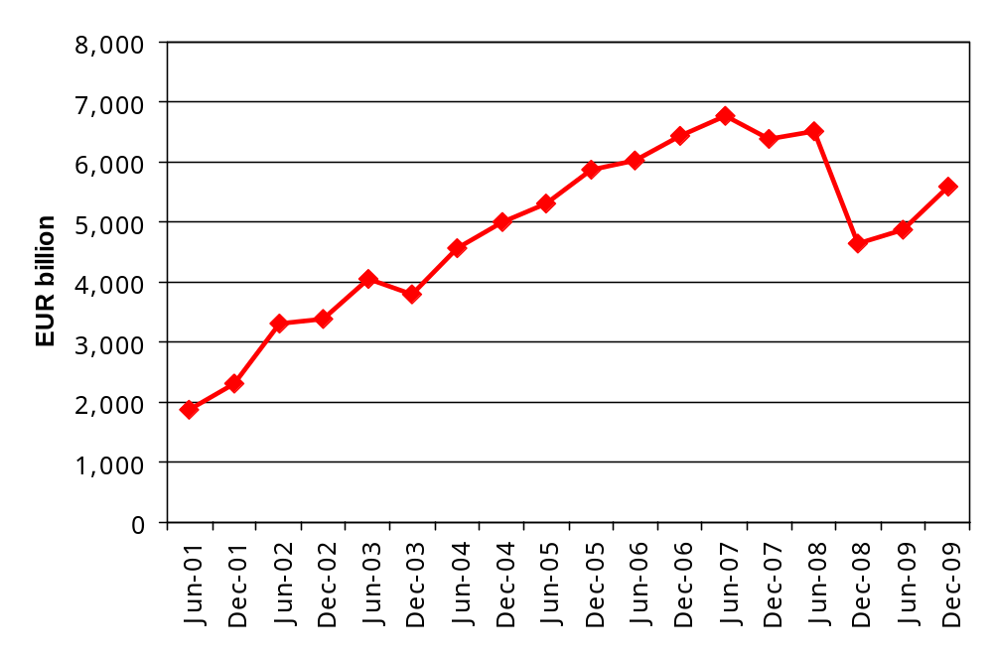
18th European repo market survey conducted in December 2009
Headline numbers

Slide 5

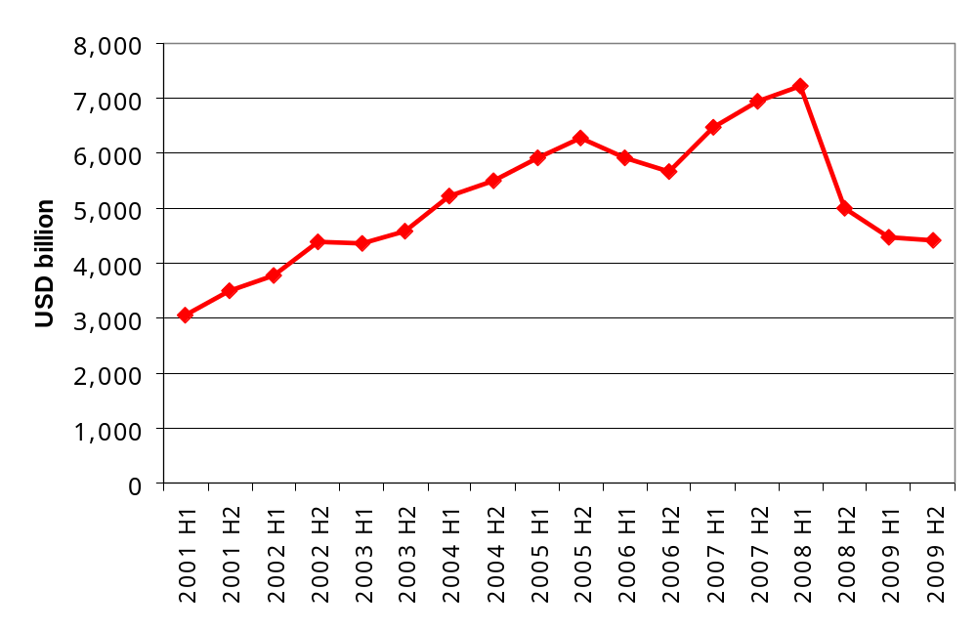
18th European repo market survey conducted in December 2009
US market
US primary dealers
(source: FRBNY)

Slide 6

18th European repo market survey conducted in December 2009
Comparable market growth
51 respondents in last 3 surveys
  +18.0% year-on-year
  +20.2% since June 2009

Slide 7

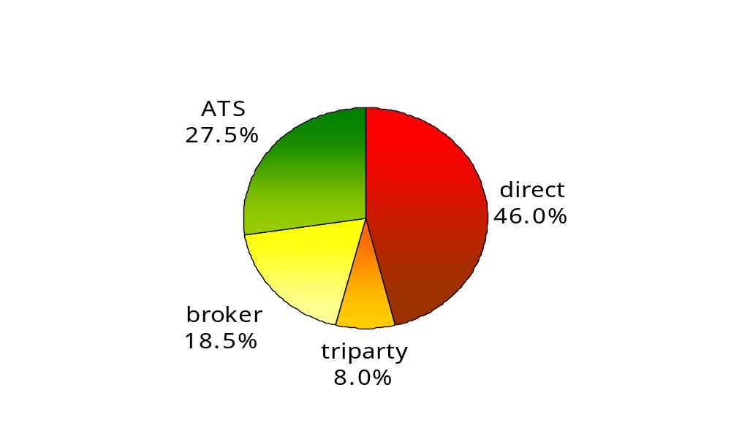
18th European repo market survey conducted in December 2009
Counterparty analysis

Slide 8

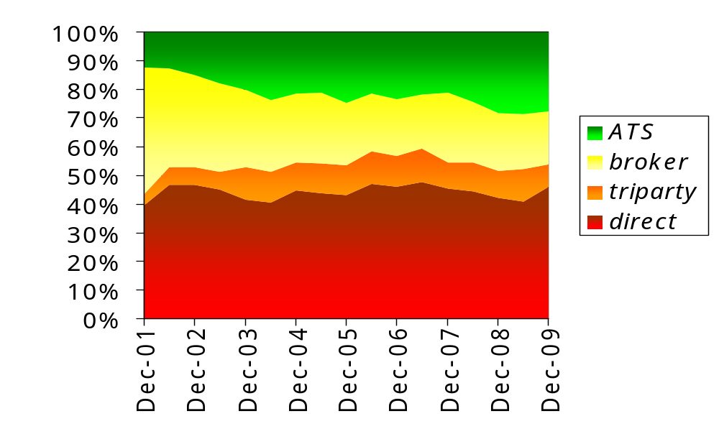
18th European repo market survey conducted in December 2009
Counterparty analysis

Slide 9

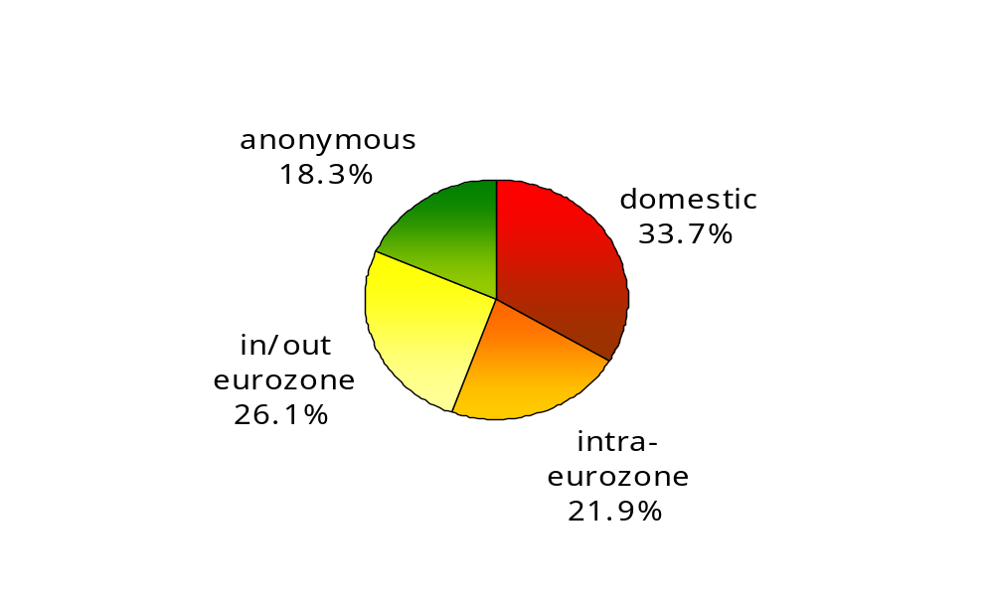
18th European repo market survey conducted in December 2009
Geographical analysis

Slide 10

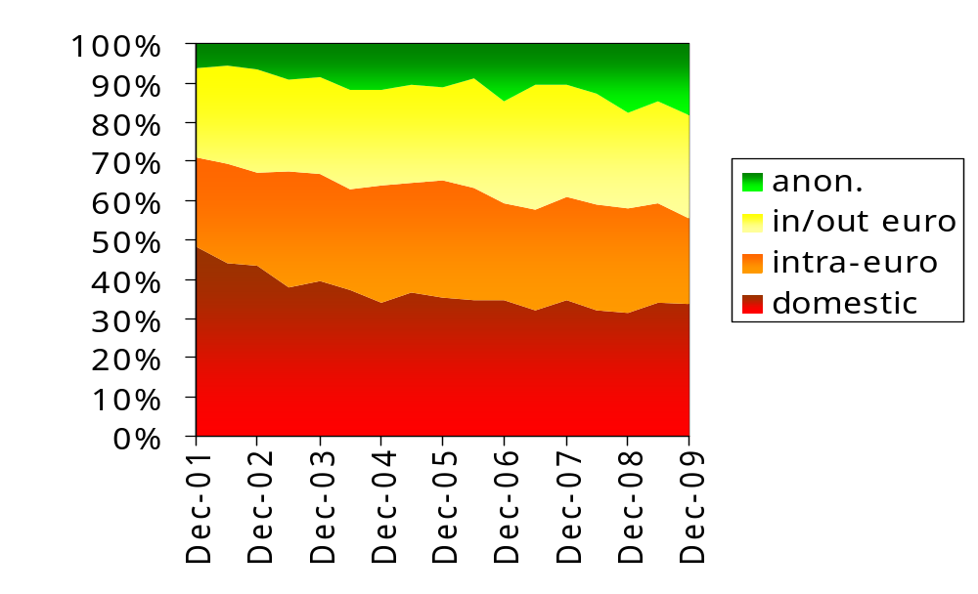
18th European repo market survey conducted in December 2009
Geographical analysis

Slide 11

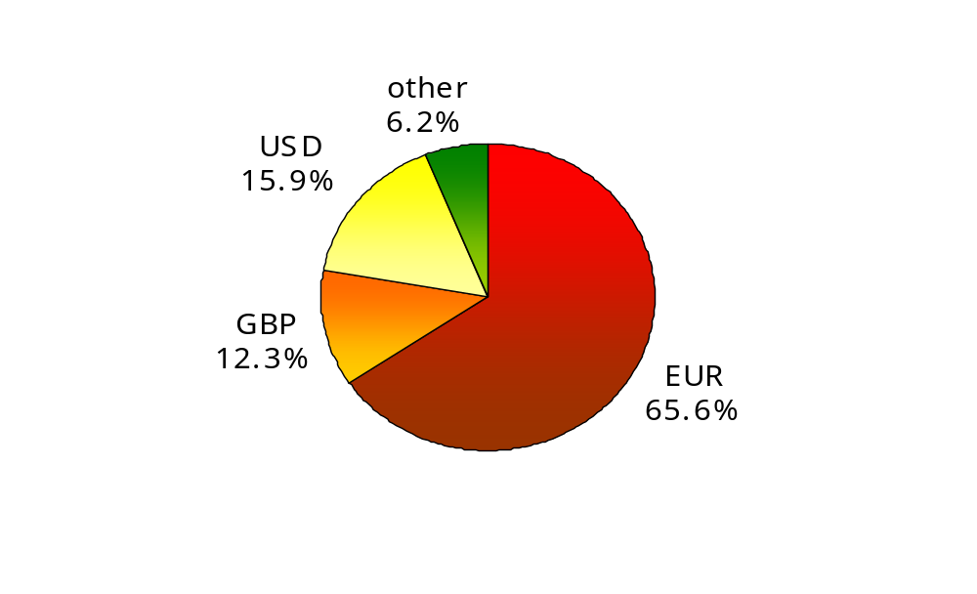
18th European repo market survey conducted in December 2009
Currency analysis

Slide 12

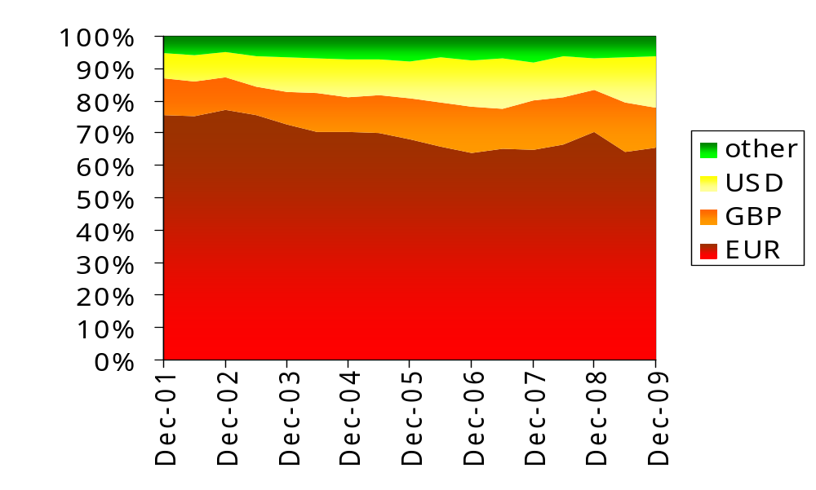
18th European repo market survey conducted in December 2009
Currency analysis

Slide 13

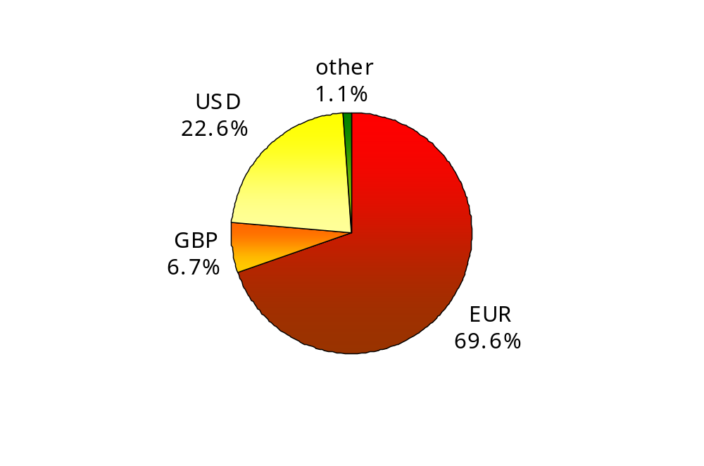
18th European repo market survey conducted in December 2009
Currency comparison
banks
triparty

Slide 14
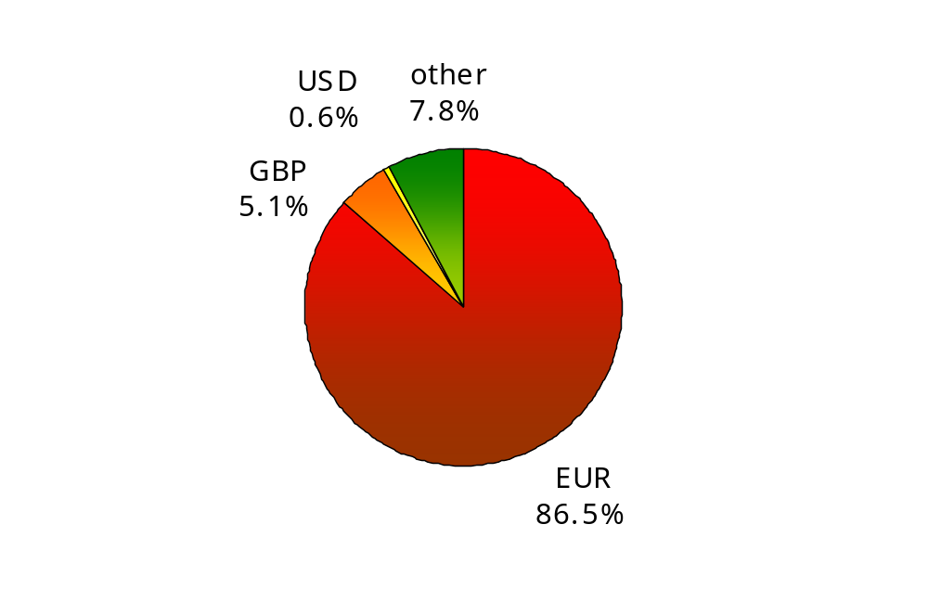
18th European repo market survey conducted in December 2009
Currency comparison
banks
ATS

Slide 15

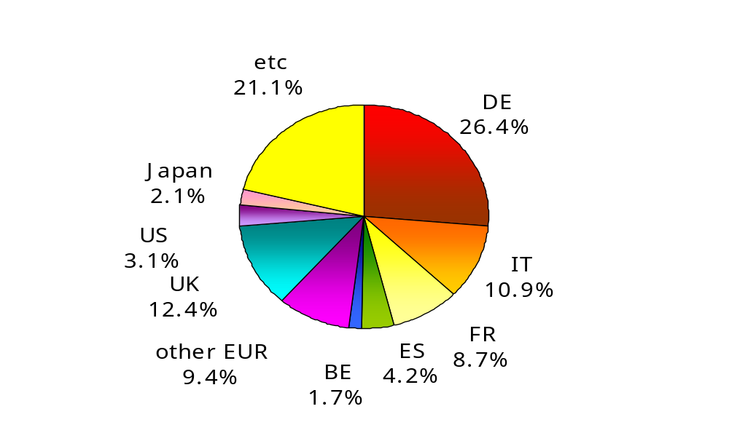
18th European repo market survey conducted in December 2009
Collateral analysis

Slide 16
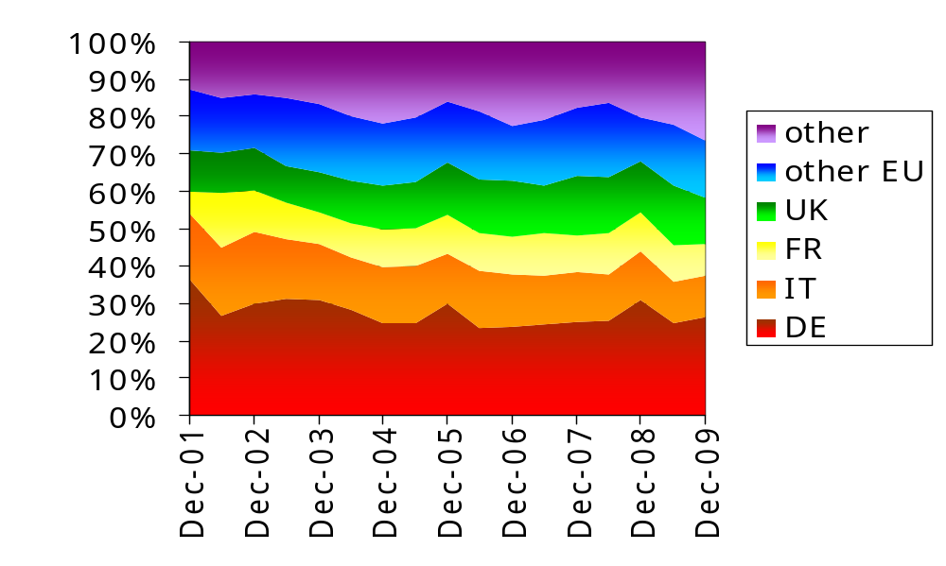
18th European repo market survey conducted in December 2009
Collateral analysis

Slide 17

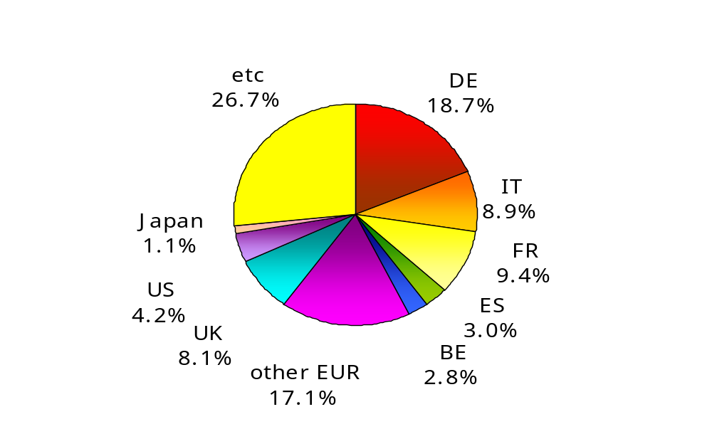
18th European repo market survey conducted in December 2009
Collateral comparison
banks
triparty

Slide 18
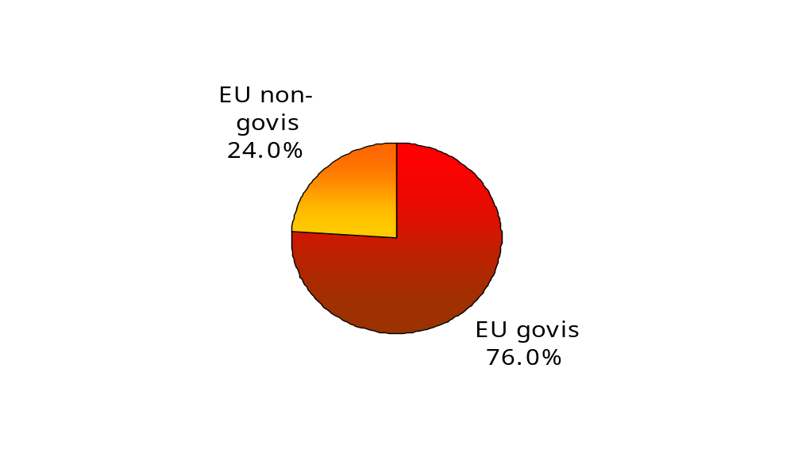
18th European repo market survey conducted in December 2009
Collateral analysis

Slide 19
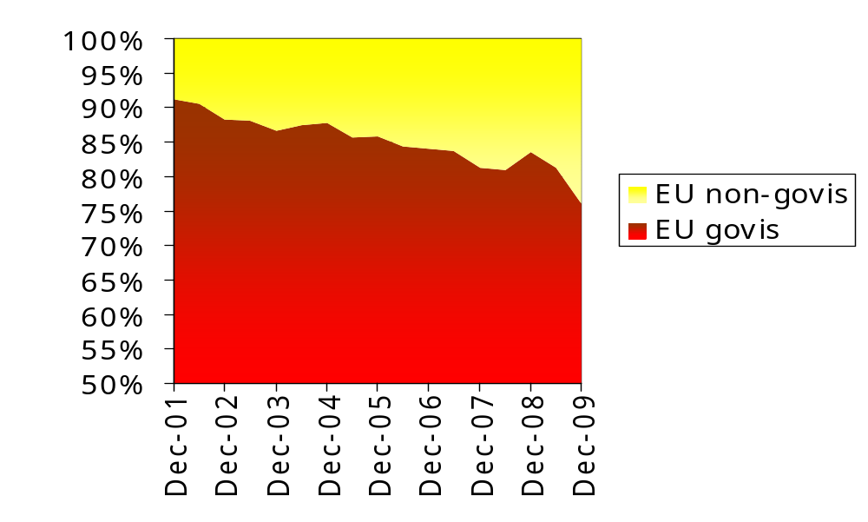
18th European repo market survey conducted in December 2009
Collateral analysis

Slide 20

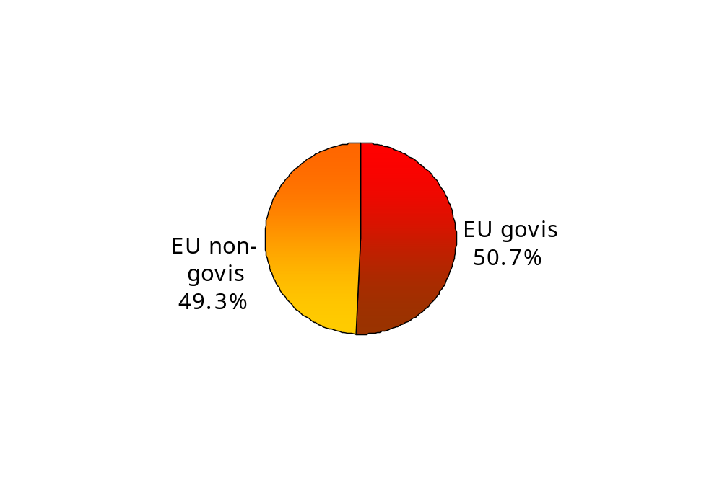
18th European repo market survey conducted in December 2009
Collateral comparison
banks
triparty

Slide 21
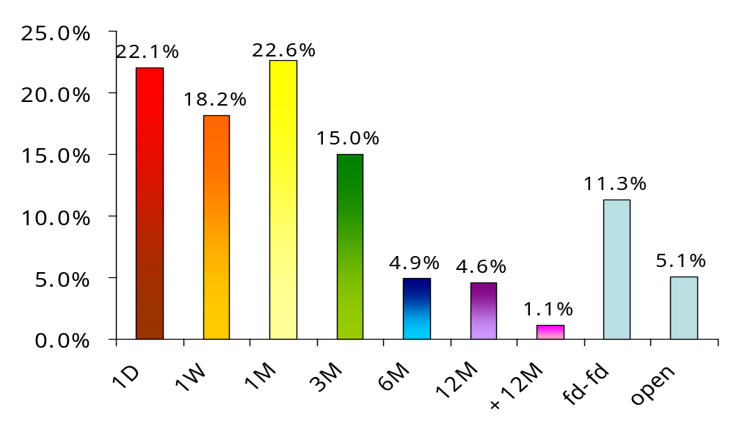
18th European repo market survey conducted in December 2009
Maturity analysis

Slide 22
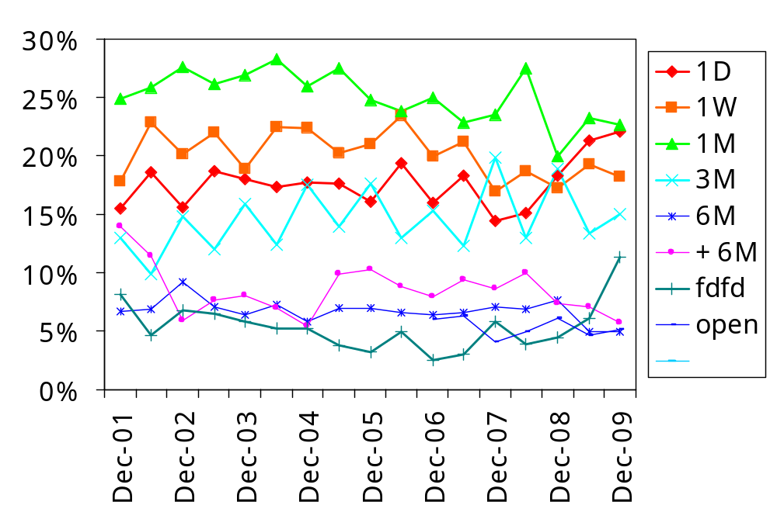
18th European repo market survey conducted in December 2009
Maturity analysis

Slide 23
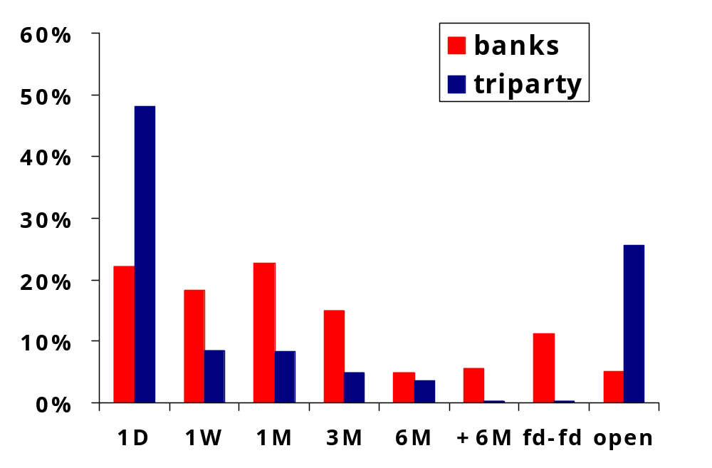
18th European repo market survey conducted in December 2009
Maturity comparison

Slide 24
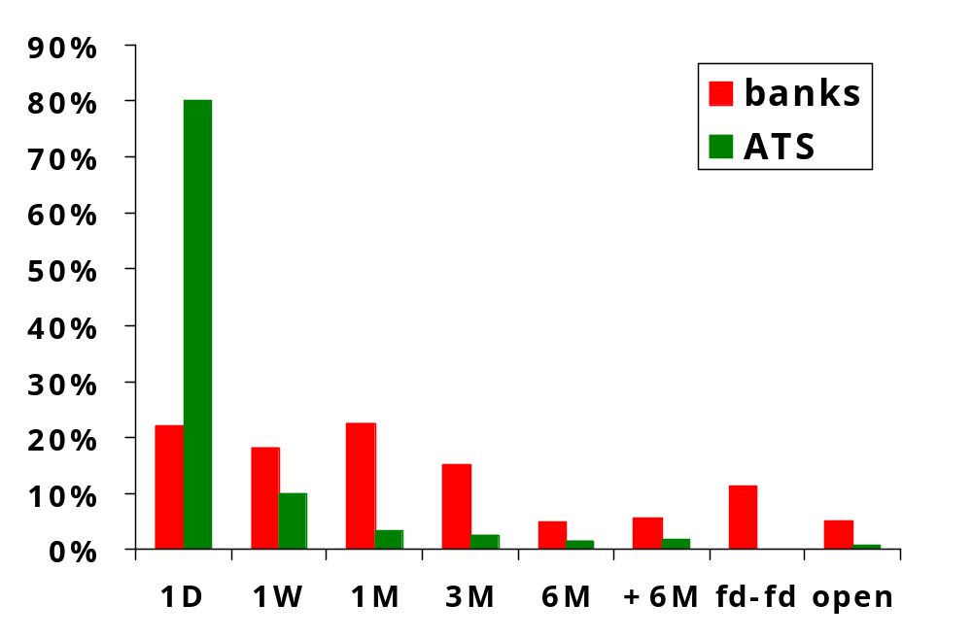
18th European repo market survey conducted in December 2009
Maturity comparison

Slide 25
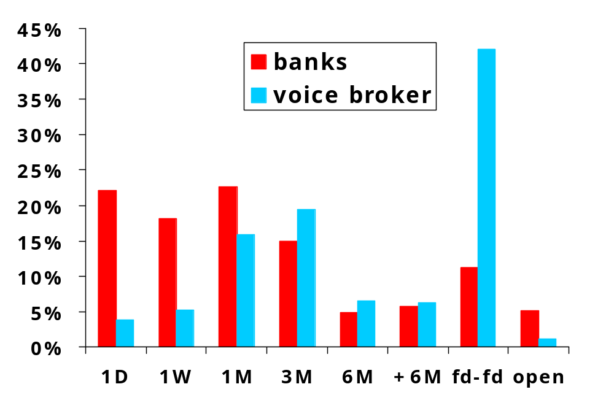
18th European repo market survey conducted in December 2009
Maturity comparison

Slide 26
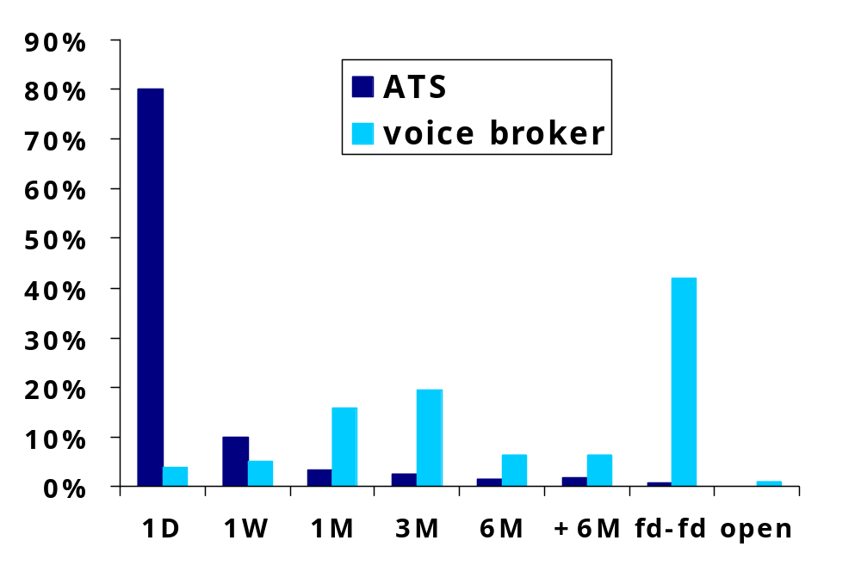
18th European repo market survey conducted in December 2009
Maturity comparison

Slide 27
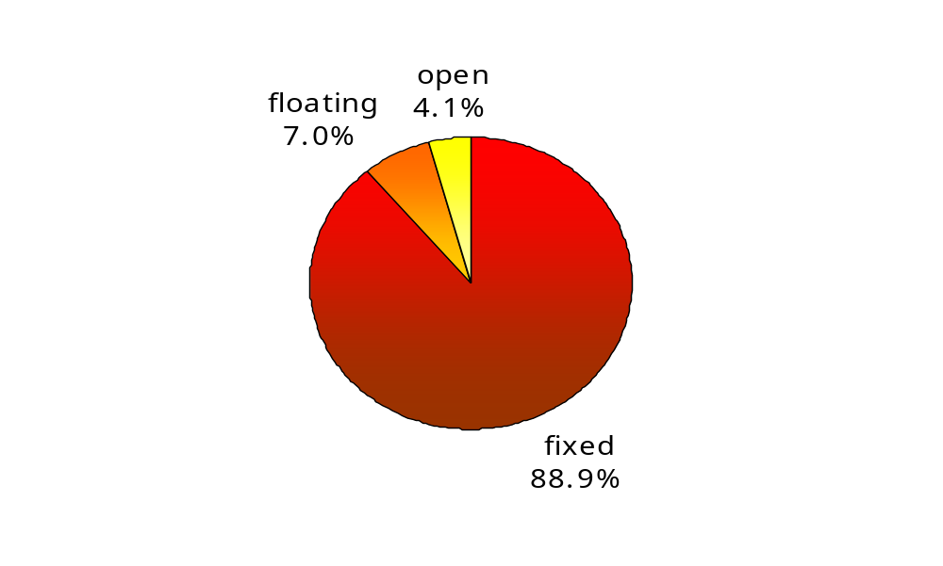
18th European repo market survey conducted in December 2009
Rate analysis

Slide 28
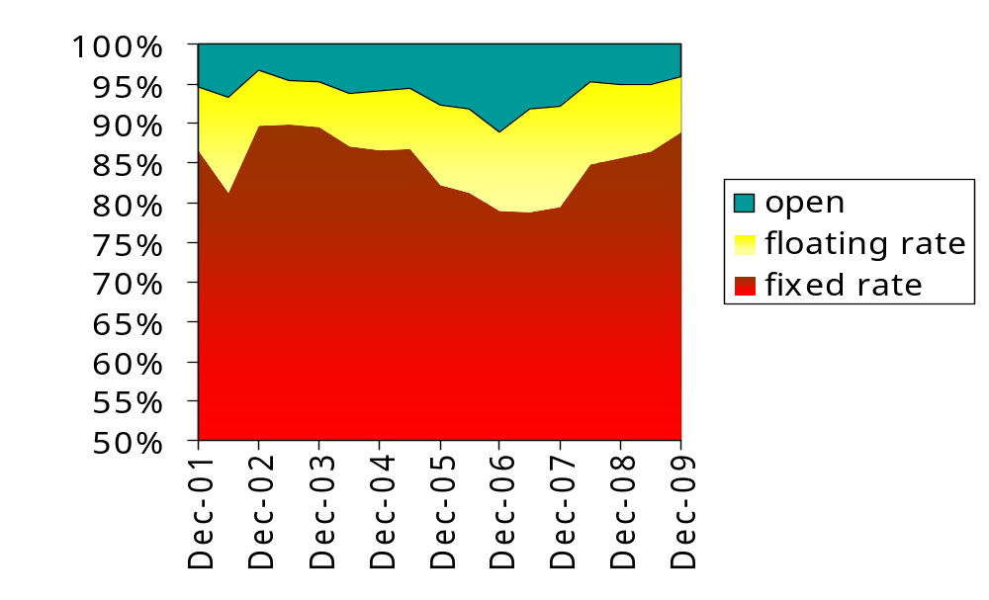
18th European repo market survey conducted in December 2009
Rate analysis

Slide 29
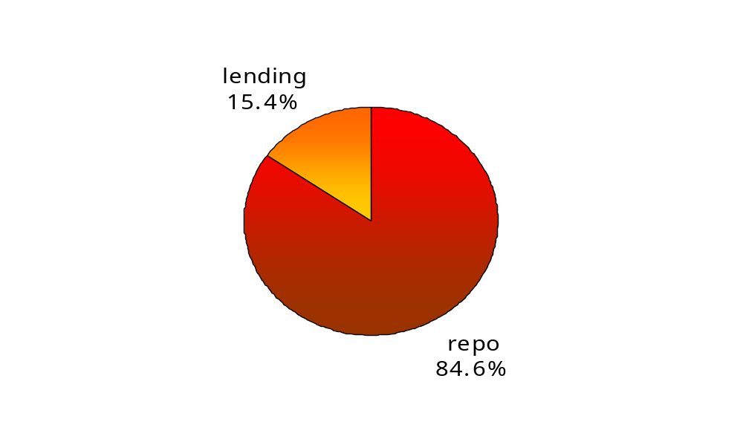
18th European repo market survey conducted in December 2009
Product analysis

Slide 30
18th European repo market survey conducted in December 2009
Next survey
Wednesday, 9th June 2010

Slide 31
European Repo Council
18th European repo market survey conducted in December 2009

