Slide 1
GSL Chicago 12th May, 2011
Global Securities Lending Update
Timothy Smith
Executive Vice President
SunGard’s Astec Analytics

Slide 2
Introduction
2010 - year at the crossroads
2011 – a new dawn?
Global themes
Changing environment
New ways of doing business
Regional differences
Specials only market?
Local factors
Conclusion

Slide 3
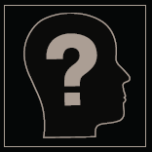
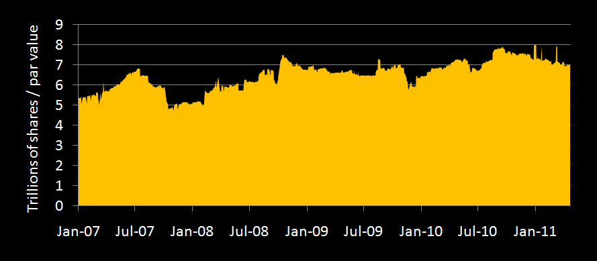
Available trending down slightly
Source: SunGard Astec Analytics

Slide 4
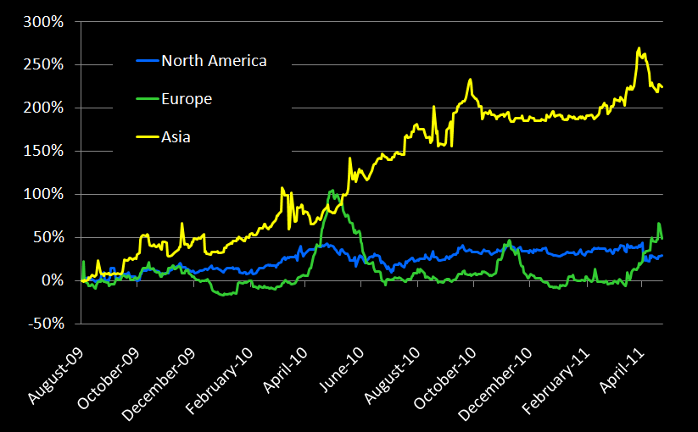
Equity market value on loan
Source: SunGard Astec Analytics

Slide 5
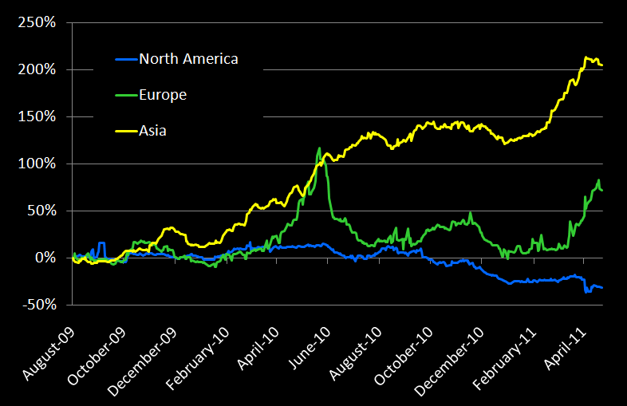
Equity number of shares borrowed
Source: SunGard Astec Analytics

Slide 6
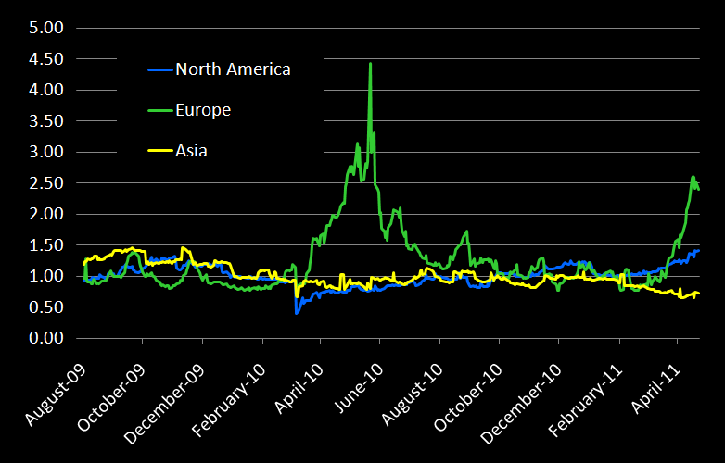
Equity borrowing costs
Source: SunGard Astec Analytics

Slide 7
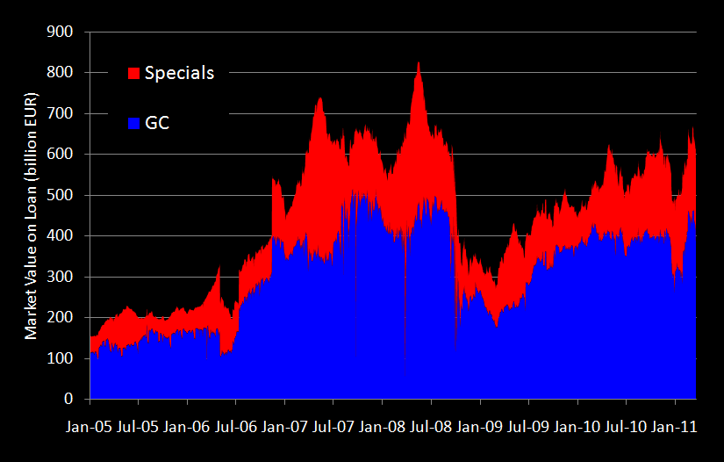
Is it a specials only market?
Source: SunGard Astec Analytics

Slide 8
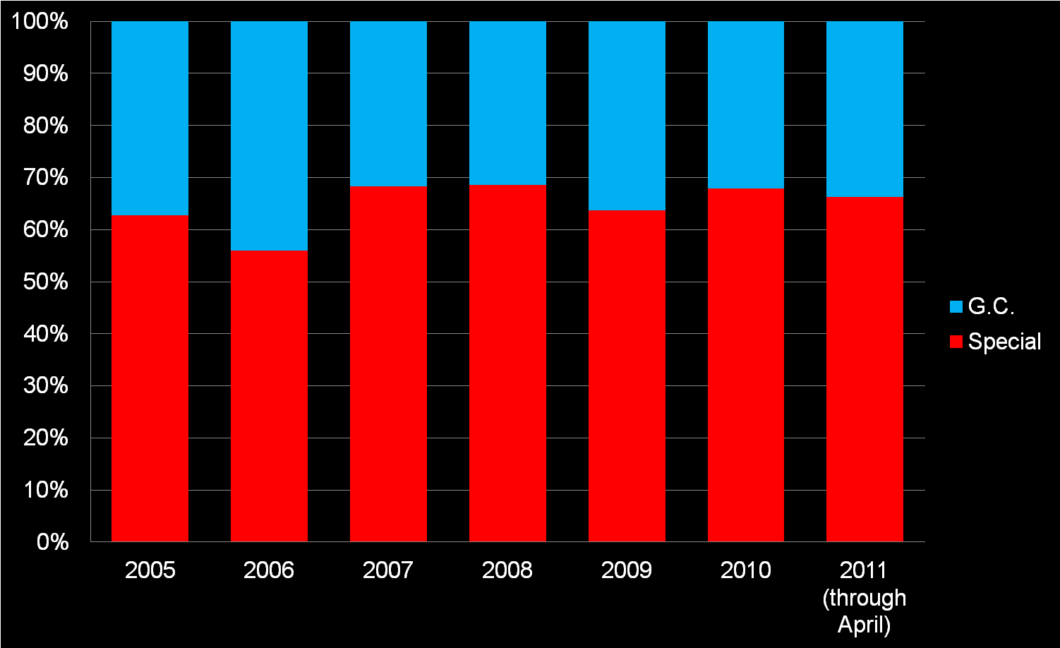
Share of Revenue due to Specials
Source: SunGard Astec Analytics

Slide 9
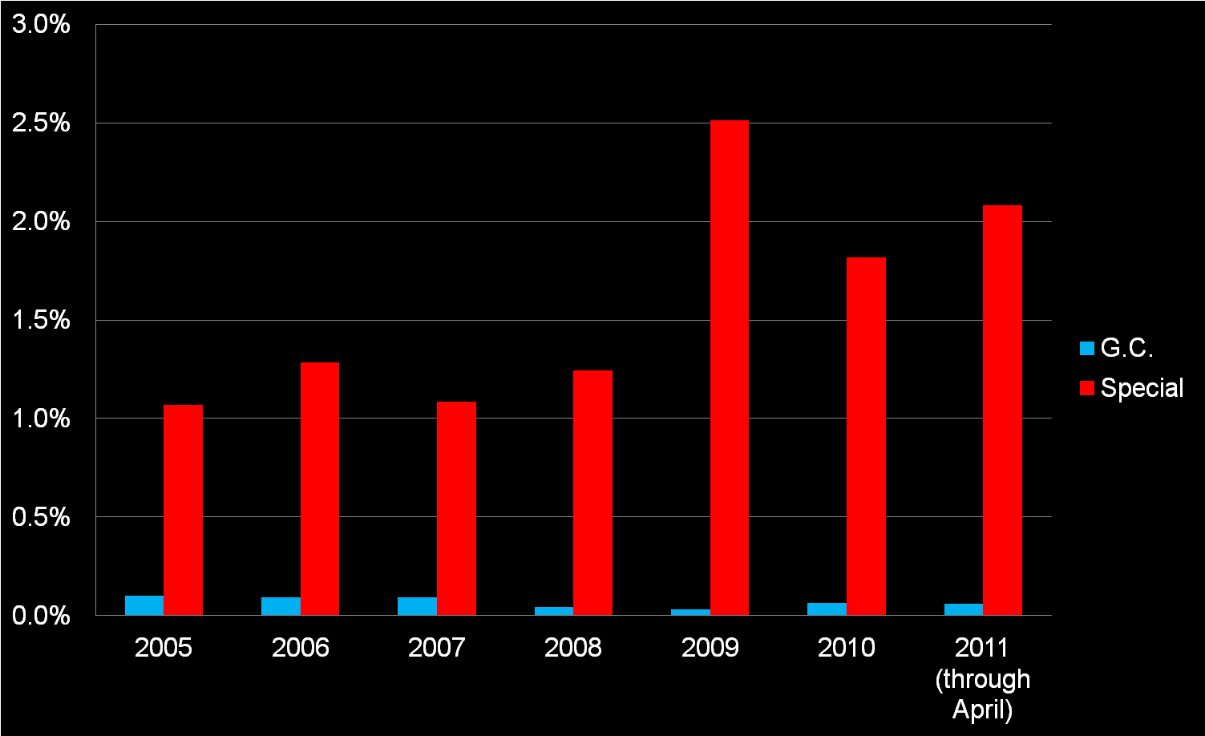
Intrinsic Rate of Specials
Source: SunGard Astec Analytics

Slide 10
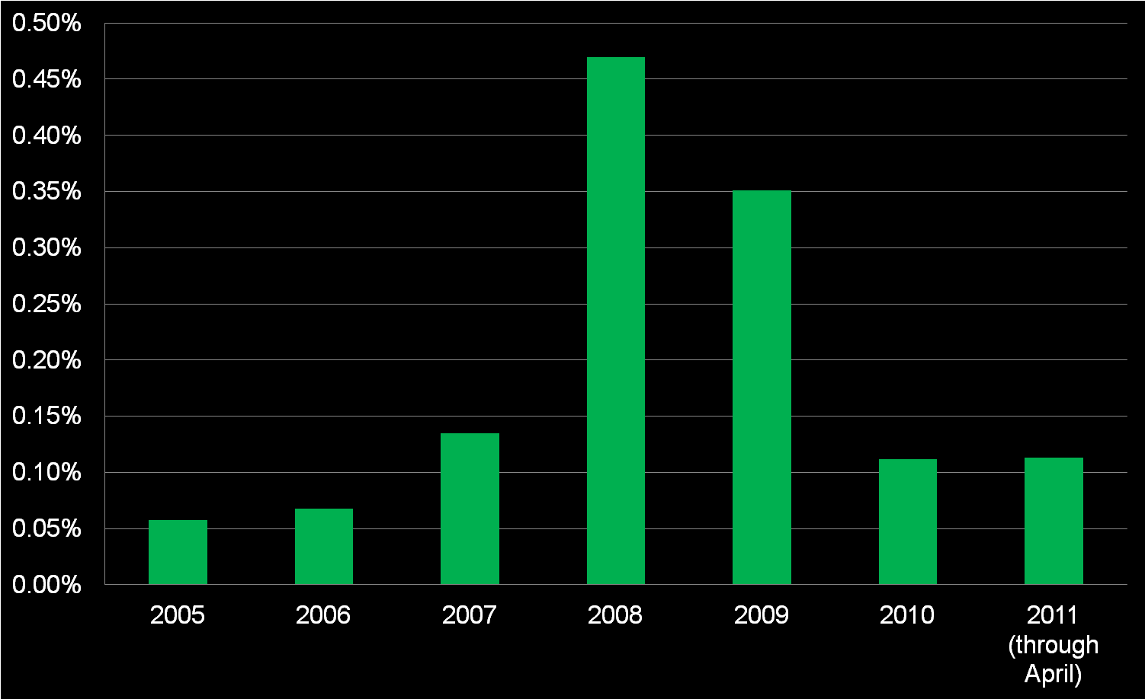
Cash Yield Premium
Source: SunGard Astec Analytics

Slide 11
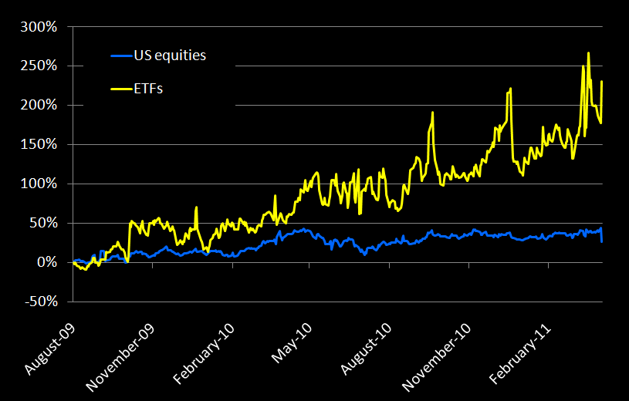
Growth in ETFs outpaces equities
Source: SunGard Astec Analytics

Slide 12
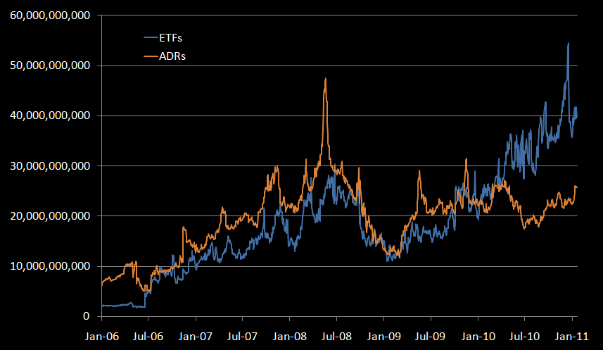
New products - Market value of ETFs and ADRs on loan
Source: SunGard Astec Analytics

Slide 13
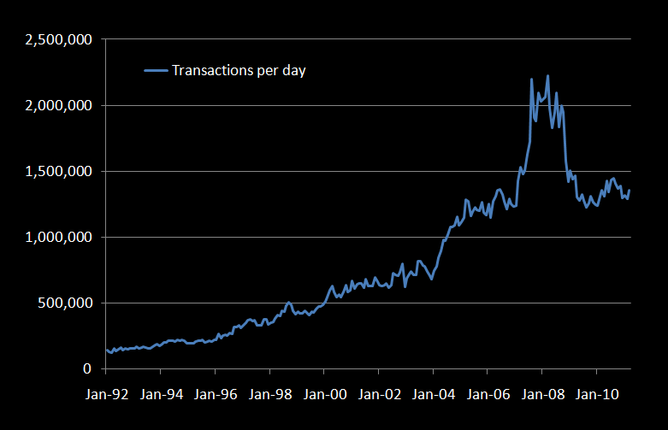
Growth in US securities lending since ‘92
Source: SunGard Astec Analytics

Slide 14
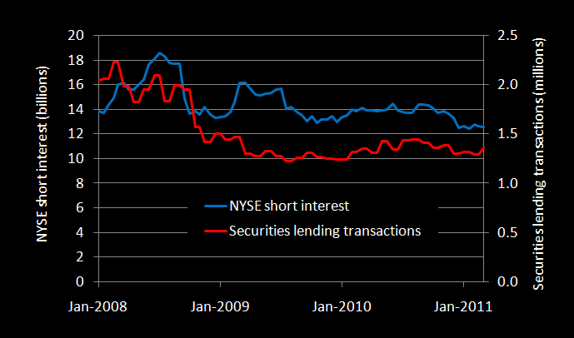
NYSE short interest vs Lending transactions
Source: SunGard Astec Analytics

Slide 15
Conclusion
Adapting to change
Integration
Flexibility
Risk/reward
Regulation
Where is the demand?

