Slide 1
GSL North American Summit 2011
Securities Lending Panel Session 1:
Maximising program Performance
Moderator:
Tom McKeown, FinTuition
Panellists
Michael Barrett, Global Collateral Management Solutions
Peter Bassler, eSecLending
LJ Jhangiani, Allstate Investments
Bill Pridmore, William F. Pridmore, Ltd.

Slide 2
GSL North American Summit 2011
What are YOUR earnings expectations for the next 12 months compared to the last 12 months?
Pessimistic
Slightly pessimistic
Indifferent
Cautiously optimistic
Optimistic

Slide 3
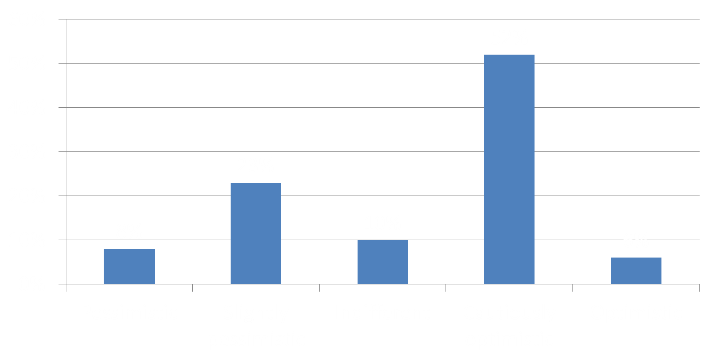
What are YOUR earnings expectations for 2011 compared to 2010?

Slide 4
GSL North American Summit 2011
Which area will people be focussing on to boost returns over the next 18 months?
Intrinsic Value (i.e. specials)
Volume
Cash Collateral
Collateral Optimisation
Switching Providers/ Changing Structure

Slide 5
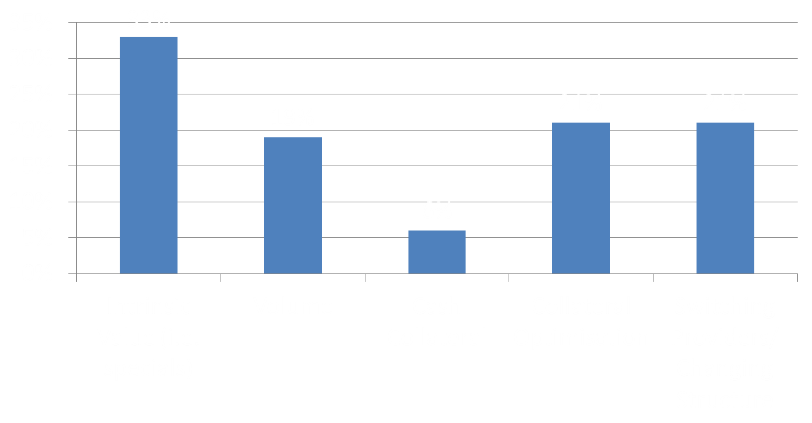
Which area will people be focussing on to boost returns over the next 18 months?

Slide 6
GSL North American Summit 2011
Is non-cash an acceptable form of collateral for ANY of your/your clients’ programs?
Yes
No

Slide 7
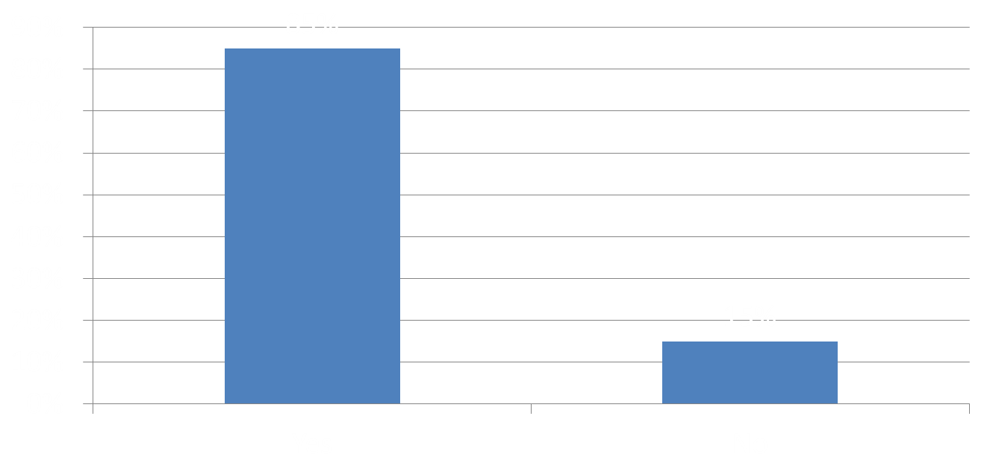
Is non-cash an acceptable form of collateral for ANY of your/your clients’ programs?

Slide 8
GSL North American Summit 2011
Is there a trend towards or away from in-house cash collateral management?
A significant number of firms outsourcing collateral management
Some firms outsourcing collateral management
No change
Some firms moving to manage collateral in-house
A significant number of firms taking cash collateral management in-house

Slide 9
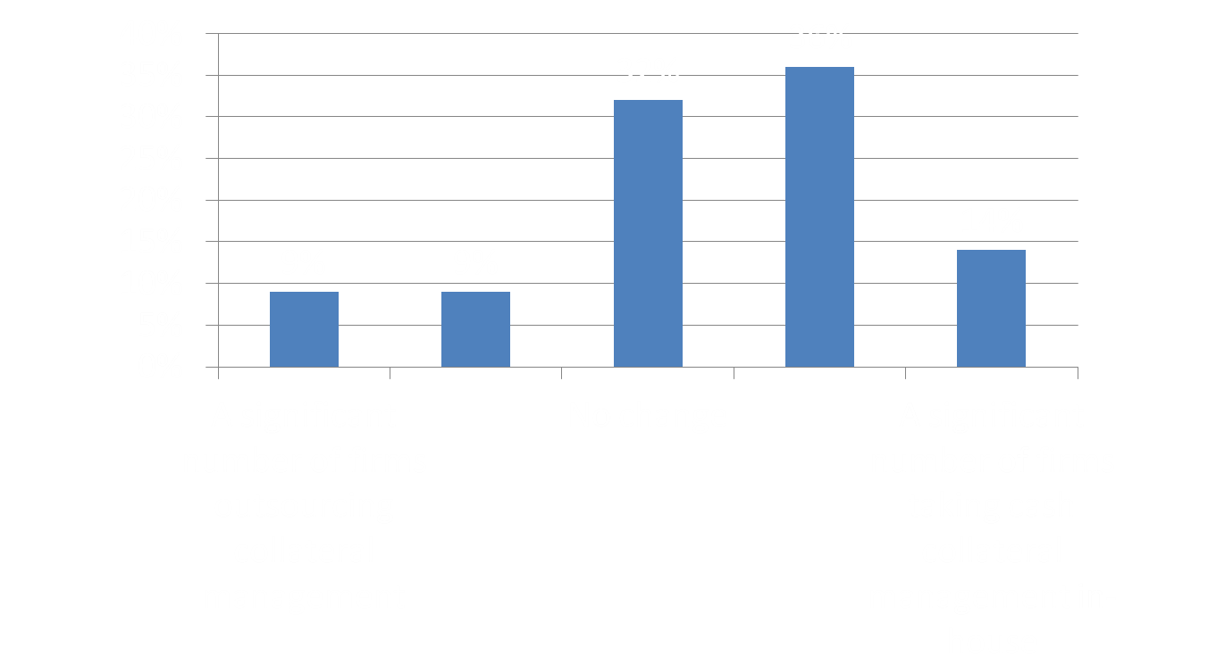
Is there a trend towards or away from in-house cash collateral management?

