Slide 1
GSL North American Summit 2011
Securities Lending Panel Session 2: 2011 Industry Roundtable
Moderator:
Tim Smith, SunGard Astec Analytics
Panellists
Jeff Benner, Global Collateral Management Solutions
Robert Cleasby, Bank of America Merrill Lynch
Joseph Pellegrini, OCC
Richard L Rosenthal, Garwood Securities
Brian Yeazel, Mason Street Advisors

Slide 2
GSL North American Summit 2011
Are the current levels of transparency in the industry in all aspects...
Too much
About right
Too little

Slide 3
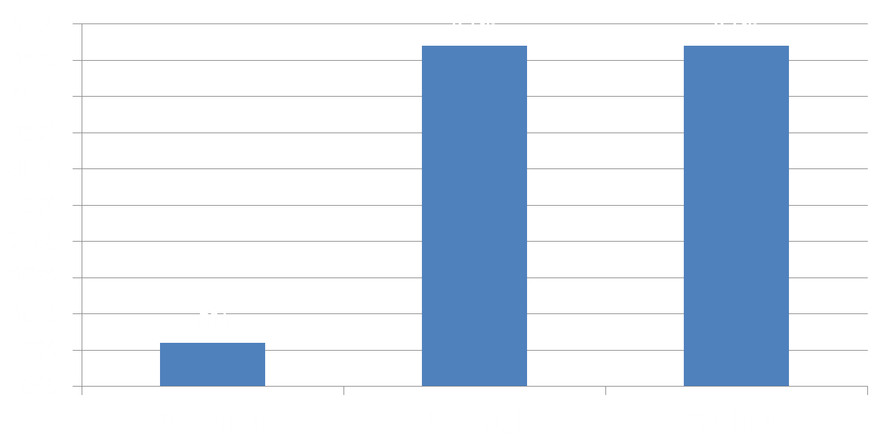
Are the current levels of transparency in the industry in all aspects...

Slide 4
GSL North American Summit 2011
Which stakeholder is the most powerful in the industry right now, excluding the regulators?
Beneficial owners
Agents
Brokers
Hedge Funds

Slide 5
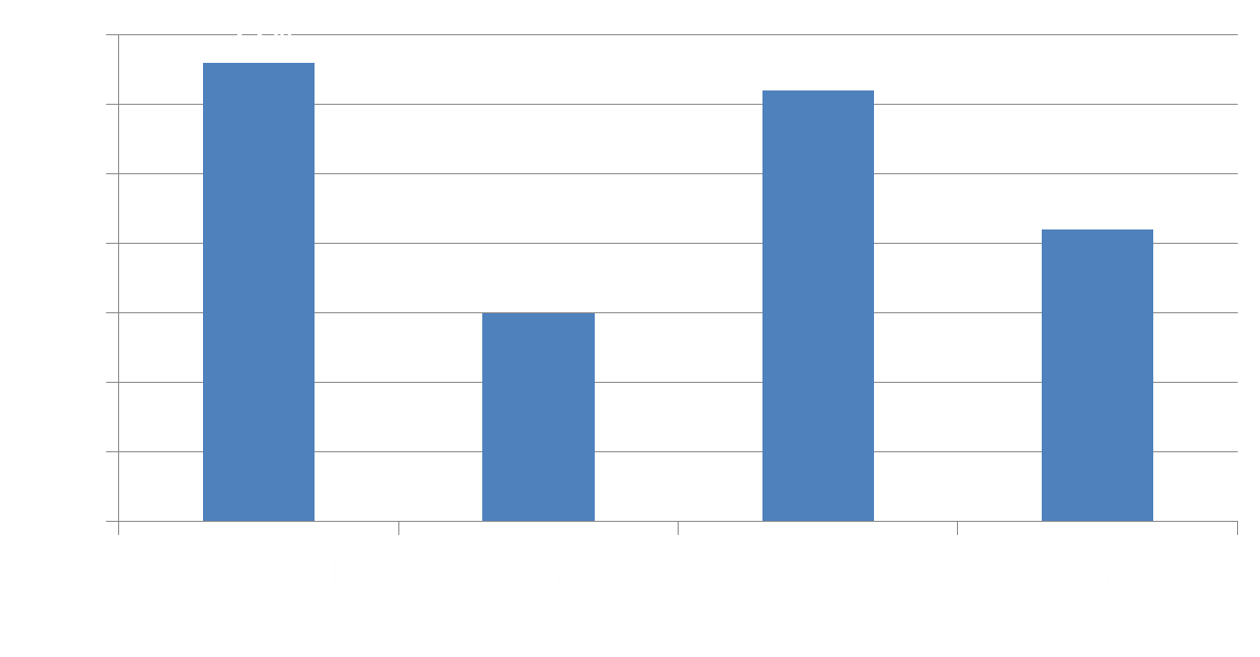
Which stakeholder is the most powerful in the industry right now, excluding the regulators?

Slide 6
GSL North American Summit 2011
Which aspect of the business will have the most effect on the industry over the coming year – again, taking regulation out of the equation?
Risk
Transparency
Collateral changes
CCPs
New markets

Slide 7
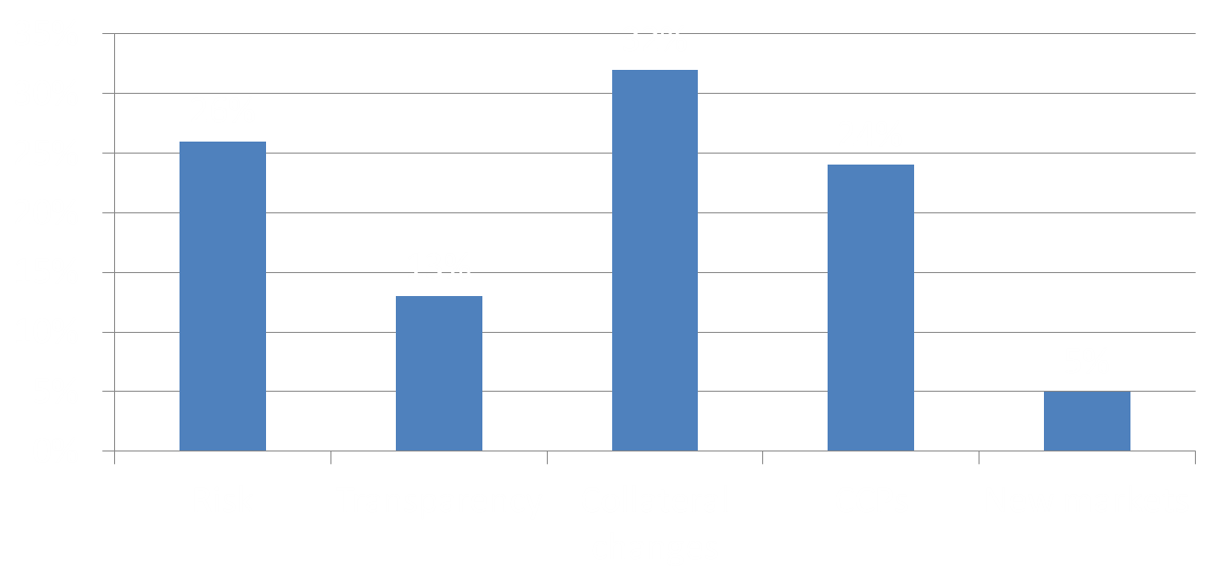
Which aspect of the business will have the most effect on the industry over the coming year – again, taking regulation out of the equation?

