Slide 1
GSL Summit – Boston
Securities Lending Market Activity
Timothy Smith
SunGard’s Astec Analytics
4th November, 2010

Slide 2
Introduction
2010 – Year at the crossroads
Reality
Idleness/Sameness
Global uncertainty
New direction
Art or science
Conclusion

Slide 3
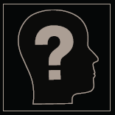
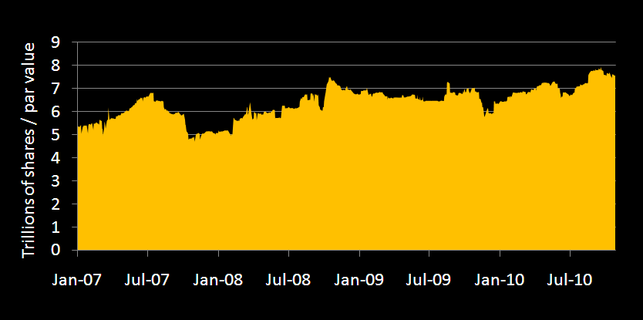
Available shares continue to increase
Source: SunGard Astec Analytics

Slide 4
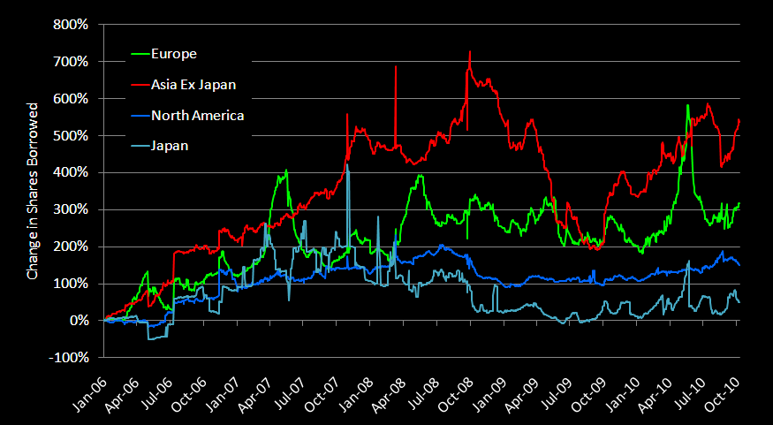
Equity loan volume – shares
Source: SunGard Astec Analytics

Slide 5
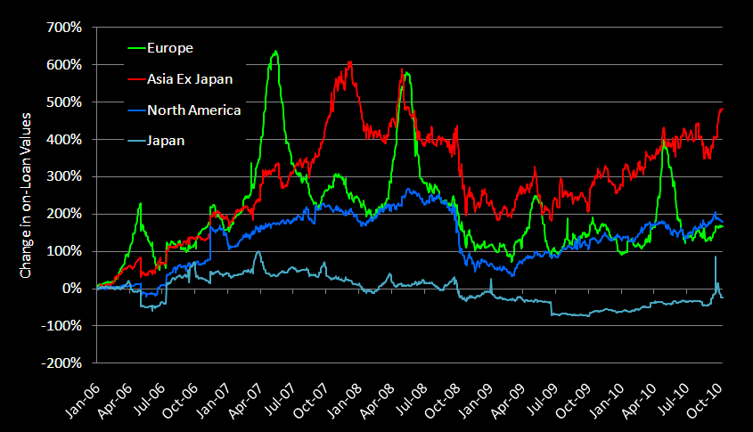
Equity loan volume – market value
Source: SunGard Astec Analytics

Slide 6
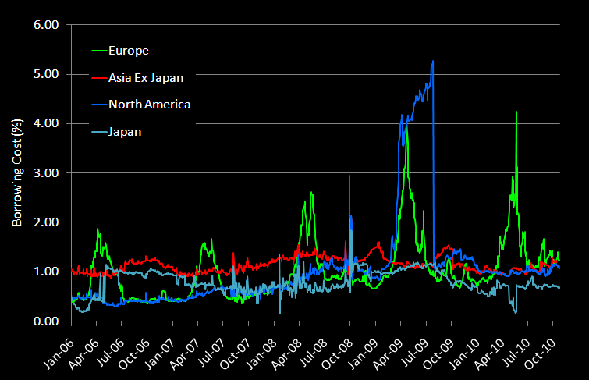
Equity borrowing costs
Source: SunGard Astec Analytics

Slide 7
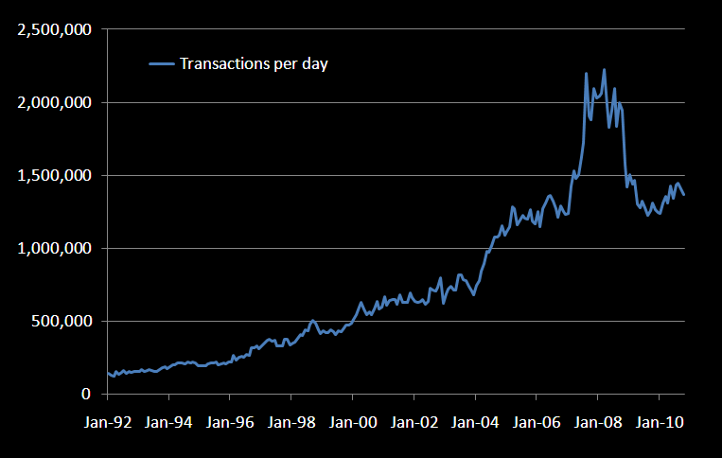
Growth in US securities lending since ‘92
Source: SunGard Astec Analytics

Slide 8
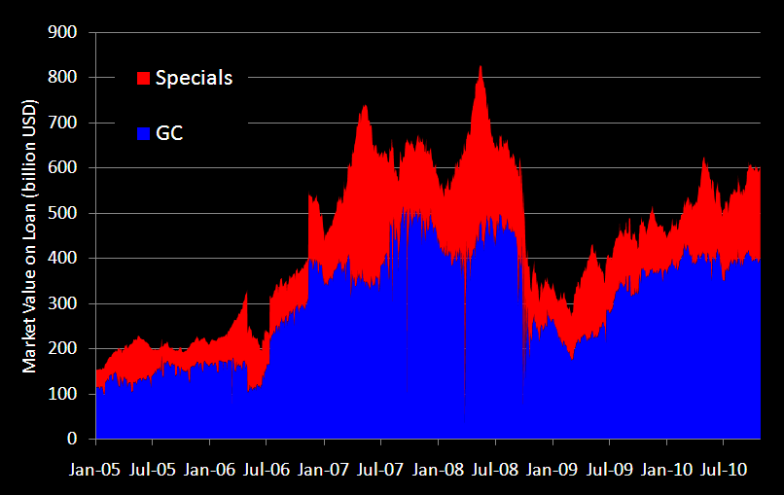
Specials only market?
Source: SunGard Astec Analytics

Slide 9
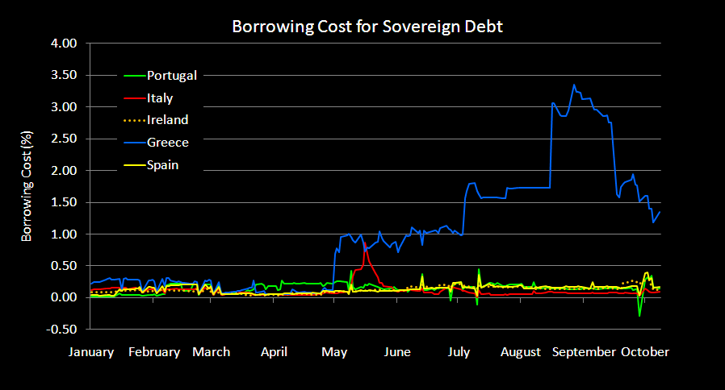
Global uncertainty - PIIGS
Source: SunGard Astec Analytics

Slide 10
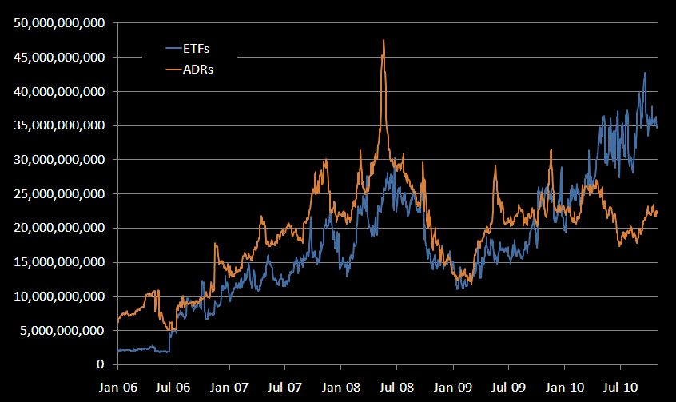
Market value of ETFs and ADRs on loan
Source: SunGard Astec Analytics

Slide 11
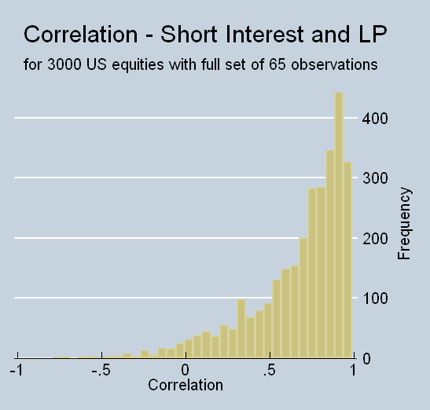
Short Interest and Shares Borrowed - US
Median .77
Source: SunGard Astec Analytics

Slide 12
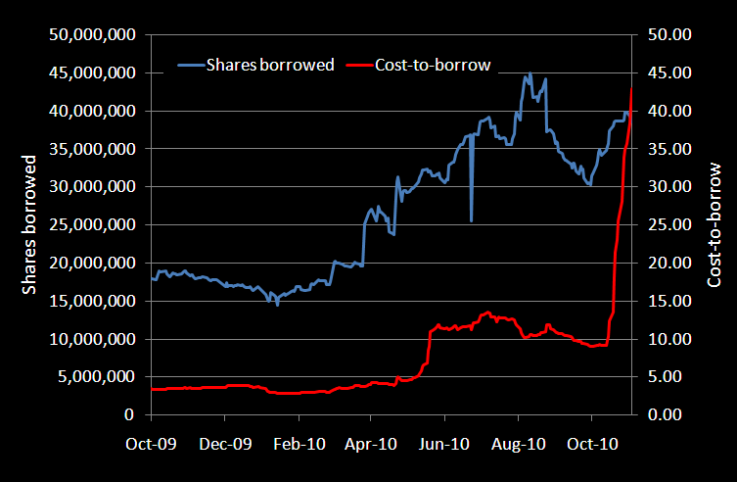
Evergreen Solar
Source: SunGard Astec Analytics
Notes:
Evergreen’s share price is up 30% over the past month and evidently short sellers disagree.

Slide 13
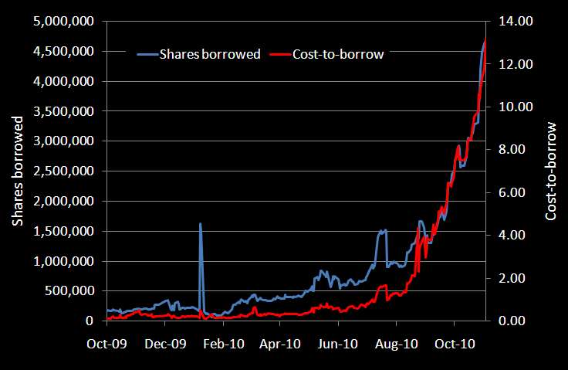
Biodel
Source: SunGard Astec Analytics
Notes:
Biodel is down 62% over the past month. The FDA asked for more tests to be performed regarding BIOD’s diabetes drug.

Slide 14
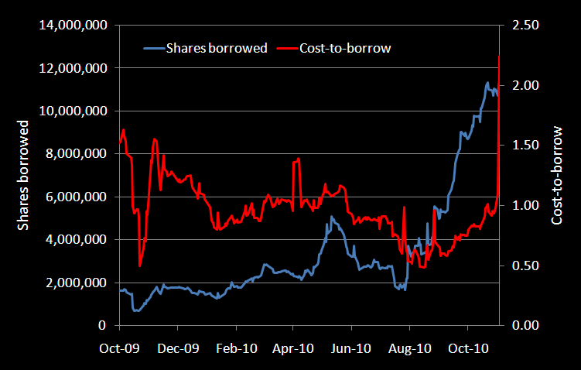
Avanir Pharmaceuticals
Source: SunGard Astec Analytics
Notes:
This is an example of a stock that increased in short interest and loan volume on Lending Pit, yet increased significantly in share price after its drug was approved by the FDA. So one can’t always assume that rising loan volume and short interest indicates that hedge funds know something. Sometimes the smart money is wrong! AVNR’s share price is up 55% over the past month.

Slide 15
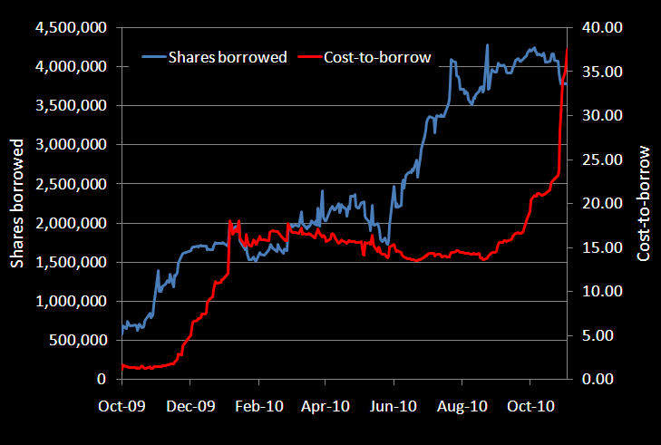
Mela Sciences
Source: SunGard Astec Analytics

Slide 16
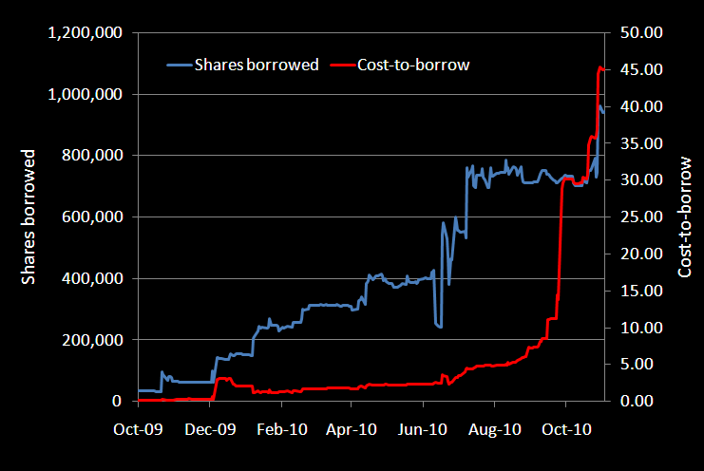
Cascade Financial
Source: SunGard Astec Analytics

Slide 17
Conclusion
Early indications of recovery?
New dynamics
Regulatory uncertainty
Transparency is king
2011 – What next?

