Slide 1
GSL Summit 2010
Securities Lending Market Activity

Slide 2
Introduction
Do you remember when………?
2008/2009 – Crisis of Confidence – Paradise Lost
2010 – At the Crossroads

Slide 3
The Market Today
No central theme
Global, Regional and seasonal factors
PIIGS
Regulatory scrutiny and effects?
New ways of doing business?
Availability versus demand – more than enough?
Back to fundamentals – case studies and analytics

Slide 4
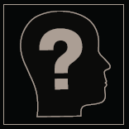
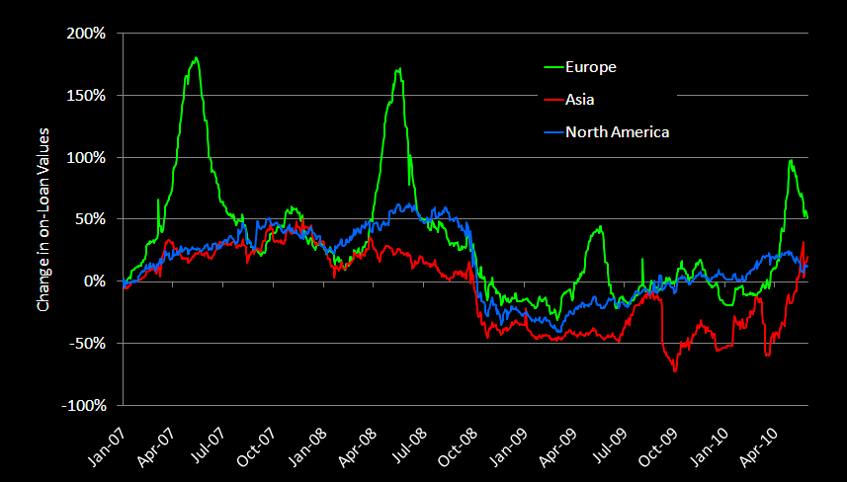
Equity volume – market value
Source: SunGard Astec Analytics

Slide 5
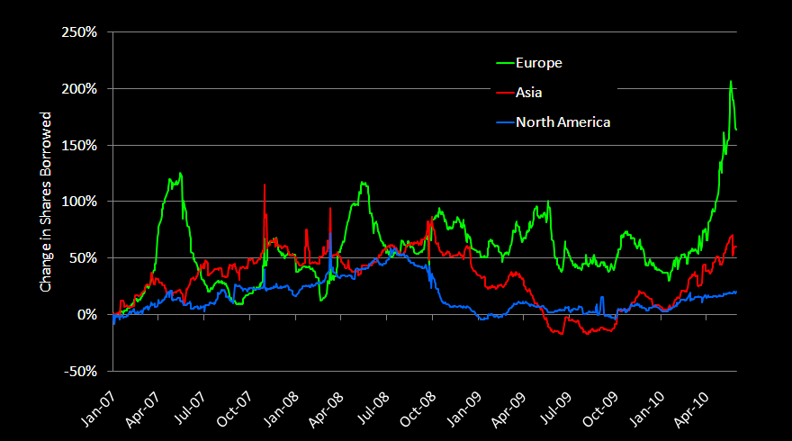
Equity volume – shares borrowed
Source: SunGard Astec Analytics

Slide 6
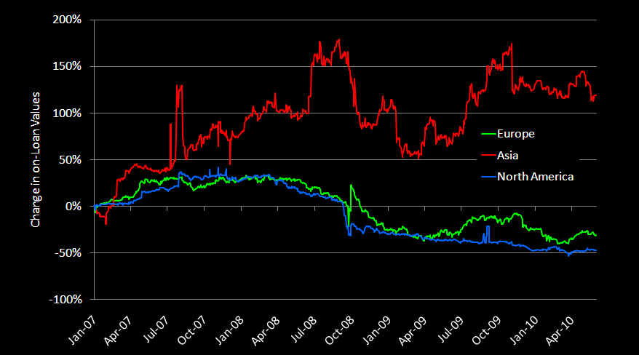
Fixed income volume – market value
Source: SunGard Astec Analytics

Slide 7
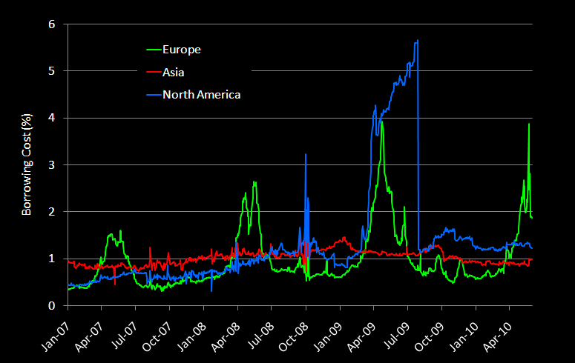
Equity borrowing costs
Source: SunGard Astec Analytics

Slide 8
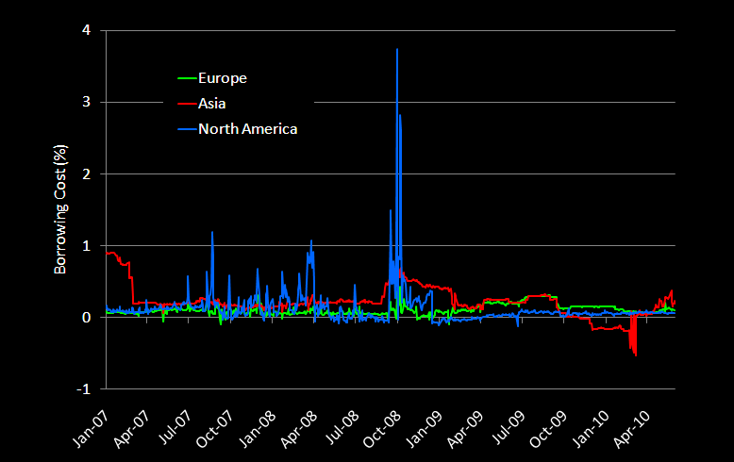
Fixed income borrowing costs
Source: SunGard Astec Analytics

Slide 9
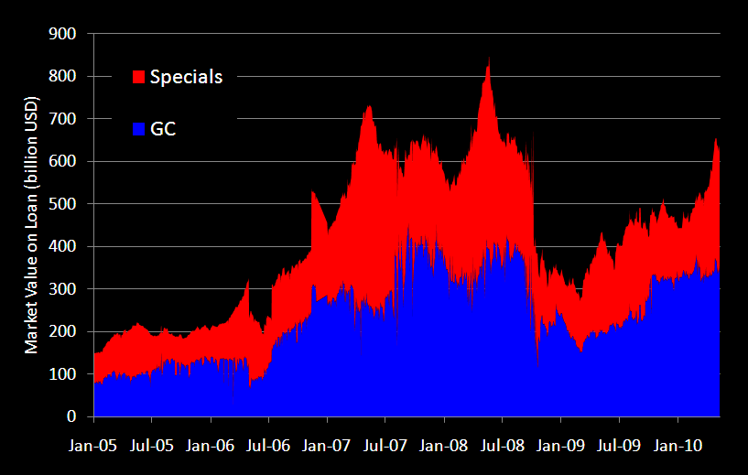
Specials increase as percent of total market
Source: SunGard Astec Analytics

Slide 10
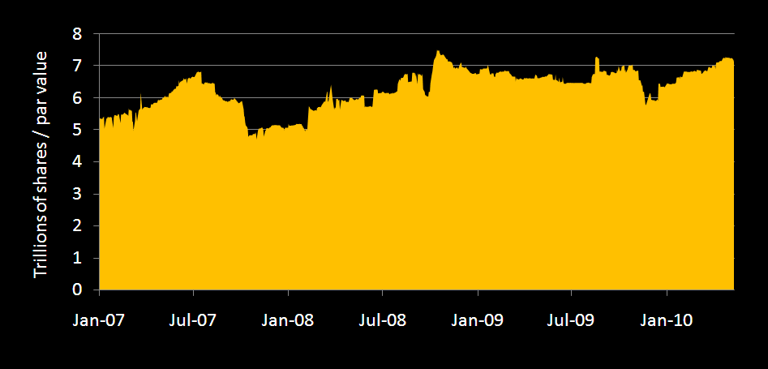
Availability rebounding
Source: SunGard Astec Analytics

Slide 11
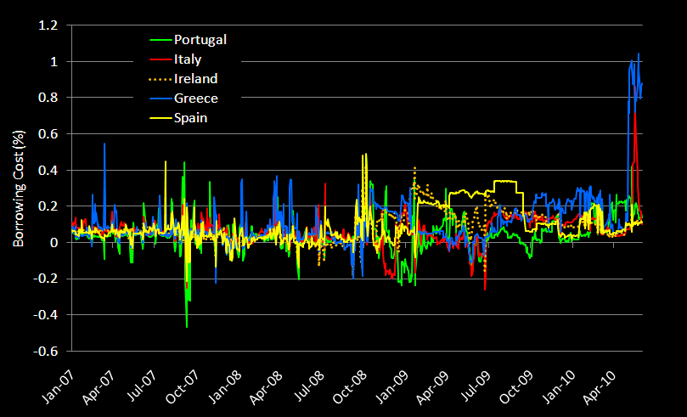
PIIGS’ government bond borrowing costs rise
Source: SunGard Astec Analytics

Slide 12
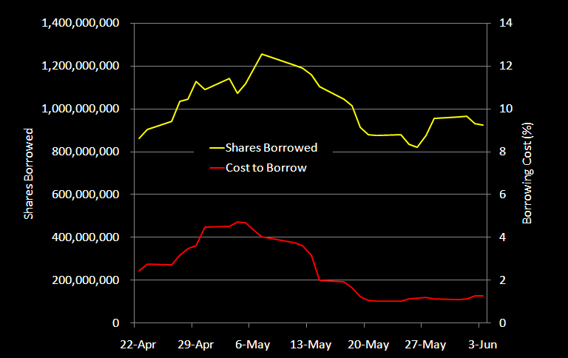
Ban has little effect on German SBL market
Source: SunGard Astec Analytics

Slide 13
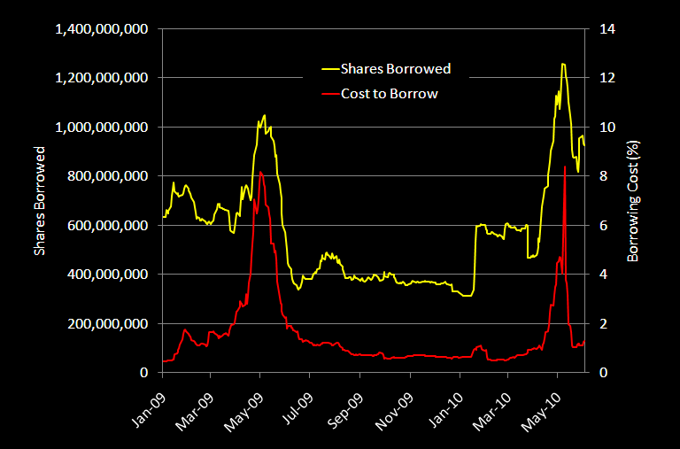
Ban has little effect on German SBL market
Source: SunGard Astec Analytics

Slide 14
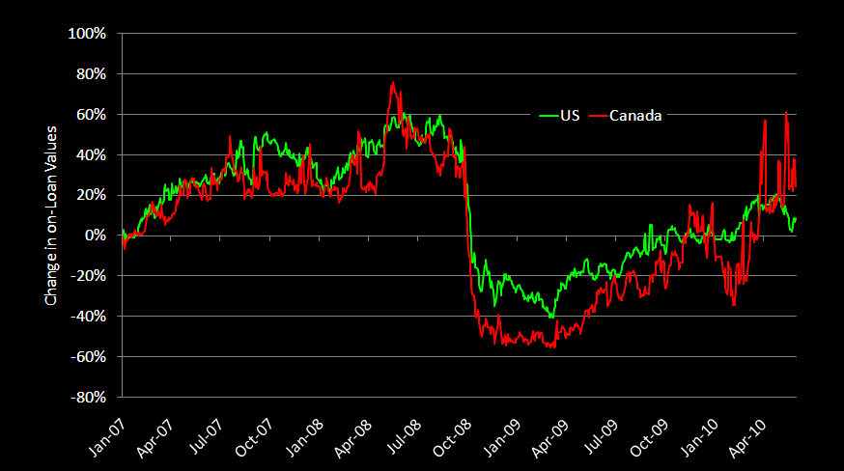
Equity volume – market value
Source: SunGard Astec Analytics

Slide 15
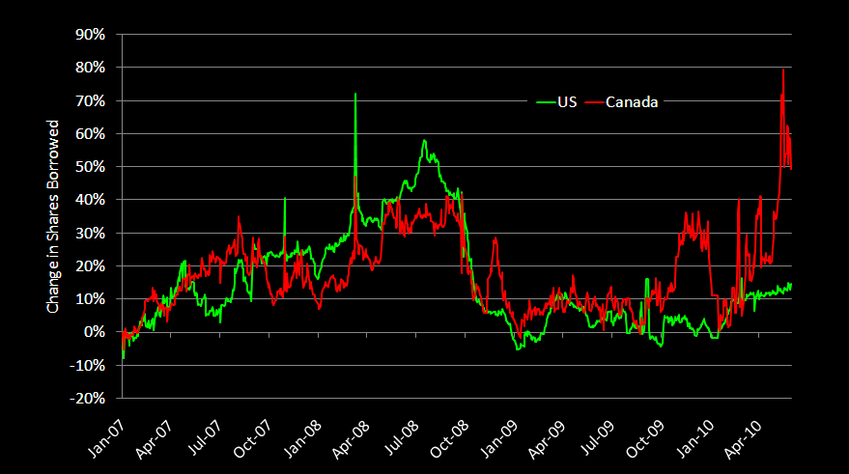
Equity volume – shares borrowed
Source: SunGard Astec Analytics

Slide 16
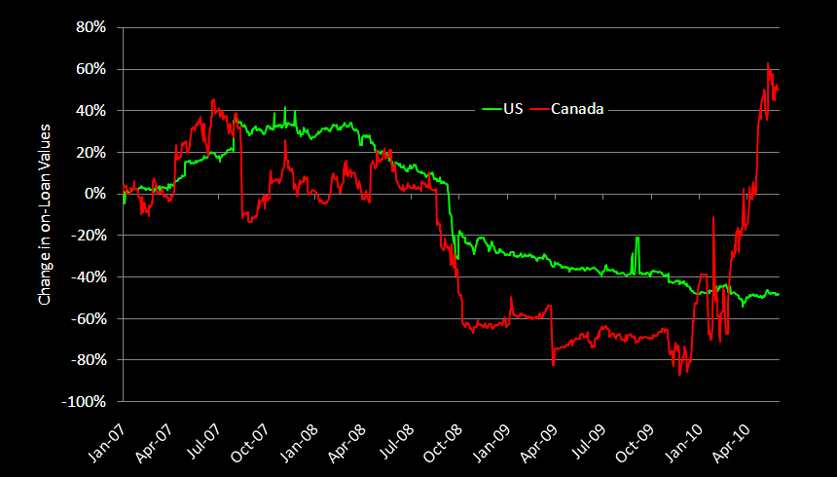
Fixed income volume – market value
Source: SunGard Astec Analytics

Slide 17
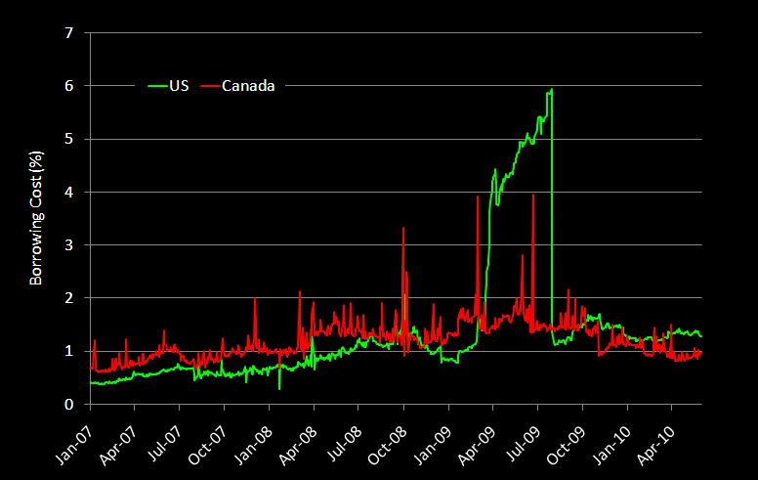
Equity borrowing costs
Source: SunGard Astec Analytics

Slide 18
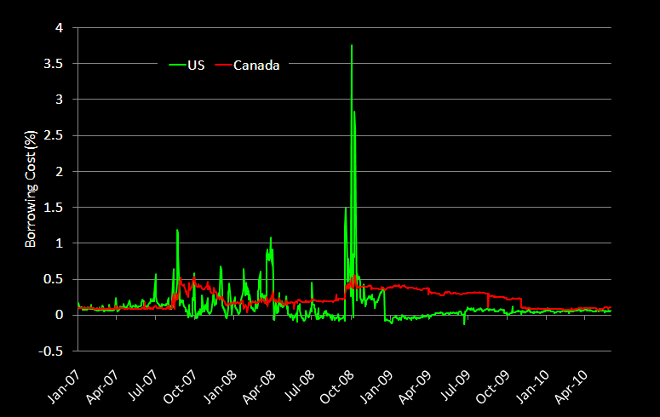
Fixed income borrowing costs
Source: SunGard Astec Analytics

Slide 19
CASE STUDIES - ANALYTICS

Slide 20
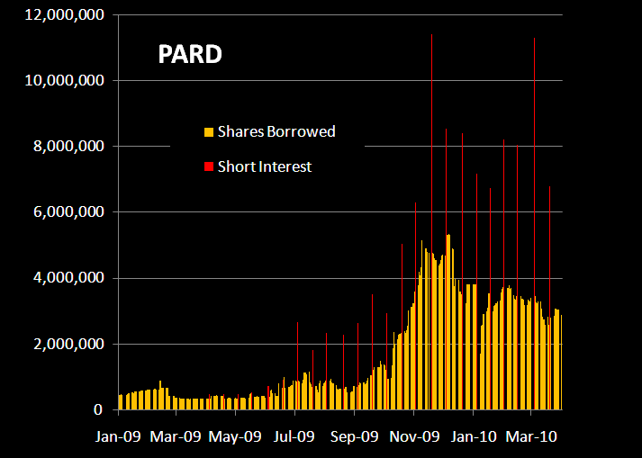
Positive Correlation of .94 with Short Interest
Source: SunGard Astec Analytics

Slide 21
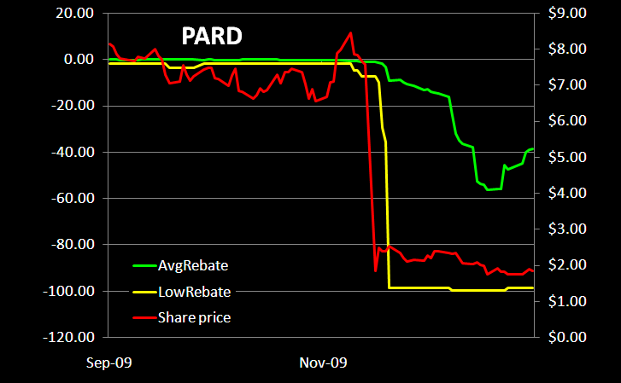
Low rebate is advanced indicator
Source: SunGard Astec Analytics

Slide 22
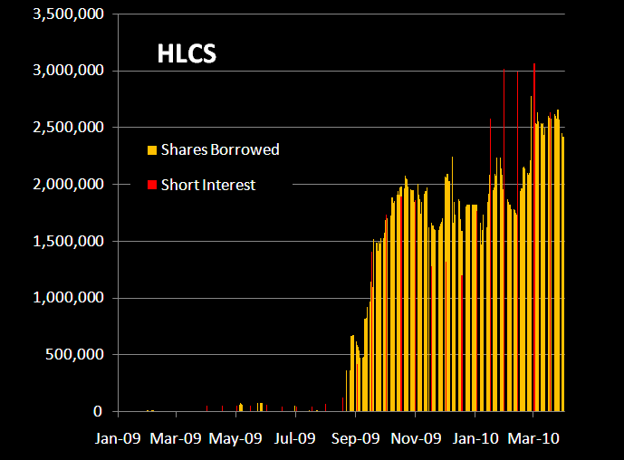
Positive Correlation of .93 with Short Interest
Source: SunGard Astec Analytics

Slide 23
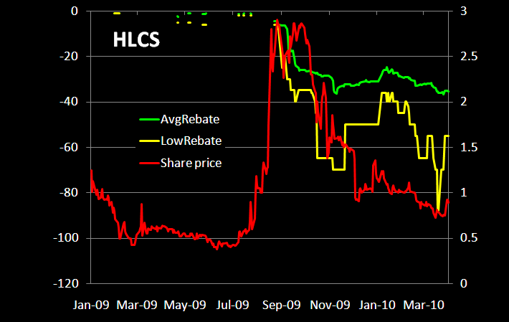
Low rebate is advanced indicator
Source: SunGard Astec Analytics

Slide 24
Conclusion
Early indications of recovery or not!
New dynamics
Transparency is king
Paradise Regained

