Slide 1
Presentation to GSL End of Year Summit
27 November 2009
Ed Oliver

Slide 2
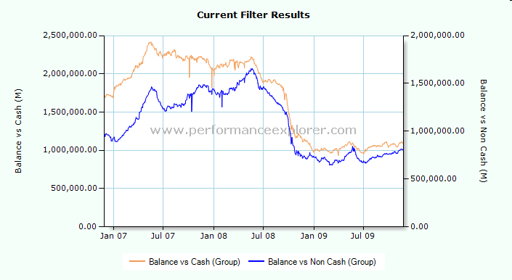
Cash vs Non-cash Collateral Balances

Slide 3
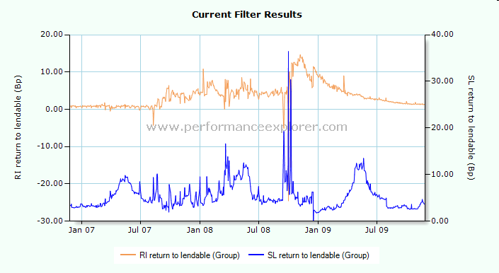
SL vs RI Returns

Slide 4
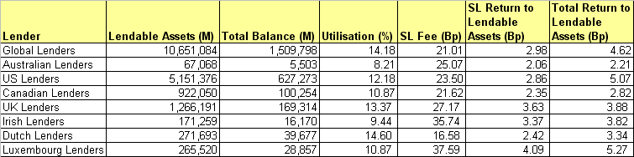
Returns by Domicile

Slide 5
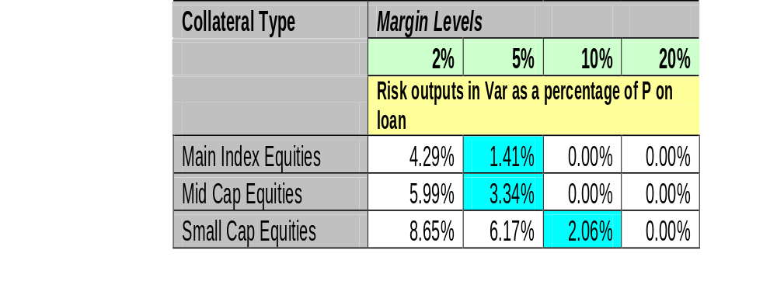
Risk Outputs – non-US equity loans

Slide 6
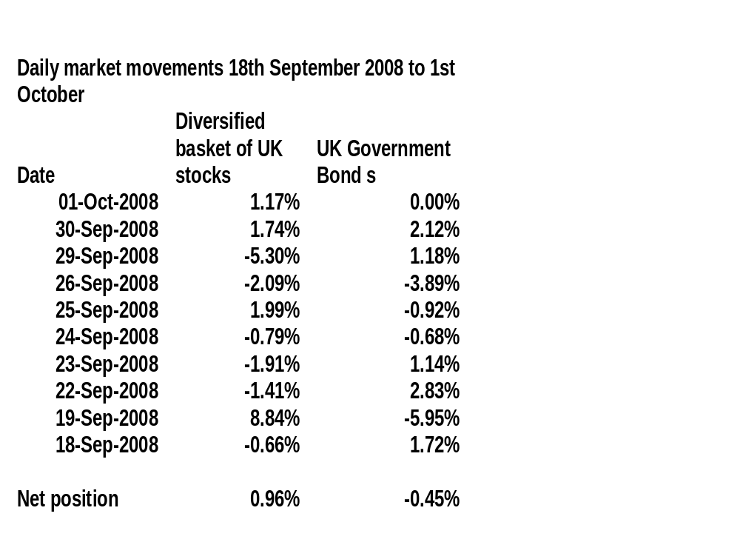
Correlation or non-correlation?

