Slide 1
A major crisis
Across market segments
Unsecured
Money markets
Derivatives
Securities lending
Repo
Central bank credit/liquidity
Cash collateral
Cash driven
No collateral !
Securities collateral
Securities collateral
Routine
(e.g. tenders, …)
No collateral!
Securities driven
Contingency
Cash collateral
Turmoil
Unsecured is not an option anymore
Regulatory concerns
Severely impacted
Concerns of final Beneficial Owners
No more term financing
Secured money market
CCP GC baskets
Massive intermediation
Contingency schemes
Unsecured dried-up
+
-
-
-
-

Slide 2

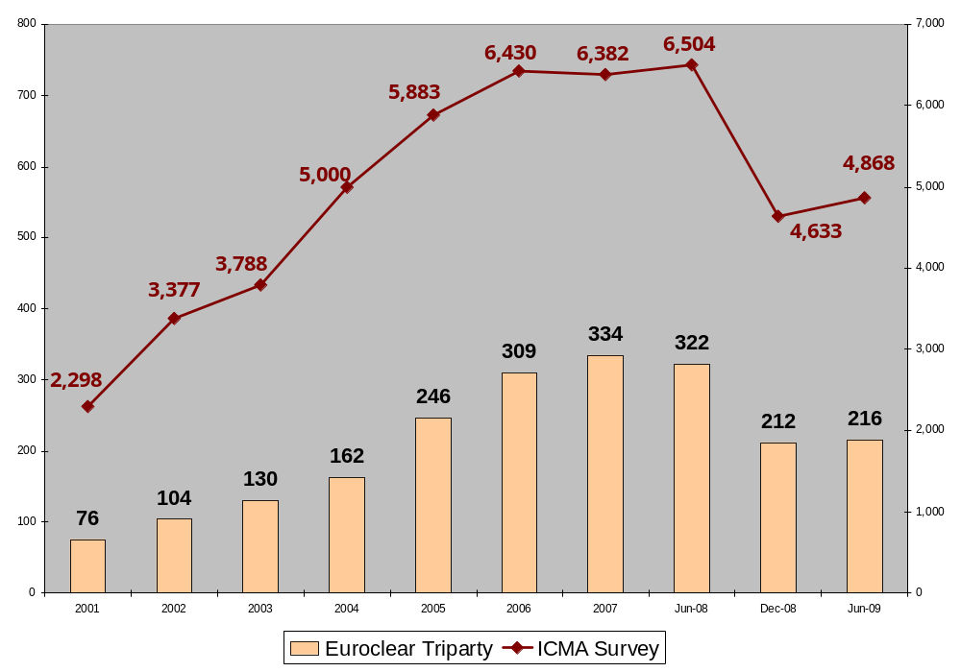
Triparty Collateral Management
Euroclear Triparty vs. ICMA Total Repo market
Volumes (EUR billion)

Slide 3
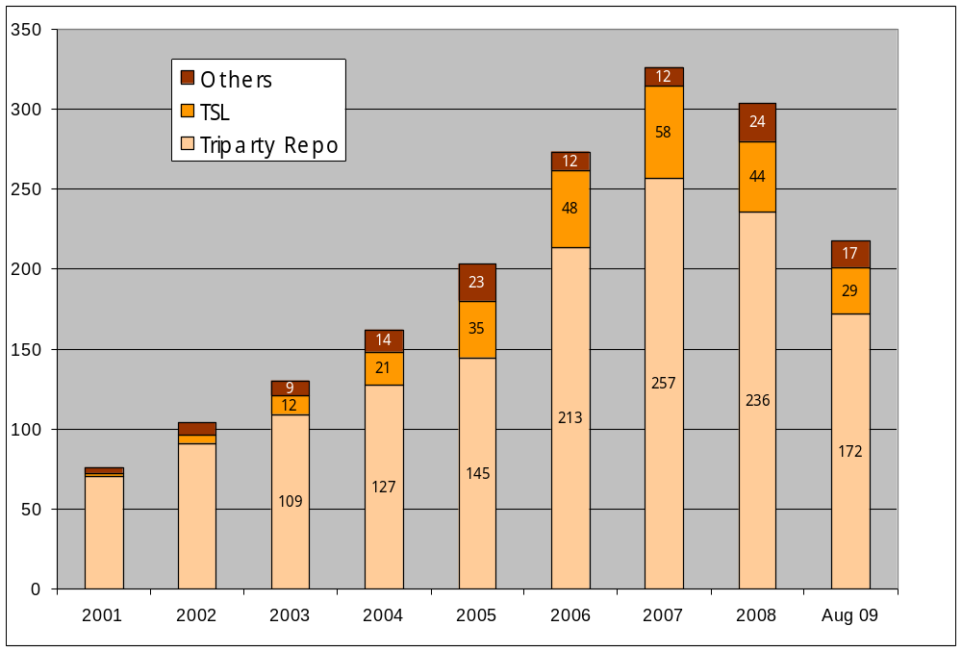
Business update
Collateral mix
Collateral outstanding (yearly average in EUR bio)

Slide 4
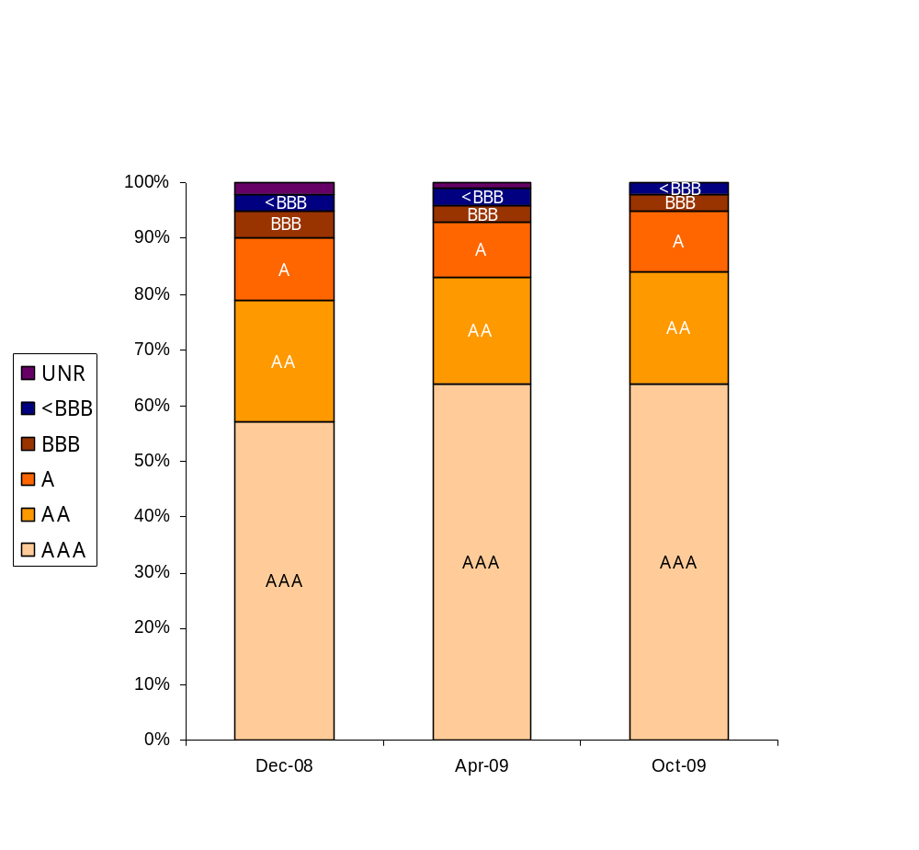
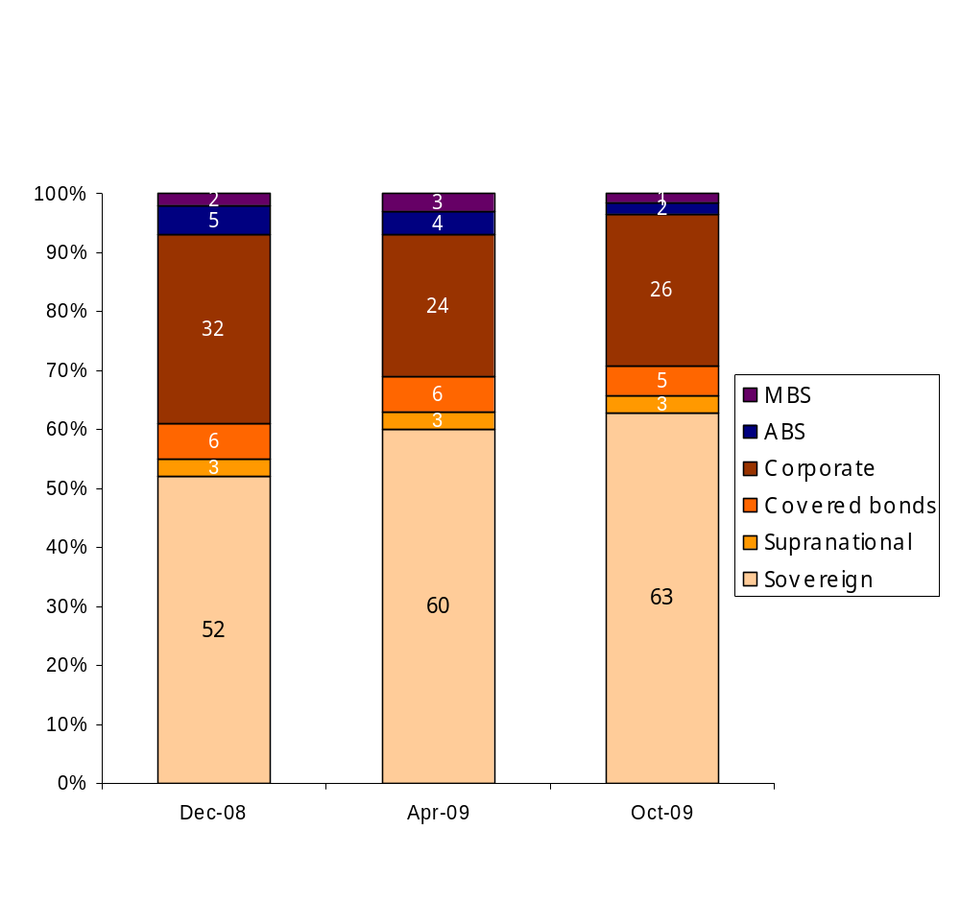
Collateral analysis
Evolution of rating mix in triparty
AAA - A 90% 93% 95%
Investment grade 95% 96% 98%

Slide 5
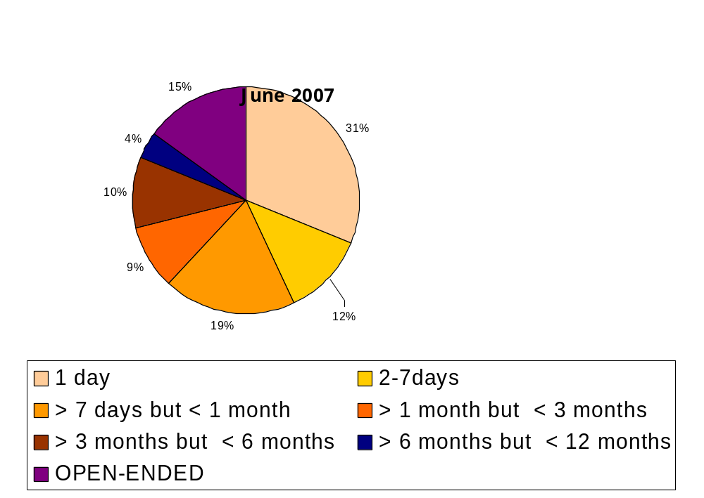
Collateral analysis
Remaining time to maturity of repos in triparty *
December 2007
December 2008
April 2009
Sept 2009
11%
13%
17%
20%
2%
0%
28%
1%
2%
10%
7%
2%
41%
45%
13%
9%
7%
52%
9%
11%
11%
17%
13%
10%
6%
13%
16%
14%
* As reported for the ICMA repo survey

