Slide 1
Market Activity
Jane Milner
SunGard (data from Astec Analytics)
GSL London, October, 2010

Slide 2

Introduction
“The only constant is change”
Heraclitus
2008/2009
  crisis of confidence
2010
  at the crossroads

Slide 3
The ‘Scrutiny’ Factors
Press
Regulation
Trade Bodies
Beneficial Owner Boards
Risk Managers
Legal Framework

Slide 4
The ‘Transparency’ Factors
Risk Reward Ratio
Rates
Intrinsic lending
Fee Splits
Management Information
Education
Central Counterparty
Benchmarking

Slide 5
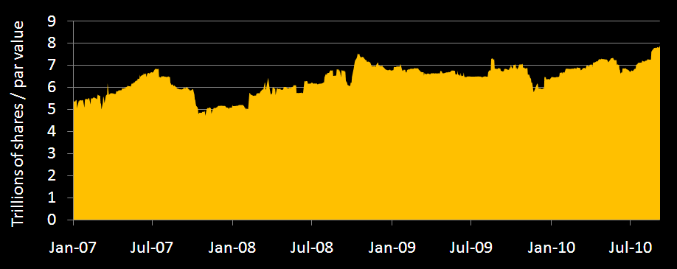
Available shares continue to increase
Source: SunGard Astec Analytics

Slide 6
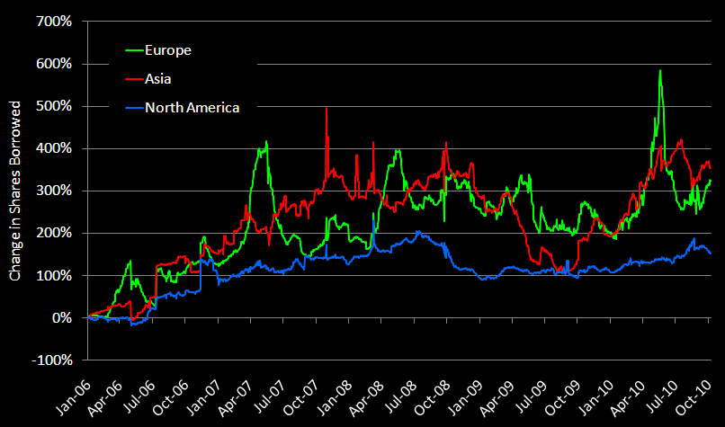
Equity loan volume – shares
Source: SunGard Astec Analytics

Slide 7
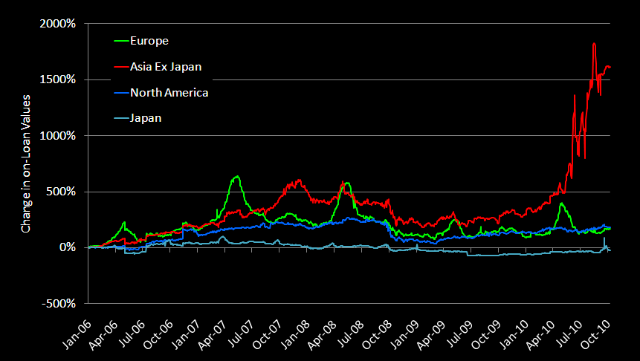
Equity loan volume – shares – Asia ex Japan
Source: SunGard Astec Analytics

Slide 8
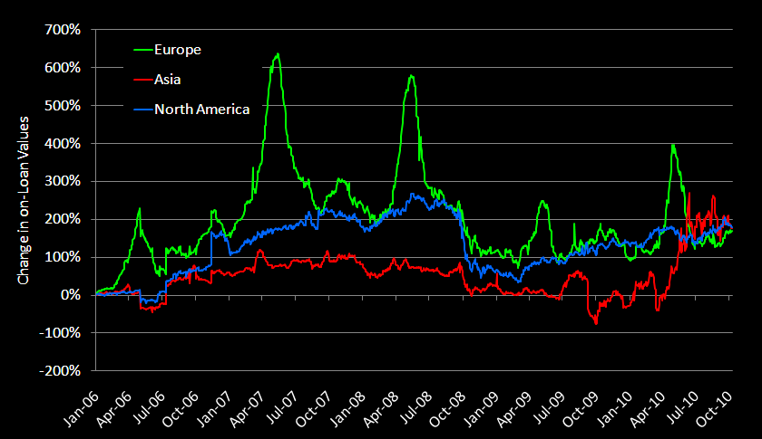
Equity loan volume – market value
Source: SunGard Astec Analytics

Slide 9
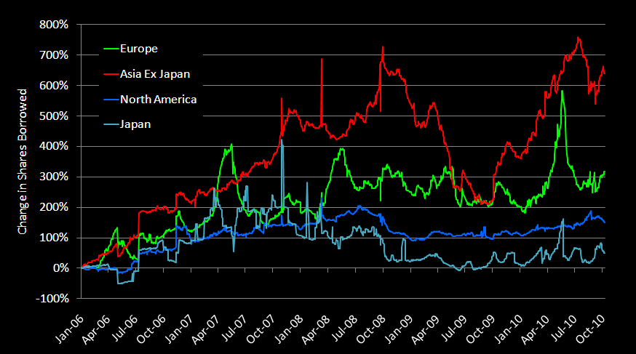
Equity loan volume – value – Asia ex Japan
Source: SunGard Astec Analytics

Slide 10
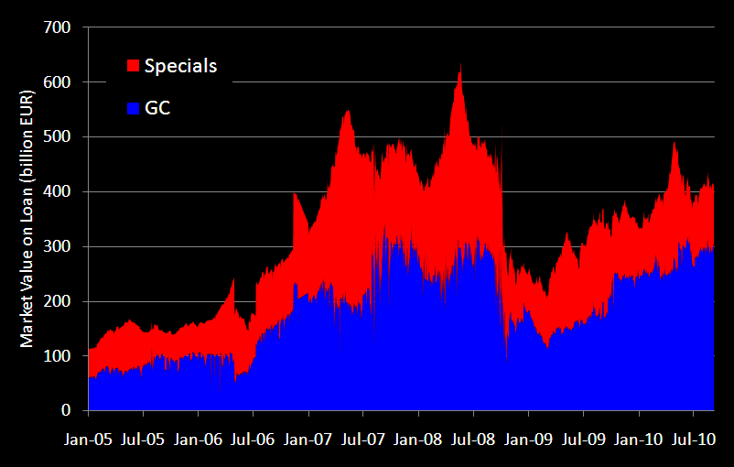
Specials hold steady as market climbs
Source: SunGard Astec Analytics

Slide 11
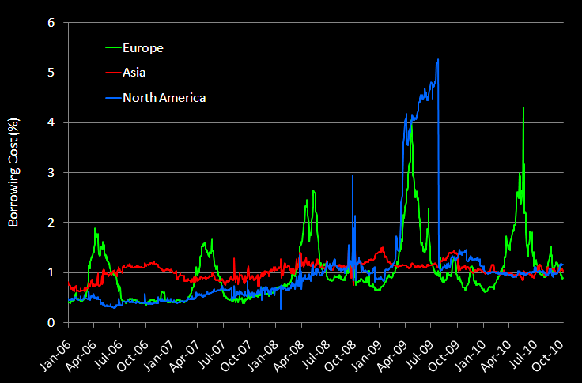
Equity borrowing costs
Source: SunGard Astec Analytics

Slide 12
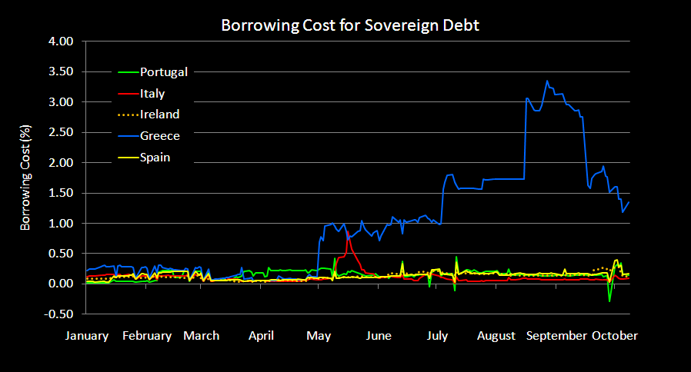
Fixed income borrowing costs - PIIGS
Source: SunGard Astec Analytics

Slide 13
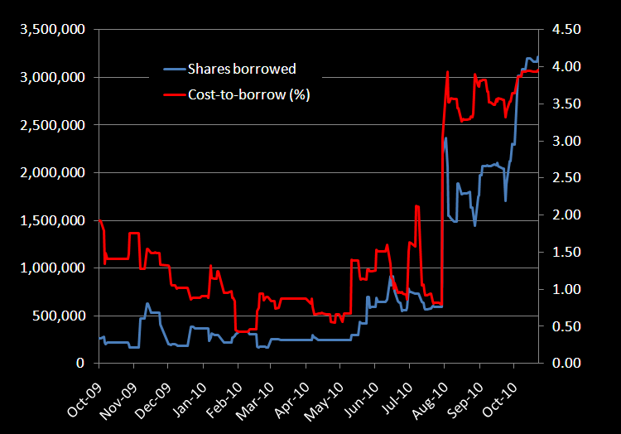
PureCircle Ltd.

Slide 14
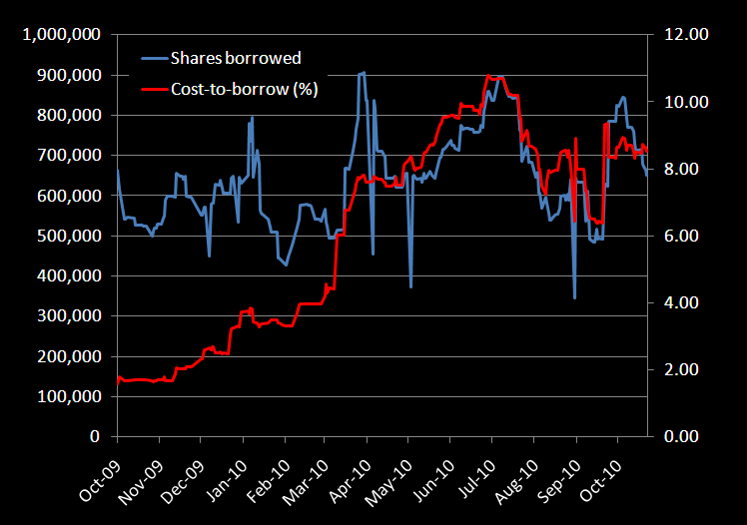
City of London Investment Trust

Slide 15
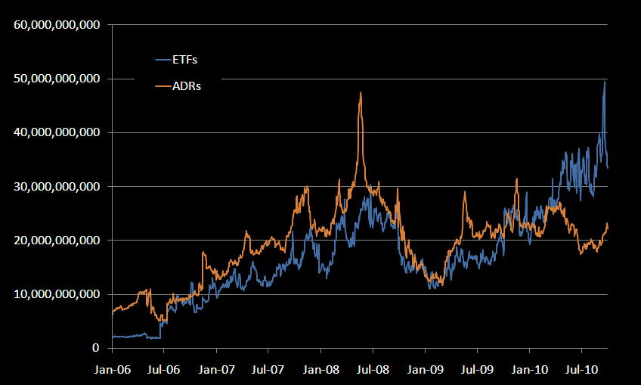
Market value of ETFs and ADRs on loan
Source: SunGard Astec Analytics

Slide 16
Changing Dynamics in 2010
Emphasis on risk as well as reward
Lines of demarcation break down
  Prop desk spin offs
  Long only investors forming hedge funds
  Hedge Fund re-defined
  Prime Brokers and Global Custodians role changes
Regulation on the increase
  Capital preservation
  Liquidity buffers
  Locates management
  Move to central counterparties
The rise of new markets and instruments

Slide 17

Conclusion
“The only constant is change”
Information and transparency are key

