Slide 1
Presentation to GSL Nordic Summit
January 28, 2010
Andrew Dyson

Slide 2
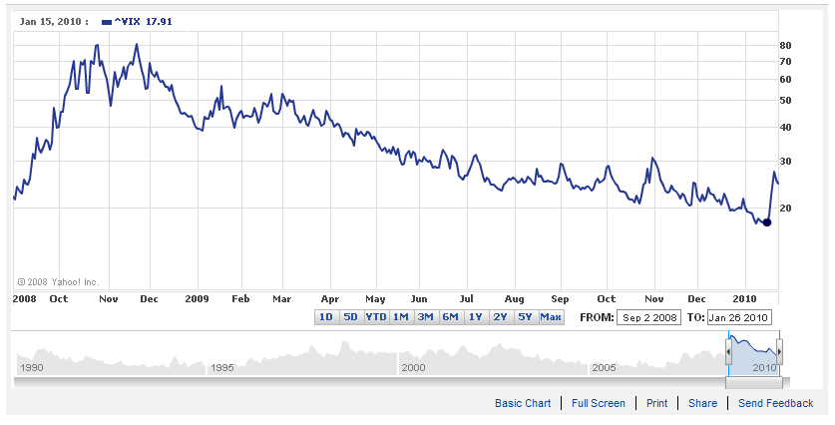
VIX

Slide 3
The Global Markets
Historically high level of volatility
Extensive de-leveraging
Structural changes
Government intervention
Global phenomenon
Affecting all participants
Impacting all markets
Securities lending is not an exception
Securities Finance Update – 29th September 2009
Notes:
02/24/09

Slide 4
Industry Impact
Increased uncertainty for all market participants
Trust and confidence have declined or disappeared
Reduced Demand from position takers
Discouraged both long and short position – hedging
Reduced supply from some institutions
Unintended consequences - CP and Money Markets
A clamour for action – regulation and transparency
Securities Finance Update – 29th September 2009

Slide 5
Challenges
Rebuilding trust and confidence – Some beneficial owners feel let down.
Collateral – The traditional European non cash model is back in favour.
Cash collateral -How will it be viewed in the future?
Fee splits – Some of the extremes now look uneconomic and unsustainable.
Indemnification- Is its role as a ‘comfort blanket’ really justified?
  And are they really what they seem?
Exclusives – Falling demand from buy side combined with perceived higher risk has undermined this ‘route to market’
Securities Finance Update – 29th September 2009

Slide 6
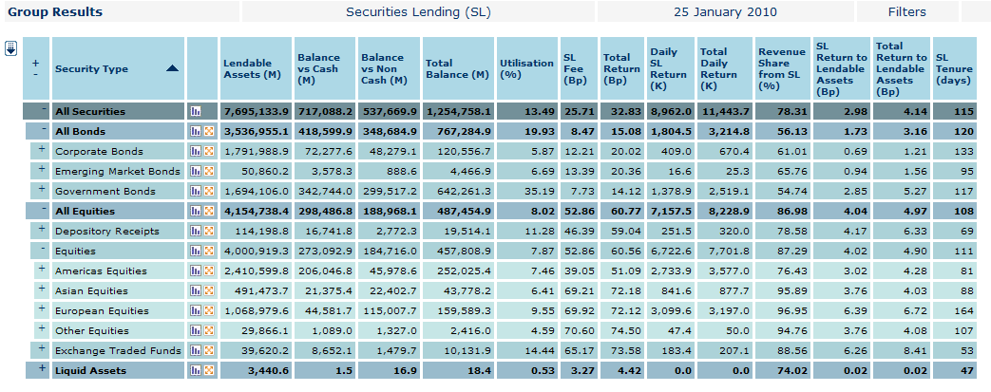
Is there still a market ?

Slide 7
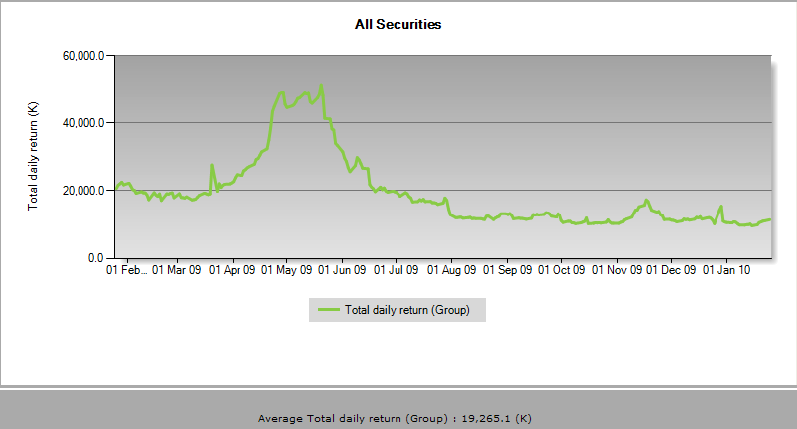
Is there still a market ?

Slide 8
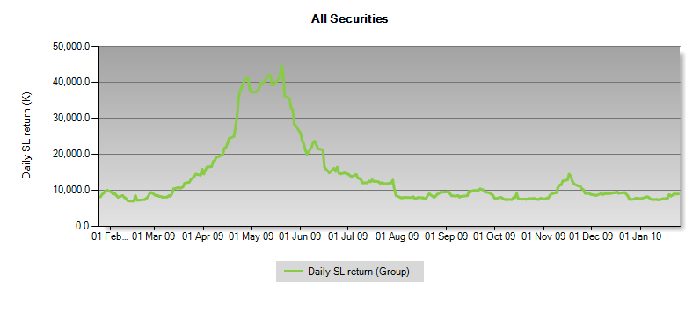
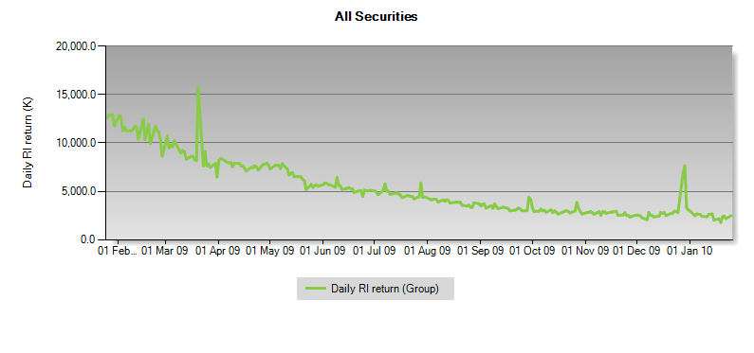
Is there still a market ?

Slide 9
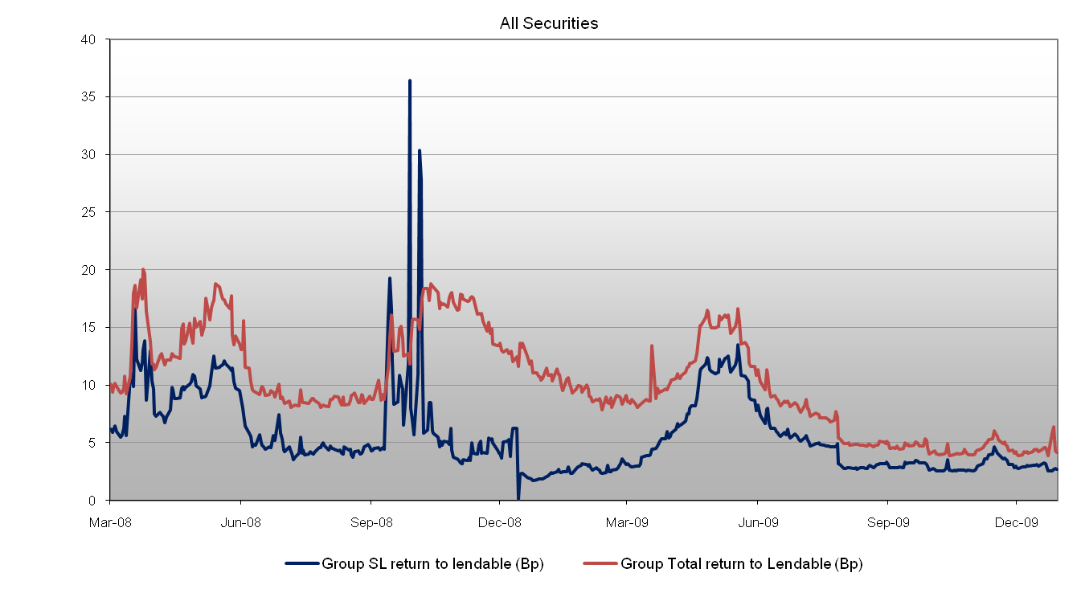
All Securities - SL & Total Return to Lendable

Slide 10
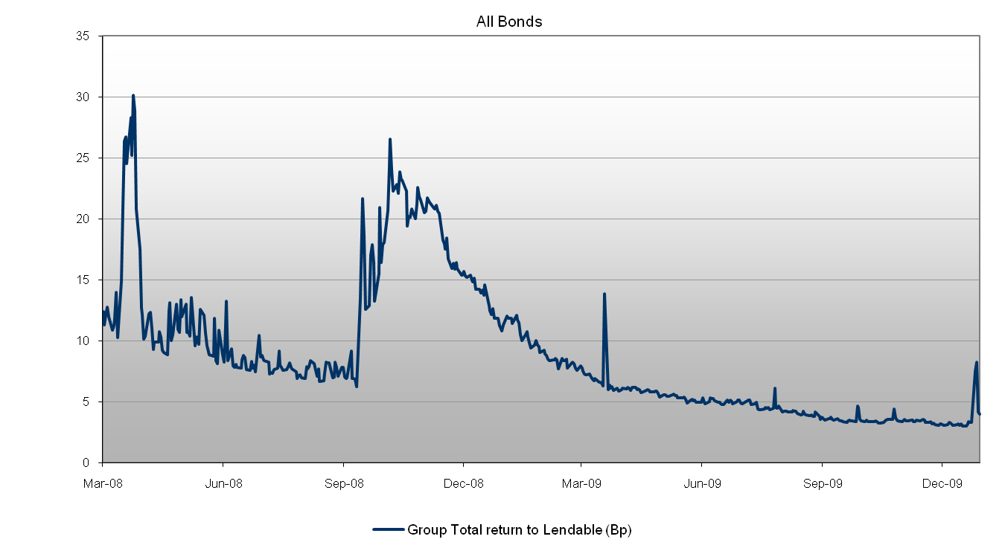
All Bonds – Total Return to Lendable

Slide 11
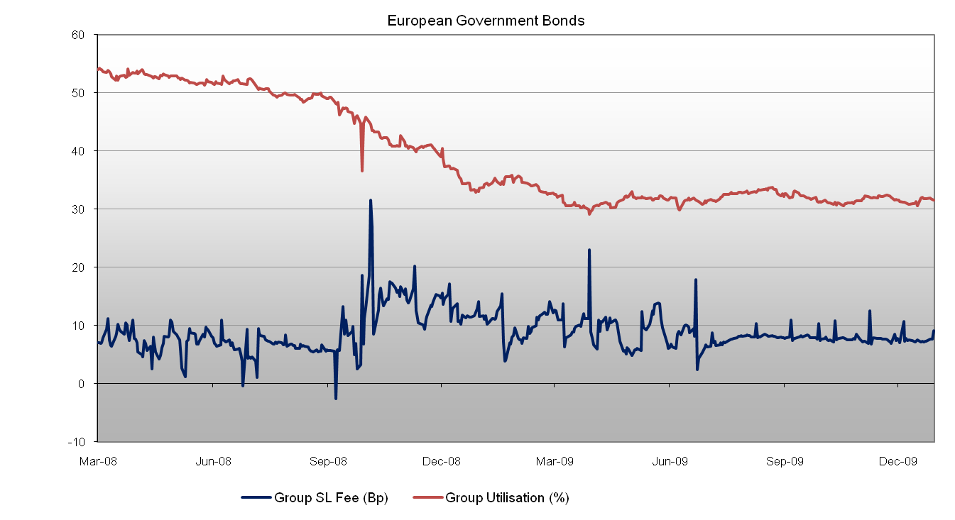
European Government Bonds

Slide 12
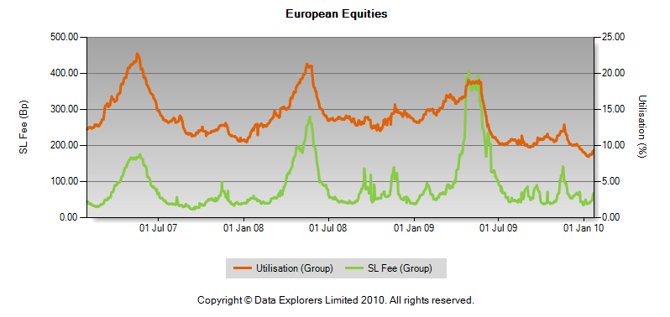
Fee vs Utilisation – European Equities

Slide 13
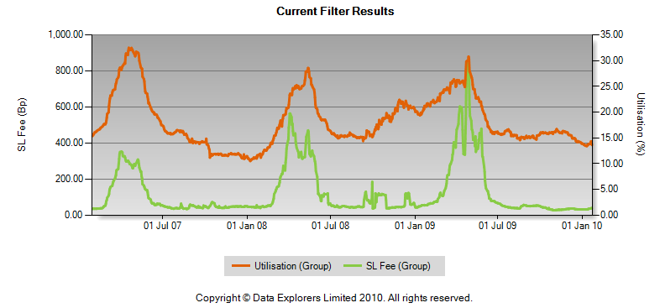
Denmark, Finland, Norway and Sweden

Slide 14
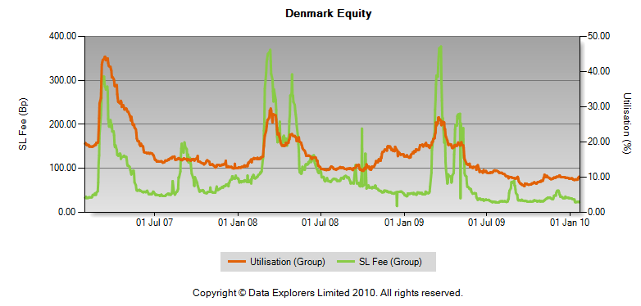
Fee vs Utilisation - Denmark

Slide 15
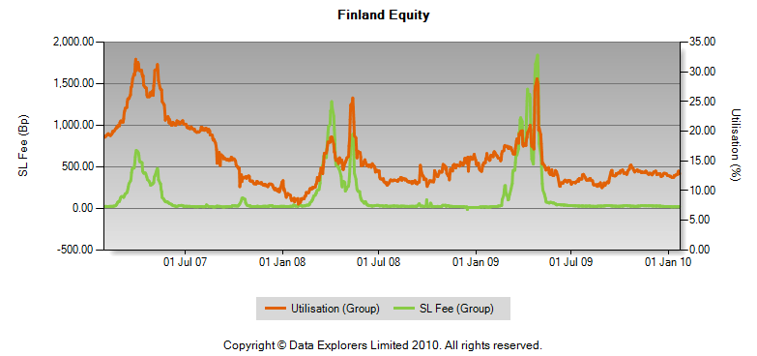
Fee vs Utilisation - Finland

Slide 16
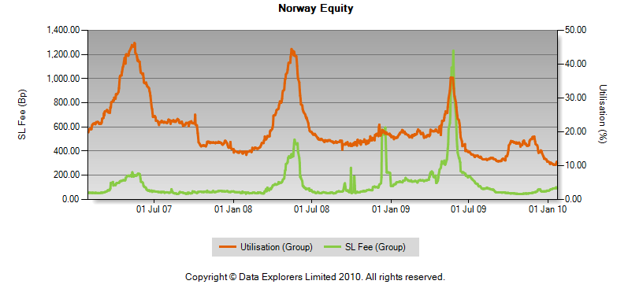
Fee vs Utilisation - Norway

Slide 17
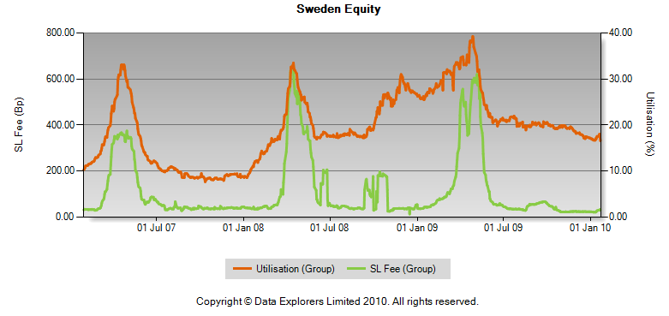
Fee vs Utilisation - Sweden

Slide 18
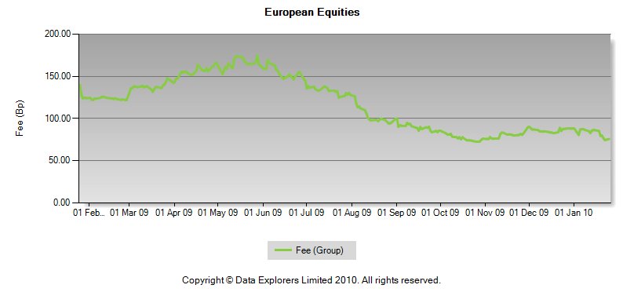
Hedge Fund Cost of Borrow – European Equities

Slide 19
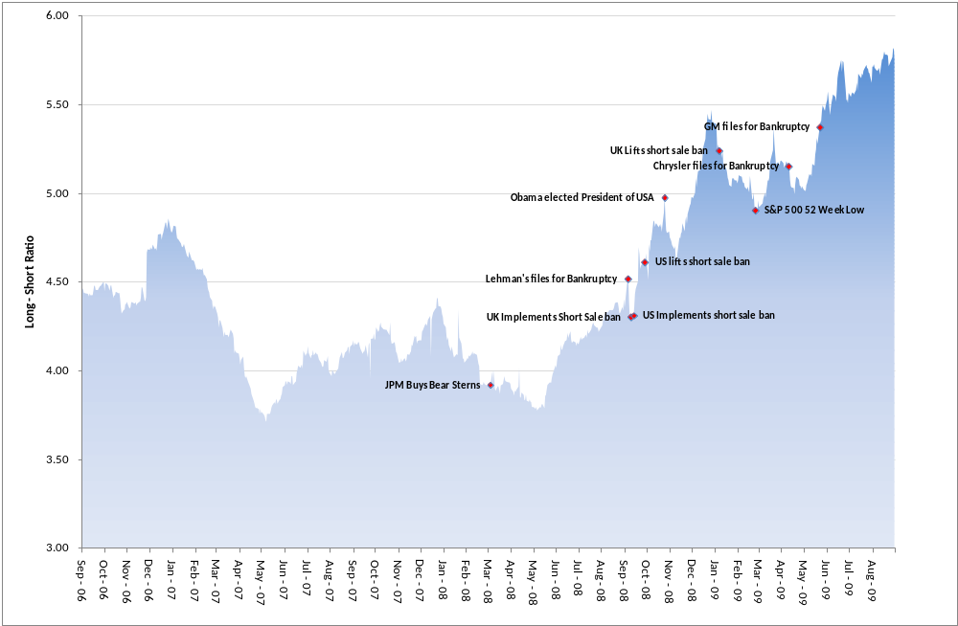
Global DX Long-Short Ratio
Notes:
<number><number>

Slide 20
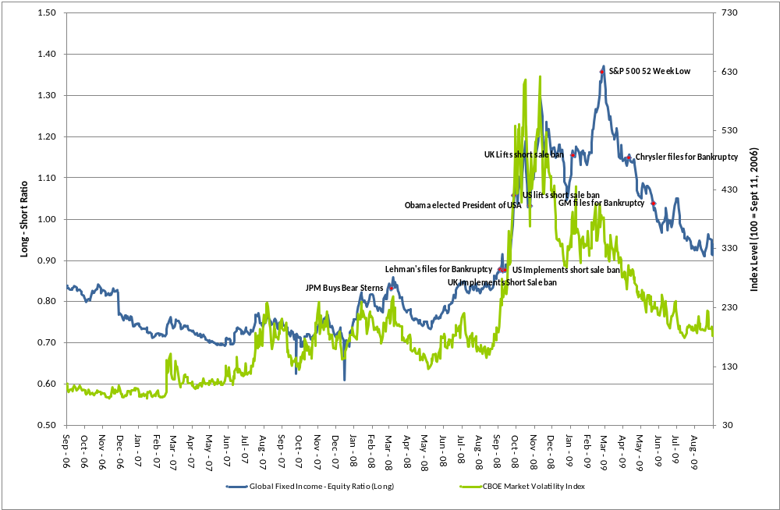
Global DX Fixed Income – Equity Ratio (Long) vs. VIX
Notes:
<number><number>

Slide 21
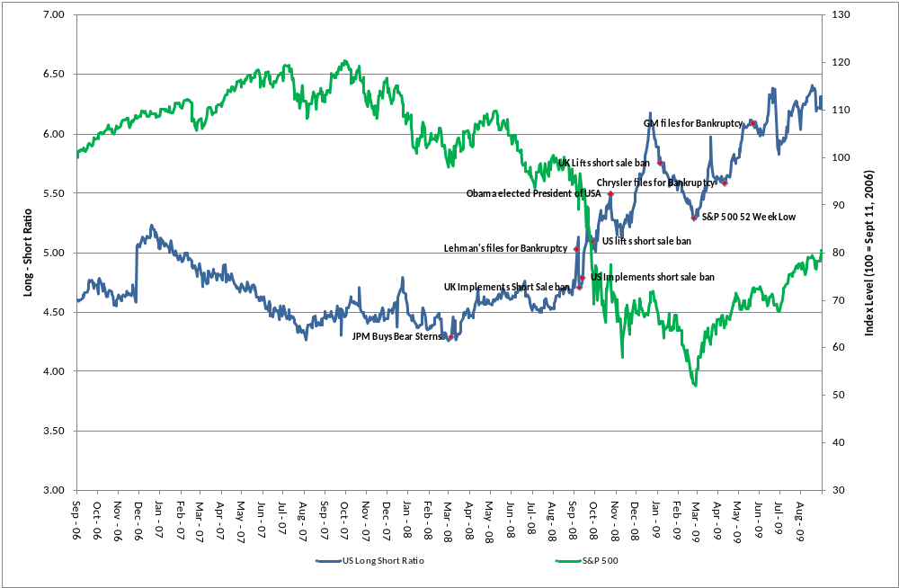
Equity Ratio (Long) vs. S&P 500
Notes:
<number><number>

Slide 22
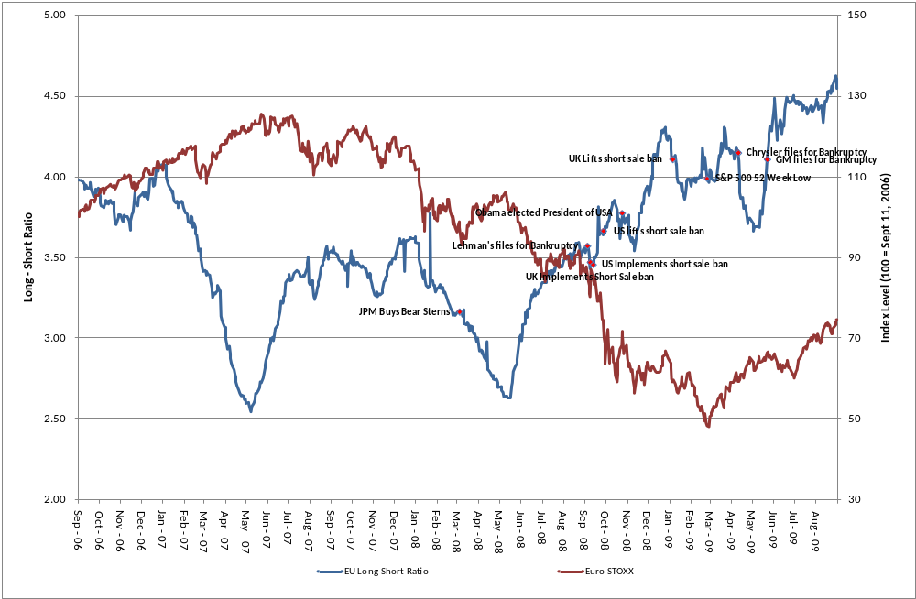
Long-Short Ratio vs. Euro Stoxx
Notes:
<number><number>

Slide 23
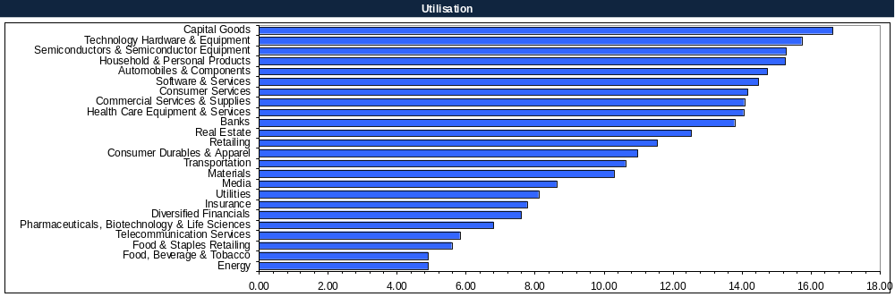
Sector Overview - Europe
Notes:
<number><number>

Slide 24
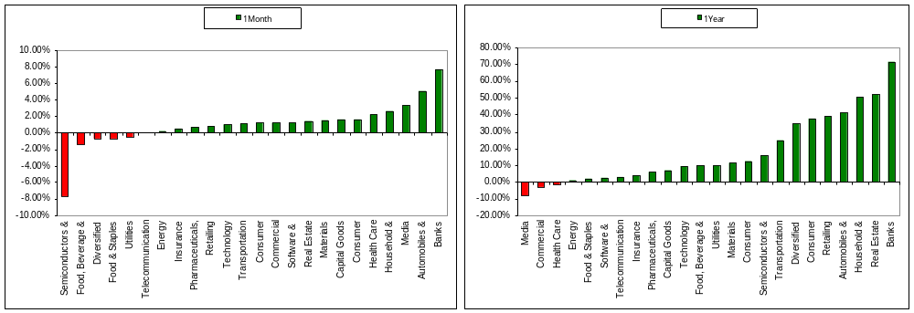
Institutional Buying - Europe
Notes:
<number><number>

Slide 25
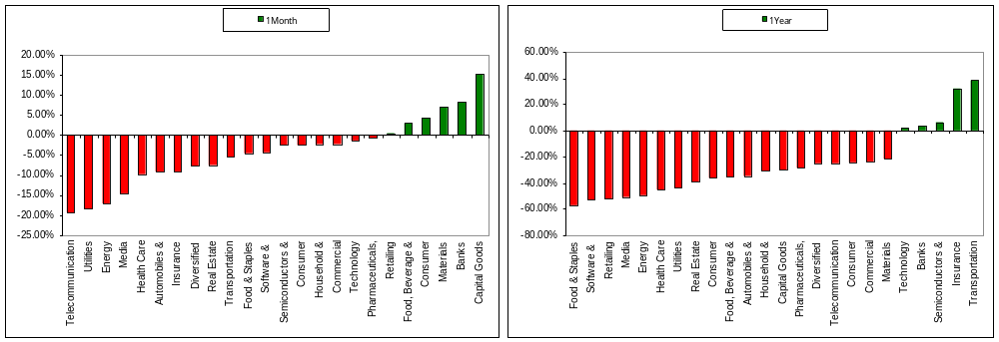
Short Selling - Europe

Slide 26
Remember …
This Trillion dollar industry makes a positive contribution to the functioning of the global capital markets
  Efficient pricing
  Enhanced liquidity
  Hedging facilitation
  Supporting capital market financing
Any current losses need to be seen in their context
  In relation to your historic annuity revenues
  Compared to other activities you conduct
  In relation to the demands you made of your provider
Securities Finance Update – 29th September 2009
Notes:
02/24/09

