Slide 1
GSL Stockholm 31st March, 2011
Securities Lending Global Update
Timothy Smith
Executive Vice President
SunGard’s Astec Analytics

Slide 2
Introduction
2010 - year at the crossroads
2011 – a new dawn?
Global themes
Changing environment
New ways of doing business
Regional differences
Specials only market?
Local factors
Conclusion

Slide 3
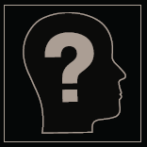
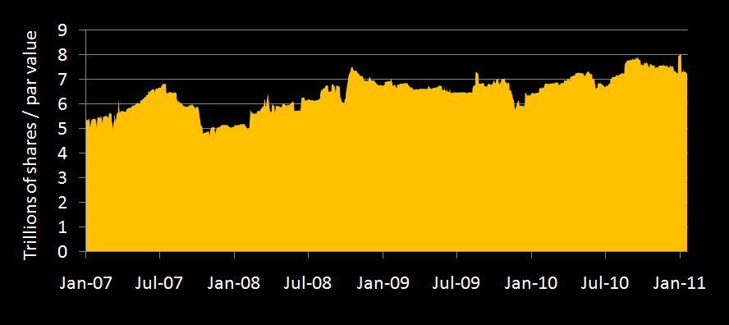
Availability - without the market effect
Source: SunGard Astec Analytics

Slide 4
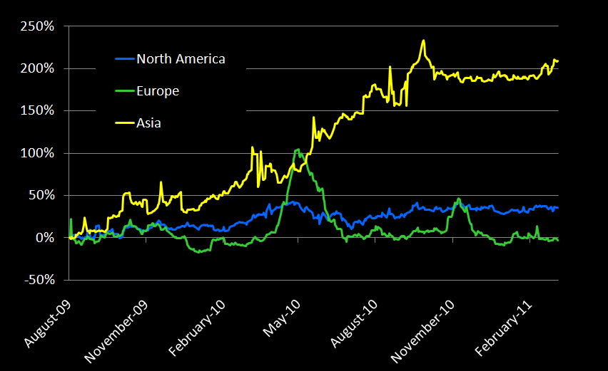
Equity market value on loan
Source: SunGard Astec Analytics

Slide 5
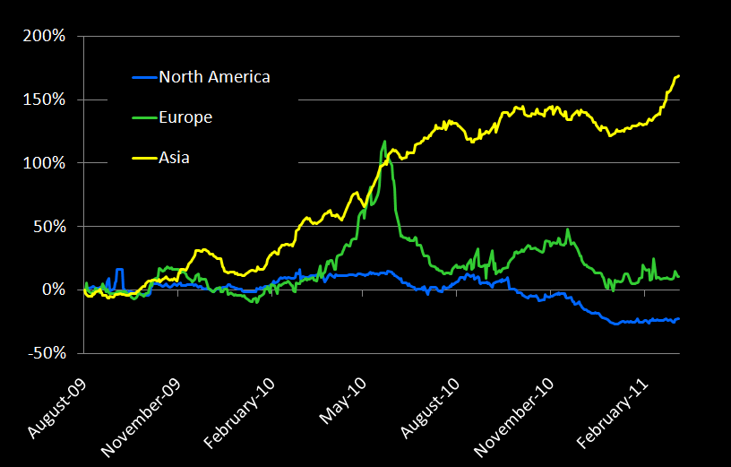
Equity number of shares borrowed
Source: SunGard Astec Analytics

Slide 6
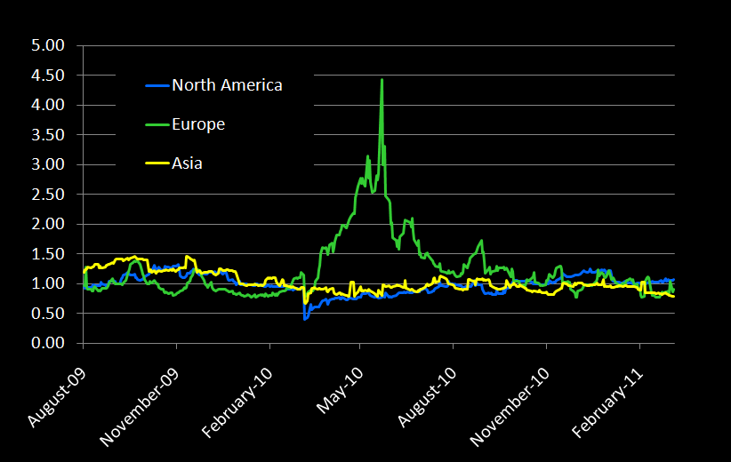
Equity borrowing costs
Source: SunGard Astec Analytics

Slide 7
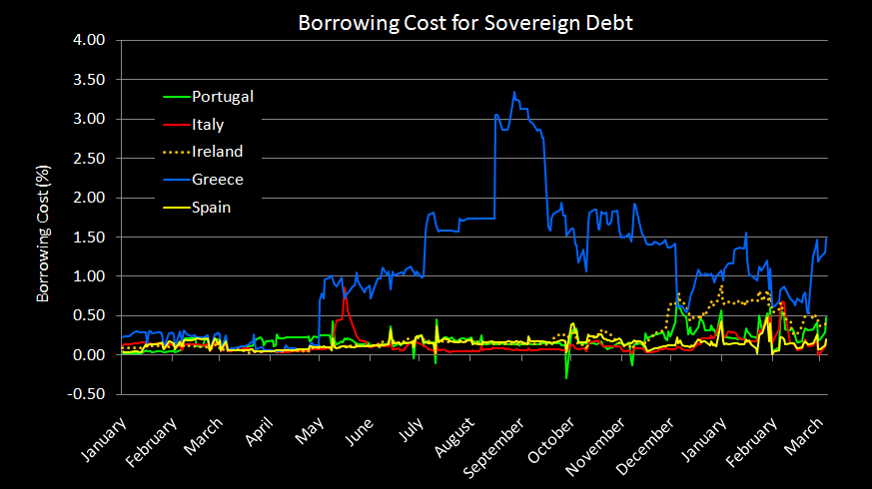
Fixed income borrowing costs - PIIGS
Source: SunGard Astec Analytics

Slide 8
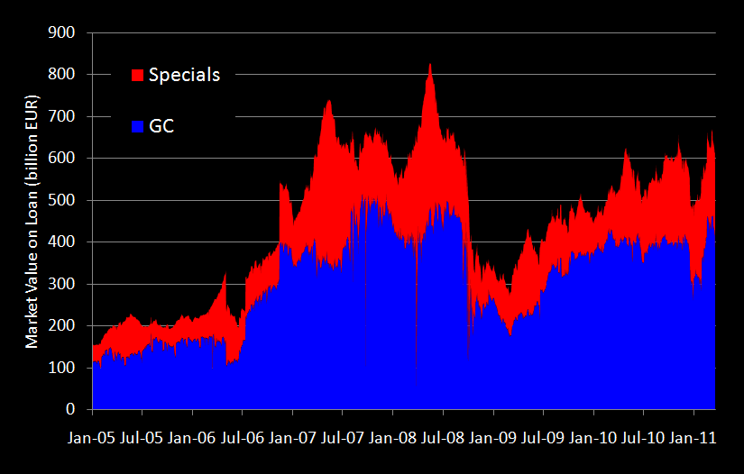
Specials almost back to pre-crisis level
Source: SunGard Astec Analytics

Slide 9
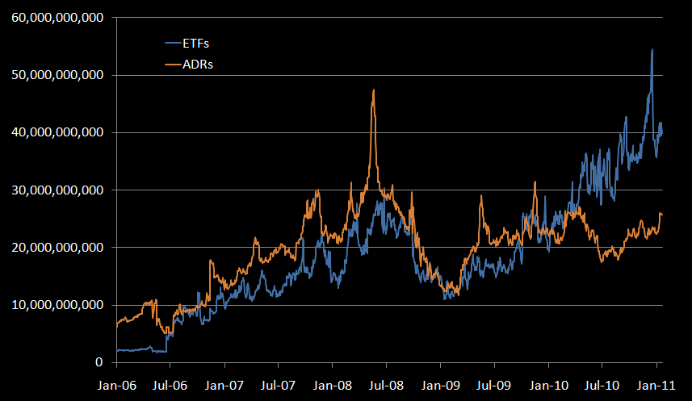
New products - Market value of ETFs and ADRs on loan
Source: SunGard Astec Analytics

Slide 10
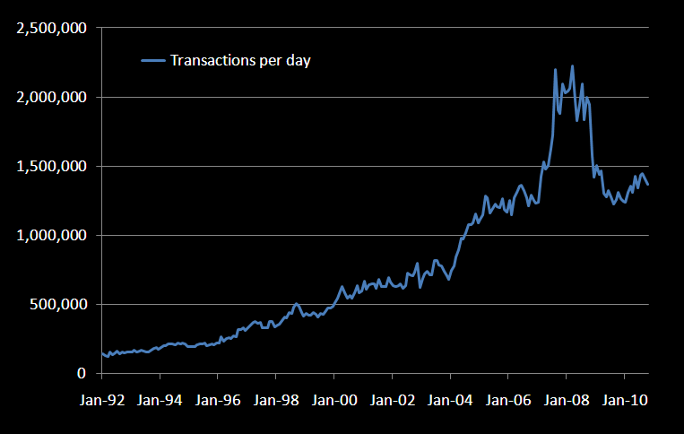
US Market - Growth in transactions in securities lending since ‘92
Source: SunGard Astec Analytics

Slide 11
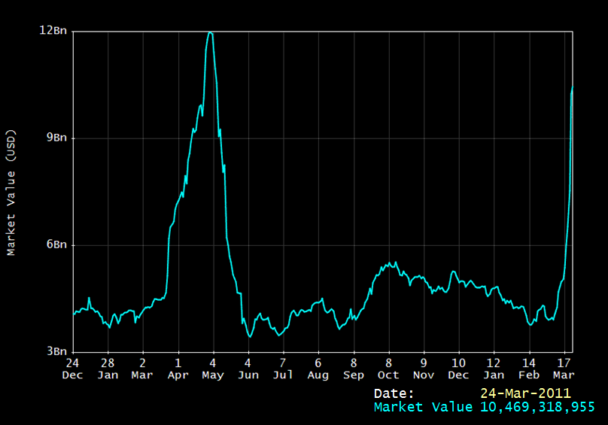
Swedish equity loan volume
Source: SunGard Astec Analytics

Slide 12
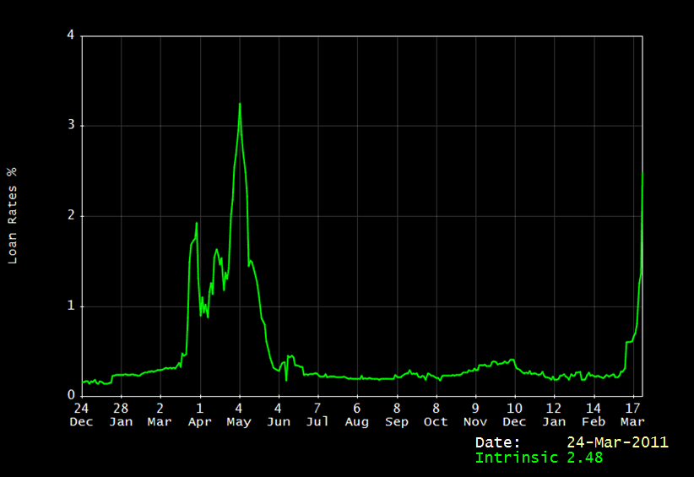
Swedish equity borrowing cost
Source: SunGard Astec Analytics

Slide 13
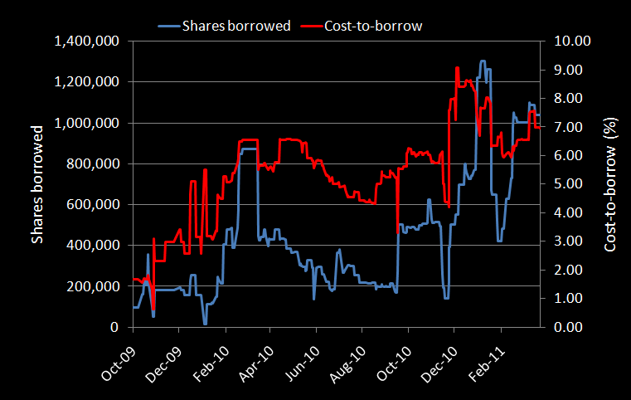
Karo Bio AB
Source: SunGard Astec Analytics

Slide 14
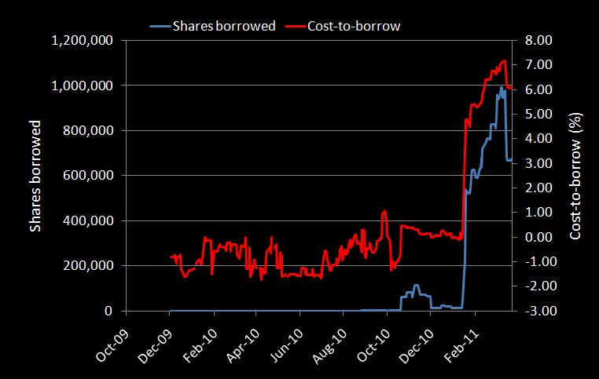
Hexpol
Source: SunGard Astec Analytics

Slide 15
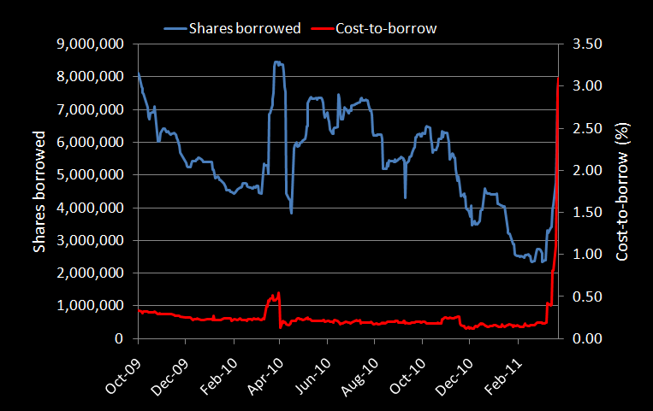
Fabege AB
Source: SunGard Astec Analytics

Slide 16
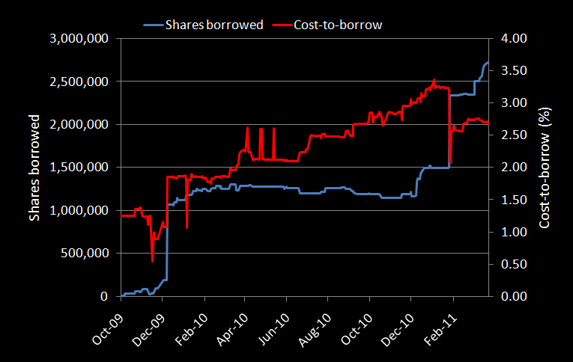
Net Insight
Source: SunGard Astec Analytics

Slide 17
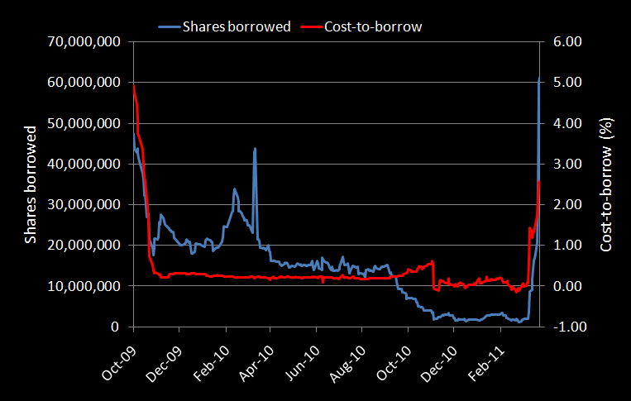
Swedbank AB
Source: SunGard Astec Analytics

Slide 18
Conclusion
Adapting to change
Integration
Flexibility
Risk/reward
Regulation
Where is the demand?

