Slide 1
GSL Summit – Hong Kong
Securities Lending Market Activity

Slide 2
Introduction
Remember When?
2008/2009 – Crisis of Confidence – Paradise Lost
2010 – At the Crossroads

Slide 3
The Market Today
No central theme
Regional and seasonal factors
PIIGS – and when they don’t fly!
Regulatory scrutiny
New ways of doing business?
Availability versus demand – more than enough?
Back to fundamentals – case studies and analytics

Slide 4
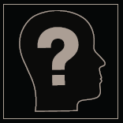
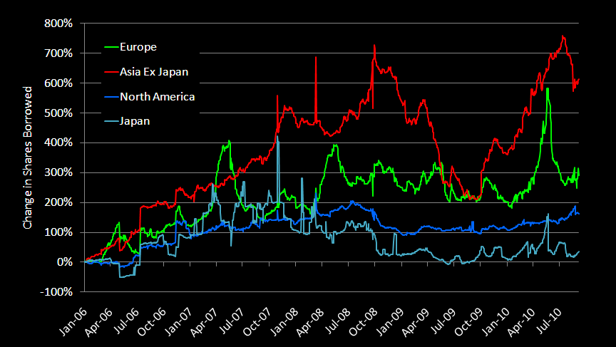
Equity loan volume – shares
Source: SunGard Astec Analytics

Slide 5
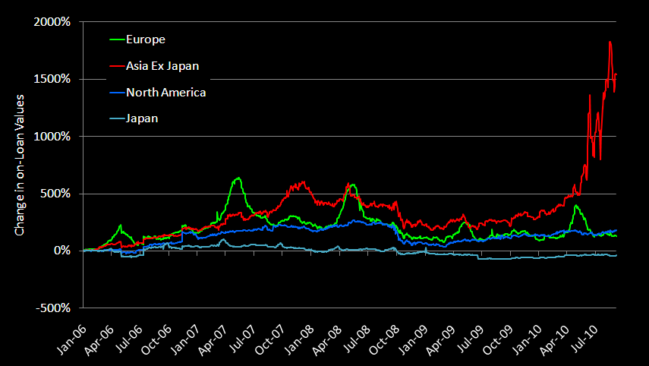
Equity loan volume – market value
Source: SunGard Astec Analytics

Slide 6
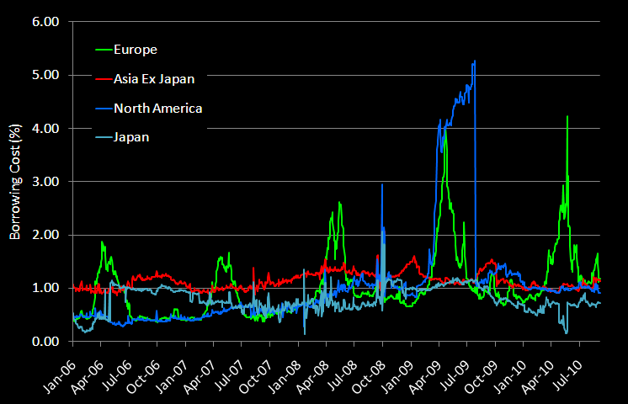
Equity borrowing costs
Source: SunGard Astec Analytics

Slide 7
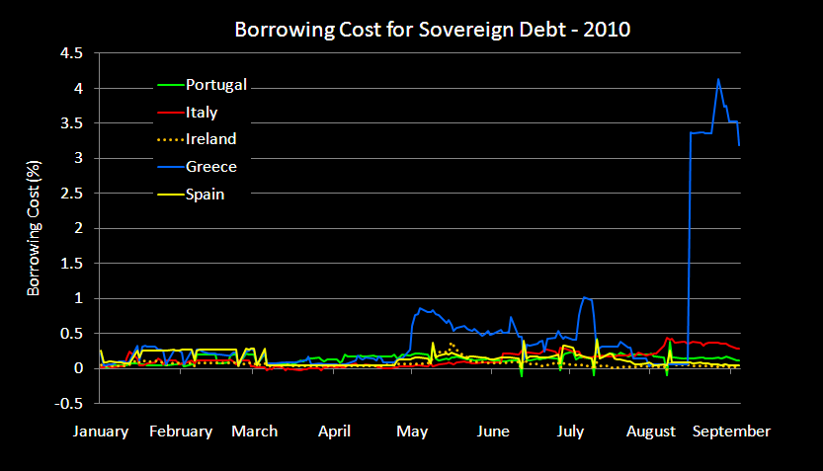
Fixed income borrowing costs - PIIGS
Source: SunGard Astec Analytics

Slide 8
CORRELATION BETWEEN
SHORT INTEREST AND SBL MARKET

Slide 9
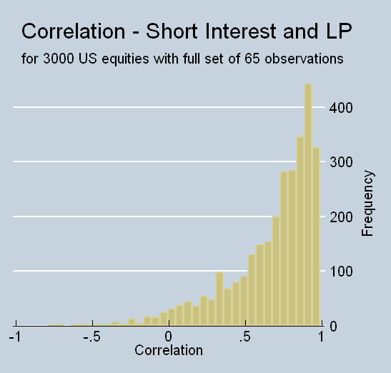
Short Interest and Shares Borrowed - US
Median .77
Source: SunGard Astec Analytics

Slide 10
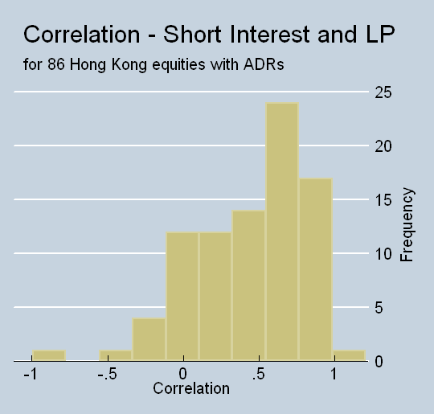
Short Interest and Shares Borrowed - HK
Median .53
Source: SunGard Astec Analytics

Slide 11
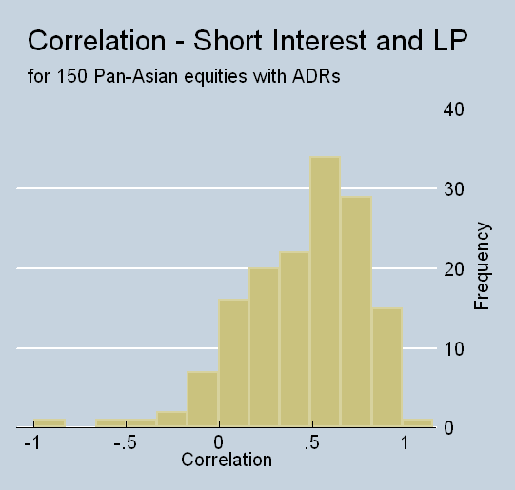
Short Interest and Shares Borrowed - Asian
Median .53
Median .52
Source: SunGard Astec Analytics

Slide 12
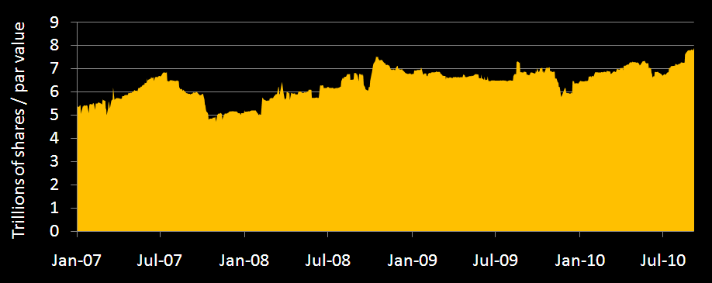
Available shares continue to increase
Source: SunGard Astec Analytics

Slide 13
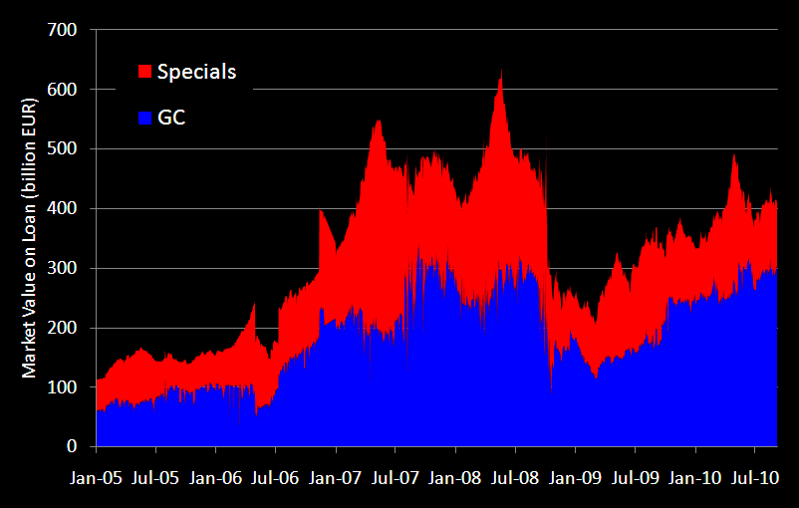
Specials hold steady as market climbs
Source: SunGard Astec Analytics

Slide 14
CASE STUDIES - ANALYTICS

Slide 15
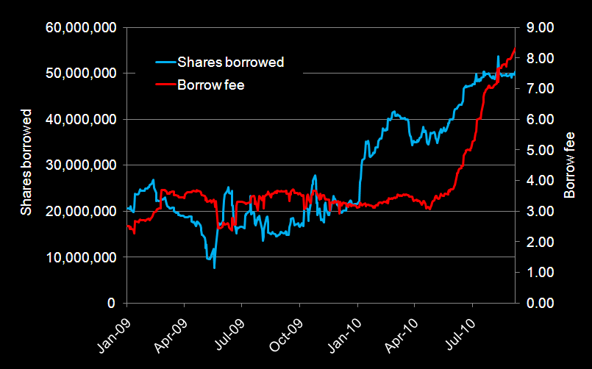
BYD Co Ltd
Source: SunGard Astec Analytics

Slide 16
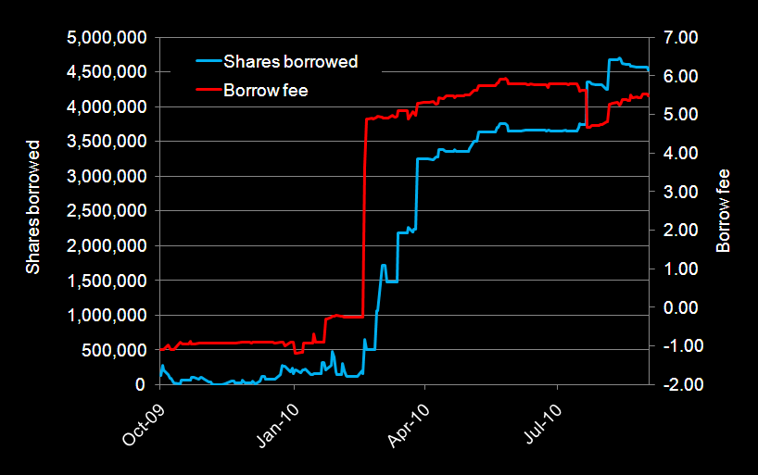
Hong Kong Resources Holding Co Ltd
Source: SunGard Astec Analytics

Slide 17
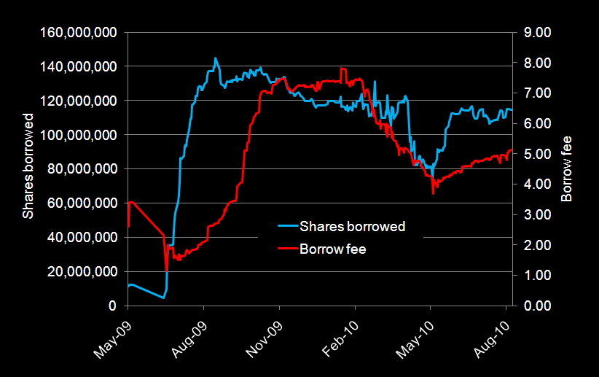
China Zhongwang Holdings Ltd
Source: SunGard Astec Analytics

Slide 18
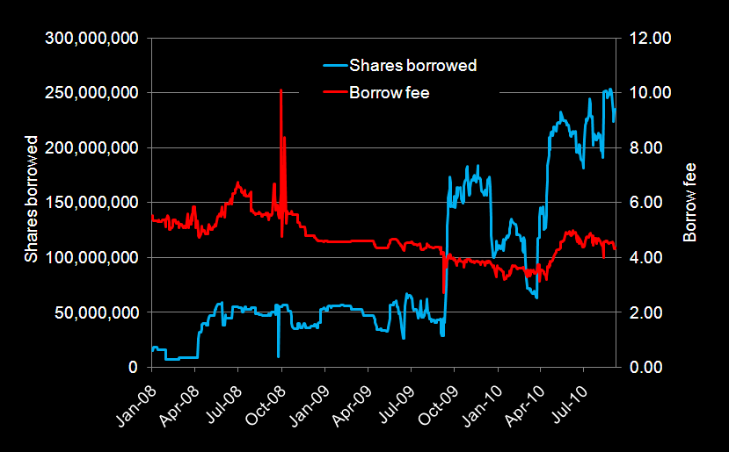
Geely Automobile Holdings Ltd
Source: SunGard Astec Analytics

Slide 19
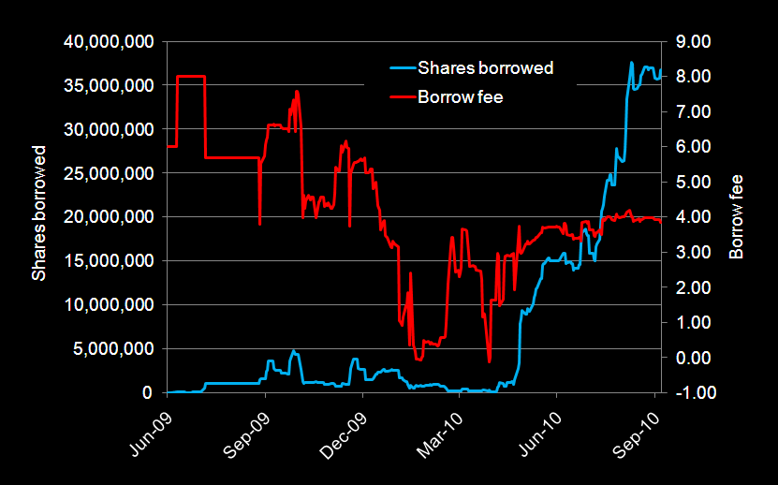
Real Gold Mining Ltd
Source: SunGard Astec Analytics

Slide 20
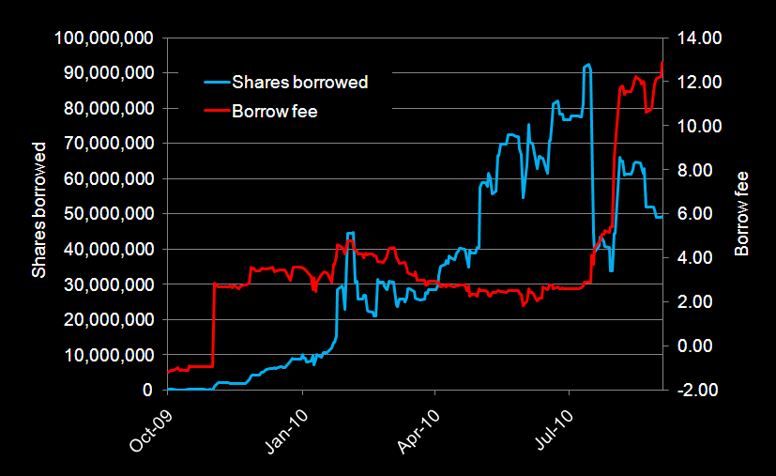
BaWang International Group Holding Ltd
Source: SunGard Astec Analytics

Slide 21
Conclusion
Early indications of recovery or not!
New dynamics
Transparency is king
Paradise Regained

