Slide 1
GSL Summit
Academic overview
8th October 2009 - AMSTERDAM
Jean-René Giraud
EDHEC Risk and Asset Management Research Centre
jrg@edhec-risk.com
www.edhec-risk.com

Slide 2
The failure of external risk control constraints
So far, regulators have taken the route of imposing indirect controls through:
  Ruling the investor’s side (e.g., FoHF constraints on their liquidity )
  Imposing strict access to market through intermediaries (prime brokerage)
  Promoting independent valuation
Those rules, when badly drafted, or not verifiable, have very often led to increased moral hazard and adverse selection.

Slide 3
The failure of external risk control constraints
For example, funds of hedge funds on which liquidity constraints have been imposed are the ones that increase the problem because of imposed redemption conditions while they invest in less liquid assets.
By creating a false sense of liquidity through the implementation of liquidity rules that have proven inapplicable and inefficient, the regulator has led final investors to invest in hedge funds in poor conditions.

Slide 4
The failure of external risk control constraints
Serious doubt has been cast on the idea that imposing regulated structures will control hedge fund operations and guarantee their assets.
“Indirect” hedge fund regulation did not survive the liquidation of a prime broker as significant as Lehman; had Bear Stearns not been bailed out by JP Morgan and the Fed, one of the largest counterparties of hedge funds and funds of hedge funds would simply have gone bankrupt.

Slide 5
The failure of external risk control constraints
Because the regulator is rarely able to prevent all risks through systematic control of industry practices, it seems that a structure whereby control is mutually organized throughout the industry itself is highly desirable:
  Reinforcement of the responsibility of the administrator/custodian with regard to pricing the financial instruments of the funds (obligation of result with associated financial responsibility)
  Responsibility of the auditors with regard not only to the accounting schemes but also to the actual published NAVs
  Increased transparency on the nature of the risks incurred by underlying investments (including liquidity)

Slide 6
Going forward
Rather than attempting to forbid unsound practices (supposing that the regulator is able to detect them before they hurt the investor), why not favor sound practices?
Why not favor, for example, under a certain number of strict constraints, the cross-border distribution (with advertising) of single hedge funds or funds of hedge funds and at the same time investment in those vehicles with:
  Formal segregation of assets and independent responsibility for valuation and control
  Assets handled in the form of managed accounts
  Greater transparency of financial and operational risks
  Full transparency on levels of liquidity and counterparty risks

Slide 7
Case Study – Short sellers
Practitioners see a positive role for short selling:
  “efficient price discovery”
  “mitigating market bubbles”
  “increasing market liquidity”
  “facilitating hedging and other risk management“
Financial Economists underline the dangers of short sale constraints. Such constraints may lead to
  overpricing of stocks, see Miller (1977), Jarrow (1980) Jones and Lamont (2002), Chen, Hong, and Stein (2002)
  asset price bubbles and subsequent crashes, see Ofek and Richardson (2003) , Hong and Stein (2003)
  higher volatility of restricted stocks, see Ho (1996)

Slide 8
Case Study – Short sellers
Hong, H., and J. Stein. 2003.
  Short sale constraints prevent information from being integrated quickly and smoothly into prices.
  Negative information about stock prices may be hidden since potential short sellers face barriers to expressing their opinion in the market. Such negative information may be revealed to market participants only when the market starts to drop.
  The price drop may then be exacerbated as negative information becomes more widely known.
  Short sale constraints in this model account for
    sudden price decreases without news on fundamentals
    negative skewness of stock returns
    increasing correlation between stocks during market crashes.

Slide 9
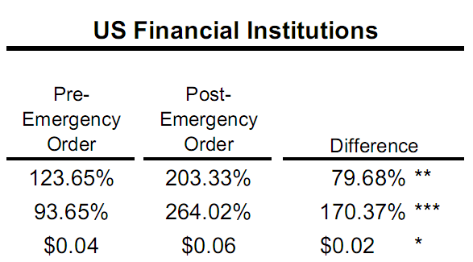
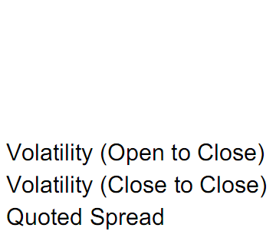
Case Study – Short sellers
Recent short selling restrictions by regulators have been ineffective
Higher volatility and lower liquidity for US Financial Stocks after the SEC Emergency Order from July 2008
Source: A. Bris, 2008, ‘Short Selling Activity in Financial
Stocks and the SEC July 15th Emergency Order’, working paper

Slide 10
Conclusion: Caveat Emptor
In the end, everything has to be done so that investors feel responsible for their investment decision:
  “Modest” communication approach by the regulator
  Rather than attempting to develop internationally recognized rules (hence, very often limited to the smallest common denominator), which usually have a great “advertising” effect that encourages overconfidence, why not favor transparency and the disclosure of information on risk levels.
Increasing the financial community’s memory of the losses caused by the various risks will help ensure investor protection. It is, in all likelihood, one of the great coming challenges.

Slide 11
EDHEC European Survey Conclusions
Industry practices fall short of academic standards for hedge fund reporting
 | Academic Literature | Industry practices
Non-normality of hedge fund returns | Hedge fund returns are not normally distributed (Agarwal and Naik, 2004) | 62% do not know how to test for non-normality 68% prefer Shape ratio
Dynamic factor exposure of hedge funds | Linear factor models are not appropriate (Fung and Hsieh, 1997) | 78% use linear factor models
Alpha analysis | Should be based on factor models; peer groups inappropriate (Sharpe, 1991) | about 50% prefer peer group or HF index
Smooth returns due to illiquid assets | Hedge fund returns are smoother than they ought to be (Getmansky et al., 2004) | only 5% use return smoothing-robust measures

Slide 12
EDHEC European Survey Conclusions
Industry guidelines fall short of providing sufficient guidance
 | AIMA | HFSB | MFA | PWG | IOSCO
Reporting style | + | + | + | O
Valuation framework | + | + | O | O | +
Past returns | O | O | + | O
Extreme risks |  | O
Factor exposure |  |  |  | O
Portfolio composition
Leverage risk | O | O |  | O
Liquidity risk | O | + |  | O
Hedge fund structure | O | + | + | +
Operational risk | + | + |  | +

