Slide 1
GSL Summit, Amsterdam
8th October 2009
Mark C Faulkner
Founder, Head of Innovation
Notes:
13/10/09

Slide 2
Topics
Securities Lending Industry trends
Hedge Fund cost of borrowing
How have investment banks been affected ?
The short selling environment
Sector overview

Slide 3
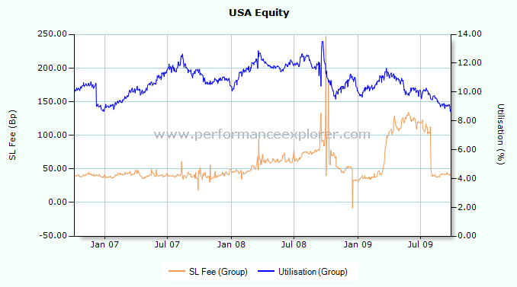
Wholesale Average Weighted Fee - USA

Slide 4
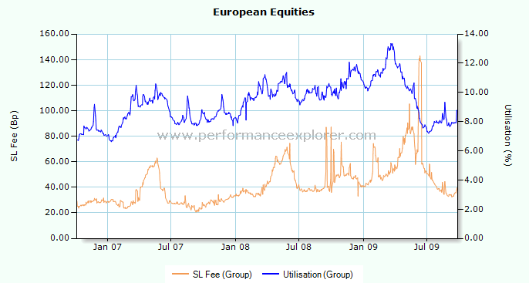
Wholesale Average Weighted Fee – Europe

Slide 5
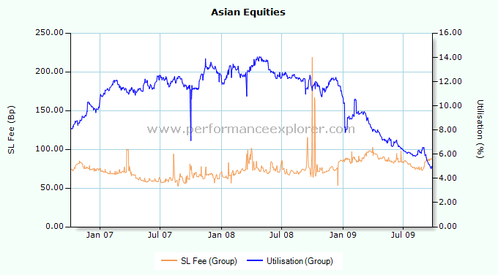
Wholesale Average Weighted Fee – Asia

Slide 6
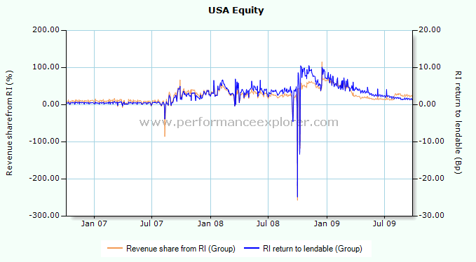
Re-investment landscape

Slide 7
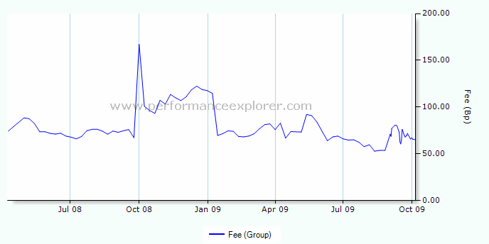
Hedge Fund Cost of Borrow

Slide 8
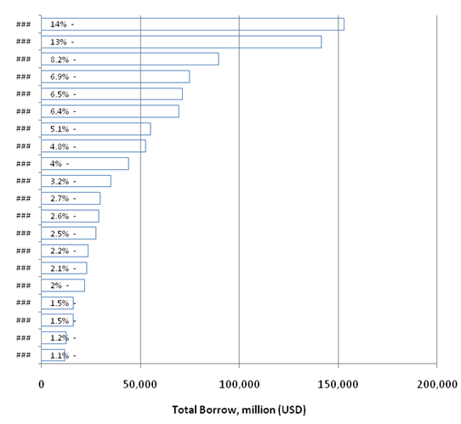
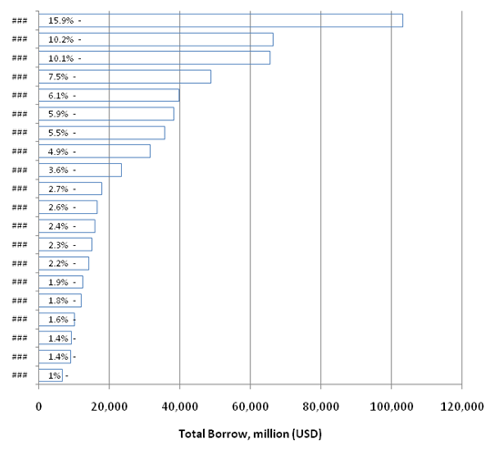
Prime Broker landscape
March 2008 - $1.029 trillion
March 2009 - $0.648 trillion
Notes:
13/10/09

Slide 9
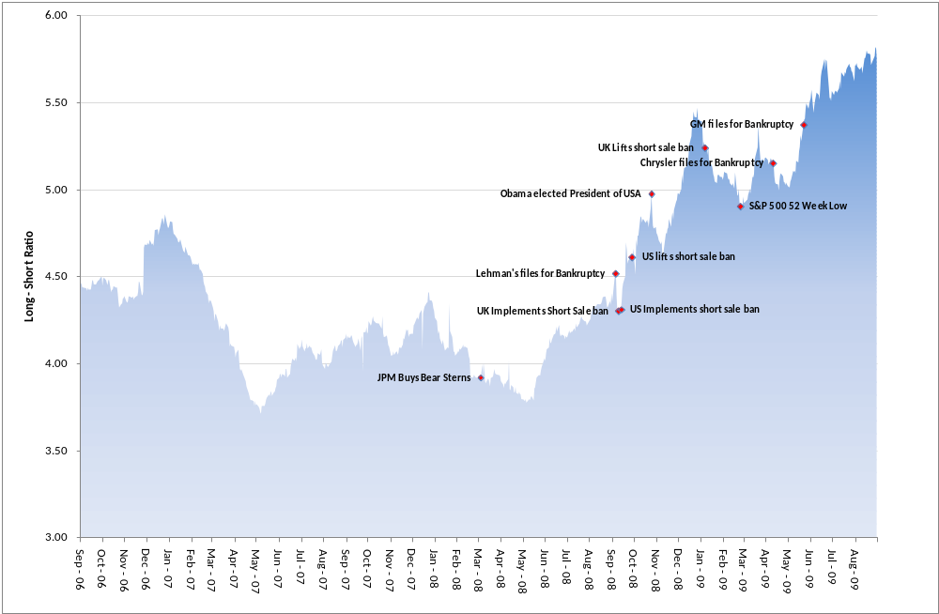
Global DX Long-Short Ratio
<number><number>
Notes:
<number><number>

Slide 10
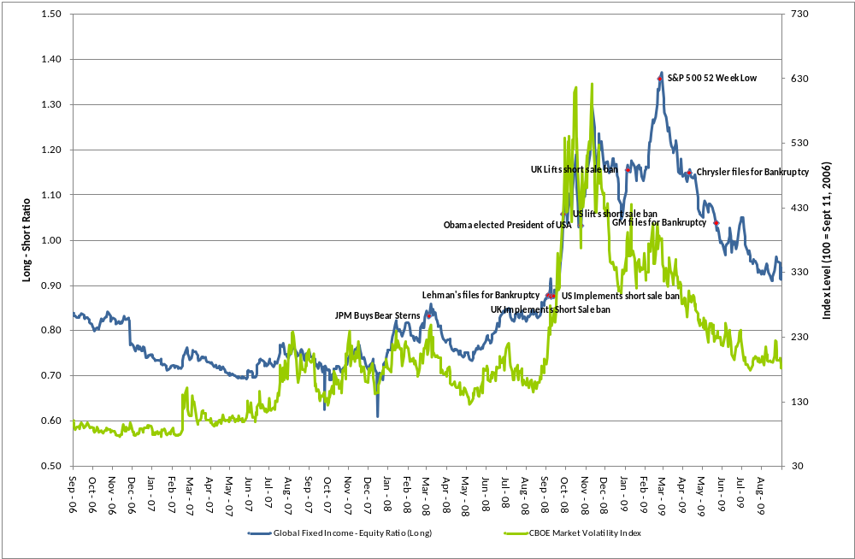
Global DX Fixed Income – Equity Ratio (Long) vs. VIX
<number><number>
Notes:
<number><number>

Slide 11
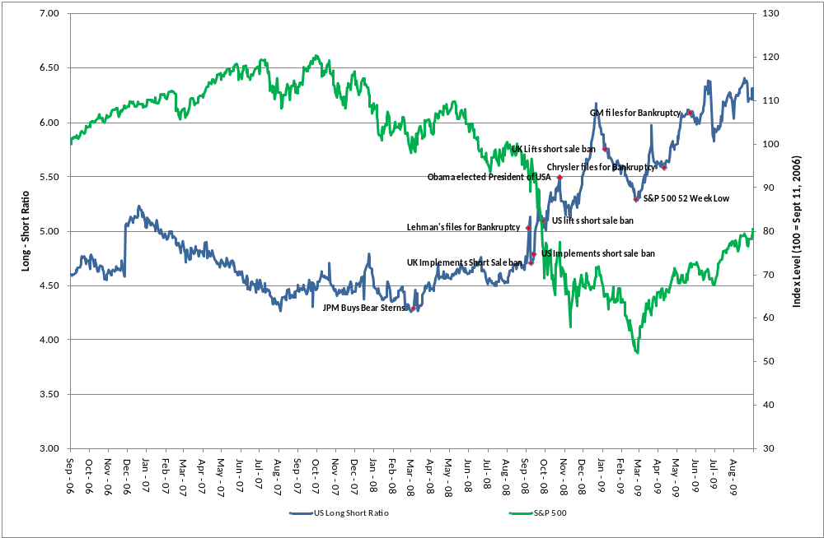
Equity Ratio (Long) vs. S&P 500
<number><number>
Notes:
<number><number>

Slide 12
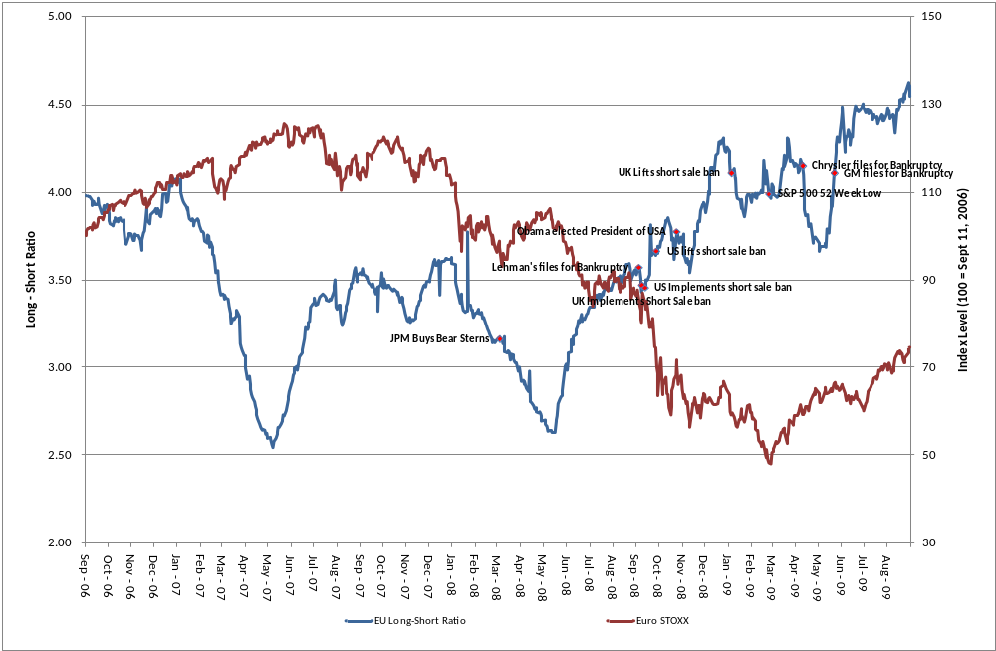
Long-Short Ratio vs. Euro Stoxx
<number><number>
Notes:
<number><number>

Slide 13
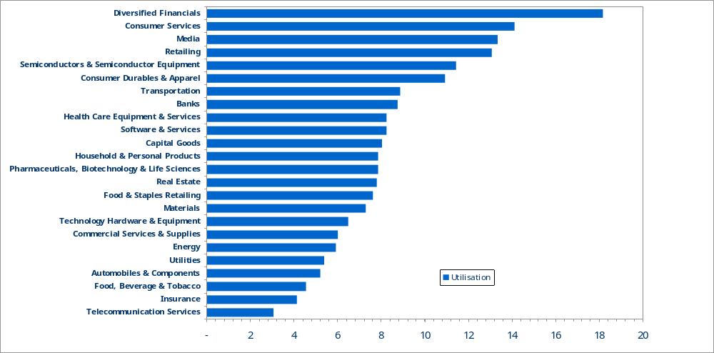
Sector Overview - Europe
Utilisation
<number><number>
Notes:
<number><number>

Slide 14
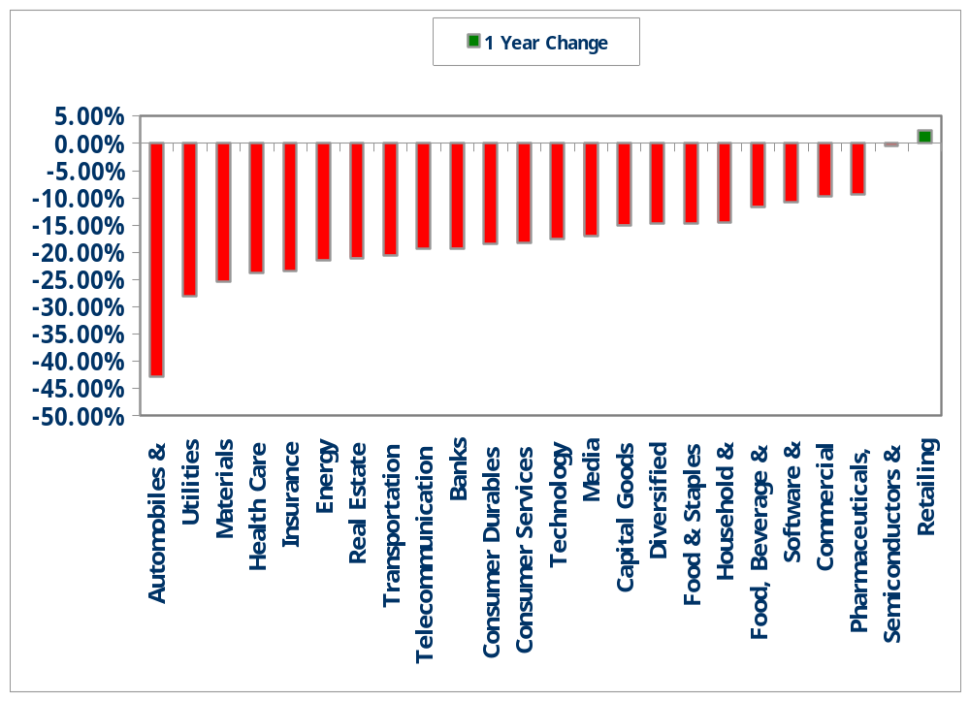
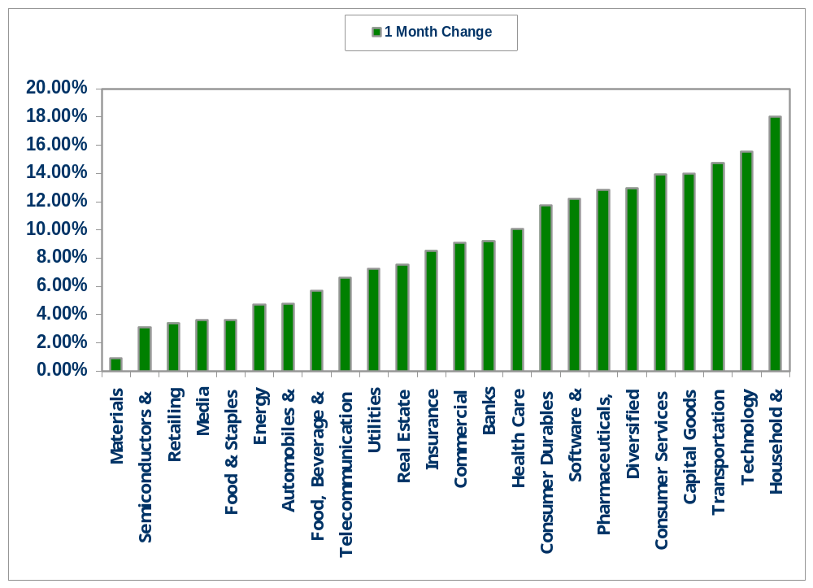
Institutional Buying - Europe
<number><number>
Notes:
<number><number>

Slide 15
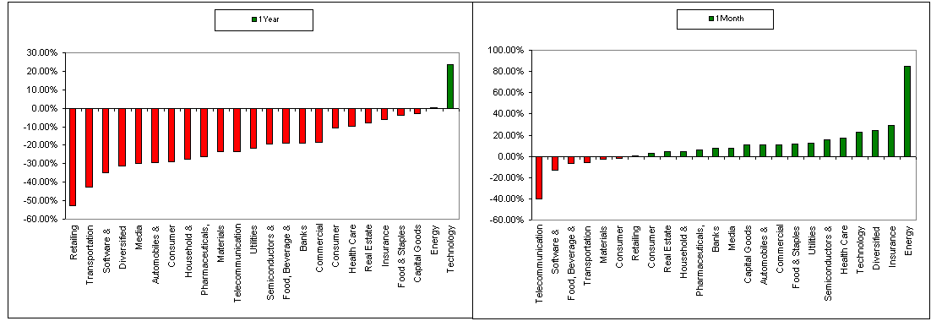
Short Selling - Europe

Slide 16
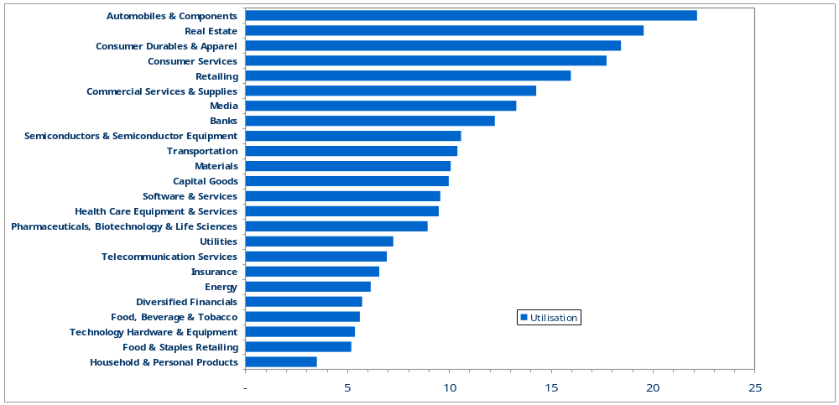
Sector Overview - USA
Utilisation
<number><number>
Notes:
<number><number>

Slide 17
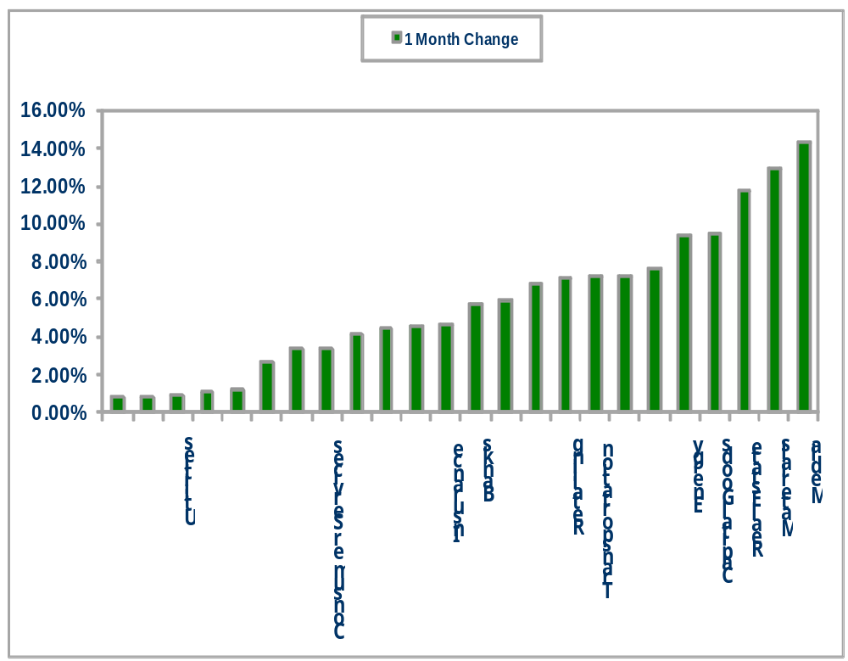
Institutional Buying – North America

Slide 18
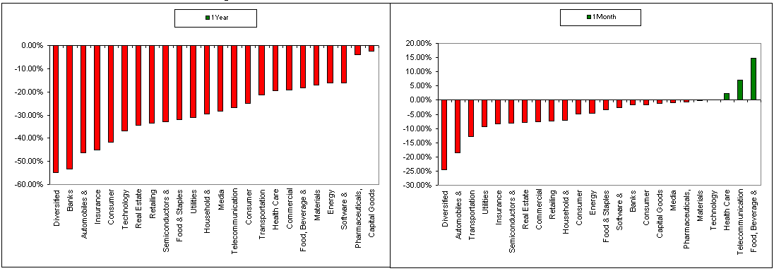
Short Selling – North America

Slide 19
Summary
  Mean reversion
  Securities Lending still profitable
  Risk is the new metric
  Period of low demand to borrow
  Changes imminent

Slide 20
GSL Summit, Amsterdam
8th October 2009
Mark C Faulkner
Founder, Head of Innovation
Notes:
13/10/09

