Slide 1
GSL Nordic Summit 2011
Securities Lending Panel Session 1:
Maximising Programme Performance
Moderator : Tom McKeown, FinTuition
Panellists : Tim Harrold, J.P. Morgan
        David Lewis, Brown Brothers Harriman
        Simon Lee, eSecLending
        David Little, Calypso

Slide 2
GSL Nordic Summit 2011
What are YOUR earnings expectations for 2011 compared to 2010?
Pessimistic
Slightly pessimistic
Indifferent
Cautiously optimistic
Optimistic

Slide 3
GSL Nordic Summit 2011
Where do you think people will look for MOST of their returns in over next 18 months?
Intrinsic Value (i.e. specials)
Volume
Cash Collateral
Collateral Optimisation
Switching Providers/ Changing Structure

Slide 4
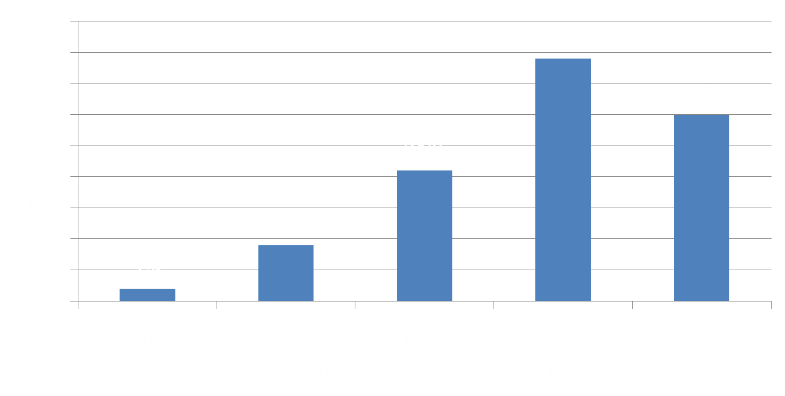
What are YOUR earnings expectations for 2011 compared to 2010?

Slide 5
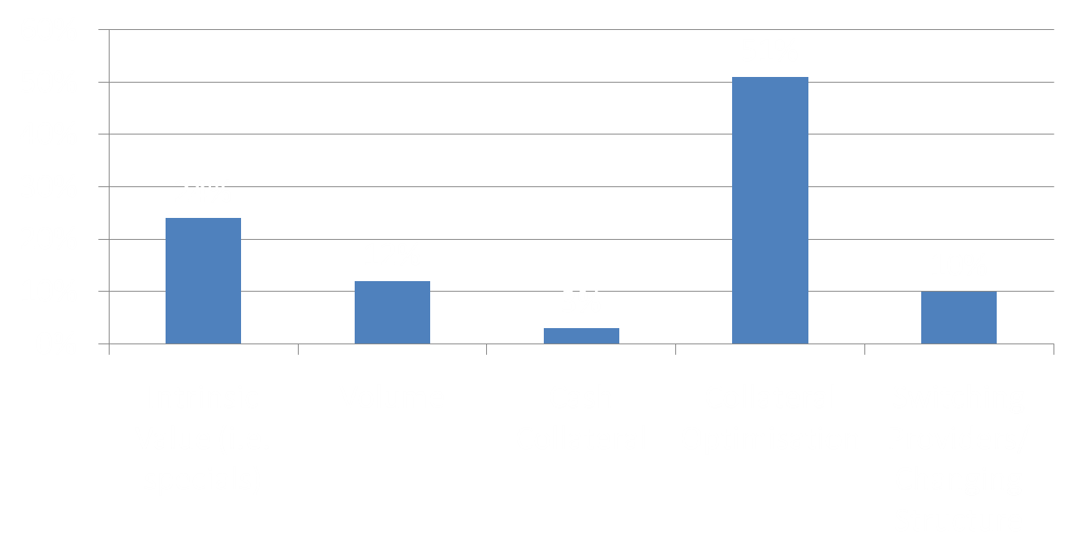
Where do you think people will look for MOST of their returns in over next 18 months?

Slide 6
GSL Nordic Summit 2011
Is cash an acceptable form of collateral for ANY of your/your clients’ programmes?
Yes
No

Slide 7
GSL Nordic Summit 2011
Which collateral asset class do your/your clients’ lending programmes principally take?
AAA government debt
Other investment-grade debt e.g. supranational, corporate etc.
Equity
Cash
Other

Slide 8
GSL Nordic Summit 2011
Do you currently see the role of collateral as:
Exclusively as an “insurance policy”?
An important component of increasing revenue?

Slide 9
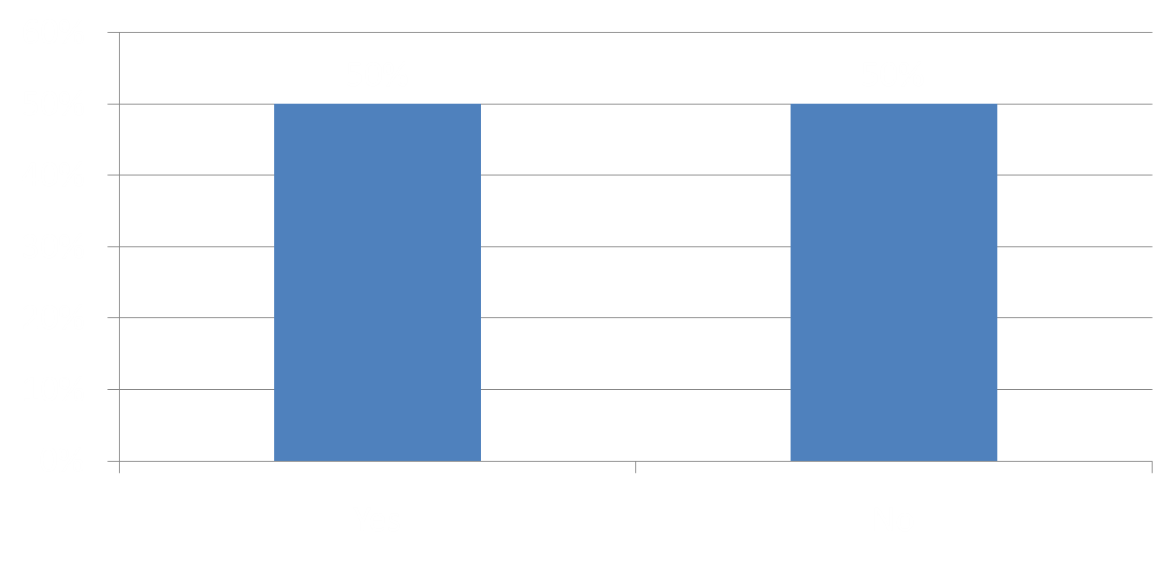
Is cash an acceptable form of collateral for ANY of your/your clients’ programmes?

Slide 10
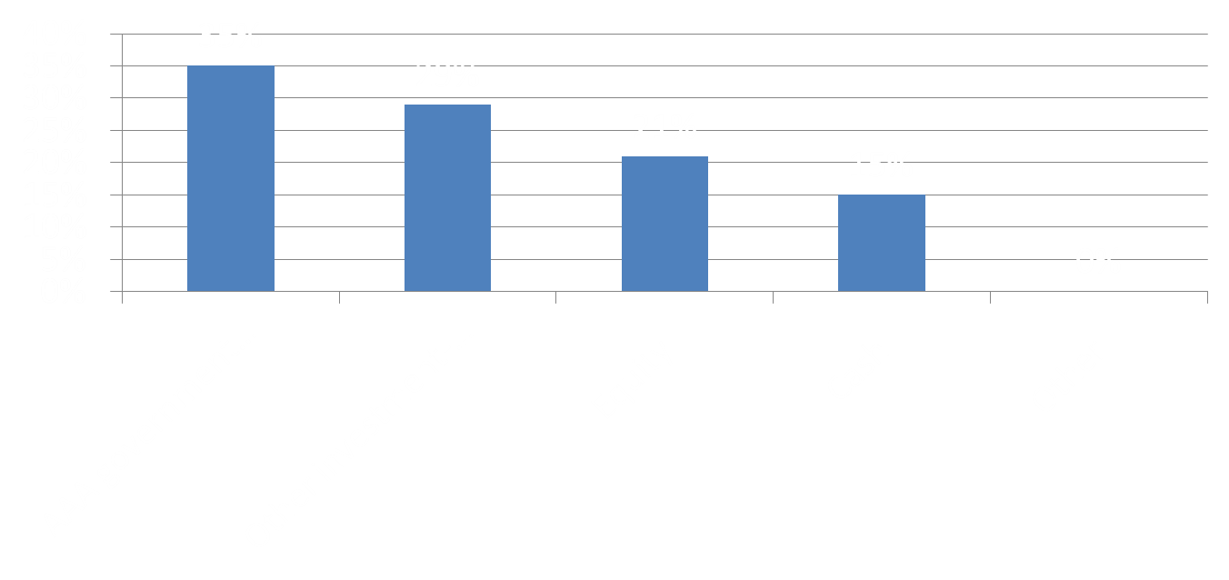
Which collateral asset class do your/your clients’ lending programmes principally take?

Slide 11
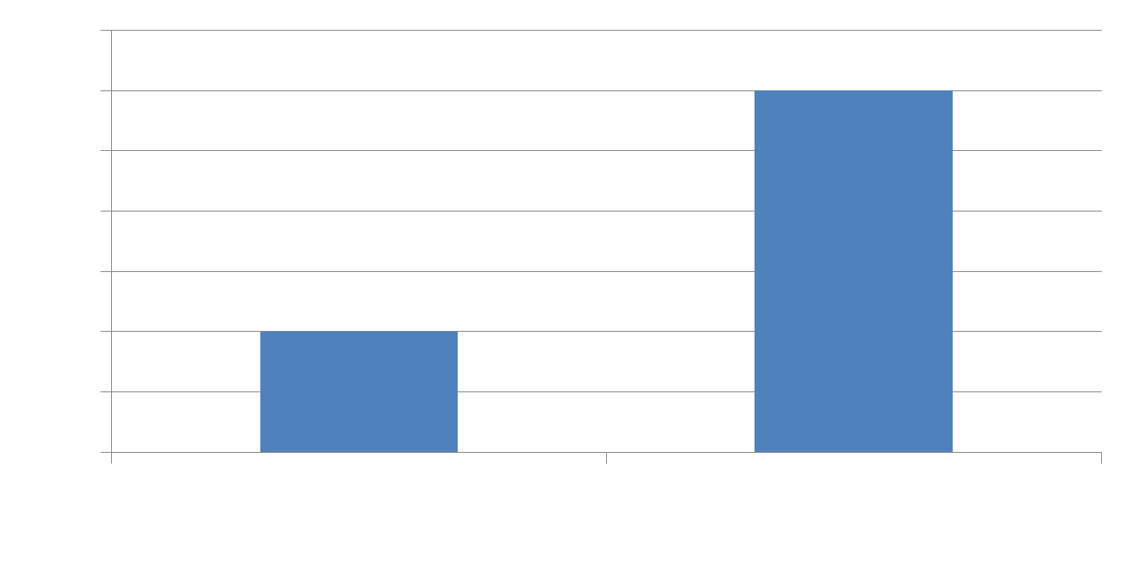
Do you currently see the role of collateral as:

Slide 12
GSL Nordic Summit 2011
What is the perceived greatest value in Beneficial Owners being flexible on collateral currently?
Greater utilisation
Greater fees
Lower concentration risk

Slide 13

What is the perceived greatest value in Beneficial Owners being flexible on collateral currently?

