Slide 1
GSL Nordic Summit 2011
Securities Lending Panel Session 2:
2011 Industry Discussion & Analysis
Moderator : Tim Smith, SunGard Astec Analytics
Panellists : Sunil Daswani, Northern Trust
Gösta Feige, Clearstream
Joakim Håkansson, Handelsbanken
Arne Theia, UniCredit
Magnus Ward, SEB

Slide 2
GSL Nordic Summit 2011
How do you feel about the current levels of transparency in all aspects of the business at the moment?
Not enough
Sufficient
Too much
Enough in some areas but not enough in others

Slide 3
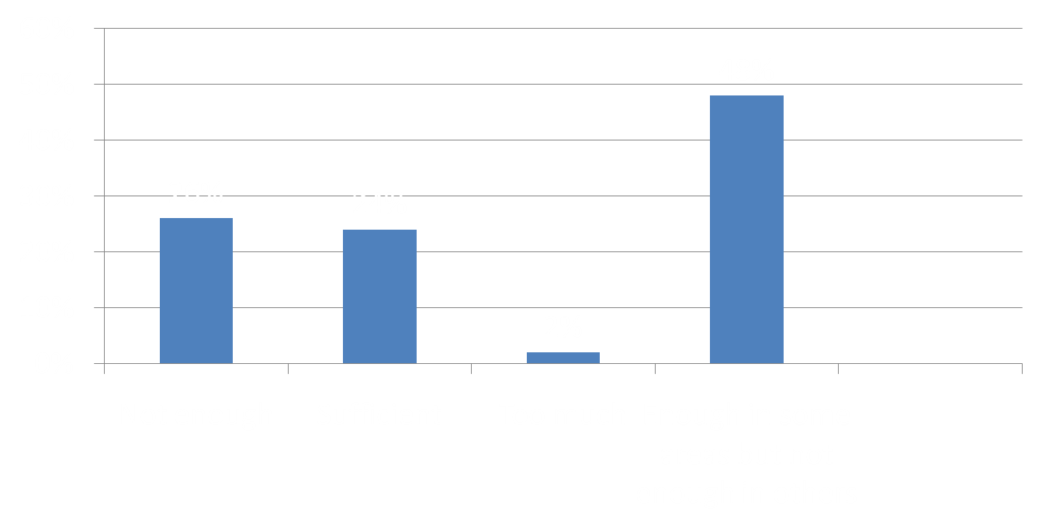
How do you feel about the current levels of transparency in all aspects of the business at the moment?

Slide 4
GSL Nordic Summit 2011
Central counterparties will be in place in all mature securities lending markets:
Never
In 10 years
In 5 years

Slide 5
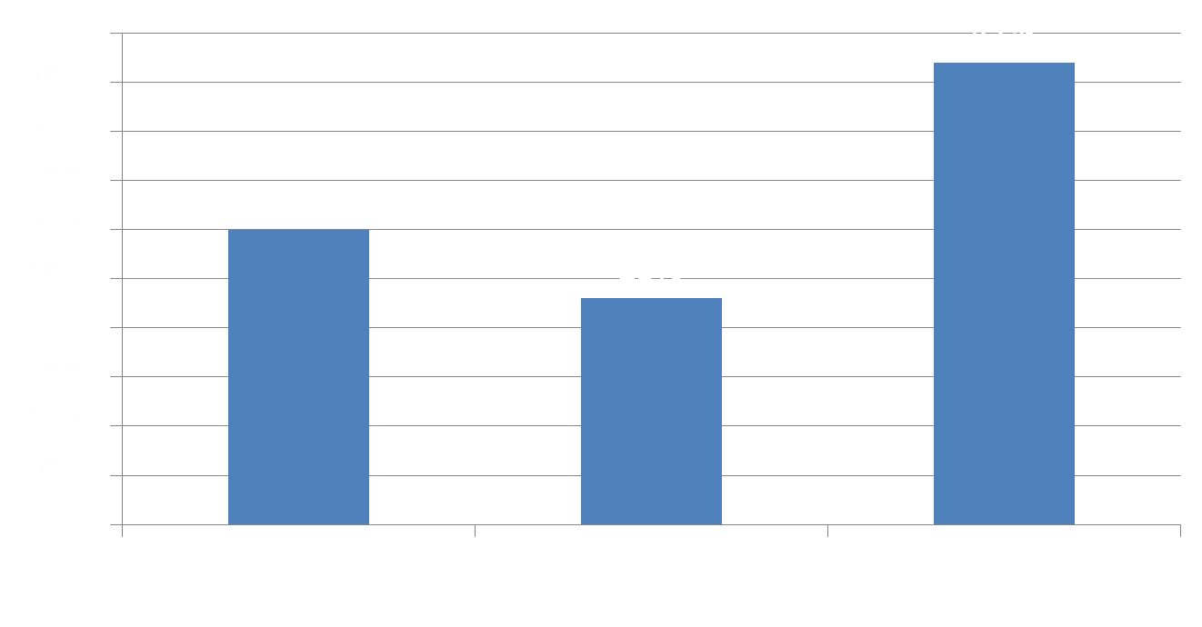
Central counterparties will be in place in all mature securities lending markets:

Slide 6
GSL Nordic Summit 2011
Assuming that there will be more regulation and scrutiny on a global basis, will the form be:
The same around the world
Similar but with regional twists
Totally different in nature and scope

Slide 7
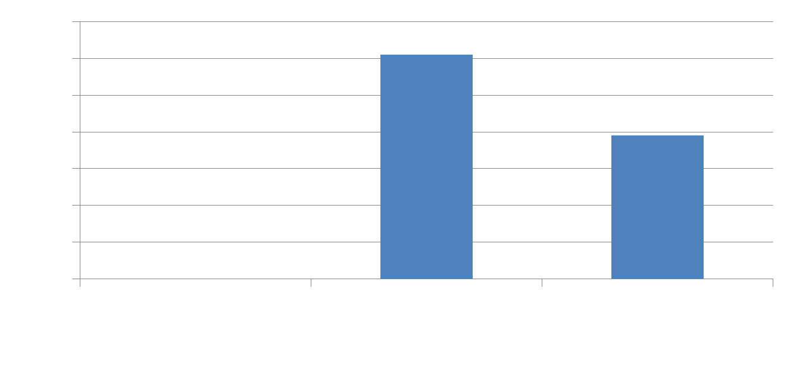
Assuming that there will be more regulation and scrutiny on a global basis, will the form be:

Slide 8
GSL Nordic Summit 2011
Participants in securities lending and repo did not used to speak with each other. Is this:
Still the same
Getting more communicative
Now integrated

Slide 9
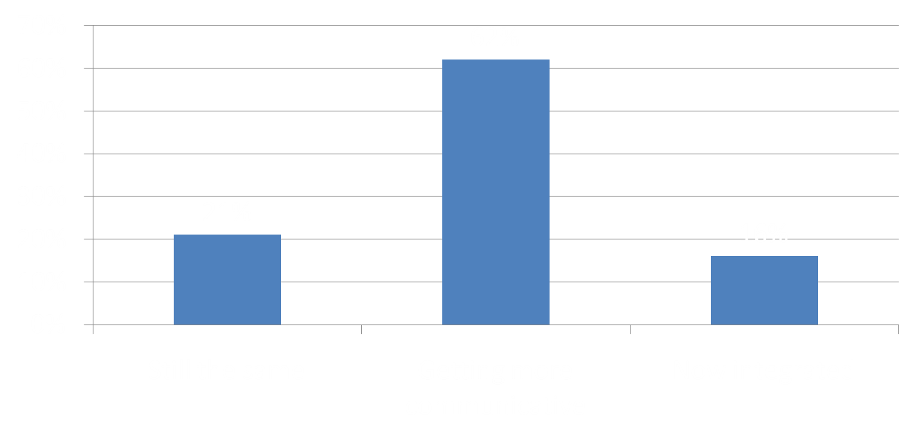
Participants in securities lending and repo did not used to speak with each other. Is this:

