Slide 1
Investor Services Journal Summit
Regional Realities
Roger Fishwick
^{30th} September 2010

Slide 2
Agenda
Investor Services Journal Summit
Introduction
Regional Custody trends
Regional custody Issues
Is the custody business model bust?
What about the new requirements?
Understanding risks
Summary
Questions?

Slide 3


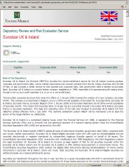
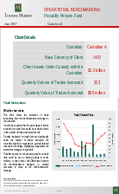
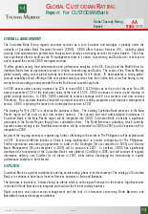
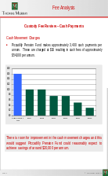
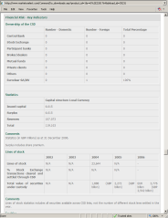
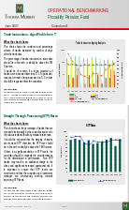
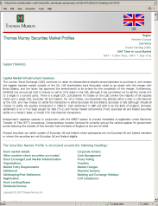
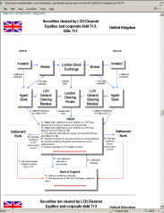
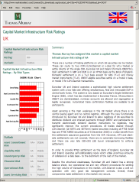
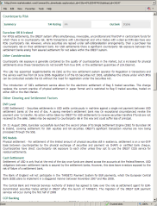
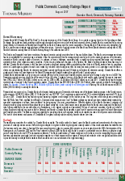
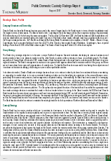
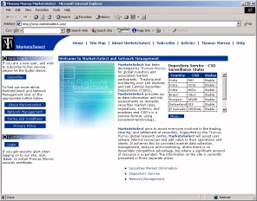
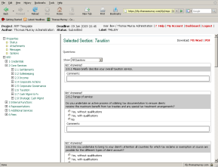
Investor Services Journal Summit
Introduction: Thomas Murray’s businesses
GLOBAL CUSTODIAN AND SPECIALIST RATINGS, MONITORING AND ADVISORY - INSTITUTIONAL SERVICES
  Global custodian and specialist ratings
  Custodian monitoring
  Institutional custody and value added reviews
  Specialist advisory, including overseas advisory
  Delivery and RFP technology
CAPITAL MARKET, CSD AND AGENT BANK RATINGS - DATA SERVICES
  CSD ratings
  Capital market ratings
  Agent bank ratings
  Securities market data
  Daily market newsflashes
  Data management and RFP technology
PRIMARY RESEARCH, ANALYSIS AND INFORMATION
Representations
4.3 Core Services
4.3.15 Will all corporate governance information be supplied to clients in English?
2.5.13 What is your cut-off time prior to the meeting by which the client must instruct?
Horizontal
Vertical
COMMENTS
VOTING INSTRUCTION REQUIRED WITHIN 1
DAY OF MARKET DEADLINE
5
The bank can provide all information in English except Notices of Agenda
Bank of Tokyo
due to the time restraints.
DD
Mitsubishi
4
The bank’s standard deadline to receive voting instructions from the client
is 4 business days prior to the meeting date.
Fuji Bank Ltd
10
Yes, the bank will supply information in English.
DD
The bank’s cut-off time varies between 0-72 hours depending on request
MEETING/VOTING
FB
ALL MEETING/
7
significance first, followed by processing time and volume..
INFORMATION NOT
VOTING
6
The bank's standard reporting items in English on Corporate Governance are:
HSBC
SCB
SMBC
INFORMATION
Meeting date/place, meeting type, available holdings, agenda items and instruction
SUPPLIED IN
SUPPLIED IN
HSBC
deadline. As the bank has previously mentioned that Corporate Governance
ENGLISH
BTM
ENGLISH
services are classed as a value added service at additional cost, it is unclear if
CITI
5
these items are included in the standard custody fee.
DD
The bank’s cut-off time is 9:00 (JST).
10
Yes, the bank will supply information in English within 24 hours from its
Standard Chartered
receipt of the information.
DD
Bank
5
The bank expects voting instructions to be provided 3 business days prior
to the meeting, 5 business days in the case of partial votes.
VOTING INSTRUCTION REQUIRED WITHIN
Sumitomo Mitsui
10
Yes, the bank will supply information in English.
DD
7 DAYS OF MARKET DEADLINE
Banking Corporation
5
The bank’s cut-off time is 8:00 3 business days prior to the meeting.
5
No, the bank states that English is mandatory only for those stocks listed
Citibank
on the Nikkei 225, all other corporate governance instructions would be
4
distributed in Japanese.
DD
PROPRIETARY & CONFIDENTIAL
The client must instruct the bank 1 week before the actual meeting.
DD
Copyright © Thomas Murray Ltd 2002

Slide 4
Investor Services Journal Summit
Introduction: The Types of Players
Local/Local
  Domestic only custodians that offer clearing in their legal location
  Examples: Maybank, Itau
Global/Local
  Custodians with a number of local footprints, often as a regional solution, but with no global network.
  Examples: Deutsche Bank, UniCredit, Standard Chartered
Local/Global
  Custodians operating a network but only for clients from a single location
  Examples: Santander, SEB, UBS, Standard Bank, SGSS
Global/Global
  Custodians operating a network and offering global custody from a number of booking centres
  Examples: State Street, Bank of New York Mellon, Citi, JPMorgan, Northern Trust
Some players do not fit neatly into this model, as they are in more than one box, for example BNP Paribas and HSBC

Slide 5
Investor Services Journal Summit
Introduction: Custodians – Concentration of Business
Rank Provider
The Bank of New York Mellon
JP Morgan
State Street
4 Citigroup
BNP Paribas Securities Services
6 Société Générale
7 HSBC
Northern Trust
CACEIS
RBC Dexia Investor Services
Mitsubishi UFJ Financial Group
SIX SIS Ltd
UBS AG
Brown Brothers Harriman
Indicative
Assets Under Custody ($bn)
22,400
14,900
14,058
11,068
5,793 4,491
4,400
3,600
3,250
2,720
2,540
2,310
2,275
2,000
Source: globalcustody.net, July 2010

Slide 6
Investor Services Journal Summit
Regional Custody - Trends
There is a distinct trend towards global custodians and other financial institutions appointing sub-custodians on a regional basis, with all the benefits that I have no doubt the panelists to follow will wax lyrical about, such as:
Economies of scale, centralised processing (offshoring), improved fee levels for clients
Consistency of communication and reporting
Single contract, point of contact and common service level for the region
Ability to connect either directly to each market or via a hub (do all offer this?)
As a result we have seen the regional custodians expanding their proprietary networks
  BNP Paribas is expanding into Asia
  HSBC’s move into Latin America
  Standard Chartered have bought the Barclays Africa business
As well as a bit of a fight back/new entrants into the business, such as Danske developing a regional offering as it finds its single country offering squeezed

Slide 7
Investor Services Journal Summit
Regional Custody - Issues
Concentration risk – especially for cash. Is there a solution to this?
Where does a regional custodian end and a global begin? Might the regional custodians begin to threaten the business of the global custodians? Many already compete for local global business with the big globals
Is a partial region offering worthwhile or is it all or nothing?
For example, it may be economic to open in Brazil to offer sub-custody, but what about Peru?
Will buyers buy one market like that, leaving their existing regional provider with just the smaller markets in that region?
What about regions that are less well served by regional providers, such as South America?
Threat in Europe of disintermediation of regional custodians by the ECB with T2S
There are also issues of language support and technology as regional players move into the frontier markets, where infrastructure may not be so well developed
The range of services required has expanded, to local fund services, broker dealer back office insourcing, for example

Slide 8
Investor Services Journal Summit
Is the custody business model bust?
The custody business model relies on the following primary revenue sources
  direct fees for transactions and safekeeping
  interest
  FX
  Securities lending
All these revenue sources are under attack:
  direct transaction fees are threatened by the introduction of CCP’s (e.g. Danske)
  Interest income has been badly impacted by the prolonged period of low rates
  FX volatility has reduced
  Securities lending has halved since the pre-Lehman period
What will the regional custodians do to change their business model in response?

Slide 9
Investor Services Journal Summit
What about the new requirements?
Markus, in his presentation at the start, touched on a number of themes. The global custodians will be looking to their regional providers to support them, potentially, in:
  Handling increasing asset class diversification, where required, not just long only positions in listed securities in the local markets
  Helping to support short as well as long positions
  Providing operational flexibility
  Nimbleness, time to market
  targeted investment – intelligent use of IT
  Global data management
  Risk management, intraday reporting to enable counterparty monitoring
  Support with collateral management, as the requirement to collateralise exposures increases
  All this in an environment of cost containment!

Slide 10
Investor Services Journal Summit
What about the new requirements?
Post crisis focus on safeguarding client assets – may translate into more account segregation? Could the regional players handle thousands of accounts for each global custodian client?
Segregation of client cash – difficult for the sub-custodian who normally just has a cash omnibus for the global custodian – what innovative solutions could there be?
Provision of support for both long and short positions – this may be providing specialist sourcing of stocks in difficult markets such as some of those in Asia and Africa, as well as handling the asset servicing requirements
Markus asks whether big really is beautiful, or is it:
  Standardised and rigid
  Slow moving and difficult to change
How are the large regional players going to show the agility and adaptability to the future needs of their clients that Markus requires?

Slide 11
Investor Services Journal Summit
Understanding risks – where does the buck stop?
If global custodians are being asked to assume more risks by their clients, what will they do?
Are the regional custodians prepared to take on more liability, for
  direct losses? Even if the fault of the market infrastructure?
  what about markets where the infrastructure is defective?
  restitution in a “Madoff” type case involving UCITS funds at the global custodian level?
  consequential losses?
  How would such risks and liabilities be priced and will the global custodians pay?
Should regional custodians be judged on a local standard of care or a global standard?
How much responsibility for educating the end investor clients of the global custodians will the regional custodians take?
Are there other regulatory issues upcoming for the regional and domestic custodians outside the EU ones (AIFM, UCITS)?

Slide 12
Investor Services Journal Summit
Regulatory Requirements to Monitor Custodians
Global financial markets are seeing change with the introduction of additional regulatory requirements surrounding the safety and security of assets. Increased regulatory scrutiny and events such as the bankruptcy of Lehman’s and the “Madoff” scandal are forcing banks into refining their internal controls surrounding monitoring of regional and sub-custodians
The need for visible, transparent and pro-active global, regional and domestic sub-custodian monitoring is now more evident. It can no longer be satisfied by a reliance on industry surveys, web-conferencing or sub-custodian relationship and sales visits. The need for continuous and active monitoring, including on-the-ground operational review visits cannot be avoided and must be the minimum in meeting best market practice. Utilising proven methodologies and rating processes applied during regular on-the-ground operational reviews, Thomas Murray offers an independent appraisal of the business counterparties, their strengths and weaknesses and provides an early warning of potential custodial problems and agreed triggers of increased counterparty risk
The world is moving in two directions. This is driving the need for sub-custodian and local capital market infrastructure reviews:
  recognition by funds that global custodians are taking less and less responsibility for sub custodians/CSDs/infrastructure
  regulatory moves by countries (France) to make global custodian more responsible for assets, wherever held

Slide 13
Investor Services Journal Summit
Summary
How do the service providers plan to change/enhance/adapt their models in order to support their clients and their clients’ clients in their initiatives?
Is the risk reward ratio adequately balanced?
Will there be a shift in pricing to reflect this?
How will the custody business model evolve?
Is increased pricing realistic in the post-financial crisis environment?

Slide 14
Investor Services Journal Summit
Questions?
?
Roger Fishwick
Director of Ratings
Thomas Murray Investor Services
Horatio House
77 – 85 Fulham Palace Road
Hammersmith, London. W6 8JA
+44 (0) 20 8600 2300
rfishwick@thomasmurray.com
Website: www.thomasmurray.com

