Slide 1
EU Regulation on Short Selling
Mats Beckman, Head of Compliance,
SEB Merchant Banking Division
Notes:
A lot of new regulatory initiatives in the wake of the financial turmoil, including in particular enhanced and adjusted requirements in respect of regulatory reporting and transparency; EMIR, TD (harmonised thresholds + cash settled derivatives), transparecny requirements on cash settled derivatives AND short selling (just to mention a few)
I will toiday restrict my self taking about SHORT SELLING; starting with a brief historic outlook, moving to current discussions and then a few words about the NORDIC PICTURE.

Slide 2
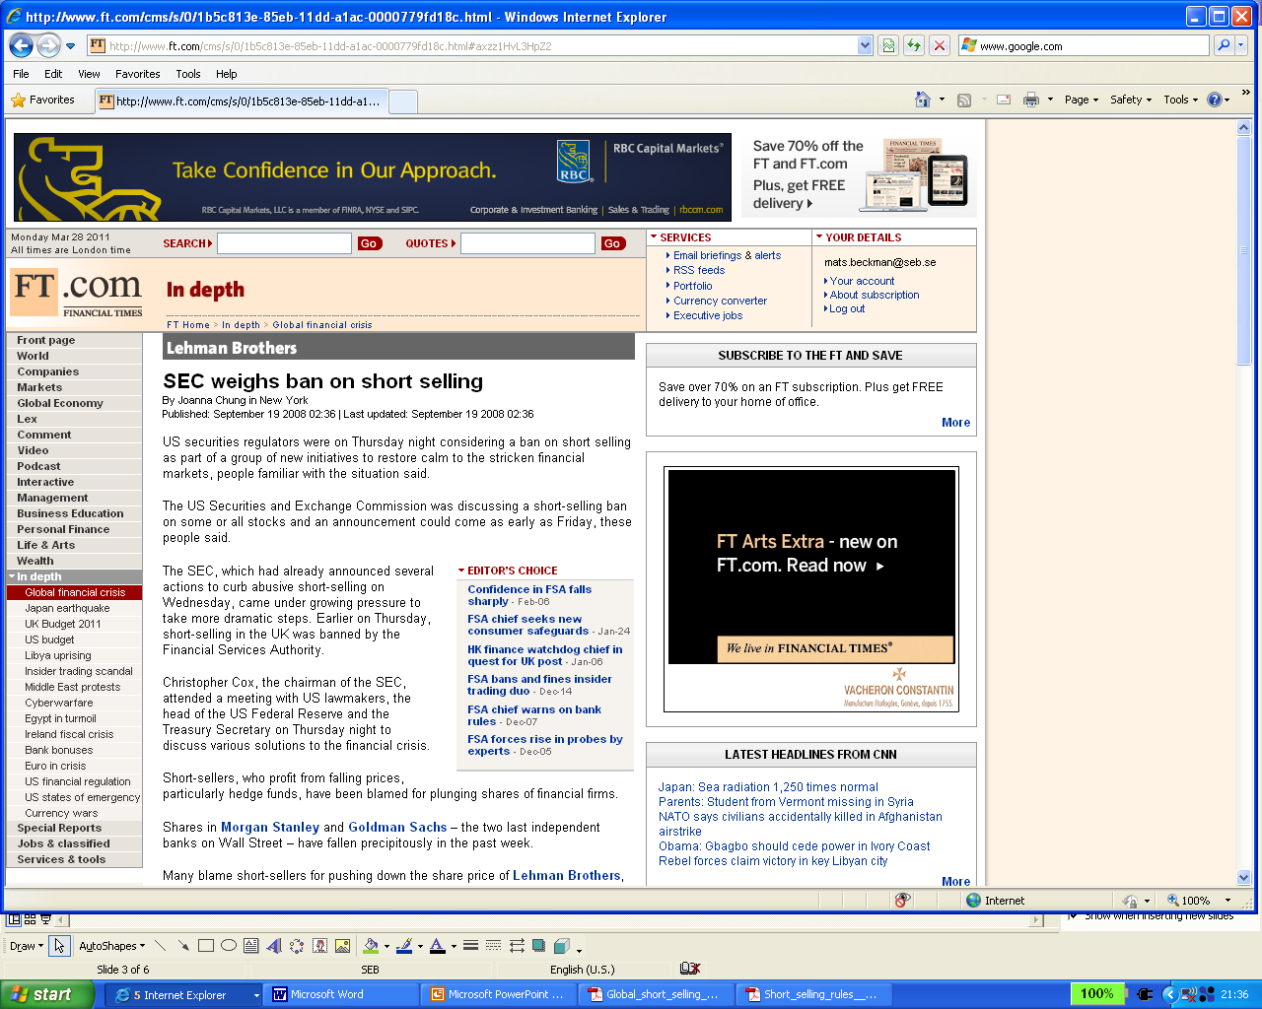
The trigger events…….
The SEC, which had already announced several actions to
curb abusive short-selling on Wednesday, came under
growing pressure to take more dramatic steps.
Earlier on Thursday, short-selling in the UK
was banned by the Financial Services Authority.
Notes:
On 18 September UKL FSA and US SEC overnight decided to implement temporary bans on short selling in financial stock. The move came as a surprise to most of the market.
The inititive should be viewed in the light of the – now famous – problems for certain large frinacial institutions, such as Lehman and Bear Stearns. Ther was a genuin fear of massive speculation againts other financial institutions, and that speculation againts there shares could be potentially harmful in order to keep them alive.
There was a perception – that subsequently proved to be inaccurate – that in particular Hedge Funds had taklen the lead in heavy speculation in financials by massive short selling inititives.
Both UK FSA and SEC were though clear about that the measures taklen were of a temporary nature given the extraordinary circumstances, and expressed that short selling as such generally was a good feature, in that it normally contribute to a better price formation process and improved liquidity.

Slide 3
.....followed by !!!!
Date | Country | Measures
19/9 2008 | Canada | Ban
19/9 2008 | Luxemburg | Ban
20/9 2008 | Germany | Ban
22/9 2008 | Belgium | Ban
22/9 2008 | Portugal | Disclosure
22/9 2008 | Netherlands | Ban
22/9 2008 | France | Ban
22/9 2008 | Australia | Ban
24/9 2008 | Spain | Disclosure
10/10 2008 | Denmark | Ban
Notes:
The initiatives from UK FSA and the SEC were shortly – within a couple of days followed by equivalent initiatives from at least 25 regulatorsl world wide, theser are a few of them.
The problem was that these initiatives were heavily reactive and issued in panic. They were not well thought through and the lack of coordination was apparent. Since the rules were not always sufficiently clear, and sometimes inconsistent, they were constantly changing from day to day, and some regulators issued after a while Q&A:s to bring clarity to the market. A few examples of the deviations;
Some rules banned short selling on a NSP-basis, other only looked considered gross positions in outright shares.
Some jurisdictions banned naked short, other had a ban also on covered
There was generally differences on how to define key terms such as naked short, covered short and NSP
Some rules applied only when trading on-exchange, others applied also OTC
Mostly the rules only applied to defined financial companies, the names of which were kept on certain lists (that were constantly changing, like in the US)
In terms of disclosures, the procedures as well as the trigger thresholds differed.
The need for consistency and coordination became soon apparent. CESR (now ESMA) soon started to present a list referenceing local initiatives on its webside, guidance were also issued by some major law firms and banks.

Slide 4
Objectives behind short selling regulation
Market abuse
Mitigate risk of failed settlement
”Traffic Bumper” againts fast market (sudden price drops) in extreme market conditions
Transparency
Regulatory measures taken on the national level during the financial turmoil were – on average –
not properly aligned with the above objectives. The lack of coordination amongst regulators
became a driver for subsequent regulatory initiatives.
Notes:
Before moving into were Europé currently stands, a few words about the objectives behind short selling.
Regulation of Short selling is not an entirely new feature, it has for long been subject to regulation in jurisdictions such as US, Hong Kong, Spain and – in the Nordics – Norway. However, the objectives behind the regulation has been fairly different from what was driving initiatives during the financial turmoil.
One important objective historically has been to mitigate the risk of failed settlement of trades. For example, Norway have seens long had a rule requiring – whit a certain degree of certainty – access to the relevant securities at the time of settlement.
Also, short selling has been discussed in the context of market abuse, and this was one of the references that were made during the turmoil when temporary measures were considered. For example, jurisdictions that had no rules specific for short selling, sometime referred in statements to their general rules on market abuse.
It is important to bear in mind that what drove the developments during the crises was primarily to calm down the market and not to exaberate the bad developments for financial stock. Though it was recognized that the meeasures – long term – could be potentially damaging to liquidity, they were temorarilly put in place to work as a traffic bumper, or cushion, to avoid pushing down the prices in financials (the effect of which partly was that prices became artificial)

Slide 5
The EU proposal for a regulation on Short Selling – The proposal from the EU Commission
Scope:
  Shares
  Sovereign Bonds
  CDS
Reporting/Transparency
  Reporting to FSA @ 0,2 per cent NSP
  Publication @ 0,5 per cent NSP
  Requirement apply to investor, not intermediary
  Group of companies with different business lines
Ban on Naked Short Selling
Requirement to ”flag” orders”
”Circuit Breaker” might trigger a temporary ban
Buy-In Requirements and mandatory fines
Notes:
EU proposal for a regulation presented on 15 September, following advice from inter alia CESR and ESMA and having been subject to public consultation
Regulation = directly enforceble in ms, no national regulation required (or even allowed).
Status: EP formed an opinion, Council (Hungarian Presidence) to formalise its opinion any time, then formal negotiations will start between the two, there are differences. Proposed time for entry intpo force – 1 Juli 2012 – still stands, but will most likely be postponed in the course of discussions between EP and Council.
A few issues;
Scope: PIIGS-crises added, and the initiative from Merkel and Zarkocy – sovereign bonds and CDS to the picture, this has been subject to fierce debate and – as evidenced in some recent articles – concerns about the potrential impact on the bond markets (Nordics, most a concern for bonds, some areas of Europé with less liquid markets . The CDS.initiative might be a concern. For shares: extension to equities traded only on an MTF.
Reporting/transparency; Shares 0,2 % private disclosure, 0,5 % public disclosure (EP: anonymous by supervisor, Council: with identity and from investor). Bonds/CDS: Only private disclosure at thresholds to be determined specifically for eachg issueing country.
Reporting/transparency: Initially the channels were defined, now determined more on a qualitative basis (to be determined by ESMA/the Commission.
Ban on naked short: EP: covered end of day, Council: ”Soft Locate”, e.g. Easy to borrow lists. A big worry for stakeholders on the bond markets, definition of market maker and primary dealer imperative for the outcome.

Slide 6
The Nordic picture
Country | Regulation
Sweden | No specific regulation
Finland | No specific regulation
Norway | Delivery capacity required
Denmark | Ban on short selling in shares issued by Danish banks
Notes:
Sweden and Finland, no specific rules. The reqquirements on market manipulation apply though.
Norway: Have had rules aiming at improving settlement quality, references was made to the rule during the turmoil, Have been cases were Finanstilsynet has investigatred, in particular in the context of new issues (such as Tandberg)
Denmark: Finanstilsynet published an executive order on 10 October 2008, has been unchanged ever since awaitening what will come from EU. Difficult to comprehend since it is partly inconsistent. In principle appears to prohibiting naked short, but in practise also prohibiting covered short (stock loan is not considered to establish a covered position, and derivatives should also be taken into account. As it appears, the regulation prohibits net positions in shares only, as well as NSP. Has caused practical problems, and firms were e.g. critizised publicly in a few cases (like the new issue in Amager Bank).
The rules will certainly be harmonized when the new EU rules are due.

Slide 7
Questions ????

