Slide 1

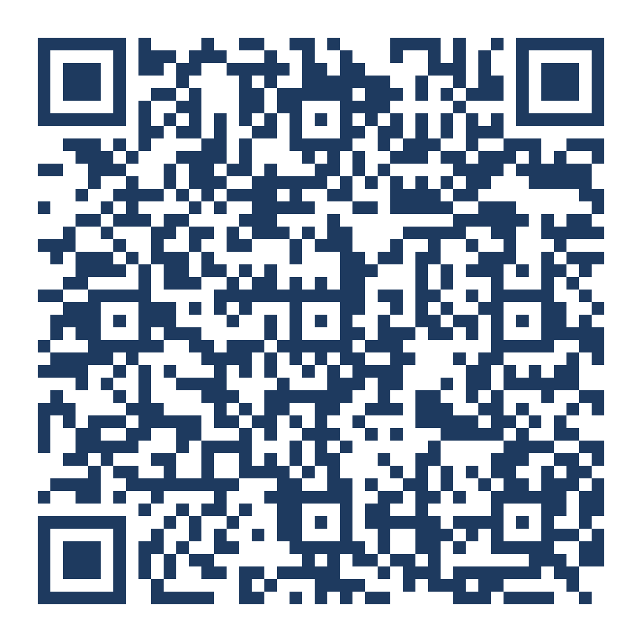
BUSINESS ANALYST SERVICES · LIVE DEMONSTRATION · 10 MINUTES
Enterprise Apps,
with Claude
Scan for the flagship
programme
One analyst, one unbroken toolchain, and a working platform in production. Ten minutes on what was built — then the pattern that lets an enterprise do the same with the vendors it already owns.
10 minutes
One team
Six vendors
300 requirements
Live walkthrough, not a video
No engineering team behind it
Miro · Jira · GitHub · Vercel · Neon · Clerk
Green before anything is promoted
business-analyst.services
Presented by Business Analyst Services
Notes:
0:00–0:45 Open here.
"Everything I'm about to show you was specified, built, tested and shipped by one business analyst working with Claude. No engineering team. The platform is live."
Do not explain the architecture yet. The QR is the flagship 12-week programme — point at it once, then move on. You will come back to it at the end.

Slide 2
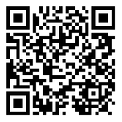

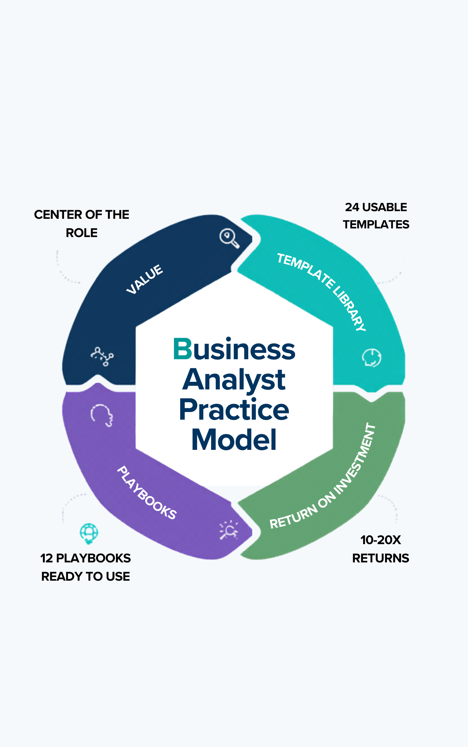

BUSINESS ANALYST SERVICES · CLAUDE DEMONSTRATION · PRACTICAL AI FOR END-TO-END BUSINESS ANALYSIS
1 / 7
PRESENTER PROFILE
Chale Dodge
Practice Lead · Business Analyst Services
Chale Dodge leads Business Analyst Services, specialising in uplifting enterprise-wide business analysis capability. A Certified Business Analysis Professional (CBAP) and IIBA member, he holds a Master of IT Leadership from Deakin University and is a certified PROSCI Change Practitioner and PRINCE2 Practitioner — blending strategy, delivery and change.
His work strengthens BA practices at scale while creating greater visibility, capability and opportunity for professionals across Sydney and NSW. Chale co-authored The Evolving Analyst with global peers, and his book (OUT NOW) introduces a scalable BA Practice Model for the practical application of AI — helping teams deliver greater value from business analysis now and into the future.
WHAT CLIENTS SAY
chaled@business-analyst.services
0451 878 883
“Chale is the best Business Analyst I have ever worked with!”
“We needed a BA Practice stood up for a team and within a few weeks, Chale had the team engaged and building out the community.”
CBAP
IIBA Member
PROSCI
Annette Gal, Project Manager · University of NSW
Pat Wrighton, Delivery Lead · UNSW College
PRINCE2
M.IT Leadership

Slide 3
BUSINESS ANALYST SERVICES · CLAUDE DEMONSTRATION · PRACTICAL AI FOR END-TO-END BUSINESS ANALYSIS
2 / 7
INTRODUCTION
What you are about to see
Three claims, in order. Hold me to the third one — it is the only one that matters outside this room.
THE ARTEFACT
THE METHOD
THE POINT
A platform, in production
A specification that is read
None of this is bespoke
Invitation-only roles across nine role types, one permission matrix, an append-only audit register, and a client document that leaves the building by email. Not a prototype and not a slide — a system with users.
Every change begins as a story with acceptance criteria in Jira. Claude builds against that spec, opens a pull request, and 27 browser specs have to be green on the release branch before anything is promoted.
Six ordinary vendors and one chain. Swap any of them for the enterprise equivalent and the pattern survives intact — which is why this transfers to Enterprise Apps rather than staying a personal-productivity story.
WATCH FOR THREE THINGS
01
The specification is read live at plan time. It is never copied, restated or summarised into the build.
02
The model never accepts its own work. Every generation is logged; a human decides whether it counts.
03
Every sensitive write and its audit row commit in one transaction — or neither of them happens.
Notes:
0:45–2:00 The frame.
Spend most of the time on the third card. A room full of mixed roles will accept the first two and quietly discount them as 'a clever person with a side project'. The answer to that is the vendor list.
The three 'watch for' items are the ones you will point back to during the walkthrough.

Slide 4
AI Platform — Architecture
3 / 7
SPECIFICATION & DELIVERY
Discovery
Specification of record
Source repository
ENVIRONMENTS
canvas
stories
a source for humans only
stories + ACs, read live
private · protected · squash
pull request
release branch
default
test cases
preview
pre-production
production
specs
Test management
Acceptance harness
exercised on the release branch, then promoted to production
an app inside the spec tool
27 browser specs
results
The Platform
OUTBOUND SERVICES
Relational store
Object store
Authenticated roles
Runtime — web application
Identity provider
invitation only — no signup
server-rendered, one region
managed hosting, from git
two pillars, one identity
migrations applied by hand
credentials + sessions only
one instance per environment
resolved per request
no authorisation logic here
single region for residency
append-only audit table
private, same region
no fetchable public URL
Platform owner
Administrators
Coordinators
Referrers
Members
Domain validators
Learners
Mentors
Budget sponsors
Email
SMS gateway
carries the client document
must report failures back
in-region provider
no credentials set
Server logic / privileged actions
authorisation: one permission matrix over the role set
every sensitive write and its audit row in one transaction
every outbound call to a third party originates here
documents and email bodies rendered in-process
the edge check verifies the session and nothing else
the sponsor is the only
client login; the buyer
never signs in at all
LLM provider
Payments and payouts
extraction and drafting
held pending a review
funds held until delivery
absent from status page
AUDIT & OBSERVABILITY — ALL OF IT IN THE RELATIONAL STORE, NOT A THIRD-PARTY TOOL
Audit register
Notification ledger
Generation log
Provider status page
append-only, written in the same
transaction as the action it records
a row is written before the send, so
a send with no record cannot happen
every model call recorded; nothing it
produces counts until a human accepts
names every provider and whether it
is configured — payments are missing
Notes:
Verified against staging @ baa4983 on 6 September 2026.
Every element on this slide is a native PowerPoint shape — edit text and move boxes directly. The SVG at docs/architecture/bas-architecture-slide.svg remains the reference rendering; if you change one, change the other.
Dashed means built and deliberately switched off: SMS has no credentials, the LLM provider is held pending a cross-border disclosure review, and payments are live in code but absent from the provider status page — so a payment failure has nowhere to surface.

Slide 5
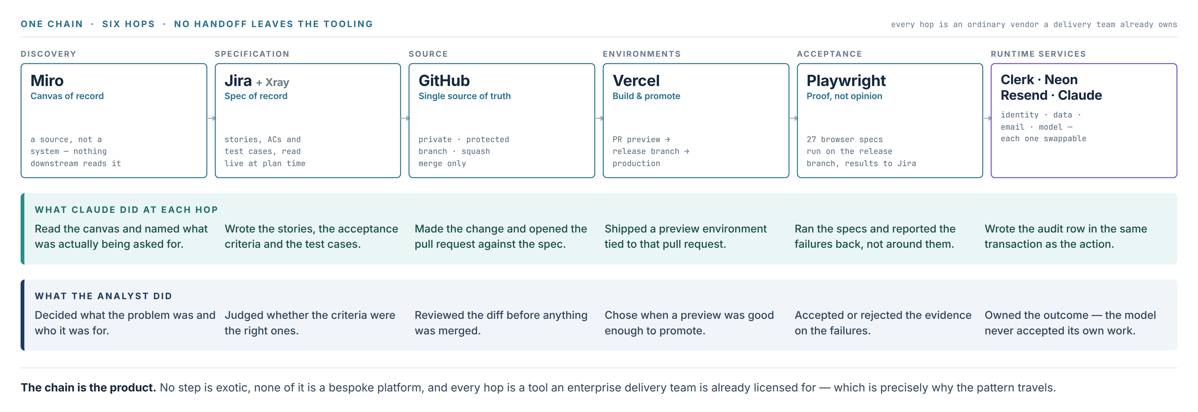
BUSINESS ANALYST SERVICES · CLAUDE DEMONSTRATION · PRACTICAL AI FOR END-TO-END BUSINESS ANALYSIS
4 / 7
THE CHAIN
Every box has an ordinary vendor behind it
The same system, drawn as the six hops a change actually travels — and who did what at each one.
This row, left to right, is the demonstration. Ten minutes is enough because there is nothing between the hops — no export, no restatement, no second copy of the truth.
Notes:
4:00–6:00 The walkthrough spine.
Walk the top row left to right, naming the vendor each time. Then drop to the teal band and give one concrete example per hop from the live system.
The navy band is the line to land: there is no handoff between the hops. That is the whole reason it fits in ten minutes.
If time is short, skip the analyst band — but never skip 'the model never accepted its own work'.

Slide 6
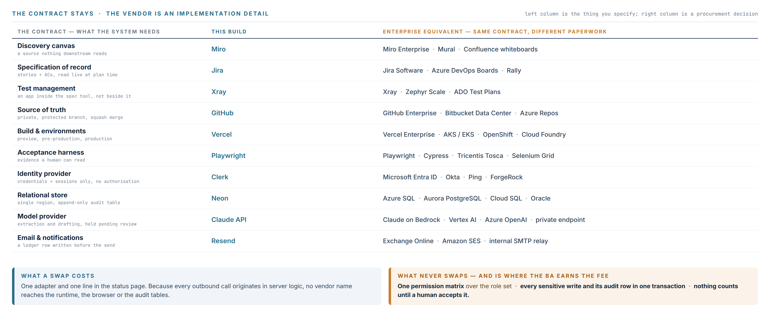
BUSINESS ANALYST SERVICES · CLAUDE DEMONSTRATION · PRACTICAL AI FOR END-TO-END BUSINESS ANALYSIS
5 / 7
SCALING IT
Swap the vendors. Keep the contract.
This is the enterprise question, answered directly: nothing in the pattern depends on the specific tools on the left.
The left column is business analysis. The right column is procurement. Confusing the two is how AI pilots become vendor trials and then quietly stop.
Notes:
6:00–8:00 The scaling argument — the reason a mixed room should care.
Read three rows only: identity, relational store, model provider. Those are the three an enterprise architect will test you on.
Then go to the amber box. The permission matrix, the audit-row transaction and the human accept gate are the parts that never swap — and all three are specified by a business analyst, not chosen by procurement.

Slide 7
BUSINESS ANALYST SERVICES · CLAUDE DEMONSTRATION · PRACTICAL AI FOR END-TO-END BUSINESS ANALYSIS
6 / 7
WHAT MAKES IT SAFE
Four decisions someone had to write down
These are the parts an enterprise cannot buy, inherit or generate. They are BA work, and they are what the course is actually about.
01
02
03
04
One permission matrix
The audit row is not optional
The model never self-accepts
Residency is a design input
Authorisation lives in server logic over the whole role set — nine roles, one matrix. The identity provider does credentials and sessions and nothing else, so an IdP swap is never an authorisation change.
Every sensitive write and its audit row commit in a single transaction. A notification row is written before the send, so a send with no record cannot happen. Append-only, in the relational store.
Every model call is recorded in the generation log and produces counts, not outcomes. Nothing becomes an artefact until a named human accepts it — the gate is in the data model, not in a policy document.
Runtime, both stores and the SMS gateway are in-region. The single offshore dependency is built and deliberately held shut. Four architecture choices fall out of one residency requirement.
THE UNCOMFORTABLE PART
No conferencing vendor, no profile API, no external telemetry. Each one was decided against rather than skipped — and the difference between those two sentences is the entire value a business analyst adds to an AI build.
Notes:
8:00–9:00 The takeaway slide. If you are running over, this is the one to keep and slide 4 is the one to cut.
The line to say out loud: a model can write the code for any of these four. It cannot decide that they are required. That decision is analysis, and it is why the role gets bigger rather than smaller.

Slide 8
BUSINESS ANALYST SERVICES · CLAUDE DEMONSTRATION · PRACTICAL AI FOR END-TO-END BUSINESS ANALYSIS
7 / 7
WHERE THIS IS TAUGHT
Practical AI for
End-to-End Business Analysis
Thu 24 Sep → Thu 10 Dec 2026 · 12 Thursdays · 19:00–22:00 Sydney
One global intake · all times shown are Sydney
Specify for a machine that builds
Stories and acceptance criteria written to be read at plan time, not filed after it.
Design the controls before the build
Permission matrices, audit transactions and accept gates — specified, defended, written down.
Run the chain end to end
Canvas to specification to source to environments to evidence, on your own tooling.
Scan to book the cohort
events.humanitix.com
Business Analyst Services · gday@business-analyst.services · business-analyst.services
Nineteen runs · three regions · Sep–Nov 2026
Notes:
9:00–10:00 Close.
Do not re-summarise. Say what the room should do next, then stop talking and leave the QR on screen while questions run.
The flagship is one global intake, 12 Thursdays, $3,000. The regional one-day and two-day courses (BA Leadership, Agile BA, BA Playbooks, the three Horizons courses) run Sep–Nov across APAC, EMEA & India and the Americas — mention them only if asked.

