Slide 1


BAS
Business Analyst Services
WHAT YOU'LL SEE
PRACTICE LEADERSHIP · TRAINING · ADVISORY
01
Agents & the roles they play
ATLASSIAN COMMUNITY · SYDNEY
Five Rovo Agents
02
Workflow & BA approval gates
03
Automation & the engine room
One Business Analyst
04
Live demo one change, end to end
Multi-agent BA delivery in Jira and Confluence.
From problem statement to published docs, with a human at every gate.
05
Rollout & what to measure
5
14
1
0
AGENTS
RULES
BA
SELF-APPROVALS
01
▶ LIVE DEMO INSIDE
Chale Dodge
Lead BA & Practice Lead, BAS
✓
HUMAN AT EVERY GATE
|
Agents draft. Only a Business Analyst approves.
Notes:
Welcome. 45 minutes: ~15 min concepts, ~15 min demo, ~7 min rollout, Q&A.
1

Slide 2

BAS
Business Analyst Services
PRACTICE LEADERSHIP · TRAINING · ADVISORY
WHY THIS MATTERS
BAs are drowning
in handoffs
Goal: speed up the drafting. Keep the BA in control.
01
02
03
04
Lost context
Broken traceability
Late rework
Ungoverned AI
Requirements, design, stories, tests and docs live in different heads and tools.
Links between Confluence pages and Jira issues drift.
Gaps surface in testing, not in analysis.
02
Fast drafts with no gates and no audit trail.
✓
BAS · AIDEL
|
Five Rovo agents, one BA · Atlassian Community Sydney · 02
Notes:
2

Slide 3
BAS
Business Analyst Services
PRACTICE LEADERSHIP · TRAINING · ADVISORY
THE AGENT TEAM
Five Rovo agents,
one pipeline
Each agent is triggered by a Jira status and hands back to a BA review status.
RA
01
SA
02
SM
03
TA
04
DOC
05
RA-Agent
SA-Agent
SM-Agent
TA-Agent
DOC-Agent
REQUIREMENTS ANALYST
SOLUTION ARCHITECT
SCRUM MASTER
TEST ANALYST
DOCUMENTATION
Spec with REQ IDs, gaps and open questions
Options, draft ADRs, NFRs, dependency issues
INVEST stories with Gherkin acceptance criteria
Test scenarios and a coverage matrix
Release notes and help page drafts
✓
BAS · AIDEL
|
Five Rovo agents, one BA · Atlassian Community Sydney · 03
Notes:
3

Slide 4
BAS
Business Analyst Services
01
Status is the handoff
PRACTICE LEADERSHIP · TRAINING · ADVISORY
A Jira status triggers each agent.
OPERATING PRINCIPLES
The rules that
02
Agents never self-approve
Only a human moves work out of review.
keep it safe
03
Traceability is mandatory
Every item carries REQ-nnn IDs.
Every rule, agent and workflow condition traces back to one of these.
04
Scoped knowledge
Each agent sees only the spaces it needs.
04
05
Everything is auditable
Outputs labelled ai-generated; page versions show BA edits.
✓
BAS · AIDEL
|
Five Rovo agents, one BA · Atlassian Community Sydney · 04
Notes:
4

Slide 5
BAS
Business Analyst Services
PRACTICE LEADERSHIP · TRAINING · ADVISORY
EPIC WORKFLOW
Status is
■ Agent step ■ Human gate
the handoff
01
02
03
04
05
06
Intake
Requirements Analysis
Requirements Review
Solution Design
Design Review
Story Breakdown
BA
RA-Agent
BA GATE
SA-Agent
BA GATE
SM-Agent
07
08
09
10
11
Refinement
In Delivery
Documentation
Docs Review
Done
PO GATE
TA-Agent
DOC-Agent
BA GATE
BA
Rework transition back from every review status, restricted to the ba-approvers group.
✓
BAS · AIDEL
|
Five Rovo agents, one BA · Atlassian Community Sydney · 05
Notes:
5

Slide 6
BAS
Business Analyst Services
PRACTICE LEADERSHIP · TRAINING · ADVISORY
BUILD THIS FIRST
Configuration
foundation
The agents and rules depend on these exact names.
SERVICE ACCOUNT
CUSTOM FIELDS
ai-delivery-bot
5 fields
Runs every automation, so audit logs show agent actions clearly.
Requirement IDs · Requirements Page · Design Page · AI Run Count · BA Notes for Agent
LABELS
CONFLUENCE SPACES
4 labels
DPACK · DA · STD · BAKB · HELP
ai-generated · ai-rework · ba-approved · needs-human
Each agent is scoped to only the spaces it needs; HELP is draft-only.
✓
BAS · AIDEL
|
Five Rovo agents, one BA · Atlassian Community Sydney · 06
Notes:
6

Slide 7
BAS
Business Analyst Services
PRACTICE LEADERSHIP · TRAINING · ADVISORY
RA-Agent · instructions
ROLE: Requirements Analyst agent.
INPUT: Epic, BA Notes, linked pages.
TASK:
1. Problem statement + objective
2. Stakeholders named in sources
3. BR-nn and REQ-nnn, testable
4. NFRs: stated / assumed
5. Assumptions, constraints, scope
6. Open questions + who to ask
7. Flag ambiguity and conflicts
GUARDRAILS:
- Never approve or transition out
- Never invent data or numbers
- Start: "AI-generated draft"
ROVO STUDIO
Inside a
Rovo agent
Role, input, numbered task steps and a strict output format in markdown or JSON blocks.
Only the actions each agent needs are enabled.
✓ Never approve
✓ Never invent
✓ Preserve REQ IDs
✓ Read BA Notes first
✓
BAS · AIDEL
|
Five Rovo agents, one BA · Atlassian Community Sydney · 07
Notes:
7

Slide 8
BAS
Business Analyst Services
PRACTICE LEADERSHIP · TRAINING · ADVISORY
THE ENGINE ROOM
Automation
plus a real pipeline
Every agent rule follows the same five-step pattern.
01
02
03
04
05
Status trigger
Loop guard
Use Rovo agent
Write output
Move to review
Transition fires the rule
AI Run Count < 3, else needs-human
Issue + BA notes as prompt
agentResponse → page or issues
The BA decides
14
<3
1
PIPELINE
GitHub Actions + Vercel run real tests and capture screenshots as evidence.
JIRA RULES
AGENT RUNS PER EPIC
WEEKLY GOVERNANCE DIGEST
✓
BAS · AIDEL
|
Five Rovo agents, one BA · Atlassian Community Sydney · 08
Notes:
8

Slide 9
BAS
Business Analyst Services
PRACTICE LEADERSHIP · TRAINING · ADVISORY
LIVE DEMO · AIDEL-57
One requirement
change, end to end
Pharmacy changes REQ-003: doses over 2× the limit become a HARD STOP, not a warning.
AGENT
RULE
PIPELINE
GATE
APP
09
Rovo agent
Jira automation
GitHub + Vercel
BA approval
Screen changed
✓
DEMO
|
If Rovo lags on the day, the next eleven frames tell the story.
Notes:
9

Slide 10
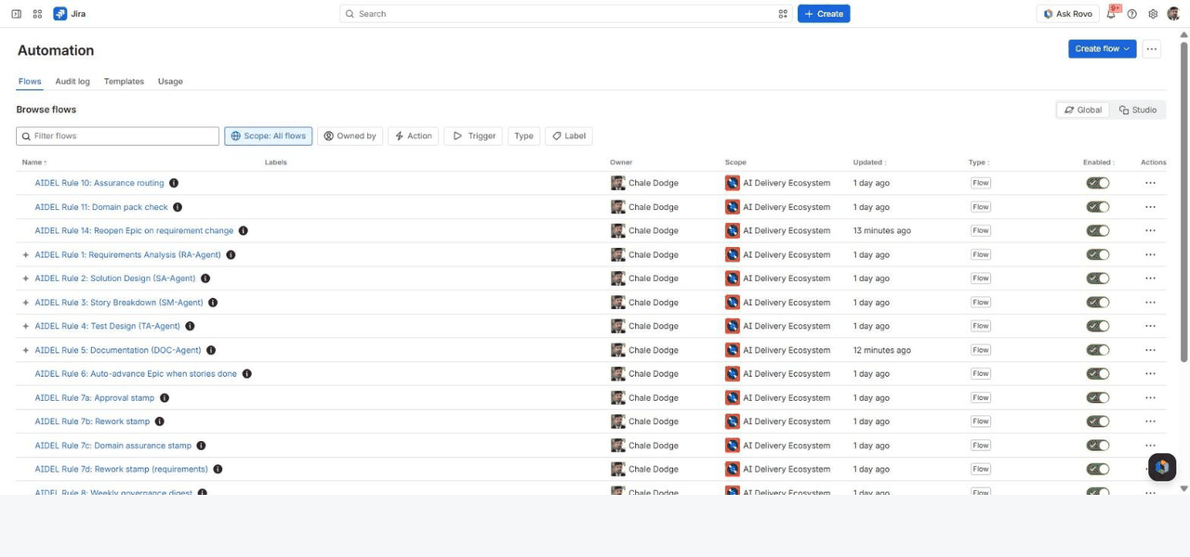
AIDEL-57 · WALKTHROUGH
SCREEN › AUTOMATION › ALL AIDEL RULES
JIRA
RULE
All AIDEL rules, live in Jira Automation
1/11
Rules marked ⚡ call a Rovo agent. All are enabled and owned by you; non-agent rules run as 'Automation for Jira'.
Notes:
All AIDEL rules, live in Jira Automation. Rules marked ⚡ call a Rovo agent. All are enabled and owned by you; non-agent rules run as 'Automation for Jira'.
10

Slide 11
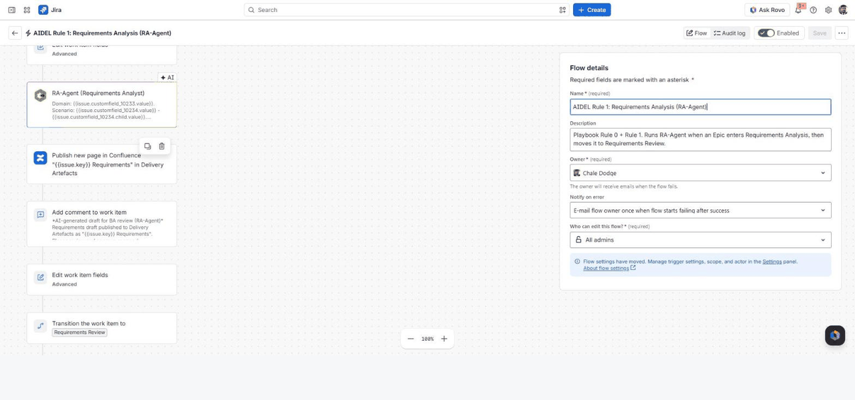
AIDEL-57 · WALKTHROUGH
SCREEN › AUTOMATION › RULE 1: REQUIREMENTS ANALYSIS
JIRA
AGENT
Inside Rule 1: the RA-Agent step
2/11
Epic → Requirements Analysis. Domain, Scenario and BA Notes go to the RA-Agent; the rule publishes its answer to Confluence, comments, and moves to Requirements Review.
Notes:
Inside Rule 1: the RA-Agent step. Epic → Requirements Analysis. Domain, Scenario and BA Notes go to the RA-Agent; the rule publishes its answer to Confluence, comments, and moves to Requirements Review.
11

Slide 12
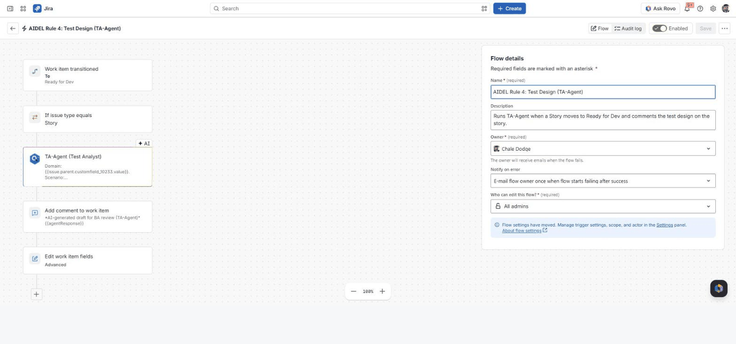
AIDEL-57 · WALKTHROUGH
SCREEN › AUTOMATION › RULE 4: TEST DESIGN
JIRA
AGENT
Inside Rule 4: the TA-Agent step
3/11
Story → Ready for Dev. The TA-Agent designs test cases for that story; they become sub-tasks and a comment for BA review.
Notes:
Inside Rule 4: the TA-Agent step. Story → Ready for Dev. The TA-Agent designs test cases for that story; they become sub-tasks and a comment for BA review.
12

Slide 13
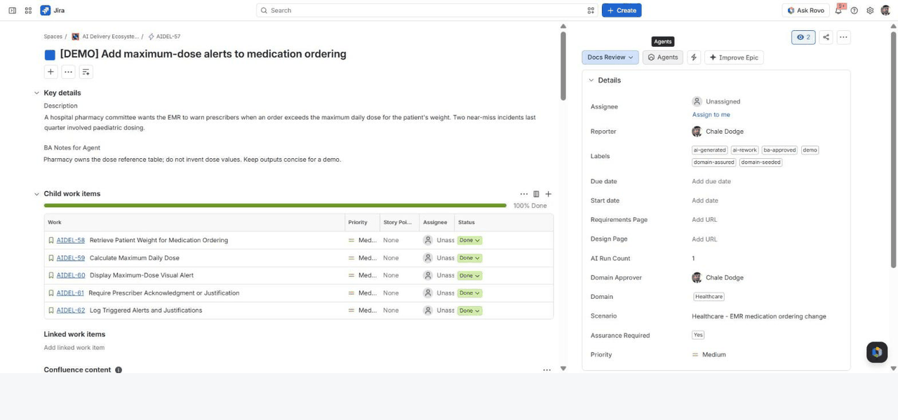
AIDEL-57 · WALKTHROUGH
SCREEN › EPIC AIDEL-57
JIRA
OVERVIEW
The epic: AIDEL-57
4/11
Five stories created by the SM-Agent, all Done. Domain Healthcare → Assurance Required = Yes, so this epic passed four BA gates.
Notes:
The epic: AIDEL-57. Five stories created by the SM-Agent, all Done. Domain Healthcare → Assurance Required = Yes, so this epic passed four BA gates.
13

Slide 14
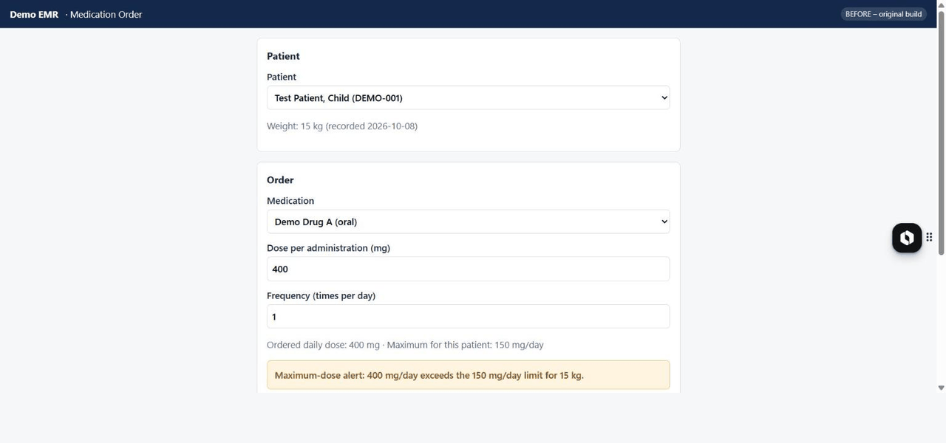
AIDEL-57 · WALKTHROUGH
SCREEN › MEDICATION ORDER (BEFORE)
DEMO EMR
APP
BEFORE: 400 mg/day only gives a warning
5/11
Limit for a 15 kg child is 150 mg/day. The original build shows an amber alert and lets the prescriber override with a justification.
Notes:
BEFORE: 400 mg/day only gives a warning. Limit for a 15 kg child is 150 mg/day. The original build shows an amber alert and lets the prescriber override with a justification.
14

Slide 15
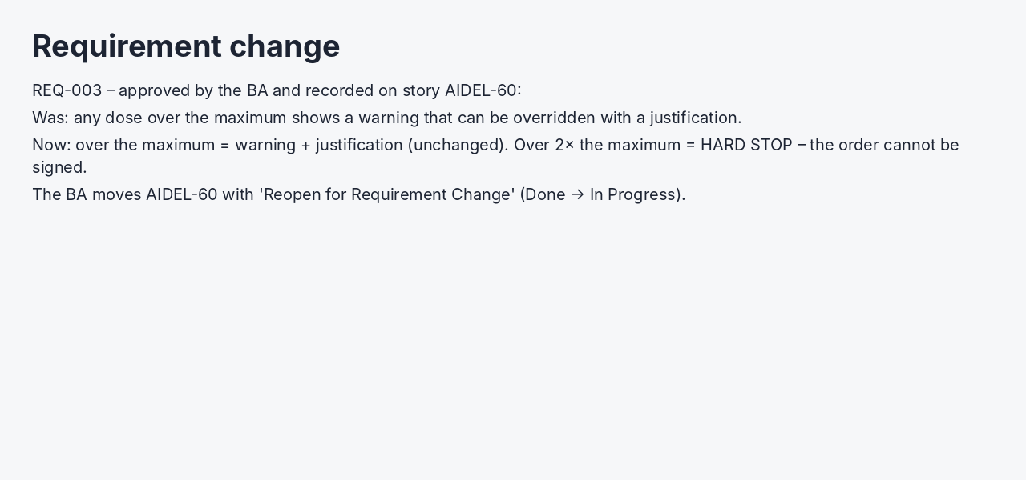
AIDEL-57 · WALKTHROUGH
SCREEN › REQ-003 ON AIDEL-60
REQUIREMENT CHANGE
GATE
The BA records the change and reopens the story
6/11
Only the affected story is reopened – nothing else is rebuilt.
Notes:
The BA records the change and reopens the story. Only the affected story is reopened – nothing else is rebuilt.
15

Slide 16
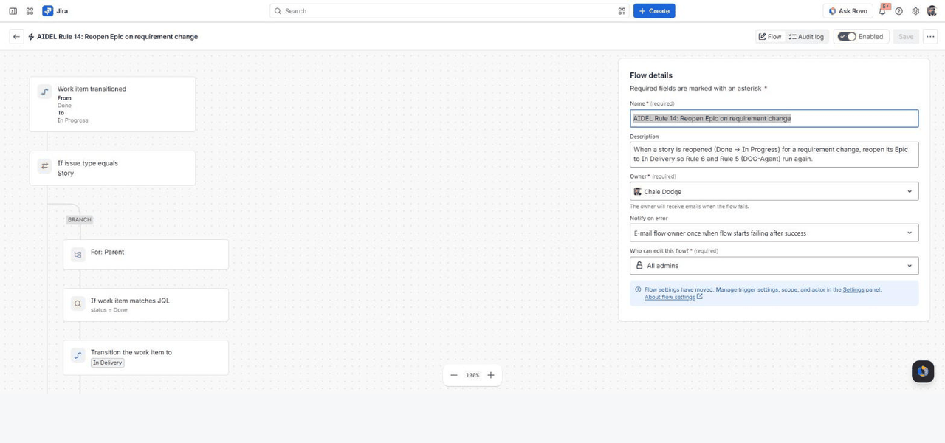
AIDEL-57 · WALKTHROUGH
SCREEN › AUTOMATION › RULE 14: REOPEN EPIC
JIRA
RULE
Rule 14 reopens the epic automatically
7/11
A story goes Done → In Progress. The rule moves the parent epic back to In Delivery, so the documentation step will run again.
Notes:
Rule 14 reopens the epic automatically. A story goes Done → In Progress. The rule moves the parent epic back to In Delivery, so the documentation step will run again.
16

Slide 17
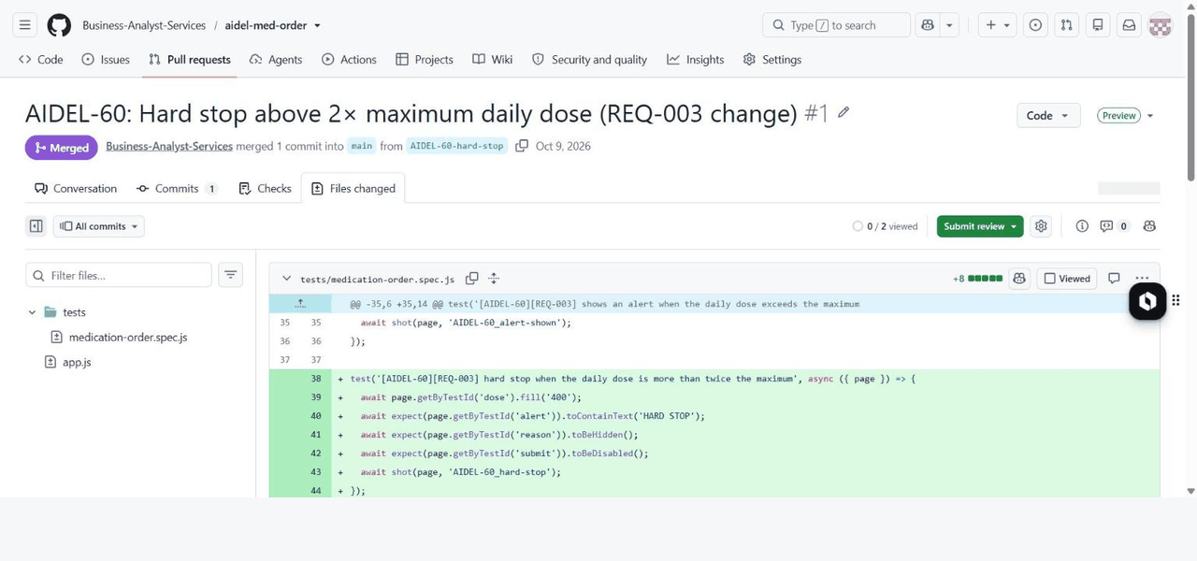
AIDEL-57 · WALKTHROUGH
SCREEN › AIDEL-MED-ORDER › PULL REQUEST #1
GITHUB
PIPELINE
The coding step: a pull request for AIDEL-60
8/11
Branch AIDEL-60-hard-stop changes app.js and adds a test tagged [AIDEL-60][REQ-003]. Vercel builds a preview.
Notes:
The coding step: a pull request for AIDEL-60. Branch AIDEL-60-hard-stop changes app.js and adds a test tagged [AIDEL-60][REQ-003]. Vercel builds a preview.
17

Slide 18
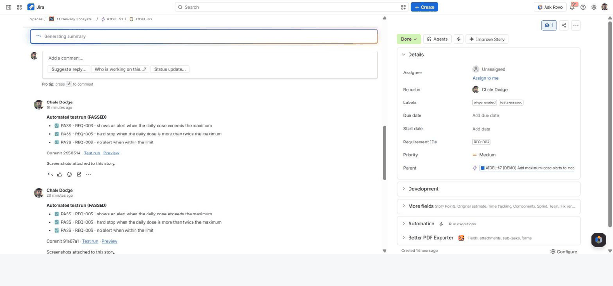
AIDEL-57 · WALKTHROUGH
SCREEN › STORY AIDEL-60 › TEST RESULTS
JIRA
PIPELINE
Tests actually run – results land on the story
9/11
GitHub Actions ran the Playwright tests, posted PASS per requirement, attached screenshots, labelled 'tests-passed' and moved the story to Build Review.
Notes:
Tests actually run – results land on the story. GitHub Actions ran the Playwright tests, posted PASS per requirement, attached screenshots, labelled 'tests-passed' and moved the story to Build Review.
18

Slide 19
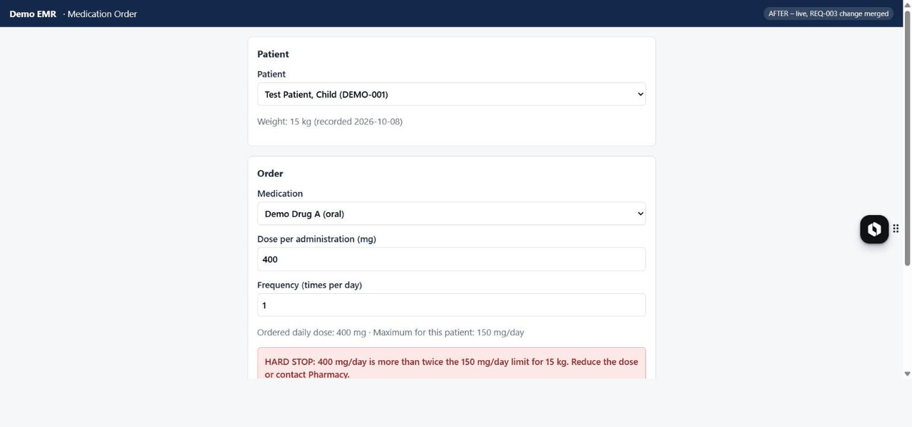
AIDEL-57 · WALKTHROUGH
SCREEN › MEDICATION ORDER (AFTER)
DEMO EMR
APP
AFTER: the same order is now a HARD STOP
10/11
The BA checks the preview, clicks Approve Build (gate), and the PR is merged. Sign order stays disabled above 2× the limit.
Notes:
AFTER: the same order is now a HARD STOP. The BA checks the preview, clicks Approve Build (gate), and the PR is merged. Sign order stays disabled above 2× the limit.
19

Slide 20
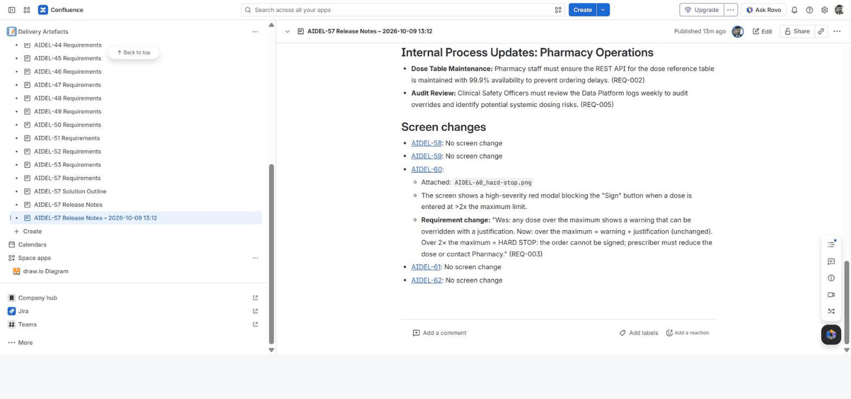
AIDEL-57 · WALKTHROUGH
SCREEN › AIDEL-57 RELEASE NOTES
CONFLUENCE
AGENT
DOC-Agent: release notes with 'Screen changes'
11/11
Rule 6 moves the epic to Documentation and Rule 5 runs the DOC-Agent. It names the new screenshot and quotes the Was/Now change for BA review.
Notes:
DOC-Agent: release notes with 'Screen changes'. Rule 6 moves the epic to Documentation and Rule 5 runs the DOC-Agent. It names the new screenshot and quotes the Was/Now change for BA review.
20

Slide 21
BAS
Business Analyst Services
PRACTICE LEADERSHIP · TRAINING · ADVISORY
AUDIT TRAIL
Traceability
you can audit
01
02
03
04
05
REQ-003
→
Story
→
Tests
→
Evidence
→
Help page
Requirement
Gherkin AC
TS sub-tasks
Pipeline run
Published by BA
Coverage checks catch any Must REQ with no story or test.
Page versions show exactly what the BA changed.
✓
BAS · AIDEL
|
Five Rovo agents, one BA · Atlassian Community Sydney · 21
Notes:
21

Slide 22
BAS
Business Analyst Services
PRACTICE LEADERSHIP · TRAINING · ADVISORY
DOMAIN VARIATIONS
Same pipeline,
The five agents stay the same. The knowledge, the gate approvers and the heaviest agent change.
any industry
Healthcare
Fintech
Insurance
Government
Logistics
EXTRA GATE
EXTRA GATE
EXTRA GATE
EXTRA GATE
EXTRA GATE
Clinical safety officer
Risk & compliance
Claims / underwriting lead
Policy owner, procurement
Operations manager
HEAVIEST AGENT
HEAVIEST AGENT
HEAVIEST AGENT
HEAVIEST AGENT
HEAVIEST AGENT
RA + TA
TA
RA
RA + DOC
SA
DATA SENSITIVITY
DATA SENSITIVITY
DATA SENSITIVITY
DATA SENSITIVITY
DATA SENSITIVITY
Very high
Very high
High
High
Low–med
✓
BAS · AIDEL
|
Five Rovo agents, one BA · Atlassian Community Sydney · 22
Notes:
22

Slide 23
BAS
Business Analyst Services
PRACTICE LEADERSHIP · TRAINING · ADVISORY
MEASURES TO TRACK
ROLLOUT
BA edit rate
Falling
Start small,
measure everything
Rework runs / epic
< 1
Uncovered REQs
0
WEEKS 1–4
WEEKS 5–8
THEN
Pilot
Extend
Scale
Cycle time
↓ vs baseline
One team, one BA, first three agents. The BA rewrites freely.
Add test and documentation agents; tune from BA edit history.
Template config and agents for other teams; review guardrails quarterly.
Escalations
Stable
✓
BAS · AIDEL
|
Five Rovo agents, one BA · Atlassian Community Sydney · 23
Notes:
23

Slide 24
BAS
THANK YOU
Questions?
Let's build it together
▶ GET THE PLAYBOOK
business-analyst.services · Chale Dodge, Lead BA & Practice Lead
✓
HUMAN AT EVERY GATE
|
Agents draft. Only a Business Analyst approves.
Notes:
24

