Slide 1
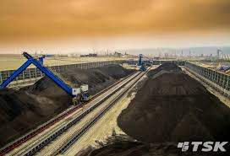
Coal Stock Yard Management

Slide 2
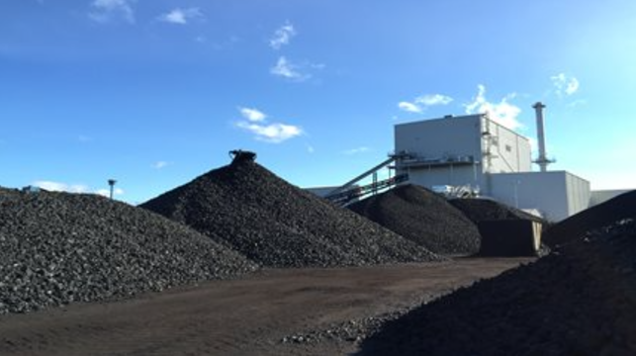


COAL STOCK YARD MANAGEMENT
Pile GCV
Aging
GCV
BLEND
Stack
B
T
T
B
B
T
T
B
D
3002
3247
3247
3247
3247
3247
2927
HEALTHY
C
3247
3247
3001
3647
3247
3247
B
3247
3547
3947
3047
3847
2947
3247
A
NOT HEALTHY
3997
3747
3047
3447
2847
3747
3100
3847
PILE 1
PILE 2
PILE 3
PILE 4
3250
3421
3112
Pile wtd GCV
Top wtd GCV
Bottom wtd GCV

Slide 3
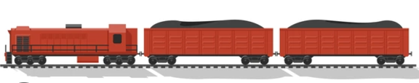
COAL STOCK YARD MANAGEMENT
Direct feed , blending and stalking decision
Aging
GCV
BLEND
Stack
Direct feeding
Direct feeding with blending
Stalking
 | Quantity top | GCV top | GCV BTM | Aging | Blending possibility @ 20% | Blending possibility @ 15% | Blending possibility @ 10% | PRIORITY
PILE 1A | 10140 | 3410 | 3148 | 40 | 3082 | 0 | 0 | 2
PILE 1B | 21723 | 3043 | 2773 | 41 | 0 | 0 | 0 | 0
PILE 1C | 10680 | 3502 | 3552 | 40 | 3100 | 3075 | 0 | 2
PILE 1D | 14369 | 3529 | 3383 | 36 | 3106 | 3079 | 0 | 2
PILE 2A | 7950 | 2655 | 2655 | 8 | 0 | 0 | 0 | 0
PILE 2B | 8405 | 3318 | 3318 | 7 | 0 | 0 | 0 | 0
PILE 2C | 8800 | 3324 | 3129 | 38 | 0 | 0 | 0 | 0
PILE 2D | 7506 | 3637 | 3637 | 6 | 3127 | 3096 | 0 | 1
PILE 3A | 10277 | 3091 | 3091 | 57 | 0 | 0 | 0 | 0
PILE 3B | 3032 | 3173 | 3022 | 77 | 0 | 0 | 0 | 0
PILE 3C | 3348 | 3153 | 3083 | 10 | 0 | 0 | 0 | 0
PILE 3D | 10173 | 3301 | 3204 | 13 | 0 | 0 | 0 | 0
PILE 4A | 12261 | 3079 | 3235 | 29 | 0 | 0 | 0 | 0
PILE 4B | 9297 | 3545 | 3322 | 46 | 3109 | 3082 | 0 | 2
PILE 4C | 5202 | 3338 | 3566 | 43 | 0 | 0 | 0 | 0
PILE 4D | 2237 | 3248 | 3371 | 38 | 0 | 0 | 0 | 0
WT | 4000 | 3200 | 3200 | 0 | 0 | 0 | 0 | 0
Incoming coal
Spur-5
Incoming GCV last 5
3000
Allowed GCV deviation
5%
Required GCV range 3470 -3130
Direct feeding with blending suggestion

