Slide 1
Hypothesis Testing
Inferential statistics

Slide 2
Inferential statistics
Inferential statistics allow us to directly test our hypothesis by evaluating our research question based on a sample, with the goal of generalizing the results to the larger population from which the sample was drawn.
Statistical hypothesis testing is defined as assessing evidence provided by the raw data in favor of or against each hypothesis about the population.
Probability is the underlying foundation of all statistical methods, so we must talk about it first.

Slide 3
Probability
Ideally, the sample should be random so that it might better represent the entire population.
Not all random samples are ideal, no random sample will be the exactly the same as any other.
We cannot know how “ideal” a random sample from a population is. This uncertainty means that we must quantify how much we expect a random sample to vary.
This allows us to draw conclusions about the population in the face of uncertainty when we use random samples.

Slide 4
Probability
We are interested in estimating the percentage of US adults who favour the death penalty.
We choose a random sample of 1,200 US adults and ask their opinion.
744 out of 1200, or 62% are in favour.
Our goal is to infer/draw conclusions about the opinions of US adults regarding the death penalty.
Based on 1200 US adults can we absolutely conclude that 62% of the population favours the death penalty?

Slide 5
Probability
Another random sample could give a very different result, so we are uncertain.
Since our sample is random we know the uncertainty is due to chance. Not due to sampling method.
Therefore we can use probability to describe the likelihood that our sample is within the desired level of accuracy.
How likely is it that our conclusion is within 3% of the ACTUAL percentage of ALL US adults who are in favour of the death penalty?

Slide 6
Probability
The answer to that question has an important impact on the confidence we can attach to the inference step.
Probability is the likelihood of something occurring; of an event occurring; the chance of something happening.
It is a mathematical description of randomness and uncertainty.
It is a way to measure or quantify uncertainty.
It is the official name for chance.

Slide 7
Probability
Gambling industry:
Cutting a deck of cards:
what are the chances that it going to be red?
what are the chances of it being a spade?
what are the chances of it being a King?
what are the chances of it being a King or a Club?
what are the chances of it being a King and being a Club?

Slide 8
Probability
The probability of an event ranges from 0 to 1.
A probability of 0 means that the event has zero chances of happening. It will never occur.
A probability of 1 means that the event will occur for certain.
A probability of .5 indicates that the event has a 50% chance of happening. The event is as likely to occur as not to occur.

Slide 9
Probability
Any probability that is greater than .5 indicates that the event is more likely to occur than it is not to occur.
Any probability that is less than .5 indicates that the event is more likely not to occur than it is to occur.
Expressing probability in percentages is very common.
The chance that an event will occur is between 0% and 100%.

Slide 10
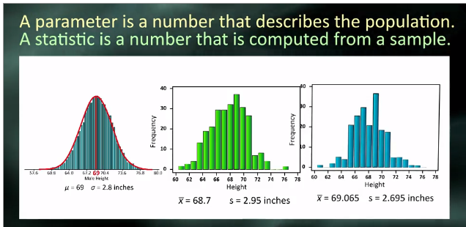
Central Limit Theorem
The parameter is 69 inches.
The statistic for sample 1 is 68.7 inches.
The statistic for sample 2 is 69.25 inches
Parameters are typically unknown.

Slide 11
Central Limit Theorem
Sampling variability
As we have already stated each random sample is different. The more random samples we use then the greater the picture of the population.
We calculate statistics from each sample, such as mean, std dev etc
Suppose we know the actual mean of the total male population height to be 69 inches. We select 30 random samples from the population, each sample size being 500.
Each sample would have slightly different mean, 68.5, 69.25 etc.
If we plotted these together we would have a normal distribution.

Slide 12
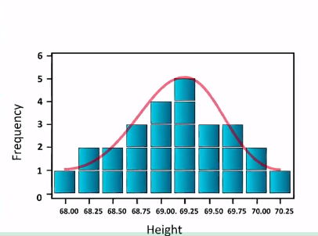
Central Limit Theorem

Slide 13
Central Limit Theorem
As long as adequately large samples and an adequately large number of samples are drawn from a population, the distribution of the statistics of the samples, whether of mean, proportion, standard deviation, or any other statistic, will be normally distributed.

Slide 14

Hypothesis Testing
This method is used when we want to make decisions concerning populations on the basis of only sample information.
Analysis of variance test, ANOVA, Chi-Square test of independence.
Same steps:
Specifying null hypothesis $H_{0}$
specifying the alternate hypothesis $H_{a}$
Choose sample, assess evidence, draw conclusion.

Slide 15

Hypothesis Testing
NESARC data set
Representative sample of 43,093 adults in U.S
Evaluate if there is an association between a diagnosis of major depression and how much a person smokes.
Step 1: Hypotheses
$H_{0}$ There is no difference in smoking quantity between people with and without depression.
$H_{a}$ There is a difference in smoking quantity between people with and without depression.

Slide 16
Hypothesis Testing
The null hypothesis says that nothing special is going on between the two variables, they are unrelated.
The alternative says there is a relationship, it could be positive or negative.
Step 2 Choose a sample:
We are going to use the nesarc data set. We are going to evaluate the hypothesis among individuals who are smokers and who are younger (aged between 18 and 25).
The sample size is 1320

Slide 17
Hypothesis testing
Assess evidence – draw conclusion
The p-value for a test is an estimate of how often we would get the obtained result by chance if in fact the null hypothesis is true.
The mean number of cigarettes smoked is 13.9 std dev 9.2 for those with depression.
the mean number of cigarettes smoked is 13.2 std dev 8.5 for those without depression.
The probability of getting a difference of .7 cigarettes smoked per day in a random sample of 1320 is roughly 17%
This means if we took 100 different random samples from the population and we rejected the null hypothesis each time, we would be wrong 17 times. (there would be 17 times the results would show a relationship but in fact there is none).
Is 17% small enough to reject the null hypothesis?

