Slide 1
Business Process Simulations - THE VALUE -
Razvan Radulian, MBA
Independent Consultant/Coach/Trainer
Why-What-How Consulting, LLC
W5HY.com

Slide 2
PICTURE THIS...
Hypothetical (…more or less) CHALLENGE:
Can a CRO* reduce its RFP/Proposal+Start-up processes from 15+30 to 5+15 days?
Some of the MANY variables to consider:
Huge stakes:
Sponsor: $600K to $8M loss per delayed-day
CRO: WIN (if profitable) or DIE (if miscalculating operational timelines and/or costs)!
Large number & diversity of players
Many AND very complex processes
Aggressive competition
Global operations
Complex Regulatory environment(s)
* CRO: Clinical Research Organization

Slide 3
How would we (YOU) handle that?
“Hmm,
I don’t know”
Is it…
…?!?

Slide 4
Another approach…
“I don’t know, but
LET’S TRY”
Can it be…
…?

Slide 5
WHY: Reasons & Expectations
PAST EXPERIENCE
What prevented us (the world without Simulations):
Too COMPLEX
Too UNCERTAIN
Too many INTERDEPENDENCIES
Myths & fears...
FUTURE EXPECTATIONS
What are we trying to achieve?
Understand & Communicate
Validate the Process Model(s)
Exploration & Experimentation
Facilitate Decisions:
Design choices
Managing Operations
Avoid the UNEXPECTED
Accept/ignore the UNEXPLAINED
EXPECT+EXPLAIN the UNEXPECTED

Slide 6
WHEN NOT TO DO IT…
Unclear Goals
Better Alternatives
Can’t Model Reality
SIMULATIONS MIGHT NOT BE THE BEST OPTION!
Alternative methods that are:
Better
Cheaper
Easier to implement/execute
Not sure why we [want to] do it…
Risks too high if tinkering with something that looks like “reality”, BUT it is not
More…

Slide 7
WHAT IS IT?
Goals & Objectives
Discover
Model
Simulate
Analyze
Optimize
Part of a larger process…

Slide 8
WHAT IS IT?
Based on Type of Analysis
Types of Simulation
Process Validation
Structural Analysis
Resource Analysis
Time Analysis
Calendar Analysis
Based on Areas of Use
Operations Management
Exploratory
Design

Slide 9
WHAT IT IS NOT
Not the Real “Thing”
Process Modeling
Pure Mathematics
Pure Testing
Guess-work
Related but not the same…

Slide 10
MYTHS: WHAT WE FEAR IT IS
Expensive
Hard to understand
Risky
Hard to do
Can’t be done with partial data
Needs tons of data
Something only Statisticians can do
“Some” fears/concerns…

Slide 11
Simulation vs. Alternatives
Experimenting with the Real Thing/Process:
Do we actually have a/the REAL THING?
Technically/operationally possible?
Convenient? Any distractions?
Can we afford it (costs, resources…)?
Can we control it? Too risky?
Do we have enough time?
Too long to even try it?
Politically/strategically possible?
Any possible misinterpretations?
Can competitors find out about it?

Slide 12
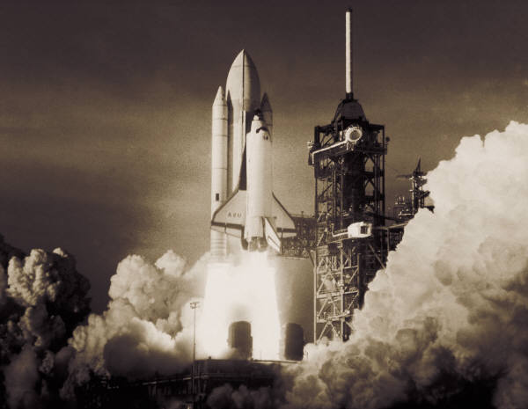
Simulation vs. Alternatives
Using Mathematical Models:
Possible?
Do we have the Knowledge?
Do we have the “Rocket scientist”?
Do we have the Data?
Too complex?
Any moving parts?
Any complex interdependencies?
Predictable? Any uncertainties?
Our we certain about these… uncertainties?
Do we even understand/model the data behind this model?

Slide 13
Simulation vs. Alternatives
Guessing (“What do we THINK it would happen?”)
Is it even possible?
How can we tell if we are right?
If wrong, how risky is it?
Who knows enough (to make a smart guess)?
Any differences of opinion? Do we all agree?
How many chances do we have (before we get it right)?

Slide 14
Myths
Limited applicability
Too complex
Too expensive (to setup and run)
Too expensive (tools)
Only highly specialized people (the SIM-experts) can do it
There are ALWAYS easier ways to do it (using other methods)
Simulations are THE ONLY WAY to do it…

Slide 15
HOW
Process Modeling
Data:
In: Parameters
Out: Results
Analysis:
Multi-level Analysis
Scenarios & What-If Analyses
Interpretation:
Unexpected (OK) vs. Unexplained (not OK!)
Options/ideas to optimize
Standards & Best Practices
Tools

Slide 16
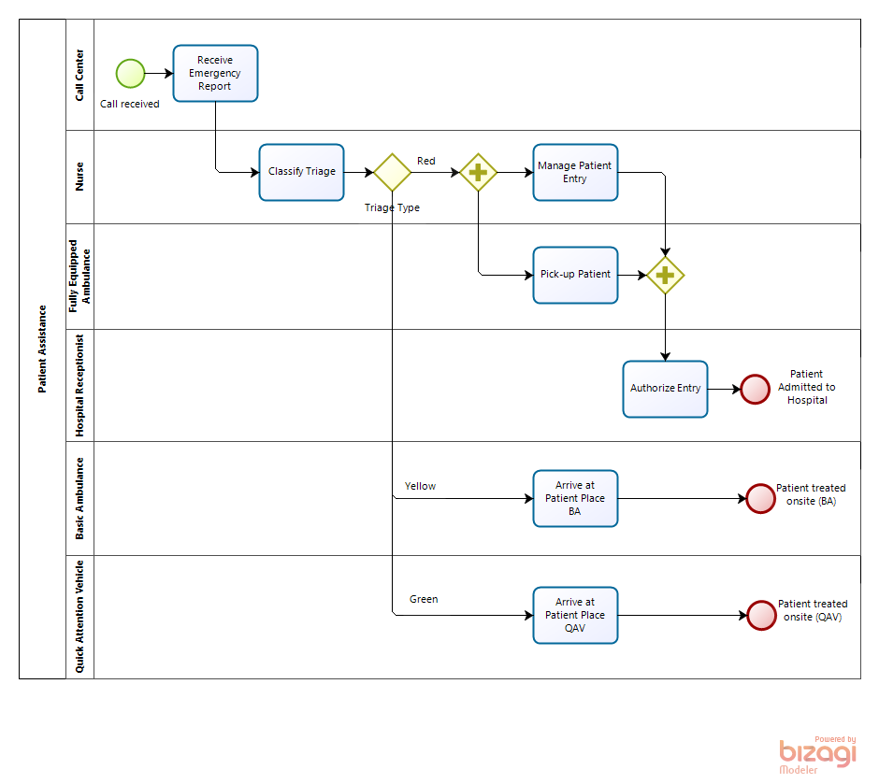
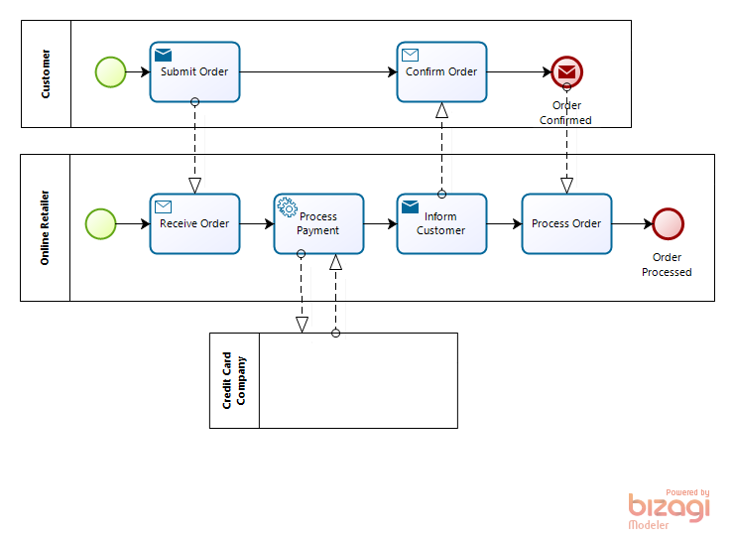
Process Model(s) [BPMN]
Core Process Elements:
Activities:
Tasks
Sub-Processes
Decisions/Gateways:
Exclusive work (either A or B)
Parallel work (A and B)
Optional work (A and/or B and/or C)
Events:
Start + Trigger
End (Waiting or Terminating)
Intermediate (e.g. Delays, Messages, etc.)
Interrupting (e.g. Timers, Exceptions, Cancellations, etc.)
Work coordination:
Orchestration (within Processes)
Collaboration (between Processes)

Slide 17
Progressive Levels of Analysis
Process Validation:
Deadlocks
Infinite loops
Branches that are never used
Logic faults (e.g. unexpected work items/tokens)
Time & Throughput Analysis:
Processing & Cycle Times
Resources & Constraint Analysis:
Resource Capacity & Over/Under Utilization
Delays (due to waiting on available resources)
Costs (fixed & variable)
Calendar:
Resources availability by Calendar Periods
“Does it even make sense?”
“Can it be done?”
“How long would it take?”
“Can we do it?”
“Can we afford it?”
“Can we do it better?”
“What’s the best way?”

Slide 18
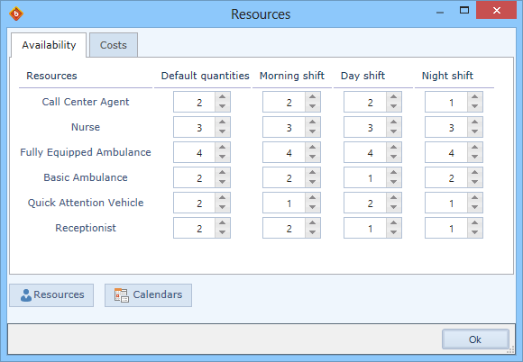
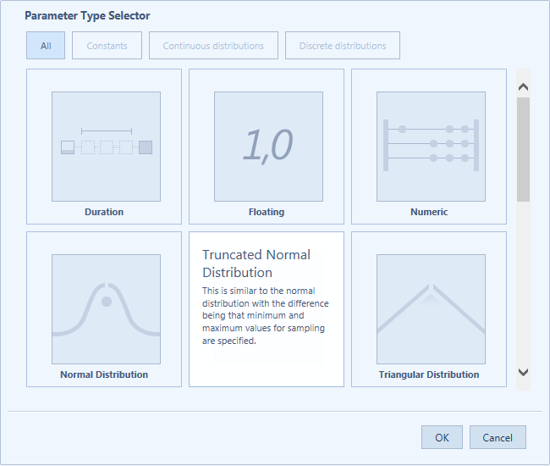
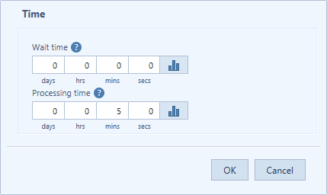
Simulation Data
Inputs (parameters):
Historical data
Estimates (constant)
Probabilistic/Statistical (distributions)

Slide 19
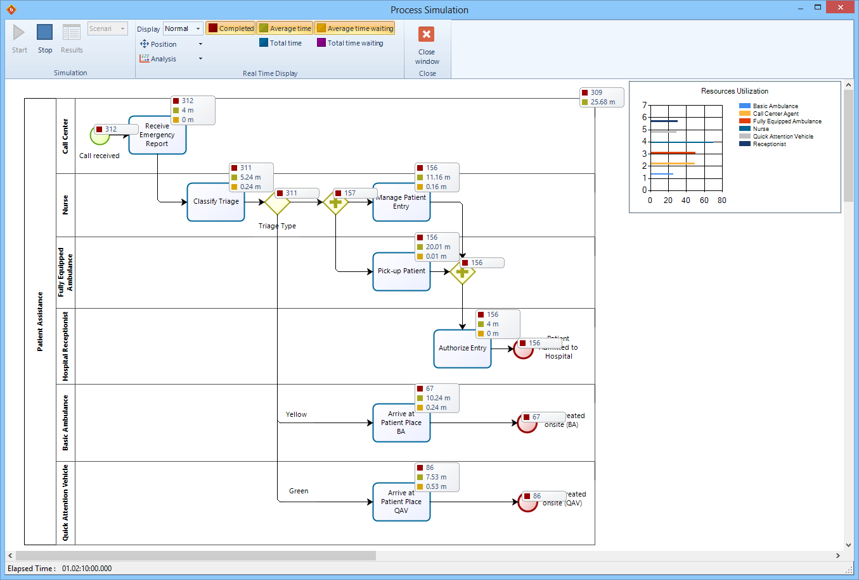
Visualizing the Data/Results
“Real-Time” (accelerated) data:
Animation
Items processed
Items waiting (to be processed)
Utilization Graphs
Etc.

Slide 20
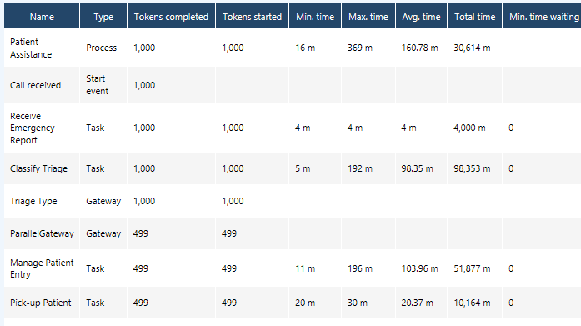
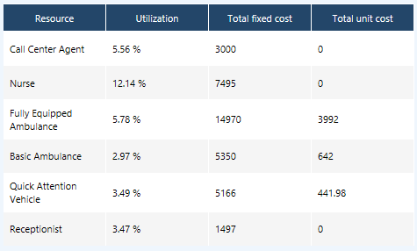
Outputs/Results:
Time Estimates
Resource Estimates
Capacity Estimates

Slide 21
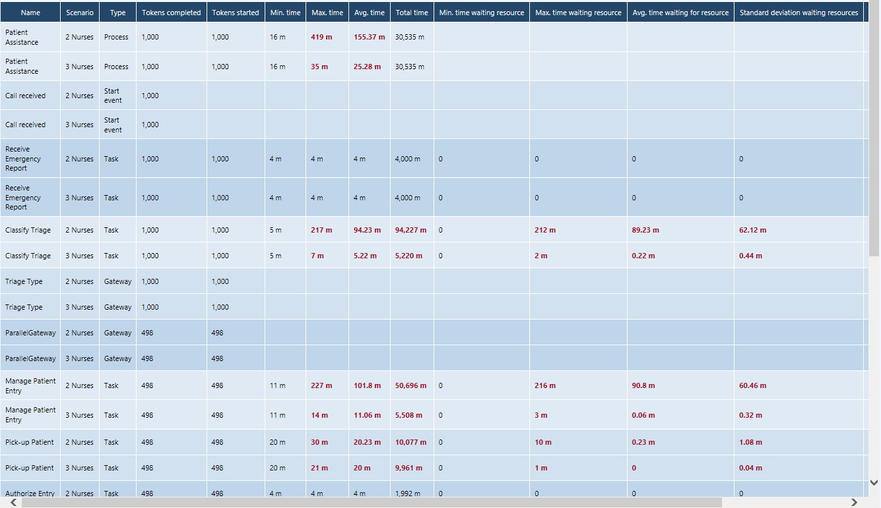
Scenarios & What-If Analyses (“2 or 3 Nurses?”)
Timing

Slide 22
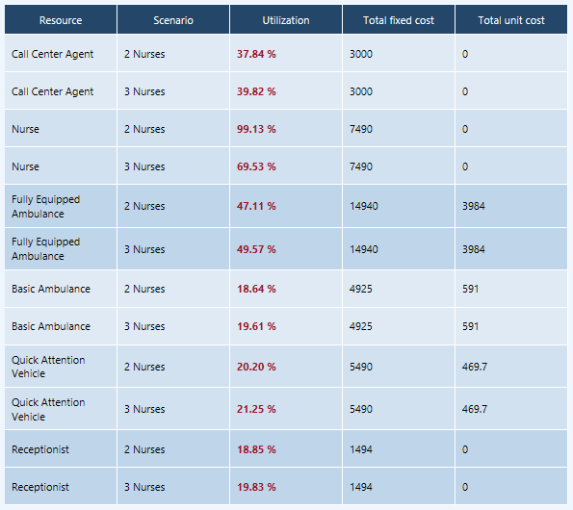
Scenarios & What-If Analyses (“2 or 3 Nurses?”)
Resources

Slide 23
LEVEL 0: BPMN VALIDATION
What are we looking for?
Verify BPMN Specification conformity
“Are we even communicating in the same language?

Slide 24
LEVEL 1: PROCESS LOGIC/STRUCTURE
What are we looking for?
Deadlocks
Infinite loops
Branches that are never used
Logic faults (e.g. unexpected work items/tokens):
Anti-patterns
“Have we modeled it in a way that makes sense?”

Slide 25
LEVEL 2: TIME ANALYSIS
Assumptions:
Level 1 assumptions +
Unlimited resources
No Costs associated with either Resources or Activities
What are we looking for?
Level 1 results (i.e. valid BPMN & Logic) +
Cycle-Time
Processing Time
Preliminary “Critical Path”
“How much time will it take?”

Slide 26
LEVEL 3a: TIME + RESOURCES ANALYSIS
Assumptions:
Level 2 assumptions +
Resources ARE limited
Resources are either People or other kind of Resources (e.g. systems, materials)
What are we looking for?
Level 2 results +
Waiting times (delays) due to Resources not being available, Critical Path
Resource Over and Under-Utilization
“Can we do it?”

Slide 27
LEVEL 3b: TIME, RESOURCES + COST ANALYSIS
Assumptions:
Levels 2, 3a assumptions +
Variable-Costs associated with Resources (e.g. hourly rate)
Fixed-Costs associated with Activities (e.g. materials)
What are we looking for?
Levels 2, 3a results +
Costs to perform the process
“Can we afford it?”

Slide 28
LEVEL 4: RESOURCES, TIME, COSTS + CALENDAR ANALYSIS
Assumptions:
Level 3 assumptions +
Resources Availability varies by Calendar Periods (e.g. Shifts)
What are we looking for?
Level 3 results +
Optimizing Costs & Resource Utilization
Identify Critical Time/Calendar Periods
Again…
“Can we do it?”
“Can we afford it?”

Slide 29
LEVEL 5: SCENARIOS & WHAT-IF ANALYSIS
Assumptions:
Level 4 assumptions +
Some scenarios may work better (or worse) than others
What are we looking for?
Level 4 results +
Optimization:
Compare various alternate scenarios
Chose BEST alternative/option
“Can we do it better?”
“What’s the best way?”

Slide 30
Remember this? … could we do it without Simulations?
Hypothetical (…more or less) CHALLENGE:
Can a CRO* reduce its RFP/Proposal+Start-up processes from 15+30 to 5+15 days?
Some of the MANY variables to consider:
Huge stakes:
Sponsor: $600K to $8M loss per delayed-day
CRO: WIN (if profitable) or DIE (if miscalculating operational timelines and/or costs)!
Large number & diversity of players
Many AND very complex processes
Aggressive competition
Global operations
Complex Regulatory environment(s)
* CRO: Clinical Research Organization

Slide 31
Standards and Best Practices
BPMN: http://www.bpmn.org/
BPSim: http://www.bpsim.org/
Patterns and Anti-Patterns

Slide 32
Tools
Many available tools:
Commercial
Open-source*
But, be aware…
… look for GOOD tools, not “just” GREAT!
* The tool and some of the examples used in this presentation were from Bizagi (Bizagi.com)

Slide 33
DEMOS & EXAMPLES
"Simple" case: Patient Assistance Process*
Complex cases: just imagine (see next)
* Source: Bizagi.com

Slide 34
SO…
What does all this mean to you?
Business Process Simulation and:
Business Analysis
Risk Management
Project Management
More (e.g. Innovation, Business Intelligence, Knowledge Management, Feasibility Studies…)

Slide 35
Some bits of ADVISE
Start SMALL
Start SIMPLE
EXPERIMENT, SHARE, INTERPRET
ADJUST
Expand SCOPE
Add more PATTERNS, more COMPLEXITY…
REPEAT
… use ITERATIVE & INCREMENTAL approach
(for PMs: progressive elaboration)

Slide 36
Q&A

Slide 37
THANKS & CONTACT INFO
Mr. Razvan Radulian
… better know as Razz:-)
razvan.radulian@why-what-how.com or razvan@w5hy.com
LinkedIn: whywhathow
Twitter: @w5hy
Blog: w5hy.com

