Slide 1

Creation of Workforce Insights Dashboard for Employee Skill and Analytics
An Intelligent Platform for Centralized Workforce Management, Analytics, Automation & Reporting
Organization
Infosys SpringBoard VirtualInternship 7.0

Slide 2
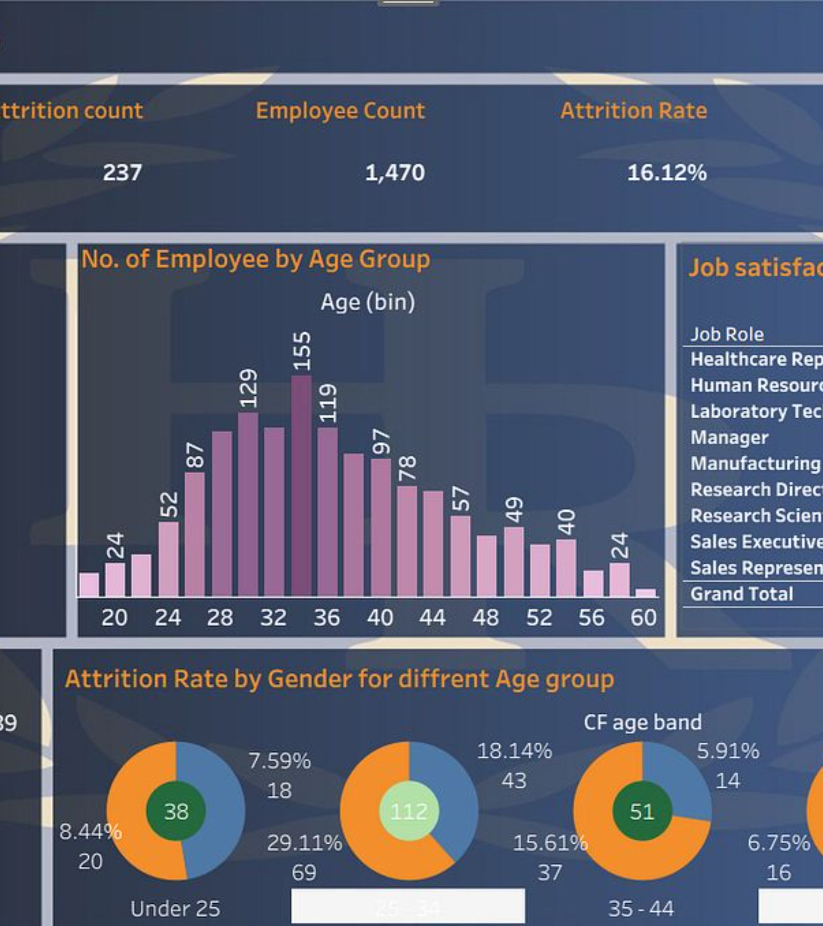


From Manual Workforce Management to Intelligent Workforce Operations
Current Challenges
Project Objective
To create a centralized platform that combines workforce management, analytics, reporting and automation.
Scattered Data
Workforce information may exist across multiple disconnected sources.
Centralize — Unified workforce information
Manual Processing
Analyze — Convert data into insights
Manual processing consumes significant time and introduces errors.
Automate — Reduce repetitive operations
Report — Generate structured reports
Repetitive Reporting
Reports can be repetitive and time-consuming to prepare.
Delayed Insights
Managers need faster access to workforce insights from raw data.

Slide 3
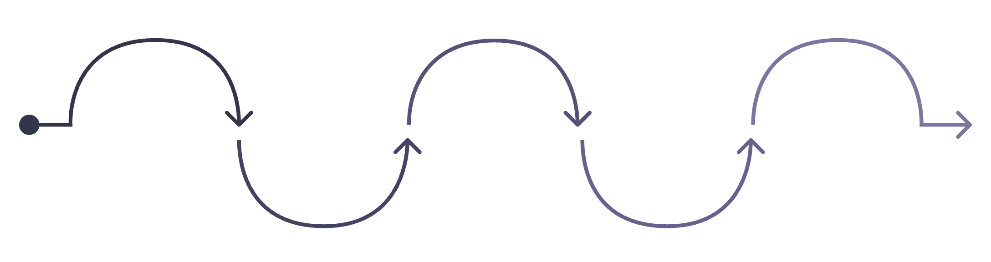
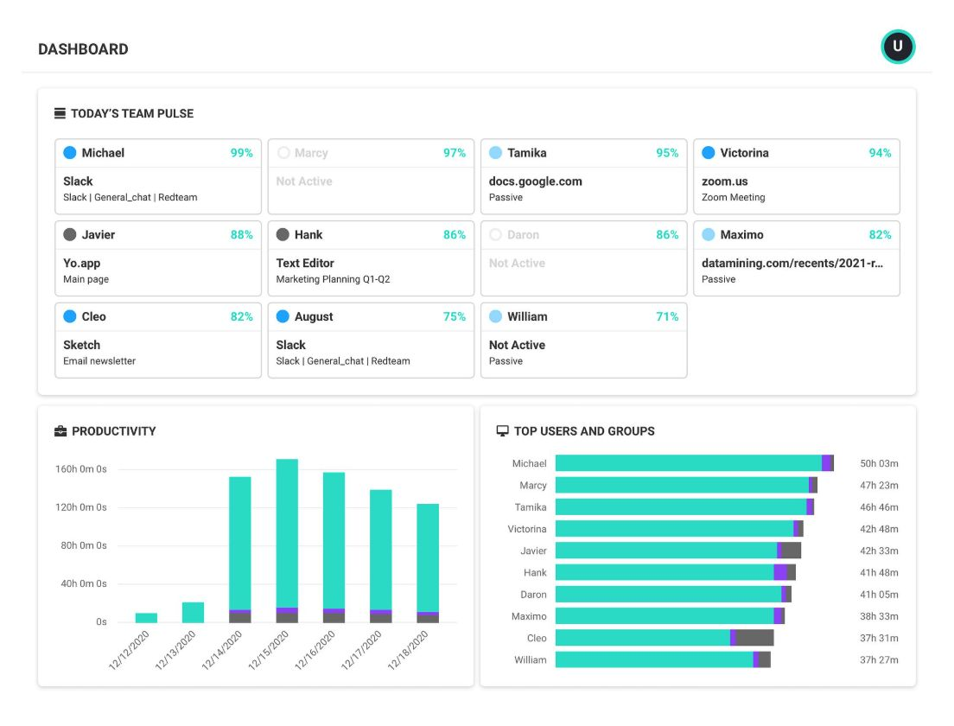

Our Proposed Solution
A centralized digital ecosystem that brings workforce information, employee operations, analytics, reporting and automation together in a single system.
Workforce Management
Analytics & Reporting
Workforce Data
Employee Management
Operational coordination and scheduling
Employee
Insights, dashboards and automation
Management Insights
Centralized employee information
HR actions and lifecycle tools
Actionable decisions and outcomes
Key Value: One platform → One workforce view → Faster insights → Better decisions

Slide 4

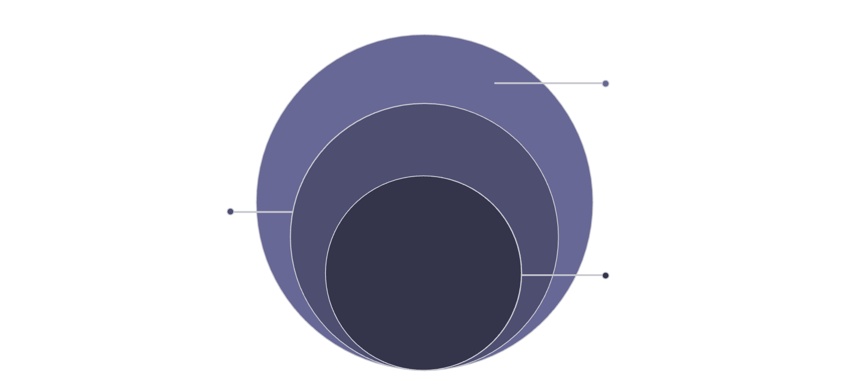




System Architecture & Technology Stack
Technology Stack
Frontend
React · TypeScript · Vite · Tailwind CSS · Shadcn/UI
API & Backend
Backend
REST API, Python, FastAPI, business logic
Python · FastAPI · Pydantic
Frontend
React, TypeScript, Vite, Tailwind CSS
Database
Core User
MongoDB
End user interacting with the system
Reporting
PDF · XLSX · CSV · JSON
Development
Git · GitHub · VS Code

Slide 5



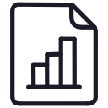


Key Modules of the System
Six integrated components forming one unified workforce management platform.
Employee Management
Workforce Dashboard
Manage and access complete employee information in one place.
Monitor important workforce KPIs at a glance.
Workforce Analytics
Reports
Visualize workforce information through charts and metrics.
Generate structured workforce reports and exports in multiple formats.
Search & Filtering
Automation & AI
Quickly locate employees and workforce segments with precision.
Support automated processes and intelligent workforce assistance where implemented.

Slide 6
WORKFORCE ANALYTICS
Workforce Dashboard & Analytics
Transforming raw workforce data into visual, actionable insights.
APIs
Charts
Quick workforce overview at a glance
Visual workforce patterns — department distribution, trends
Filters
Insights
Interactive filters for focused analysis
Data-driven support for management decisions
The dashboard content and visuals are arranged to support fast scanning, with the screenshot serving as the primary reference and the feature summary reinforcing its value.

Slide 7
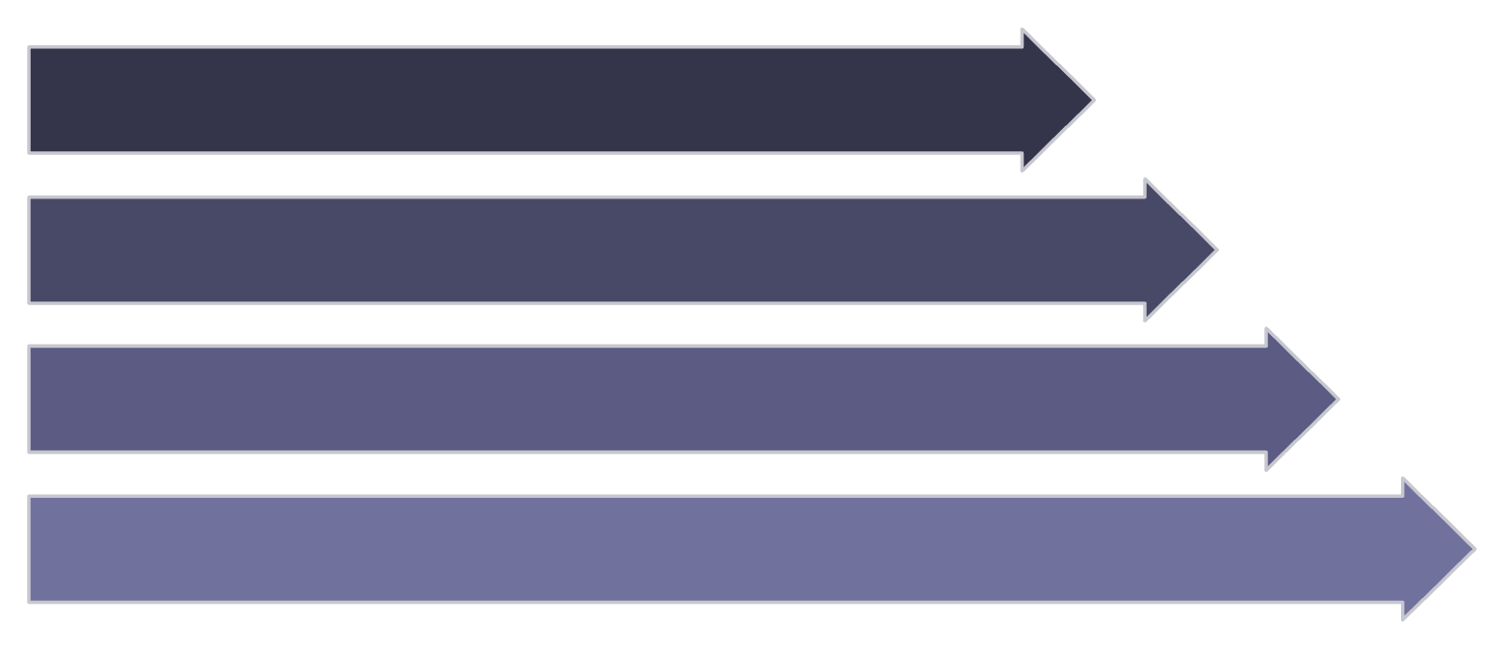
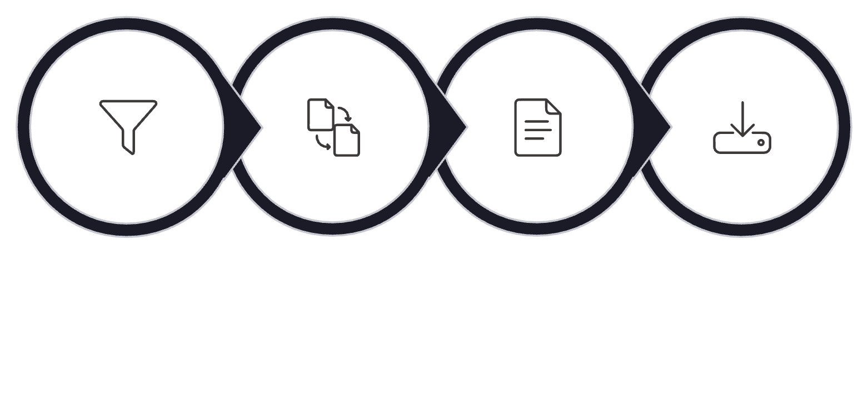
From Employee Data to Automated Reports
Less manual reporting. Faster access to structured workforce information.
Employee Management
Reporting Center
Employee Data
Search
Filter
View & Manage
Select Filters
Process Data
Generate Report
Export
Employee information & profiles
Search functionality
Department filtering & segmentation
Employee statistics
Output formats: PDF · XLSX · CSV · JSON

Slide 8

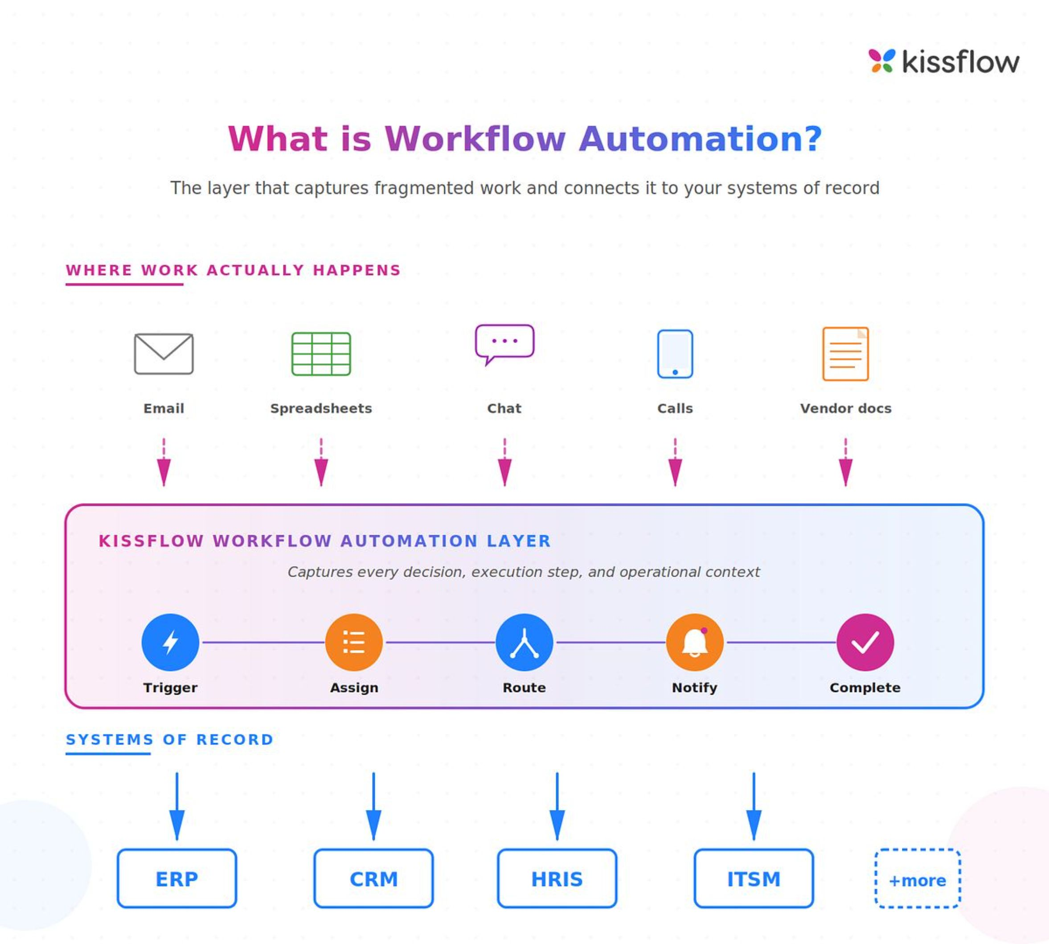
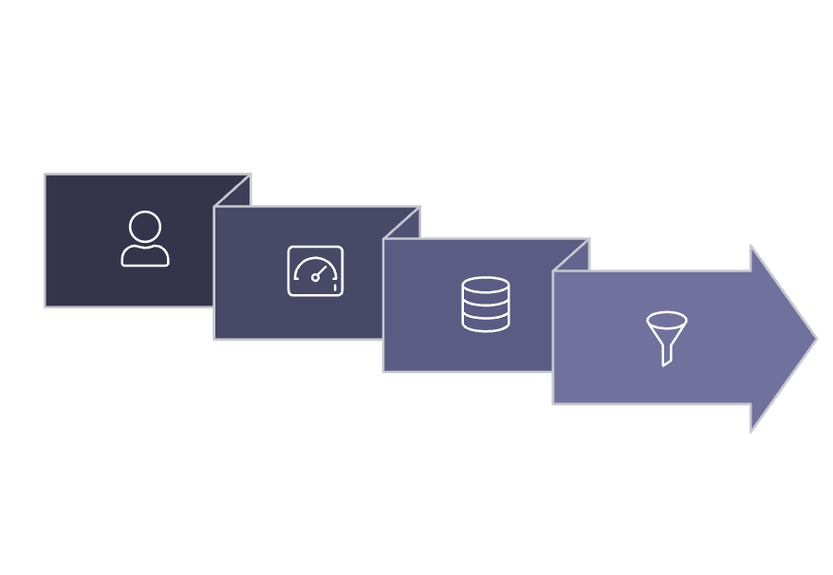

Automation & Intelligent Workforce Workflow
Automation Capabilities
AI / Intelligent Features
If implemented in the actual project:
Dashboard
Search & Filter
AI-assisted workforce queries
Workforce insights & natural-language interaction
Data-driven assistance
User
Employee Data
Key Message: Data → Automation → Insight → Action
Data Processing
Report Generation
Search & Monitor
Automated data processing and KPI calculation
Automated structured report creation and export
Automated filtering and centralized monitoring

Slide 9
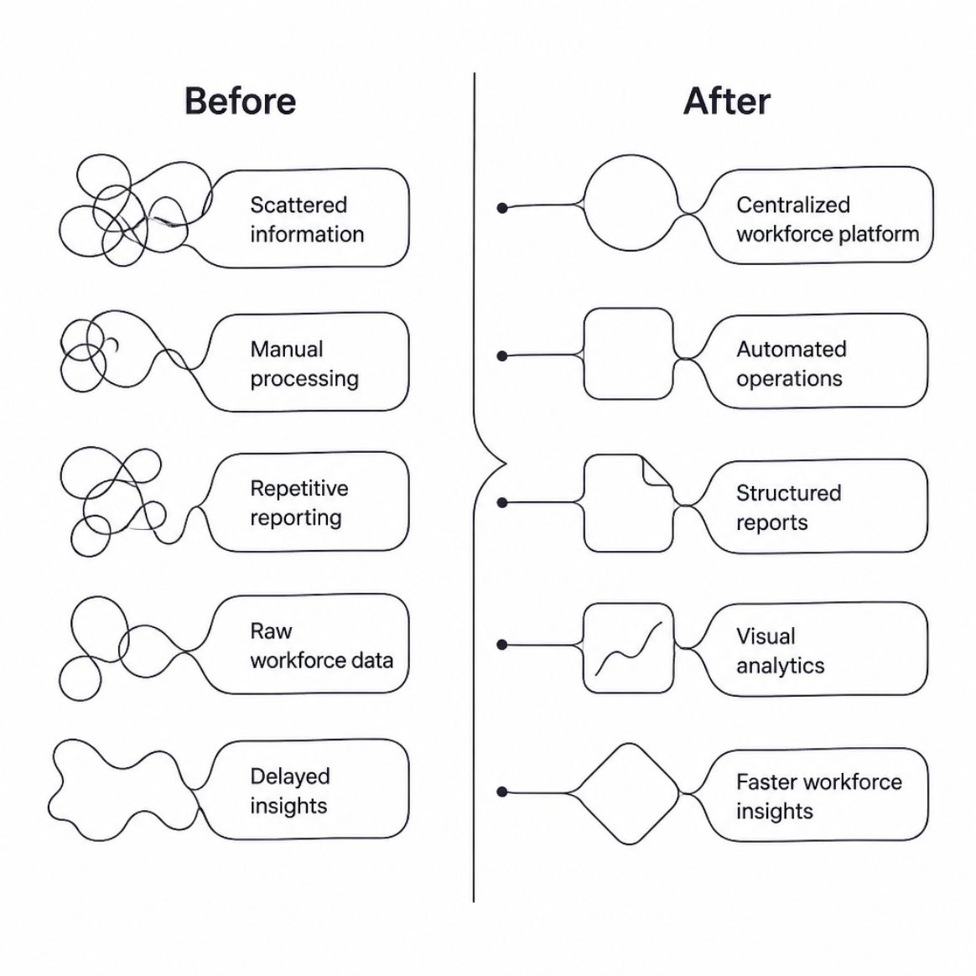
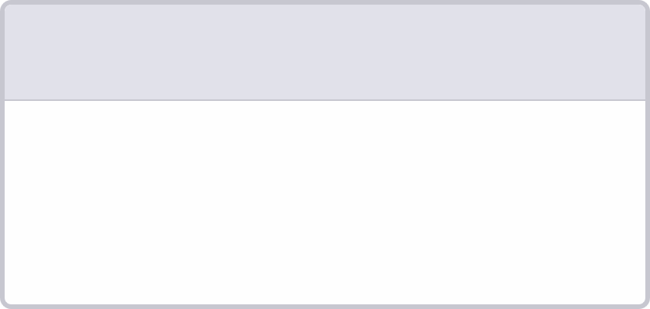
Business Impact & Future Potential
Key Benefits
FUTURE SCOPE
AI Forecasting · Predictive Analytics · Automated Alerts · Cloud Scaling · Enterprise Integration
1
2
3
4
Efficiency
Visibility
Decision Support
Scalability
Reduce repetitive manual work across workforce operations.
Centralized workforce information accessible in one platform.
Data-driven workforce insights for management.
Foundation for future enhancements and growth.

Slide 10
Conclusion & Live Demonstration
Conclusion
Live Demonstration Flow
01
The Workforce Management Automation System brings employee management, workforce analytics, reporting and automation into one centralized platform — providing a foundation for faster workforce information access, improved operational efficiency and data-driven decision-making.
Dashboard
Workforce KPIs and visual analytics overview
02
Employee Management
Search, filter, and manage employee records
03
Analytics
Charts, trends, and workforce visualizations
CENTRALIZE → ANALYZE → AUTOMATE → DECIDE
04
Reports
Generate and export structured workforce reports
05
AI / Automation
Automated workflows and intelligent features
Thank You
Questions & Discussion

Slide 11
THANK YOU

