Slide 1


Jupyter Notebook
Coding outreach group
Summer workshop 6/5/2020

Slide 2
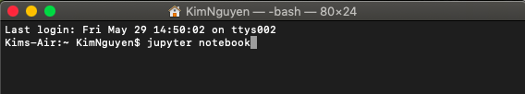
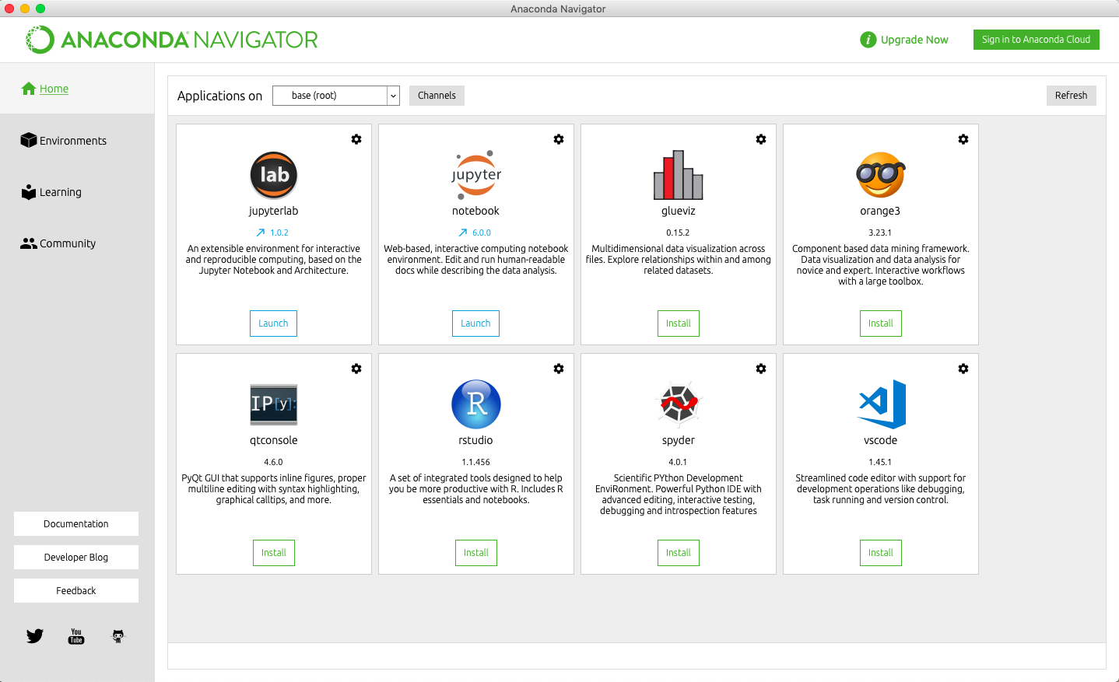
What is the Jupyter Notebook?
The Jupyter Notebook App is a server-client application that allows editing and running notebook documents using a web browser.
Jupyter Notebook can be opened on a browser without internet access or can be installed on a remote server and accessed through the internet.
We can access Jupyter Notebook through the Terminal or by downloading the app or Anaconda. This will open the Jupyter Notebook in your current directory.

Slide 3
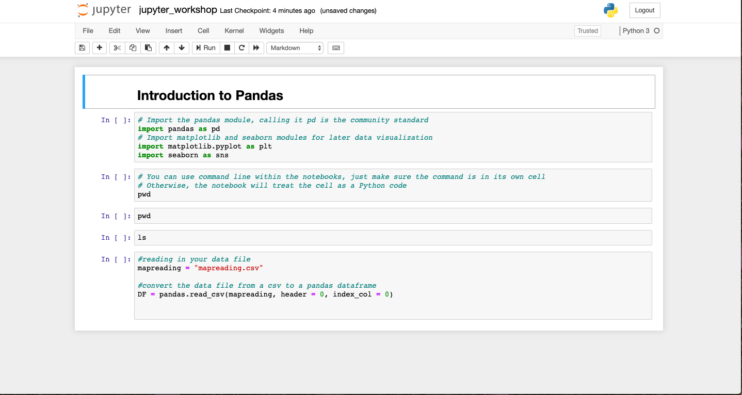
Notebook Format
Add/cut cells
Run code in cells (or use Shift + Return/enter)
Markdown/heading cells: just displays text
Code cells: where you put your code
A notebook kernel is a “computational engine” that executes the code contained in a Notebook.

Slide 4

Pandas
Python data organization and analysis software library written for Python
Uses a DataFrame object for data manipulation with integrated indexing.
Note that Python is 0-indexed, meaning the first element is 0 and the second is 1.

Slide 5
Data Visualization
matplotlib
Plotting library for Python and its extension Numpy
Very similar to the MATLAB interface, but free
seaborn
Visualization library built on matplotlib
Closely integrated with pandas data structures

