Slide 1


Jupyter Notebook Tutorial
Coding outreach group 6/3/2021
Kim Nguyen

Slide 2

Tutorial Objectives
1. Familiarize you to Jupyter Notebook
2. Start to use Jupyter Notebook for simple data management
3. and data visualization

Slide 3
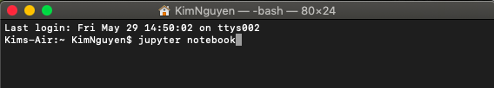
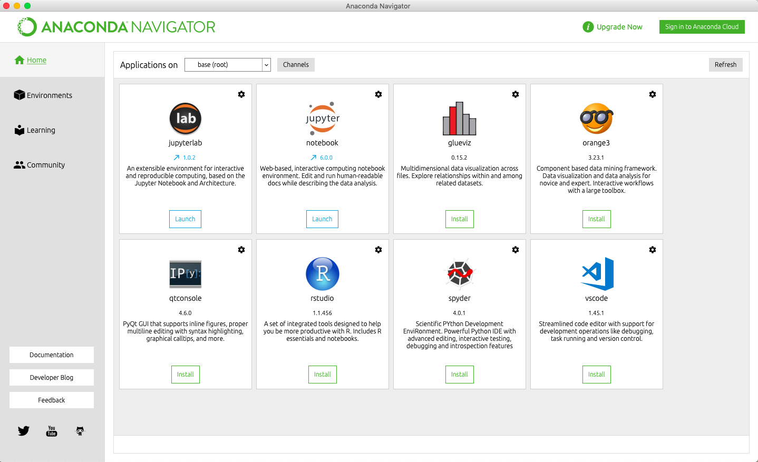
What is the Jupyter Notebook?
The Jupyter Notebook App is a server-client application that allows editing and running notebook documents using a web browser.
Jupyter Notebook can be opened on a browser without internet access or can be installed on a remote server and accessed through the internet.
We can access Jupyter Notebook through the Terminal or by downloading the app on Anaconda. This will open the Jupyter Notebook in your current directory.

Slide 4
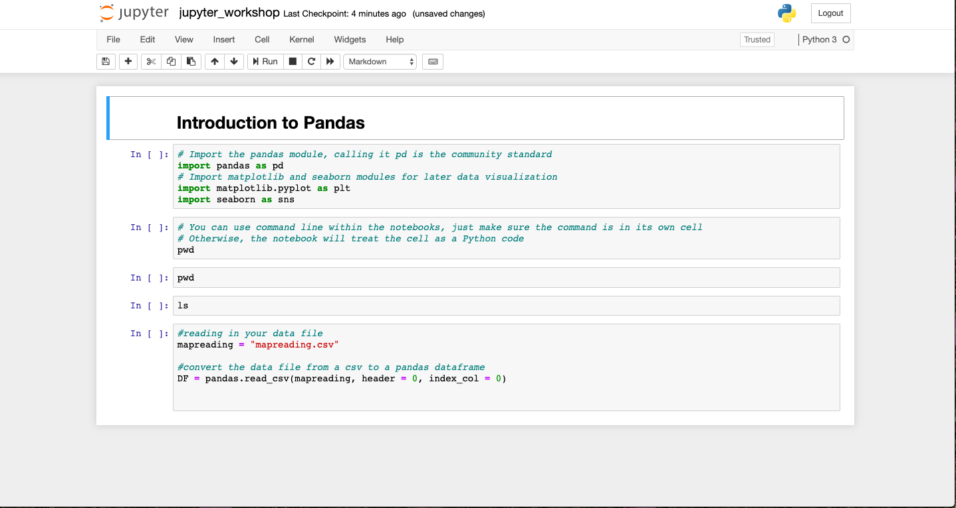
Notebook Format
Add/cut cells
Run code in cells (or use Shift + Return/enter)
Markdown/heading cells: converts text to html
Code cells: where you put your code
A notebook kernel is a “computational engine” that executes the code contained in a Notebook.

Slide 5
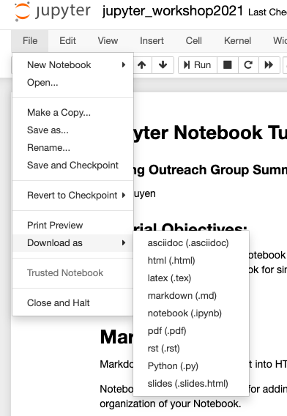
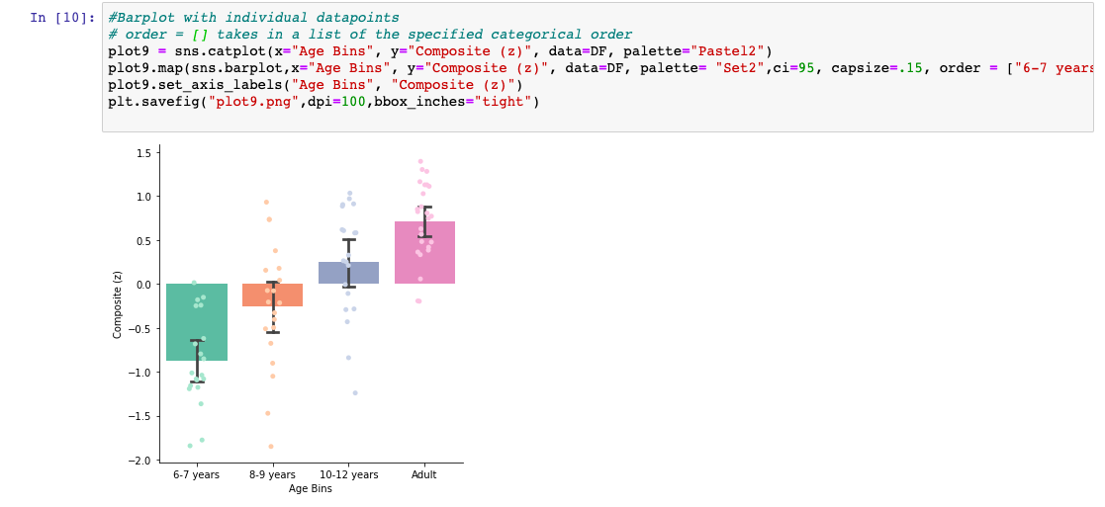
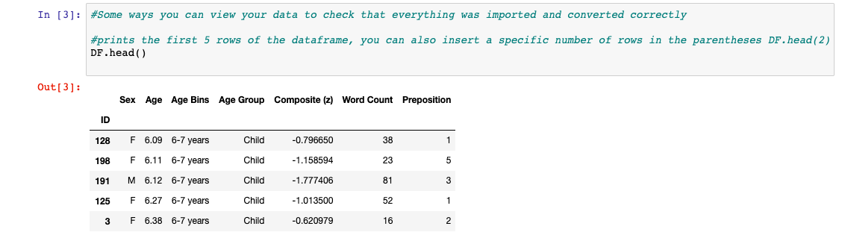
Why use Jupyter Notebook?

Slide 6
Why use Jupyter Notebook?
Allows for real-time (ish) code collaboration
Autosaves everything in the Notebook
Allows you to work non-linearly through your code
Markdowns are useful for possible conference, talk, or paper text

Slide 7
Caveats
Jupyter Notebooks are most compatible with Julia, Python, and R languages
BUT you can install other language kernels
Code collaboration could get out-of-sync
Other cons, but they don’t necessarily apply to us in a research setting

Slide 8
Thanks for watching!

