Slide 1
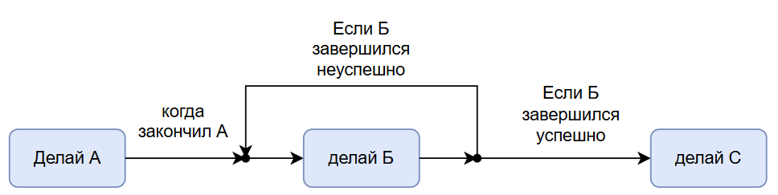
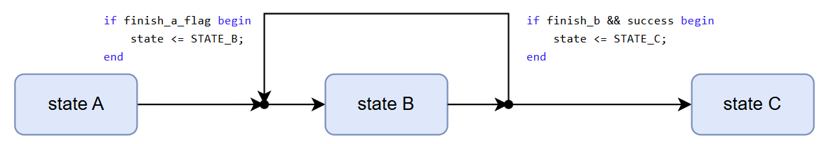
Finite State Machine
(или о том как делать вещи последовательно)
Типичная задача:

Slide 2
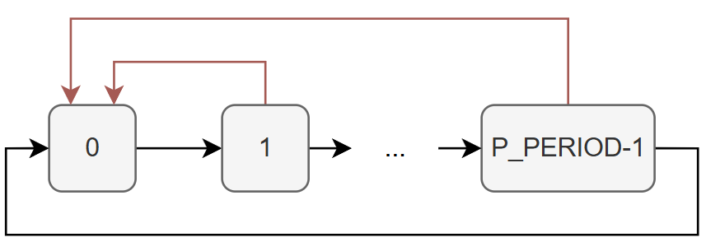
Простейший пример: Счетчик
module counter (
clk_i,
rst_i,
cnt_o
);
parameter P_PERIOD = 10;
localparam PW_CNT = $clog2(P_PERIOD);
input clk_i, rst_i;
output [PW_CNT-1: 0] cnt_o;
reg [PW_CNT-1: 0] cnt_r = {PW_CNT{1'b0}};
always @(posedge clk) begin
if (rst_i) begin
cnt_r <= {PW_CNT{1'b0}};
end else if (cnt_r == P_PERIOD-1) begin
cnt_r <= {PW_CNT{1'b0}};
end else begin
cnt_r <= cnt_r + 1'b1;
end
end
assign cnt_o = cnt_r;
endmodule
Состояние (State)

Slide 3
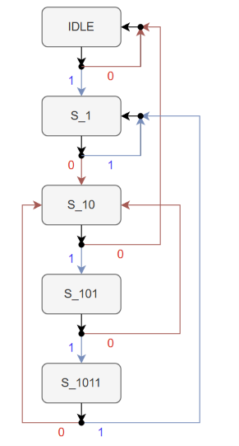
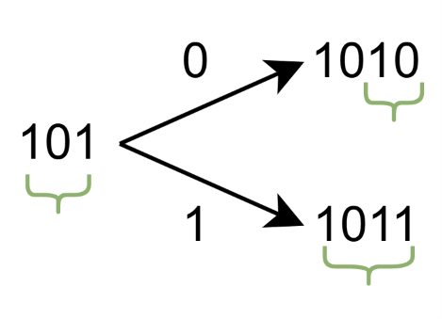
Пример детектор последовательности 1011
module sequence_detector_1011 (
input wire clk,
input wire reset,
input wire bit_in,
output reg detected
);
localparam [2:0]
S_IDLE = 3'd0,
S_1 = 3'd1,
S_10 = 3'd2,
S_101 = 3'd3,
S_1011 = 3'd4;
reg [2:0] state;
always @(posedge clk) begin
if (reset) begin
state <= S_IDLE;
detected <= 1'b0;
end else begin
detected <= 1'b0;
case (state)
S_IDLE: begin
state <= bit_in ? S_1 : S_IDLE;
end
S_1: begin
state <= bit_in ? S_1 : S_10;
end
S_10: begin
state <= bit_in ? S_101 : S_IDLE;
end
S_101: begin
state <= bit_in ? S_1011 : S_10;
detected <= bit_in;
end
S_1011: begin
state <= bit_in ? S_1 : S_10;
end
default: begin
state <= S_IDLE;
end
endcase
end
end
endmodule
Объявление состояний
Описание переходов (и возможно действий)

Slide 4
Пример детектор последовательности 1011
(вариант описания через 2 always блока)
module sequence_detector_1011 (
input wire clk,
input wire reset,
input wire bit_in,
output wire detected
);
localparam [2:0]
S_IDLE = 3'd0,
S_1 = 3'd1,
S_10 = 3'd2,
S_101 = 3'd3,
S_1011 = 3'd4;
reg [2:0] state;
reg [2:0] next_state;
// State register
always @(posedge clk) begin
if (reset)
state <= S_IDLE;
else
state <= next_state;
end
// Next-state logic
always @* begin
next_state = S_IDLE;
case (state)
S_IDLE: begin
if (bit_in)
next_state = S_1;
else
next_state = S_IDLE;
end
S_1: begin
if (bit_in)
next_state = S_1;
else
next_state = S_10;
end
....
S_1011: begin
// Preserve the suffix that can start another match.
if (bit_in)
next_state = S_1;
else
next_state = S_10;
end
default: next_state = S_IDLE;
endcase
end
// Moore output: depends only on the current state.
assign detected = (state == S_1011);
endmodule
Объявление состояний
Описание переходов (и возможно действий)
Непосредственное переключение состояний

Slide 5
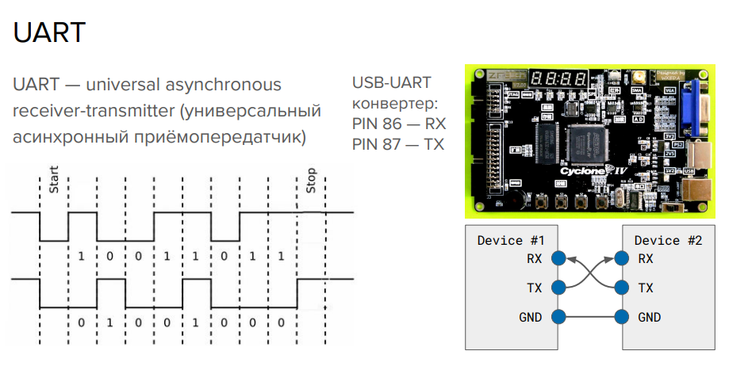

Slide 6
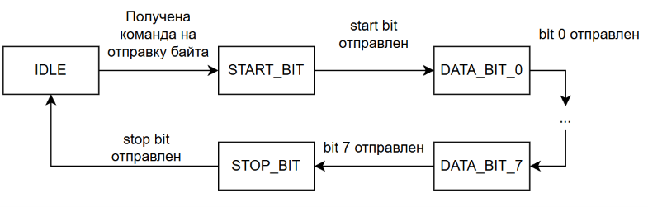
Transmitter State Machine
localparam [1:0]
S_IDLE = 2'd0,
S_START = 2'd1,
S_DATA = 2'd2,
S_STOP = 2'd3;
reg [1:0] state;
reg [2:0] bit_index;

Slide 7

Transmitter state machine
На самом деле каждое состояние можно еще подразделить на множество состояний ожидания.
parameter integer CLKS_PER_BIT = 16
localparam integer COUNT_WIDTH = $clog2(CLKS_PER_BIT);
reg [COUNT_WIDTH-1:0] count;

Slide 8
UART Transmitter
always @(posedge clk) begin
if (reset) begin
state <= IDLE;
bit_index <= 3'd0;
data_reg <= 8'd0;
tx <= 1'b1;
end else begin
case (state)
IDLE: begin
tx <= 1'b1;
bit_index <= 3'd0;
if (accept) begin
data_reg <= data_in;
tx <= 1'b0;
state <= START;
end
end
START: if (bit_done) begin
tx <= data_reg[0];
state <= DATA;
end
DATA: if (bit_done) begin
bit_index <= bit_index + 3'd1;
tx <= data_reg[bit_index];
if (bit_index == 3'd7)
state <= STOP;
tx <= 1'b1;
end
STOP: if (bit_done)
state <= IDLE;
default: begin
state <= IDLE;
tx <= 1'b1;
end
endcase
end
end
module uart_tx #(
parameter integer CLKS_PER_BIT = 16
) (
input wire clk,
input wire reset,
input wire start,
input wire [7:0] data_in,
output reg tx,
output wire busy
);
localparam integer COUNT_WIDTH =
(CLKS_PER_BIT > 1) ? clog2(CLKS_PER_BIT - 1) : 1;
localparam [1:0]
IDLE = 2'd0,
START = 2'd1,
DATA = 2'd2,
STOP = 2'd3;
reg [1:0] state;
reg [COUNT_WIDTH-1:0] count;
reg [2:0] bit_index;
reg [7:0] data_reg;
wire bit_done = (count == CLKS_PER_BIT - 1);
assign busy = (state != IDLE);
wire accept = start && !busy;
always @(posedge clk) begin
if (reset)
count <= {COUNT_WIDTH{1'b0}};
else if ((state == IDLE) || bit_done)
count <= {COUNT_WIDTH{1'b0}};
else
count <= count + 1'b1;
end

