Slide 1
BUSSINESS GALORE
A project of Software-Modeling Foundations
By: Julian David Celis Giraldo
and
Catalina Ariza Ardila

Slide 2
BUSINESS MODEL
INDEX
USER STORIES
APPLICATION PROCESSES AND COMPONENTS
ACTIVITY DIAGRAMS
CRC CARDS
DIAGRAMA DE CLASES

Slide 3





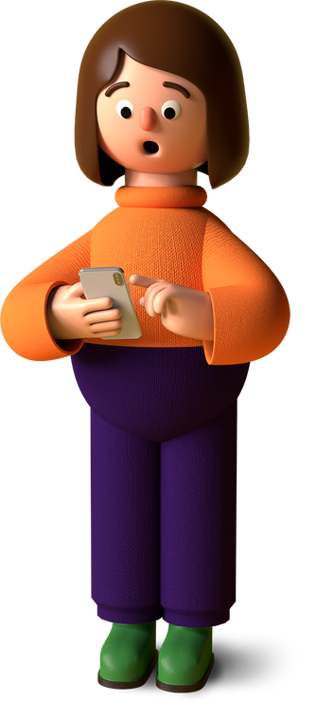

BUSINESS MODEL
BUSINESS GALORE

Slide 4
AS A MANAGER, I WANT TO BE ABLE TO REGISTER MY SHOP IN THE APPLICATION SO THAT CUSTOMERS CAN LEARN ABOUT MY BUSINESS.
AS A MANAGER, I WANT TO HAVE A SPACE TO LIST SERVICES, DETAILS, AND THE SERVICE HOURS, SO THAT CUSTOMERS ARE WELL INFORMED ABOUT THESE ASPECTS.
USER STORIES
AS A MANAGER, I WANT TO HAVE A SPACE TO SHOWCASE IN DETAIL THE WORKS OR SERVICES OFFERED IN MY SHOP, SO THAT CUSTOMERS CAN CHECK IF IT'S WHAT THEY ARE LOOKING FOR.
MANAGER (ADMINISTRATOR)
AS A MANAGER, I WANT TO BE ABLE TO SHOW BASIC INFORMATION ABOUT MY EMPLOYEES ON THE SHOP'S PROFILE, SO THAT CUSTOMERS CAN SEE RELEVANT DETAILS AND CHOOSE WHO THEY WANT TO SCHEDULE WITH.
AS A USER, I WANT TO REGISTER TO HAVE MY PROFILE IN THE APP AND ADD BASIC PERSONAL INFORMATION.

Slide 5
AS A CUSTOMER, I WANT TO SEARCH FOR SHOPS BY NAME OR CODE FOR CONVENIENCE.
AS A CUSTOMER, I WANT TO SCHEDULE ONE OR MORE SERVICES TO BE ATTENDED.
USER STORIES
AS A CUSTOMER, I WANT TO HAVE DIFFERENT PAYMENT OPTIONS IN THE APPLICATION FOR CONVENIENCE.
CUSTOMER
AS A CUSTOMER, I WANT TO SEE A SUMMARY OF MY APPOINTMENTS, BOTH PAST AND FUTURE, TO KEEP TRACK OF THE SERVICES I’VE TAKEN AND THE ONES I HAVE SCHEDULED.
AS A CUSTOMER, I WANT TO BE ABLE TO RATE THE SERVICE I RECEIVED AT THE SHOP AFTER MY APPOINTMENT, TO HELP OTHER CUSTOMERS MAKE INFORMED DECISIONS AND PROVIDE FEEDBACK TO THE SHOP.

Slide 6
AS A SHOP EMPLOYEE, I WANT TO RECEIVE NOTIFICATIONS FROM CUSTOMERS WHO CHOSE MY SERVICE.
USER STORIES
AS A SHOP EMPLOYEE, I WANT MY PROFESSIONAL INFORMATION AND THE SHOP WHERE I WORK TO BE VISIBLE IN THE APPLICATION, SO THAT CUSTOMERS CAN LEARN ABOUT MY SKILLS AND SELECT THE SERVICES I OFFER.
EMPLOYEE
AS A SHOP EMPLOYEE, I WANT TO BE ABLE TO RATE CUSTOMERS AFTER COMPLETING A SERVICE, TO HELP MAINTAIN A HISTORY OF CUSTOMER BEHAVIOR AND IMPROVE SERVICE QUALITY IN THE FUTURE.

Slide 7
APPLICATION PROCESSES AND COMPONENTS
Processes:
Components:
Sign in
Users:
Manager (Administrator)
Employee
Customer
Log in
Create shop
POO:
SOLID
Search shops
Functionalities:
Store Registration and Administration.
Service Scheduling.
Service Management.
Qualifications.
Notifications.
Find services
Schedule appointment

Slide 8
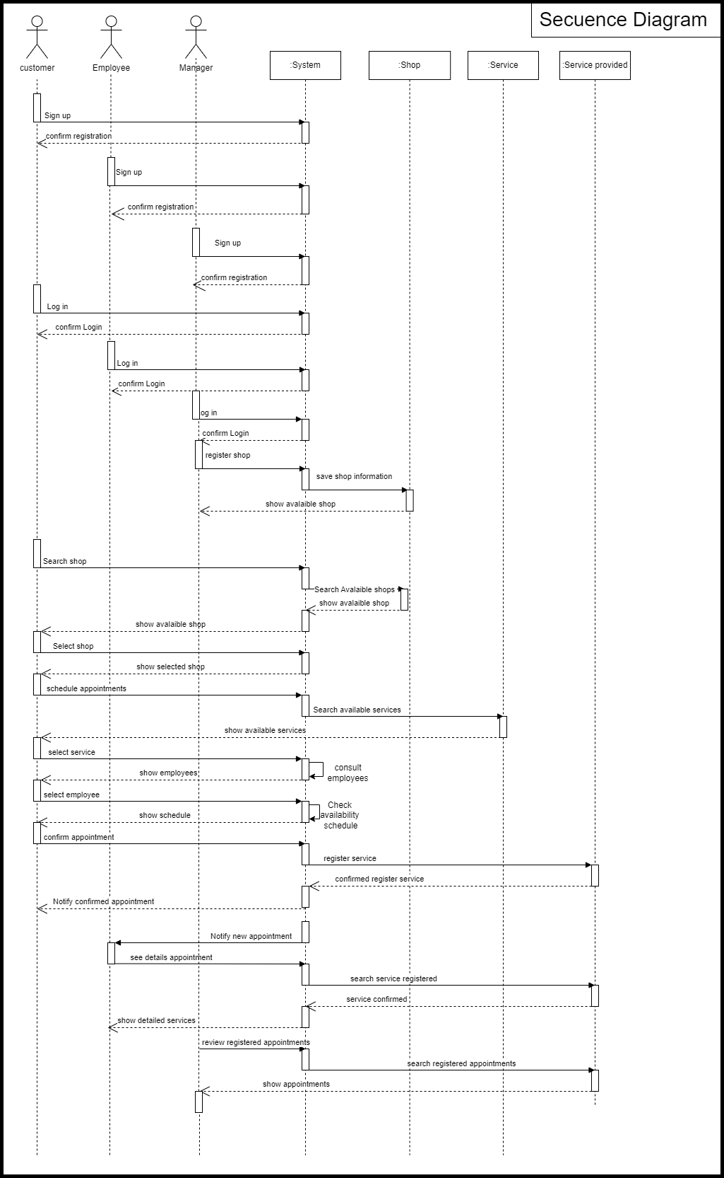
SECUENCY DIAGRAMS

Slide 9
SECUENCY DIAGRAMS

Slide 10
SECUENCY DIAGRAMS

Slide 11
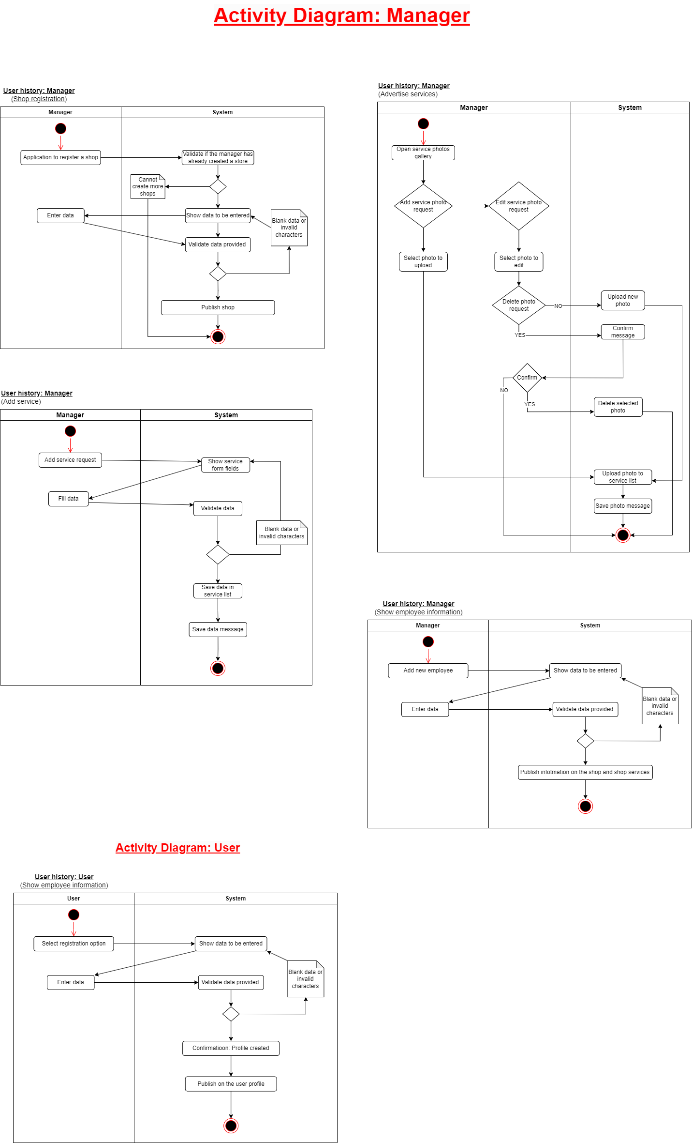
ACTIVITY DIAGRAMS
BUSINESS MANAGER

Slide 12
ACTIVITY DIAGRAMS
BUSINESS MANAGER

Slide 13
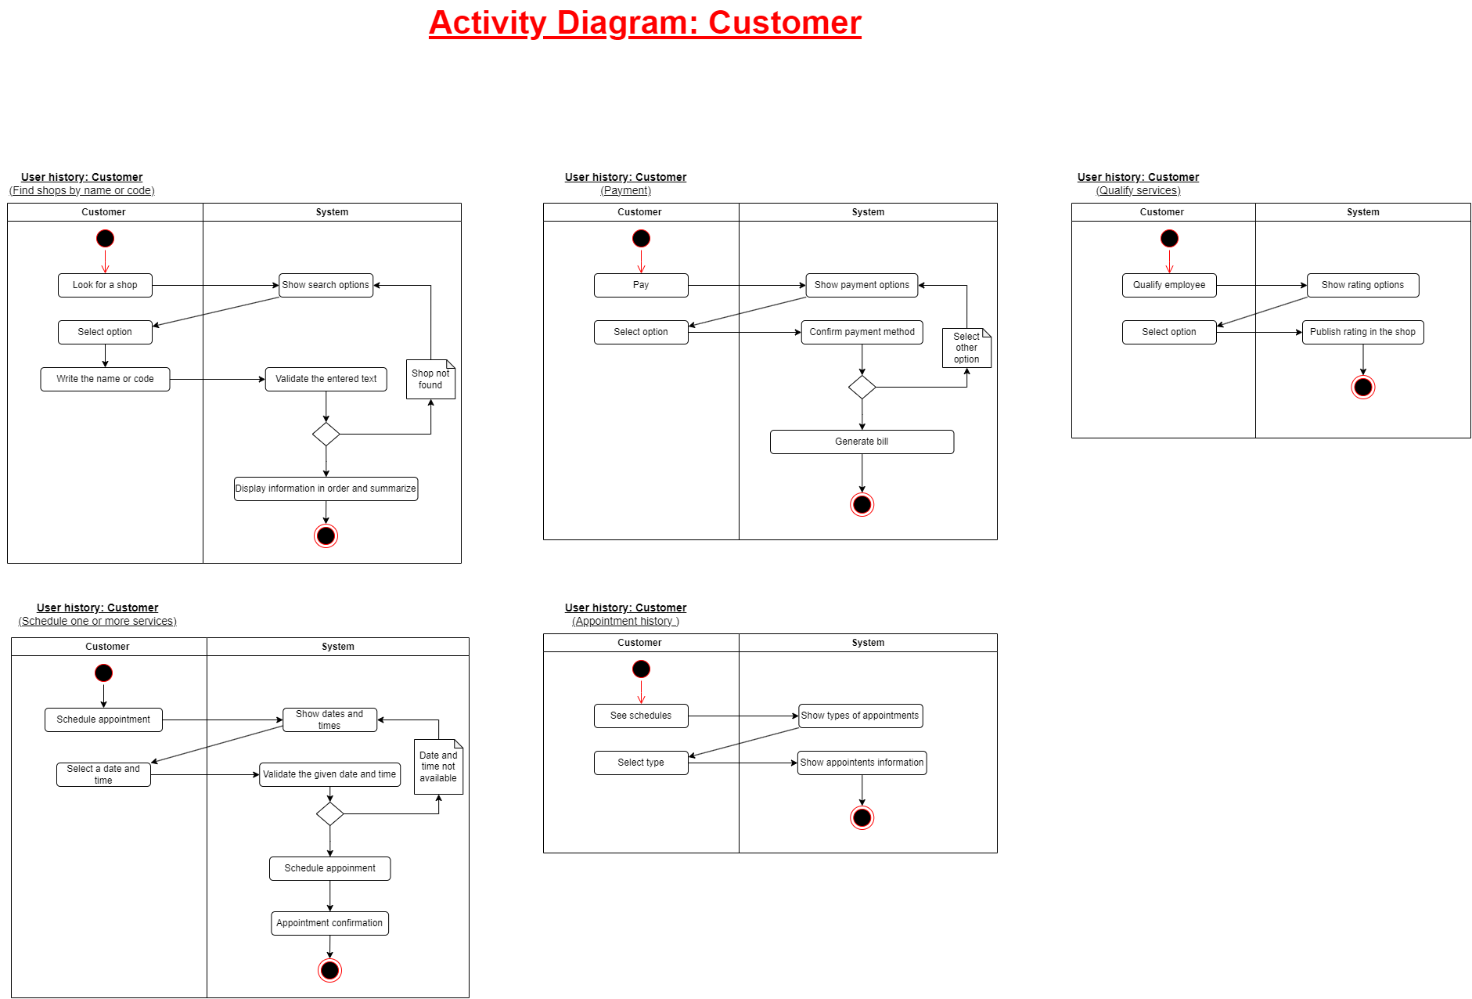
ACTIVITY DIAGRAMS
CUSTOMER

Slide 14
ACTIVITY DIAGRAMS
CUSTOMER

Slide 15
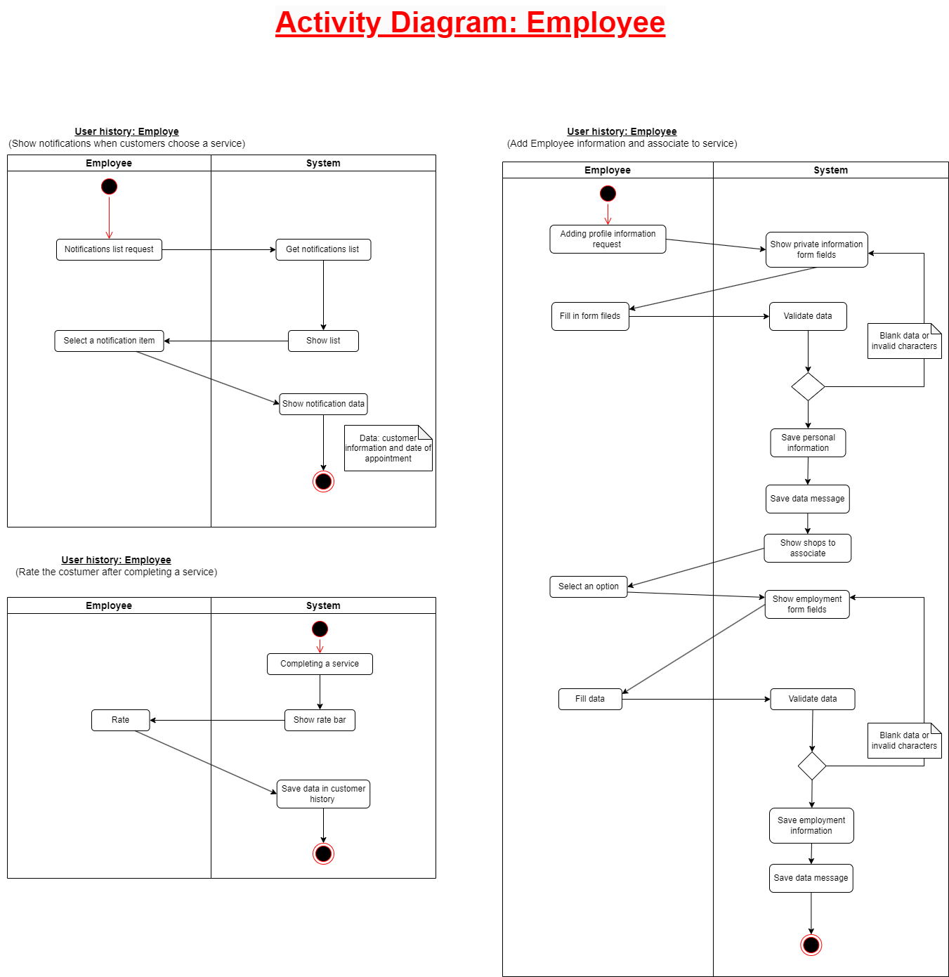
ACTIVITY DIAGRAMS
EMPLOYEE

Slide 16
ACTIVITY DIAGRAMS
USER

Slide 17
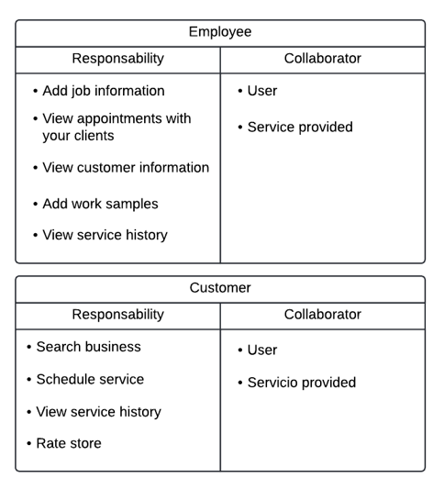

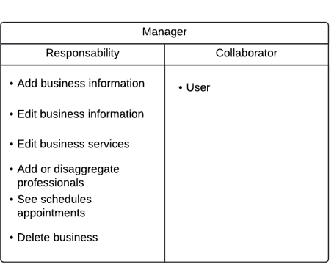
CRC CARDS

Slide 18
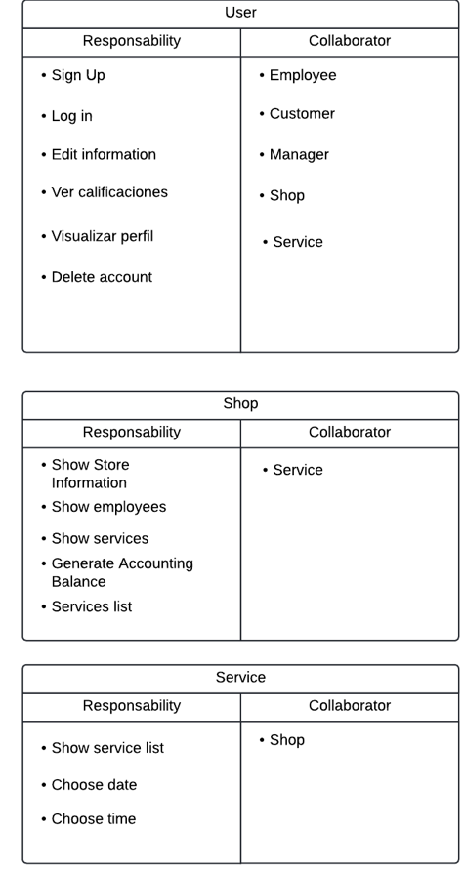
CRC CARDS

Slide 19
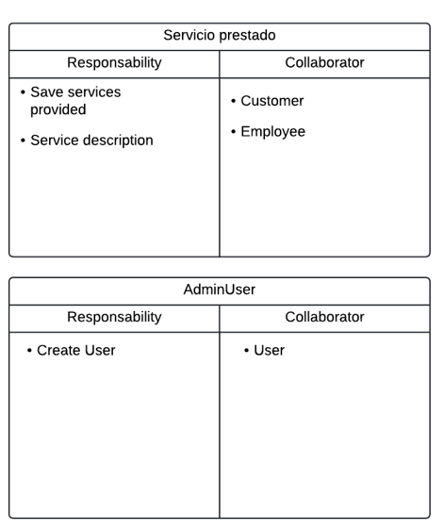
CRC CARDS

Slide 20
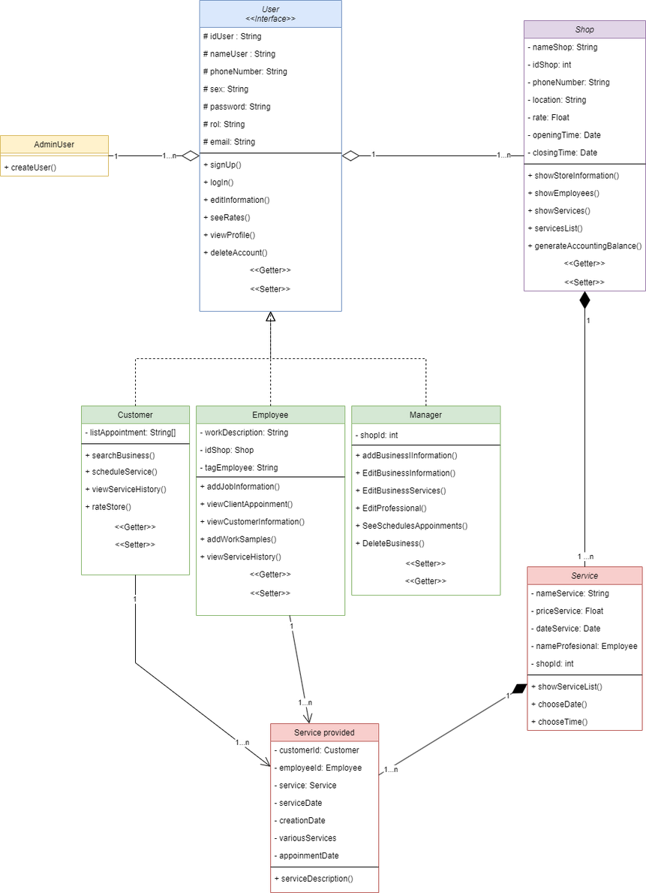
CLASS DIAGRAM

Slide 21
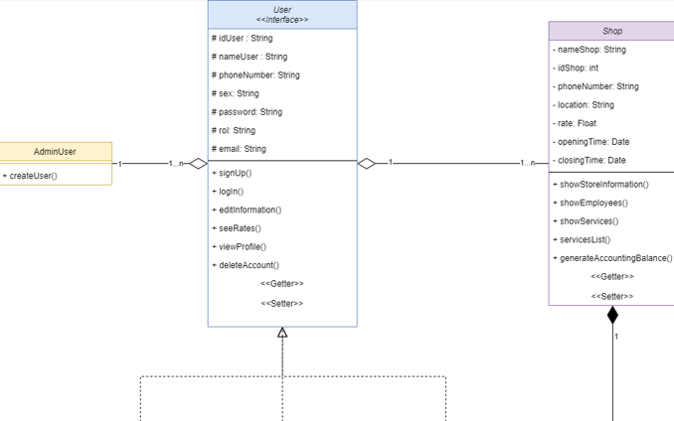

Slide 22
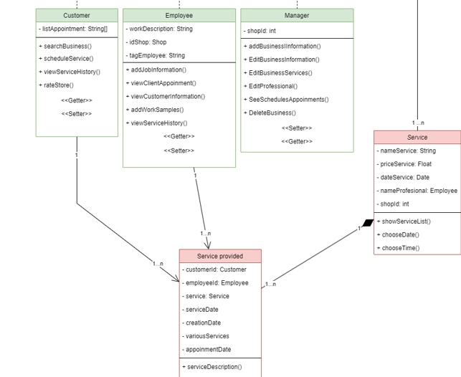

Slide 23

Thanks for your attention

