Slide 1
DYNAMIC PROGRAMMING

Slide 2
Dynamic programming
Simplest Explanation
1+1+1+1 = 4
How about 1+1+1+1+1?
We can get 5 in a short time.
We don’t need to recalculate 1+1+1+1. We already remember the answer.

Slide 3
Dynamic programming
Dynamic programming is a method for solving a complex problem by breaking it down into a collection of simpler subproblems.
It is applicable to problems exhibiting the properties of overlapping subproblems.
The method takes far less time than other methods that don't take advantage of the subproblem overlap.
We need to solve different parts of the problem (subproblems) + combine the solutions of the subproblems to reach an overall solution.
We solve each subproblems only once → we reduce the number of computations.
Subproblems can be stored („memoization”) !!!!

Slide 4
Dynamic programming
Richard Bellman invented DP in the 1950s.
Bellman named it Dynamic Programming because at the time, RAND (his employer), disliked mathematical research and didn't want to fund it.
He named it Dynamic Programming to hide the fact he was really doing mathematical research.

Slide 5
Dynamic prgramming vs „divide and conquer” method
Several problems can be solved by combining optimal solutions to non-overlapping sub-problems
This strategy is called "divide and conquer" method
Binary search problems
This is why merge sort / quick sort are not classified as dynamic programming problems
Overlapping subproblems → dynamic programming
Non-overlapping subproblems → divide and conquer method

Slide 6
FIBONACCI NUMBERS
Dynamic programming

Slide 7
Fibonacci sequence: 0 1 1 2 3 5 8 13 21 34 ...
F(N) = F(N-1) + F(N-2)
F(0) = 0 F(1) = 1
Fibonacci numbers are defined
by the recurrence relation
With generator functions we can get a closed form: „Binet formula”

Slide 8
What is the problem with the recursive formula? We calculate same
problems over and over again
f(n) = f(n-1) + f(n-2)

Slide 9
What is the problem with the recursive formula? We calculate same
problems over and over again
f(n) = f(n-1) + f(n-2)
f(4)

Slide 10
What is the problem with the recursive formula? We calculate same
problems over and over again
f(n) = f(n-1) + f(n-2)
f(4)
f(3)
f(2)

Slide 11
What is the problem with the recursive formula? We calculate same
problems over and over again
f(n) = f(n-1) + f(n-2)
f(4)
f(3)
f(2)
f(2)
f(1)
f(1)
f(0)

Slide 12
What is the problem with the recursive formula? We calculate same
problems over and over again
f(n) = f(n-1) + f(n-2)
f(4)
f(3)
f(2)
f(2)
f(1)
f(1)
f(0)
f(1)
f(0)

Slide 13
What is the problem with the recursive formula? We calculate same
problems over and over again
f(n) = f(n-1) + f(n-2)
f(4)
f(3)
f(2)
f(2)
f(1)
f(1)
f(0)
f(1)
f(0)
OVERLAPPING SUBPROBLEMS !!!

Slide 14
Fibonacci numbers
Solution: use dynamic programming and memoization in order to avoid recalculating a subproblem over and over again
We should use an associative array abstract data type (hashtable/dictionary) to store the solution for the subproblems // O(1) time complexity
On every f() method call → we insert the calculated value if necessary
Why is it good? Instead of the exponential time complexity we will have O(N) time complexity + requires O(N) space

Slide 15
What is the problem with the recursive formula? We calculate same
problems over and over again
f(n) = f(n-1) + f(n-2)
f(4)
f(3)
f(2)
f(2)
f(1)
f(1)
f(0)
f(1)
f(0)
n
Recursive approach: O(2 )
Dynamic programming: O(N)

Slide 16
Fibonacci Number Implementation

Slide 17
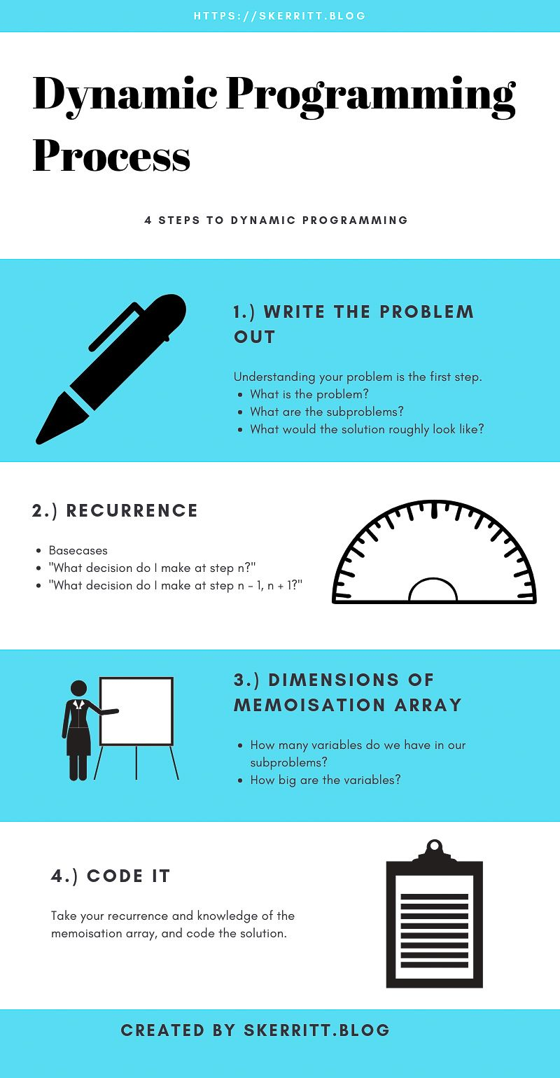

Slide 18
KNAPSACK PROBLEM
Dynamic programming

Slide 19
Knapsack problem
Its is a problem in combinatorial optimization .
Given a set of items, each with a mass w and a value v, determine the number of each item to include in a collection so that the total weight M is less than or equal to a given limit and the total value is as large as possible.
The problem often arises in resource allocation where there are financial constraints.

Slide 20
Applications
Has lots of applications of course.
Finding the least wasteful way to cut raw materials.
Selection of investments and portfolios.
Selection of assets for asset-backed securitization.
Construction and scoring of tests in which the test-takers have a choice as to which questions they answer.

Slide 21
Divisible Problem
If we can take fractions of the given items, then the greedy approach can be used.
Sort the items according to their values, it can be done in O(N*logN) time complexity.
Start with the item that is the most valuable and take as much as possible.
Than try with the next item from our sorted list.
This linear search has O(N) time complexity.
Overall complexity: O(N*logN) + O(N) = O(N*logN) !!!
So we can solve the divisible knapsack problem quite fast.

Slide 22
0-1 knapsack problem
In this case we are not able to take fractions: we have to decide whether to take an item or not.
Greedy algorithm will not provide the optimal result!!!
Another approach would be to sort by cost per unit weight and include from highest on down until knapsack is full … not a good solution too.
Dynamic programming is the right way!!!

Slide 23
Dynamic Programming
Solves larger problem by relating it to overlapping sub-problems and then solves the subproblems.
It works through the exponential set of solutions, but does not examine them all explicitly.
Stores intermediate results so that they are not recomputed
„memoization”
Solution to original problem is easily computed from the solutions to the subproblems.

Slide 24
W = 5kg
1
x v = $10
1
1
W = 7kg
2
x v = $13
2
2
W = 9kg
3
x v = $19
3
3
KNAPSACK
W = 10 kg
W = 2kg
4
x v = $4
4
4

Slide 25


x items we have // we have N items
v value of the i-th item
w weight of the i-th item
W maximum capacity of knapsack
i
i
i
-------------------------------------------------------------------------------------
$$\sum_{i=1}^{N}{v ∗ x}$$
$$\sum_{i=1}^{N}{w ∗ x <W}$$
maximize
subject to
i
i
i
i
x 0 if we do not take the i-th item, 1 if we take it
i

Slide 26
Knapsack with DP
We have to define subproblems: we have N items so we have to make N decisions whether to take the item with given index or not.
The subproblems: the solution considering every possible combination of remaining items and remaining weight.
S[i][w] the solution to the sub-problem corresponding to the first i items and available weight w.
Or in other words…
S[i][w] = the maximum cost of items that fit inside a knapsack of size (weight) w, choosing from the first i items!!!
We have to decide whether to take the item or not.

Slide 27
S[i][w] = Math.max( S[i-1][w] ; v + S[i-1][w-w ] )
i
i
do not take
i-th item
we take
i-th item
BUT !!! We are only considering S[i-1][w-w ] if it can fit w > w
If there is no room for it → the answer is just S[i-1][w] !!!
i
i

Slide 28
Time complexity
Running time of Knapsack: O(n*W).
BUT it is not polynomial, it is pseudo-polynomial.
Numeric algorithm runs in pseudo-polynomial time if its running time is polynomial in the numeric value of the input, but is exponential in the length of the input ( the number of bits required to represent it ).

Slide 29
Example

Slide 30
N = 3 items W = 5kg capacity of knapsack
Item #1 w = 4kg v = $10
Item #2 w = 2kg v = $4
Item #3 w = 3kg v = $7
1
1
2
2
3
3
 | 0 | 1 | 2 | 3 | 4 | 5
0
1
2
3
weights [kg]
No items
First item
First two items
All items
S[i][w] = Math.max( S[i-1][w] ; v + S[i-1][w-w ] )
i
i

Slide 31
N = 3 items W = 5kg capacity of knapsack
Item #1 w = 4kg v = $10
Item #2 w = 2kg v = $4
Item #3 w = 3kg v = $7
1
1
2
2
3
3
 | 0 | 1 | 2 | 3 | 4 | 5
0 | 0 | 0 | 0 | 0 | 0 | 0
1
2
3
weights [kg]
No items
First item
First two items
All items
S[i][w] = Math.max( S[i-1][w] ; v + S[i-1][w-w ] )
i
i

Slide 32
N = 3 items W = 5kg capacity of knapsack
Item #1 w = 4kg v = $10
Item #2 w = 2kg v = $4
Item #3 w = 3kg v = $7
1
1
2
2
3
3
 | 0 | 1 | 2 | 3 | 4 | 5
0 | 0 | 0 | 0 | 0 | 0 | 0
1 | 0
2 | 0
3 | 0
weights [kg]
No items
First item
First two items
All items
S[i][w] = Math.max( S[i-1][w] ; v + S[i-1][w-w ] )
i
i

Slide 33
N = 3 items W = 5kg capacity of knapsack
Item #1 w = 4kg v = $10
Item #2 w = 2kg v = $4
Item #3 w = 3kg v = $7
1
1
2
2
3
3
 | 0 | 1 | 2 | 3 | 4 | 5
0 | 0 | 0 | 0 | 0 | 0 | 0
1 | 0 | 0
2 | 0
3 | 0
weights [kg]
No items
First item
First two items
All items
S[i][w] = Math.max( S[i-1][w] ; v + S[i-1][w-w ] )
i
i

Slide 34
N = 3 items W = 5kg capacity of knapsack
Item #1 w = 4kg v = $10
Item #2 w = 2kg v = $4
Item #3 w = 3kg v = $7
1
1
2
2
3
3
 | 0 | 1 | 2 | 3 | 4 | 5
0 | 0 | 0 | 0 | 0 | 0 | 0
1 | 0 | 0 | 0
2 | 0
3 | 0
weights [kg]
No items
First item
First two items
All items
S[i][w] = Math.max( S[i-1][w] ; v + S[i-1][w-w ] )
i
i

Slide 35
N = 3 items W = 5kg capacity of knapsack
Item #1 w = 4kg v = $10
Item #2 w = 2kg v = $4
Item #3 w = 3kg v = $7
1
1
2
2
3
3
 | 0 | 1 | 2 | 3 | 4 | 5
0 | 0 | 0 | 0 | 0 | 0 | 0
1 | 0 | 0 | 0 | 0
2 | 0
3 | 0
weights [kg]
No items
First item
First two items
All items
S[i][w] = Math.max( S[i-1][w] ; v + S[i-1][w-w ] )
i
i

Slide 36
N = 3 items W = 5kg capacity of knapsack
Item #1 w = 4kg v = $10
Item #2 w = 2kg v = $4
Item #3 w = 3kg v = $7
1
1
2
2
3
3
 | 0 | 1 | 2 | 3 | 4 | 5
0 | 0 | 0 | 0 | 0 | 0 | 0
1 | 0 | 0 | 0 | 0 | 10
2 | 0
3 | 0
weights [kg]
No items
First item
First two items
All items
S[i][w] = Math.max( S[i-1][w] ; v + S[i-1][w-w ] )
i
i

Slide 37
N = 3 items W = 5kg capacity of knapsack
Item #1 w = 4kg v = $10
Item #2 w = 2kg v = $4
Item #3 w = 3kg v = $7
1
1
2
2
3
3
 | 0 | 1 | 2 | 3 | 4 | 5
0 | 0 | 0 | 0 | 0 | 0 | 0
1 | 0 | 0 | 0 | 0 | 10 | 10
2 | 0
3 | 0
weights [kg]
No items
First item
First two items
All items
S[i][w] = Math.max( S[i-1][w] ; v + S[i-1][w-w ] )
i
i

Slide 38
N = 3 items W = 5kg capacity of knapsack
Item #1 w = 4kg v = $10
Item #2 w = 2kg v = $4
Item #3 w = 3kg v = $7
1
1
2
2
3
3
 | 0 | 1 | 2 | 3 | 4 | 5
0 | 0 | 0 | 0 | 0 | 0 | 0
1 | 0 | 0 | 0 | 0 | 10 | 10
2 | 0 | 0
3 | 0
weights [kg]
No items
First item
First two items
All items
S[i][w] = Math.max( S[i-1][w] ; v + S[i-1][w-w ] )
i
i
S[2][1] = Math.max( S[1][1] ; $4 + S[1,1-2] ) = max(0,0)

Slide 39
N = 3 items W = 5kg capacity of knapsack
Item #1 w = 4kg v = $10
Item #2 w = 2kg v = $4
Item #3 w = 3kg v = $7
1
1
2
2
3
3
 | 0 | 1 | 2 | 3 | 4 | 5
0 | 0 | 0 | 0 | 0 | 0 | 0
1 | 0 | 0 | 0 | 0 | 10 | 10
2 | 0 | 0 | 4
3 | 0
weights [kg]
No items
First item
First two items
All items
S[i][w] = Math.max( S[i-1][w] ; v + S[i-1][w-w ] )
i
i
S[2][2] = Math.max( S[1][2] ; $4 + S[1,2-2] ) = max(0,4)

Slide 40
N = 3 items W = 5kg capacity of knapsack
Item #1 w = 4kg v = $10
Item #2 w = 2kg v = $4
Item #3 w = 3kg v = $7
1
1
2
2
3
3
 | 0 | 1 | 2 | 3 | 4 | 5
0 | 0 | 0 | 0 | 0 | 0 | 0
1 | 0 | 0 | 0 | 0 | 10 | 10
2 | 0 | 0 | 4 | 4
3 | 0
weights [kg]
No items
First item
First two items
All items
S[i][w] = Math.max( S[i-1][w] ; v + S[i-1][w-w ] )
i
i
S[2][3] = Math.max( S[1][3] ; $4 + S[1,3-2] ) = max(0,4)

Slide 41
N = 3 items W = 5kg capacity of knapsack
Item #1 w = 4kg v = $10
Item #2 w = 2kg v = $4
Item #3 w = 3kg v = $7
1
1
2
2
3
3
 | 0 | 1 | 2 | 3 | 4 | 5
0 | 0 | 0 | 0 | 0 | 0 | 0
1 | 0 | 0 | 0 | 0 | 10 | 10
2 | 0 | 0 | 4 | 4 | 10
3 | 0
weights [kg]
No items
First item
First two items
All items
S[i][w] = Math.max( S[i-1][w] ; v + S[i-1][w-w ] )
i
i
S[2][4] = Math.max( S[1][4] ; $4 + S[1,4-2] ) = max(10,4)

Slide 42
N = 3 items W = 5kg capacity of knapsack
Item #1 w = 4kg v = $10
Item #2 w = 2kg v = $4
Item #3 w = 3kg v = $7
1
1
2
2
3
3
 | 0 | 1 | 2 | 3 | 4 | 5
0 | 0 | 0 | 0 | 0 | 0 | 0
1 | 0 | 0 | 0 | 0 | 10 | 10
2 | 0 | 0 | 4 | 4 | 10 | 10
3 | 0
weights [kg]
No items
First item
First two items
All items
S[i][w] = Math.max( S[i-1][w] ; v + S[i-1][w-w ] )
i
i
S[2][5] = Math.max( S[1][5] ; $4 + S[1,5-2] ) = max(10,4)

Slide 43
N = 3 items W = 5kg capacity of knapsack
Item #1 w = 4kg v = $10
Item #2 w = 2kg v = $4
Item #3 w = 3kg v = $7
1
1
2
2
3
3
 | 0 | 1 | 2 | 3 | 4 | 5
0 | 0 | 0 | 0 | 0 | 0 | 0
1 | 0 | 0 | 0 | 0 | 10 | 10
2 | 0 | 0 | 4 | 4 | 10 | 10
3 | 0 | 0
weights [kg]
No items
First item
First two items
All items
S[i][w] = Math.max( S[i-1][w] ; v + S[i-1][w-w ] )
i
i
S[3][1] = Math.max( S[2][1] ; $7 + S[2,1-3] ) = max(0,0)

Slide 44
N = 3 items W = 5kg capacity of knapsack
Item #1 w = 4kg v = $10
Item #2 w = 2kg v = $4
Item #3 w = 3kg v = $7
1
1
2
2
3
3
 | 0 | 1 | 2 | 3 | 4 | 5
0 | 0 | 0 | 0 | 0 | 0 | 0
1 | 0 | 0 | 0 | 0 | 10 | 10
2 | 0 | 0 | 4 | 4 | 10 | 10
3 | 0 | 0 | 4
weights [kg]
No items
First item
First two items
All items
S[i][w] = Math.max( S[i-1][w] ; v + S[i-1][w-w ] )
i
i
S[3][2] = Math.max( S[2][2] ; $7 + S[2,2-3] ) = max(4,0)

Slide 45
N = 3 items W = 5kg capacity of knapsack
Item #1 w = 4kg v = $10
Item #2 w = 2kg v = $4
Item #3 w = 3kg v = $7
1
1
2
2
3
3
 | 0 | 1 | 2 | 3 | 4 | 5
0 | 0 | 0 | 0 | 0 | 0 | 0
1 | 0 | 0 | 0 | 0 | 10 | 10
2 | 0 | 0 | 4 | 4 | 10 | 10
3 | 0 | 0 | 4 | 7
weights [kg]
No items
First item
First two items
All items
S[i][w] = Math.max( S[i-1][w] ; v + S[i-1][w-w ] )
i
i
S[3][3] = Math.max( S[2][3] ; $7 + S[2,3-3] ) = max(4,7)

Slide 46
N = 3 items W = 5kg capacity of knapsack
Item #1 w = 4kg v = $10
Item #2 w = 2kg v = $4
Item #3 w = 3kg v = $7
1
1
2
2
3
3
 | 0 | 1 | 2 | 3 | 4 | 5
0 | 0 | 0 | 0 | 0 | 0 | 0
1 | 0 | 0 | 0 | 0 | 10 | 10
2 | 0 | 0 | 4 | 4 | 10 | 10
3 | 0 | 0 | 4 | 7 | 10
weights [kg]
No items
First item
First two items
All items
S[i][w] = Math.max( S[i-1][w] ; v + S[i-1][w-w ] )
i
i
S[3][4] = Math.max( S[2][4] ; $7 + S[2,4-3] ) = max(10,7)

Slide 47
N = 3 items W = 5kg capacity of knapsack
Item #1 w = 4kg v = $10
Item #2 w = 2kg v = $4
Item #3 w = 3kg v = $7
1
1
2
2
3
3
 | 0 | 1 | 2 | 3 | 4 | 5
0 | 0 | 0 | 0 | 0 | 0 | 0
1 | 0 | 0 | 0 | 0 | 10 | 10
2 | 0 | 0 | 4 | 4 | 10 | 10
3 | 0 | 0 | 4 | 7 | 10 | 11
weights [kg]
No items
First item
First two items
All items
S[i][w] = Math.max( S[i-1][w] ; v + S[i-1][w-w ] )
i
i
S[3][5] = Math.max( S[2][5] ; $7 + S[2,5-3] ) = max(10,11)

Slide 48
N = 3 items W = 5kg capacity of knapsack
Item #1 w = 4kg v = $10
Item #2 w = 2kg v = $4
Item #3 w = 3kg v = $7
1
1
2
2
3
3
 | 0 | 1 | 2 | 3 | 4 | 5
0 | 0 | 0 | 0 | 0 | 0 | 0
1 | 0 | 0 | 0 | 0 | 10 | 10
2 | 0 | 0 | 4 | 4 | 10 | 10
3 | 0 | 0 | 4 | 7 | 10 | 11
weights [kg]
No items
First item
First two items
All items
Solution: value in the last row and last column !!!
→ we can make $11 from the items we have taken. But what are these items?

Slide 49
N = 3 items W = 5kg capacity of knapsack
Item #1 w = 4kg v = $10
Item #2 w = 2kg v = $4
Item #3 w = 3kg v = $7
1
1
2
2
3
3
 | 0 | 1 | 2 | 3 | 4 | 5
0 | 0 | 0 | 0 | 0 | 0 | 0
1 | 0 | 0 | 0 | 0 | 10 | 10
2 | 0 | 0 | 4 | 4 | 10 | 10
3 | 0 | 0 | 4 | 7 | 10 | 11
weights [kg]
No items
First item
First two items
All items
Solution: value in the last row and last column !!!
→ we can make $11 from the items we have taken. But what are these items?

Slide 50
N = 3 items W = 5kg capacity of knapsack
Item #1 w = 4kg v = $10
Item #2 w = 2kg v = $4
Item #3 w = 3kg v = $7
1
1
2
2
3
3
 | 0 | 1 | 2 | 3 | 4 | 5
0 | 0 | 0 | 0 | 0 | 0 | 0
1 | 0 | 0 | 0 | 0 | 10 | 10
2 | 0 | 0 | 4 | 4 | 10 | 10
3 | 0 | 0 | 4 | 7 | 10 | 11
weights [kg]
No items
First item
First two items
All items
Solution: value in the last row and last column !!!
→ we can make $11 from the items we have taken. But what are these items?

Slide 51
N = 3 items W = 5kg capacity of knapsack
Item #1 w = 4kg v = $10
Item #2 w = 2kg v = $4
Item #3 w = 3kg v = $7
1
1
2
2
3
3
 | 0 | 1 | 2 | 3 | 4 | 5
0 | 0 | 0 | 0 | 0 | 0 | 0
1 | 0 | 0 | 0 | 0 | 10 | 10
2 | 0 | 0 | 4 | 4 | 10 | 10
3 | 0 | 0 | 4 | 7 | 10 | 11
weights [kg]
No items
First item
First two items
All items
Solution: value in the last row and last column !!!
→ we can make $11 from the items we have taken. But what are these items?

Slide 52
N = 3 items W = 5kg capacity of knapsack
Item #1 w = 4kg v = $10
Item #2 w = 2kg v = $4
Item #3 w = 3kg v = $7
1
1
2
2
3
3
 | 0 | 1 | 2 | 3 | 4 | 5
0 | 0 | 0 | 0 | 0 | 0 | 0
1 | 0 | 0 | 0 | 0 | 10 | 10
2 | 0 | 0 | 4 | 4 | 10 | 10
3 | 0 | 0 | 4 | 7 | 10 | 11
weights [kg]
No items
First item
First two items
All items
Solution: value in the last row and last column !!!
→ we can make $11 from the items we have taken. But what are these items?

Slide 53
N = 3 items W = 5kg capacity of knapsack
Item #1 w = 4kg v = $10
Item #2 w = 2kg v = $4
Item #3 w = 3kg v = $7
1
1
2
2
3
3
 | 0 | 1 | 2 | 3 | 4 | 5
0 | 0 | 0 | 0 | 0 | 0 | 0
1 | 0 | 0 | 0 | 0 | 10 | 10
2 | 0 | 0 | 4 | 4 | 10 | 10
3 | 0 | 0 | 4 | 7 | 10 | 11
weights [kg]
No items
First item
First two items
All items
Solution: value in the last row and last column !!!
→ we can make $11 from the items we have taken. But what are these items?

Slide 54
Knapsack Problem Implementation

Slide 55
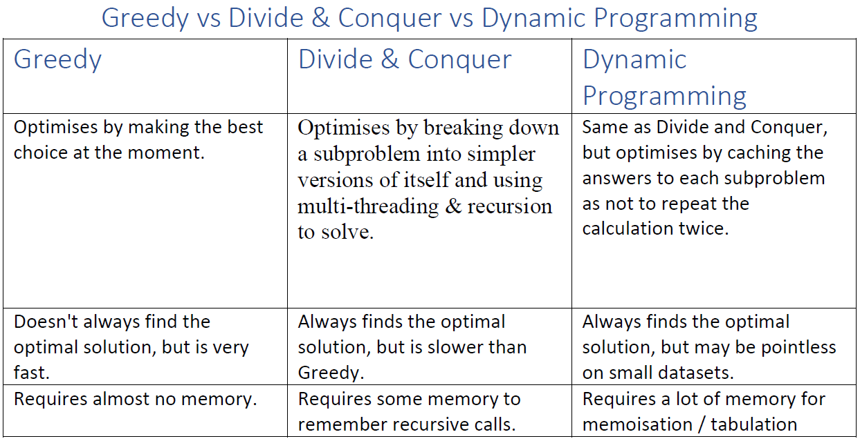
Greedy vs DC vs DP

Slide 56
Memoisation and Tabulation
Memoisation (Top-Down)
We would then perform a recursive call from the root, and hope we get close to the optimal solution or obtain a proof that we will arrive at the optimal solution.
Memoization ensures you never recomputed a subproblem because we cache the results, thus duplicate sub-trees are not recomputed.
Fibonacci with memorization.
This starts at the top of the tree and evaluates the subproblems from the leaves/subtrees back up towards the root.

Slide 57
Memoisation and Tabulation
Tabulation (Bottom-Up)
We've also seen Dynamic Programming being used as a 'table-filling' algorithm.
Usually, this table is multidimensional.
This is like memoisation, but with one major difference.
We have to pick the exact order in which we will do our computations.
The knapsack problem we saw, we filled in the table from left to right - top to bottom.
We knew the exact order of which to fill the table.

Slide 58
Memoisation and Tabulation
Memoisation vs Tabulation
 | Tabulation | Memoisation
Code | Harder to code as you have to know the order | Easier to code as functions may already exist to memoise
Speed | Fast as you already know the order and dimensions of the table | Slower as you're creating them on the fly
Table completeness | The table is fully computed | Table does not have to be fully computed

