Slide 1
COLORING PROBLEM
BACKTRACKING

Slide 2
Coloring problem
NP-complete problem !!! ~ exponential running time
Problem: coloring the vertices of a graph such that no two adjacent vertices share the same color
This is called a vertex coloring
Reached popularity with the general public in the form of the popular number puzzle Sudoku
The smallest number of colors needed to color a graph G is called its chromatic number
There may be more than one solution: for example we can color a graph with 4 vertices in 12 ways with 3 colors !!!

Slide 3
Applications

Slide 4
Bipartite graphs
Determining if a graph can be colored with 2 colors is equivalent to determining whether or not the graph is bipartite, and thus computable in linear time using breadth-first search
Bipartite graph: a graph whose vertices can be divided into two disjoint sets U and V ( U and V are independent sets ) such that every edge connects a vertex in U to one in V

Slide 5
Making schedules
We want to make an exam schedule for a university. We have different subjects and different students enrolled on every subject. Many subjects would have common students.
How do we schedule the exam so that no two exams with a common student are scheduled at the same time? How many minimum time slots are needed to schedule all exams?
This problem can be represented as a graph where every vertex is a subject and an edge between two vertices means there is a common student. So this is a graph coloring problem where minimum number of time slots is equal to the chromatic number of the graph

Slide 6
Radio frequency assignment
When frequencies are assigned to towers, frequencies assigned to all towers at the same location must be different because of the interference !!!
How to assign frequencies with this constraint? What is the minimum number of frequencies needed?
This problem is also an instance of graph coloring problem where every tower represents a vertex and an edge between two towers represents that they are in range of each other

Slide 7
Register allocation
In compiler optimization → register allocation is the process of assigning a large number of target program variables onto a small number of CPU registers

Slide 8
Map coloring
We want to construct a map of countries or states where adjacent countries or states can not be assigned the same color
This is the „tipical” coloring problem by the way !!!
Four colors are sufficient to color any map
„four color theorem”

Slide 9
Solutions
Greedy approach → finds the solution but not the most optimal one
It may uses more colors than necessary !!! (Fast)
Powell-Welsh algorithm → relies on sorting the nodes according to the degrees + we start assigning colors to the nodes with the most neighbors !!!
BACKTRACKING

Slide 10
Backtracking
We assign colors one by one to different vertices starting from the first vertex (optional)
Before assigning a color → we check for safety by considering already assigned colors to the adjacent vertices
If we find a color assignment which is feasible → we mark the color assignment as part of solution
If we do not a find color due to clashes → we backtrack !!!

Slide 11
A
B
C
E
D
F

Slide 12
vertex 0
vertex 1

Slide 13
A
B
C
E
D
F

Slide 14
A
B
C
E
D
F

Slide 15
A
B
C
E
D
F

Slide 16
A
B
C
E
D
F

Slide 17
A
B
C
E
D
F

Slide 18
A
B
C
E
D
F

Slide 19
A
B
C
E
D
F

Slide 20
A
B
C
E
D
F

Slide 21
A
B
C
E
D
F

Slide 22
A
B
C
E
D
F

Slide 23
A
B
C
E
D
F

Slide 24
A
B
C
E
D
F

Slide 25
A
B
C
E
D
F

Slide 26
Code Implementation

Slide 27
B
A
E
C
D

Slide 28
B
A
E
C
D

Slide 29
SUDOKU PROBLEM
BACKTRACKING

Slide 30
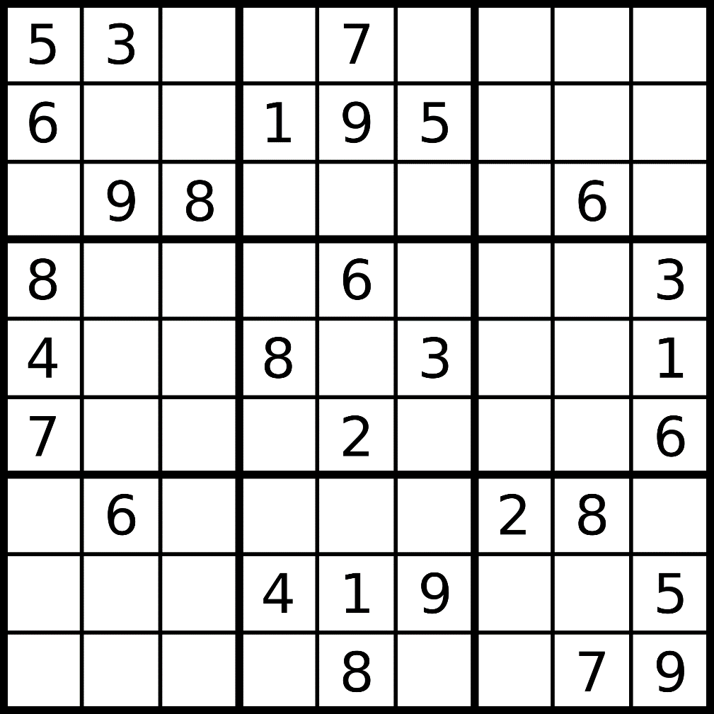

Slide 31
A single box

Slide 32
Sudoku
The aim of sudoku is to fill a 9×9 chessboard-like grid with digits
We have some rules:
Each column + each row, and each of the nine 3×3 sub-grids that compose the grid (boxes) contains all of the digits from 1 to 9
Initially we have → a partially completed grid, which for a well-posed puzzle has a unique solution
The same integer may not appear twice in the same row + column or in any of the nine 3×3 subregions / boxes of the 9x9 grid

Slide 33
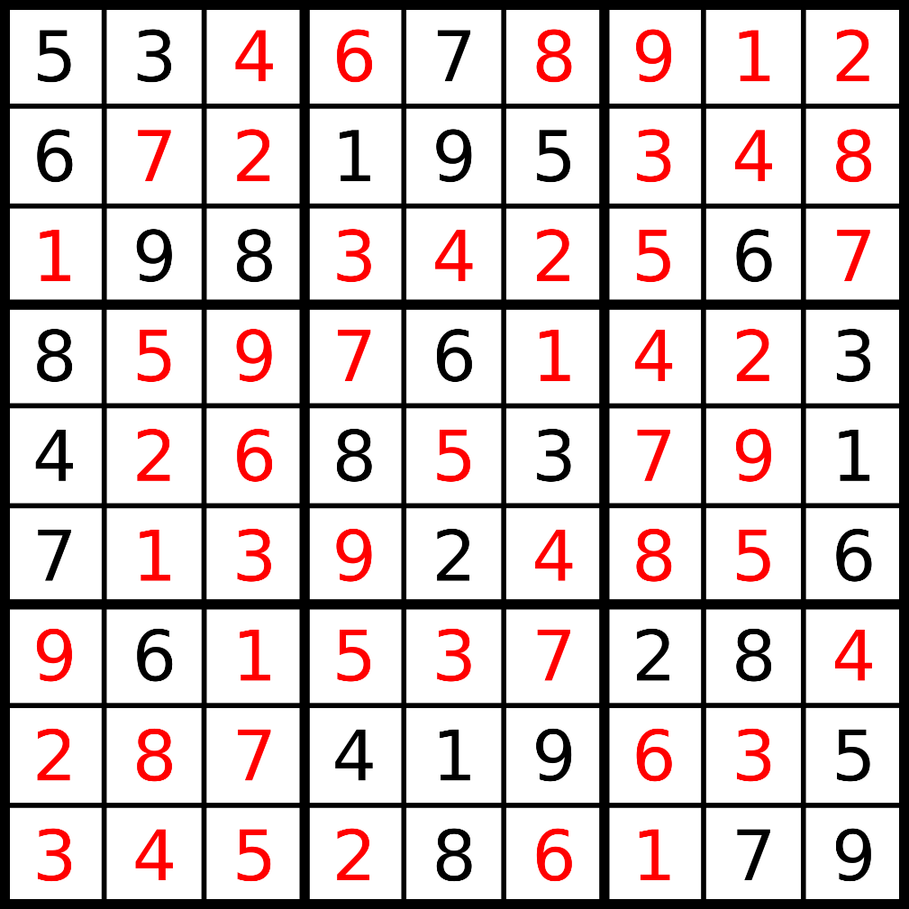

Slide 34
Sudoku
The problem itself is NP-complete
Running time complexity: O(m )
m: number of possibilities for a single cell (9)
n: number of blank fields at the beginning
Backtracking:
Iterates all the possible solutions for the given Sudoku
If the solutions assigned do not lead to the solution of Sudoku, the algorithm discards the solutions and rollbacks to the original solutions and retries again
n

Slide 35
Backtracking
Starting with an incomplete board:
Find some empty space
Attempt to place the digits 1-9 in that space
Check if that digit is valid in the current spot based on the current board
a. If the digit is valid, recursively attempt to fill the board using steps 1-3.
b. If it is not valid, reset the square you just filled and go back to the previous step.
Once the board is full by the definition of this algorithm we have found a solution.

Slide 36
Code Implementation

Slide 37
FLOOD FILL PROBLEM
backtracking

Slide 38
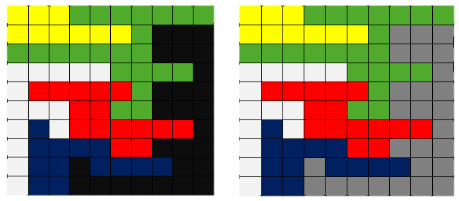
Flood Fill problem
The flood-fill algorithm takes three parameters: a start node, a target color, and a replacement color.
The algorithm looks for all nodes in the array that are connected to the start node by a path of the target color and changes them to the replacement color.

Slide 39
Code Implementation

Slide 40
KNIGHT’S TOUR PROBLEM
backtracking

Slide 41
Knight’s tour problem
A sequence of moves of a knight on a chessboard such that the knight visits every square EXACTLY once
Closed tour: when the knight end point is the same as the starting point
The knight's tour problem is an instance of the more general Hamiltonian-path problem
Closed knight tour ~ hamiltonian-cycle problem !!!
Solutions: brute-force approach + backtracking

Slide 45
Schwenk theorem
For an m x n chessboard the closed knight tour problem is always feasible, unless:
m and n are both odds
m = 1,2 or 4
m = 3 and n = 4,6 or 8

Slide 46
Backtracking
Start with an empty solution matrix / 2D array
When adding a new item → we check whether adding the current item violates the problem constraints or not
Yes: we backtrack
No: we add the item to the solution set and go to the next item
If we have considerd all the items we are ready !!!

Slide 48
1

Slide 49
2
1

Slide 50
2
3
1

Slide 51
2
3
1
4

Slide 52
2
3
1
4
5

Slide 53
2
3
1
4
6
5

Slide 54
2
3
7
1
4
6
5

Slide 55
8
2
3
7
1
4
6
5

Slide 56
8
2
3
7
9
1
4
6
5

Slide 57
8
2
3
7
9
1
4
6
10
5

Slide 58
8
2
3
7
9
1
4
11
6
10
5

Slide 59
8
2
3
7
12
9
1
4
11
6
10
5

Slide 60
8
13
2
3
7
12
9
1
4
11
6
10
5

Slide 61
8
13
2
14
3
7
12
9
1
4
11
6
10
5

Slide 62
8
13
2
14
3
7
12
9
1
4
15
11
6
10
5

Slide 63
8
13
2
14
3
7
12
9
1
4
15
11
6
10
5
16

Slide 64
8
13
2
14
3
7
12
9
1
17
4
15
11
6
10
5
16

Slide 65
8
13
2
14
3
7
12
9
1
17
4
15
18
11
6
10
5
16

Slide 66
8
13
2
14
3
7
12
9
1
17
4
15
18
11
6
10
5
16
19

Slide 67
8
13
2
14
3
7
12
9
1
20
17
4
15
18
11
6
10
5
16
19

Slide 68
8
13
2
21
14
3
7
12
9
1
20
17
4
15
18
11
6
10
5
16
19

Slide 69
8
13
2
21
14
3
22
7
12
9
1
20
17
4
15
18
11
6
10
5
16
19

Slide 70
23
8
13
2
21
14
3
22
7
12
9
1
20
17
4
15
18
11
6
10
5
16
19

Slide 71
23
8
13
2
21
14
3
22
7
12
9
24
1
20
17
4
15
18
11
6
10
5
16
19

Slide 72
23
8
13
2
21
14
3
22
7
12
9
24
1
20
17
4
15
18
11
6
25
10
5
16
19

Slide 73
Code Implementation

