Slide 1
RED-BLACK TREES

Slide 2
Construct a BST from a sorted array
[1,2,3,4]

Slide 3
1

Slide 4
1
2

Slide 5
1
2
3

Slide 6
1
2
3
4
It is a linked list: O(N) !!!

Slide 7
The running time of BST operations depends on the height of the binary search tree: we should keep the tree balanced in order to get the best performance
In an AVL tree, the heights of the two child subtrees of any node differ by at most one
Another solution to the problem is a red-black trees
AVL trees are faster than red-black trees because they are more rigidly balanced BUT needs more work
Operating Systems relies heavily on these data structures !!!

Slide 8
 | Average case | Worst case
Space | O(n) | O(n)
Insert | O(log n) | O(log n)
Delete | O(log n) | O(log n)
Search | O(log n) | O(log n)

Slide 9
Red-black properties:
Each node is either red or black
The root node is always black
All leaves (NIL or NULL) are black
Every red node must have two black child nodes and no other children → it must have a black parent
Every path from a given node to any of its descendant NIL/NULL nodes contains the same number of black nodes

Slide 10
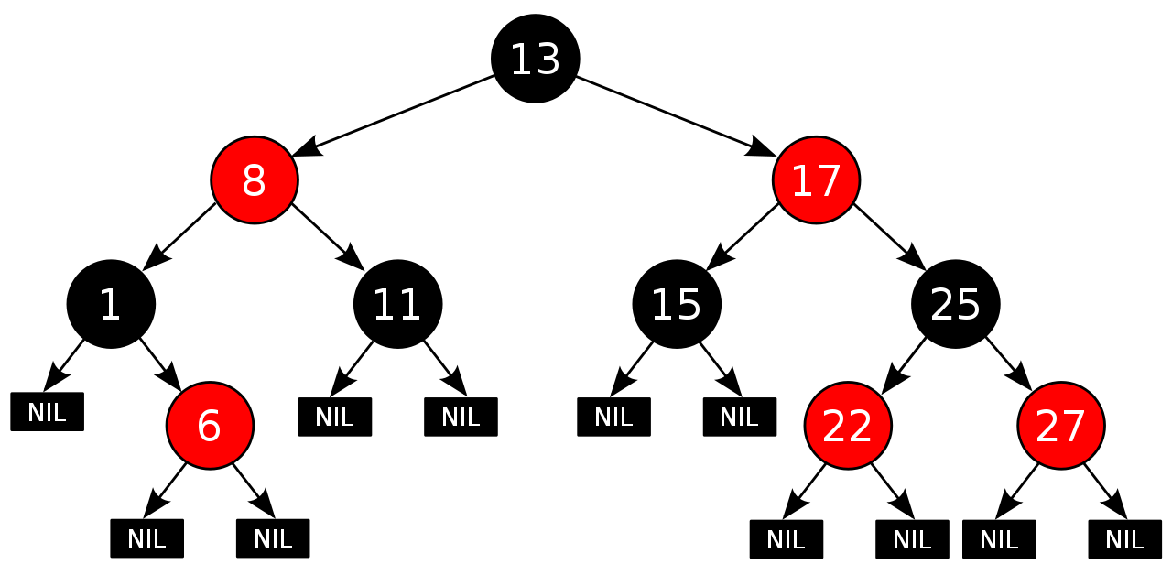

Slide 11
Rotations
Same AS AVL Tree
D
B
B
E
rightRotate(D)
A
D
A
C
leftRotate(B)
C
E
We just have to update the references which can be done in O(1)
time complexity !!! ( the in-order traversal is the same )

Slide 12
Every new node is red by default
We keep inserting new node in the same way as we have seen for binary search trees ( or AVL trees )
On every insertion → we have to check whether we have violated the red-black properties or not
If we have violated the RB properties: we have to rebalance the tree
1.) make rotations
2.) OR just recolor the nodes

Slide 13
RED-BLACK Trees Logic

Slide 14
Red-black trees logic
Every red node must have two black child nodes and no other children: it must have a black parent.
Every path from a given node to any of its descendant NIL/NULL nodes contains the same number (m) of black nodes.
Let’s assume that the shortest path from the root to any leaf has m black nodes!
If we want to construct longer paths
We can insert new red nodes but because of 1. we can not insert just a single red node !!!
So the longest possible path consists of 2*m nodes (alternating black and red)
Because of 2. every maximal paths have the same number of black nodes.
NO PATH IS MORE THAN TWICE AS LONG AS ANY OTHER PATH IN THE TREE
So the tree is approximately balanced!!

Slide 15
RED-BLACK Trees Property Violation Case I

Slide 16
Case 1:
D
E
A
x
We want to insert “x” node.
B
C

Slide 17
Case 1:
This problem is symmetric !!!
D
E
A
B
A
x
x
E
B
C
C
D

Slide 18
Case 1:
The „uncle” of x is red too !!!
D
E
A
x
B
C

Slide 19
Case 1:
We just have to recolor some nodes, quite
easy case
D
E
A
x
B
C

Slide 20
Case 1:
We just have to recolor some nodes, quite
easy case + the x will be the root node in this case
x
IMPORTANT: with this recoloring, maybe we
violate the red-black properties in other
parts of the tree !!!
~ have to check recursively on the whole tree
D
E
A
B
C

Slide 21
Case 1:
We have to check recursively (fom bottom to top)
whether the red-black properties are violated or not
x
D
E
A
B
C

Slide 22
Case 1:
A
B
x
E
C
D

Slide 23
Case 1:
A
B
x
E
C
D

Slide 24
Case 1:
A
B
x
E
C
D

Slide 25
Case 1:
x
A
B
E
C
D

Slide 26
RED-BLACK Trees Property Violation Case II

Slide 27
Case 2:
D
E
A
x
We want to insert “x” node.
B
C

Slide 28
Case 2:
The uncle of node x is a black node + node x is a right child
D
E
A
x
B
C

Slide 29
Case 2:
The uncle of node x is a black node + node x is a right child
uncle
D
E
A
x
B
C

Slide 30
Case 2:
D
E
A
x
B
C

Slide 31
Case 2:
The uncle of node x is a black node + node x is a right child
We have to make a left rotation on the node x’s parent
D
E
A
x
B
C

Slide 32
Case 2:
D
E
A
x
B
C

Slide 33
Case 2:
The uncle of node x is a black node + node x is a right child
We have to make a left rotation on the node x’s parent
We have to rotate the blue node !!!
D
E
A
x
B
C

Slide 34
Case 2:
D
E
A
x
B
C

Slide 35
Case 2:
The uncle of node x is a black node + node x is a right child
We have to make a left rotation on the node x’s parent
x
D
E
D
E
A
x
C
B
C
A
B

Slide 36
Case 2:
same problem basically but the symmetric version
A
B
x
E
C
D

Slide 37
Case 2:
The given x node is a left child
+ the parent is red
+ the uncle is black
A
B
x
E
C
D

Slide 38
Case 2:
The given x node is a left child
+ the parent is red
+ the uncle is black
A
B
x
E
C
D

Slide 39
Case 2:
The given x node is a left child
+ the parent is red
+ the uncle is black
A
B
x
E
C
D

Slide 40
Case 2:
The given x node is a left child
+ the parent is red
+ the uncle is black
We just have to make a right rotation
on the blue node !!!
A
B
x
E
C
D

Slide 41
Case 2:
x
A
B
x
E
A
B
C
C
D
D
E

Slide 42
RED-BLACK Trees Property Violation Case III

Slide 43
Case 3:
Uncle of node x is black and node x is a left child
D
E
x
C
A
B

Slide 44
Case 3:
Uncle of node x is black and node x is a left child
uncle
D
E
x
C
A
B

Slide 45
Case 3:
Uncle of node x is black and node x is a left child
We have to make a rotation on x node’s grandparent
D
E
x
C
A
B

Slide 46
Case 3:
Uncle of node x is black and node x is a left child
We have to make a rotation on x node’s grandparent
x’s grandparent
D
E
x
C
A
B

Slide 47
Case 3:
Uncle of node x is black and node x is a left child
We have to make a rotation on x node’s grandparent
x’s grandparent: we have to rotate this node
D
E
x
C
A
B

Slide 48
Case 3:
Uncle of node x is black and node x is a left child
We have to make a rotation on x node’s grandparent
x
D
E
A
B
x
C
C
A
B
It is important that after the rotations
we have to make some recoloring as well !!!
D
E

Slide 49
Case 3:
The symmetric version is basically the same just
rotate in the opposite direction
A
B
C
X
D
E

Slide 50
Case 3:
The symmetric version is basically the same just
rotate in the opposite direction
x
A
B
D
E
C
X
C
D
E
A
B

Slide 51
RED-BLACK Trees Property Violation Case IV

Slide 52
Case 4:
Uncle of node x is black and node x is a left child
+ uncle is red here in this case
We have to recolor some nodes !!!
D
E
x
C
A
B

Slide 53
Case 4:
Uncle of node x is black and node x is a left child
We have to recolor some nodes
x
íííí
D
E
D
E
x
C
C
A
B
A
B

Slide 54
Case 4:
This is the same problem but the symmetric
version !!!
A
B
C
X
D
E

Slide 55
Case 4:
This is the same problem but the symmetric
version !!!
x
A
B
A
B
C
C
X
D
E
D
E

Slide 56
EXAMPLE

Slide 57
Example:
insert(1)

Slide 58
Example:
insert(1)
1

Slide 59
Example:
insert(1)
1

Slide 60
Example:
insert(2)
1

Slide 61
Example:
insert(2)
1

Slide 62
Example:
insert(2)
1
2

Slide 63
Example:
insert(3)
1
2

Slide 64
Example:
insert(3)
1
2

Slide 65
Example:
insert(3)
1
2

Slide 66
Example:
1
2
3
It is the Case 3: because the NULL is considered to be a black node
→ the uncle of Node 3 is black
Have to make a rotation + recolor the nodes if
necessary

Slide 67
Example:
1
NULL
2
3
It is the Case 3: because the NULL is considered to be a black node
→ the uncle of Node 3 is black
Have to make a rotation + recolor the nodes if
necessary

Slide 68
Example:
insert(4)
2
1
3

Slide 69
Example:
insert(4)
2
1
3

Slide 70
Example:
insert(4)
2
1
3

Slide 71
Example:
2
1
3
4

Slide 72
Example:
2
1
3
4
It is the Case 1: the given node 4 and the parent are both red + uncle is red
Color uncle + parent to be black

Slide 73
Example:
2
1
3
4
It is the Case 1: the given node 4 and the parent are both red + uncle is red
Color uncle + parent to be black

Slide 74
Example:
2
1
3
4
It is the Case 1: the given node 4 and the parent are both red + uncle is red
Color uncle + parent to be black
VIOLATES THE PROPERTIES AGAIN
Root has to be black as well

Slide 75
Example:
insert(5)
2
1
3
4

Slide 76
Example:
insert(5)
2
1
3
4

Slide 77
Example:
insert(5)
2
1
3
4

Slide 78
Example:
insert(5)
2
1
3
4
5

Slide 79
Example:
This is the Case 3 situation, we have to make
some rotations !!!
2
1
3
4
5

Slide 80
Example:
2
1
4
3
5

Slide 81
EXAMPLE

Slide 82
Example:
32
10
55
1
19
79
16
23

Slide 83
Example:
We want to insert 12
32
10
55
1
19
79
16
23

Slide 84
Example:
We want to insert 12
32
10
55
1
19
79
16
23

Slide 85
Example:
We want to insert 12
32
10
55
1
19
79
16
23

Slide 86
Example:
We want to insert 12
32
10
55
1
19
79
16
23

Slide 87
Example:
We want to insert 12
32
10
55
1
19
79
16
23

Slide 88
Example:
32
10
55
1
19
79
16
23
12

Slide 89
Example:
On every insertion we have to check whether
the red black tree properties are violated or not !!!
32
10
55
1
19
79
16
23
12

Slide 90
Example:
On every insertion we have to check whether
the red black tree properties are violated or not !!!
32
10
55
1
19
79
16
23
12
It is violated because red node has a single red child

Slide 91
Example:
32
10
55
1
19
79
16
23
12
This is the Case1 situation: we just have
to recolor nodes

Slide 92
Example:
32
10
55
1
19
79
16
23
12
This is the Case1 situation: we just have
to recolor nodes

Slide 93
Example:
We have to check whether
the red black tree properties are violated or not !!!
32
10
55
1
19
79
16
23
12

Slide 94
Example:
32
This is the Case2
situation !!!
10
55
1
19
79
16
23
12

Slide 95
Example:
32
This is the Case2
situation !!!
10
55
1
19
79
16
23
12
We have to make a left rotation on node 10 !!!

Slide 96
Example:
32
19
55
10
23
79
1
16
12

Slide 97
Example:
We have to check whether
the red black tree properties are violated or not !!!
32
19
55
10
23
79
1
16
12

Slide 98
Example:
We have to check whether
the red black tree properties are violated or not !!!
32
This is the Case3
situation !!!
19
55
10
23
79
1
16
12

Slide 99
Example:
We have to check whether
the red black tree properties are violated or not !!!
32
This is the Case3
situation !!!
19
55
10
23
79
1
16
12
We have to make a right rotation
on the root node !!!

Slide 100
Example:
19
10
32
1
16
23
55
79
12

Slide 101
RED-BLACK Tree vs AVL Tree

Slide 102
Red-black trees
Linux kernels relies heavily on red-black tree data structure.
Insertion is fast -> because it is not rigidly balanced, we do not bother about making the tree as balanced as possible.
For an insert intensive tasks, use a Red-Black tree !!!
Java: java.util.TreeMap, java.util.TreeSet
C++ STL: map, multimap, multiset

Slide 103
AVL trees
Rigidly balanced tree and hence provide faster look-ups.
For a look-up intensive task use an AVL tree.
Insertion/deletion is not so fast -> because we keep unbalancing the tree.

