Slide 1

Introduction to Data science final project
109550198, Ralph K. W. Buteau

Slide 2

"Predictive Analytics in Social Network Advertising: Unveiling the Influence of User Demographics on Purchase Decisions"

Slide 3
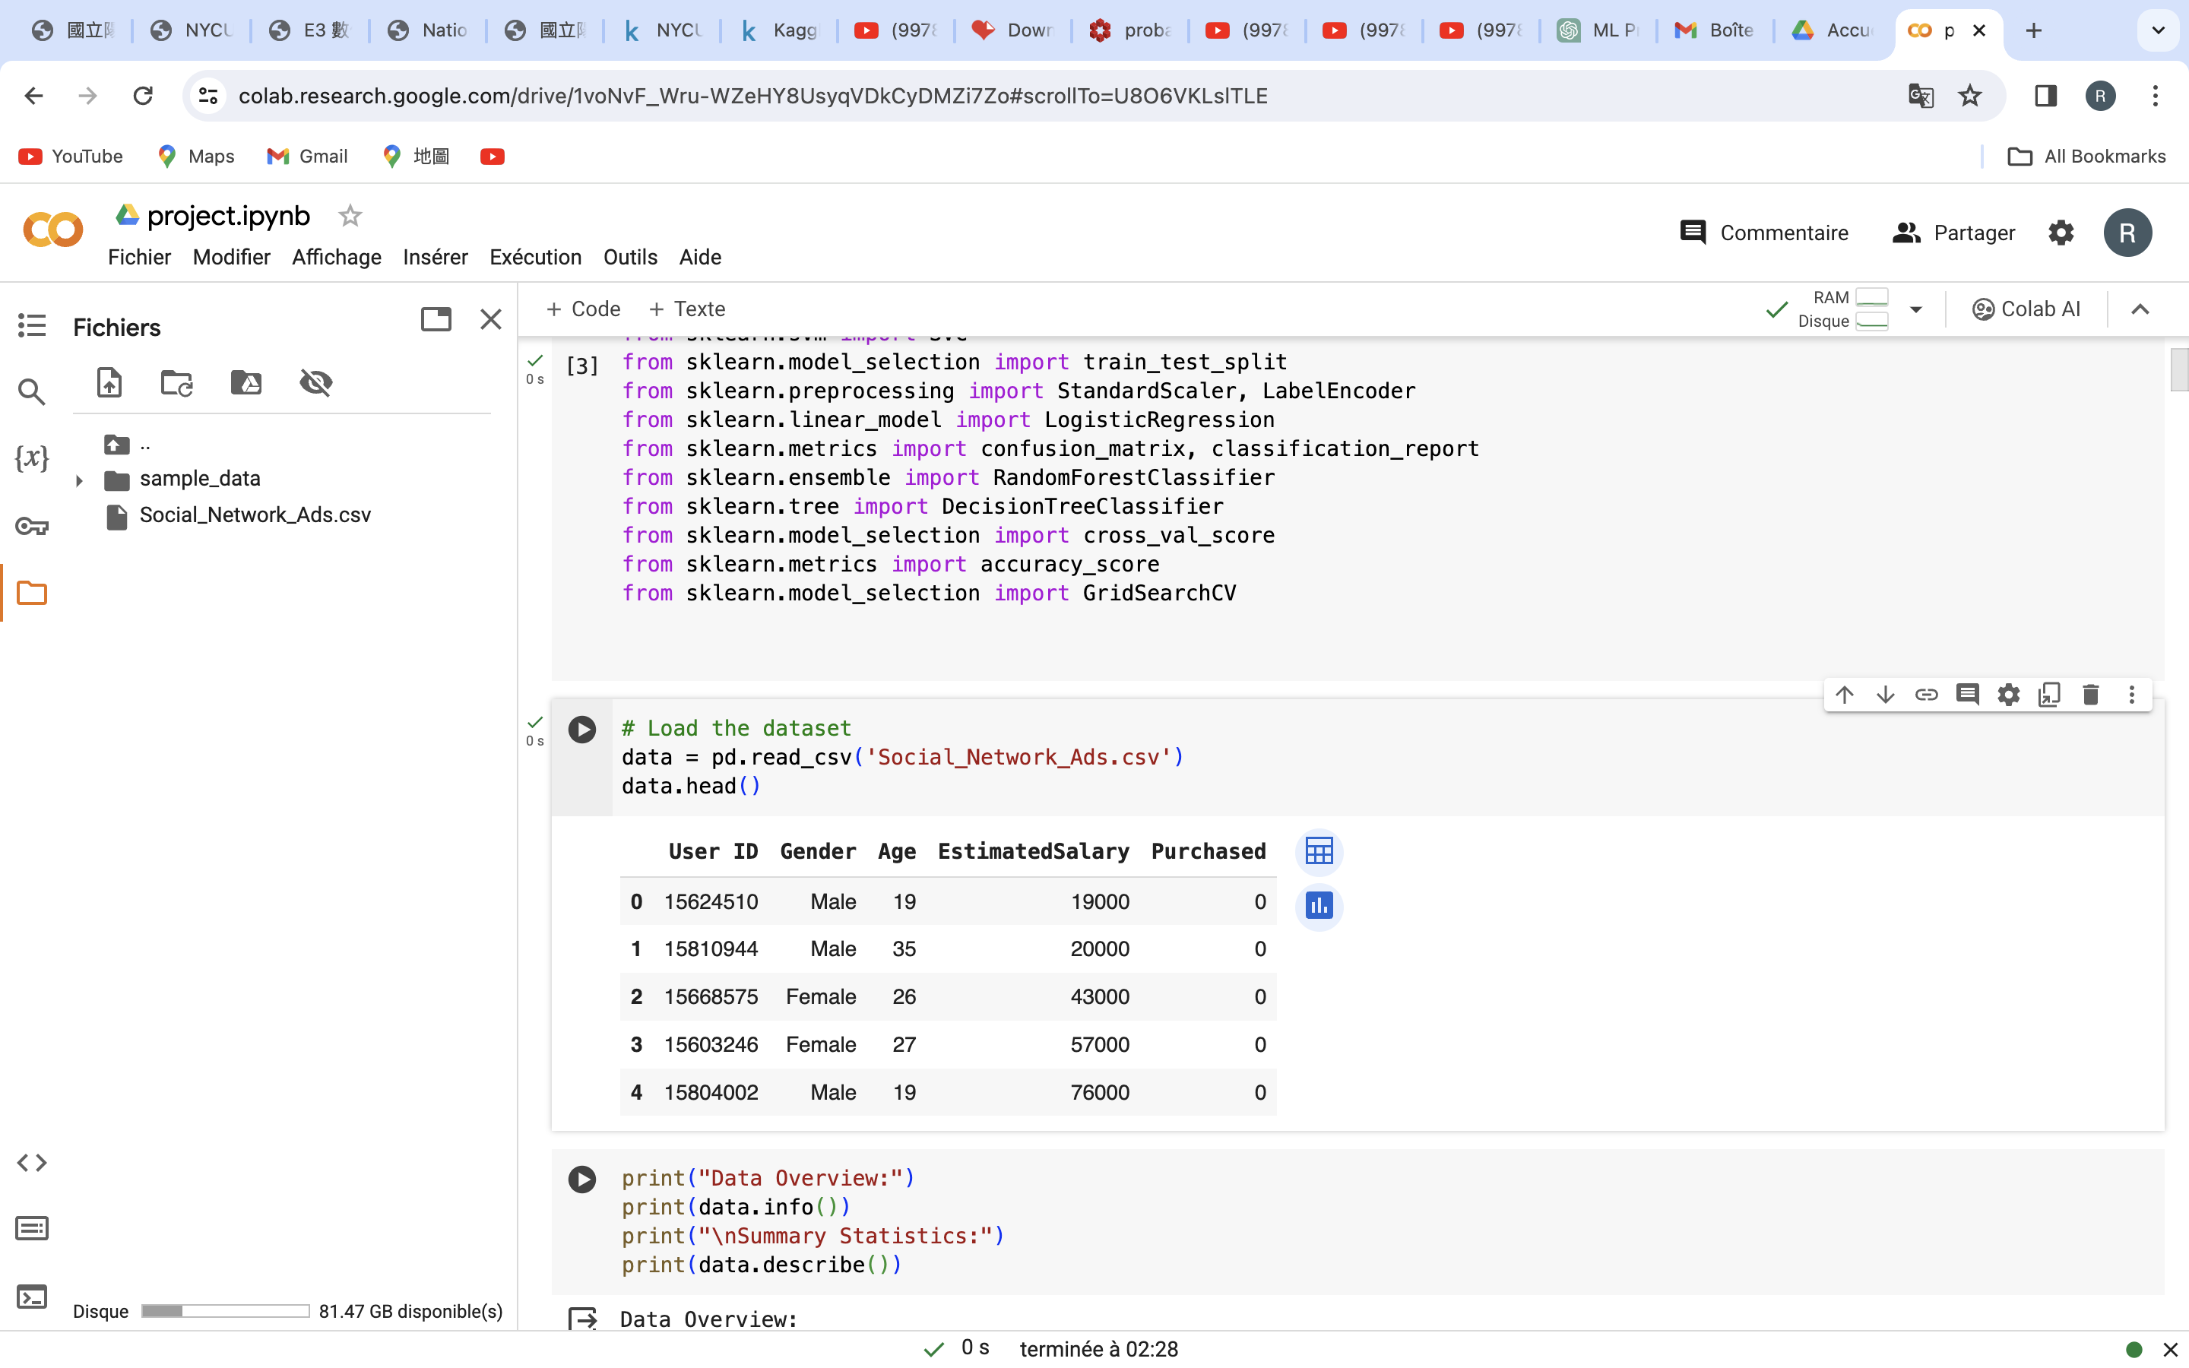
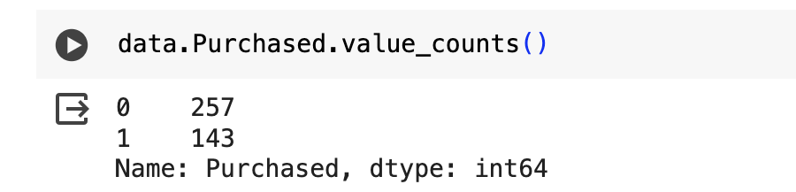
The project uses a dataset named 'Social_Network_Ads.csv’ from Kaggle.
The dataset 'Social_Network_Ads.csv' contains the following columns:
User ID: Identifier for the user.
Gender: Gender of the user (Male/Female).
Age: Age of the user.
EstimatedSalary: Estimated salary of the user.
Purchased: Whether the user purchased or not (0 = No, 1 = Yes).

Slide 4
MODEL IMPLEMENTATION
The project experiments with several classification models, including Logistic Regression, K-Nearest Neighbors (KNN), Support Vector Machine (SVM), Decision Tree, and Random Forest.
Grid Search: This technique is used for hyperparameter tuning to optimize model performance.
Cross-Validation: K-Fold Cross-Validation is employed to assess model robustness.

Slide 5
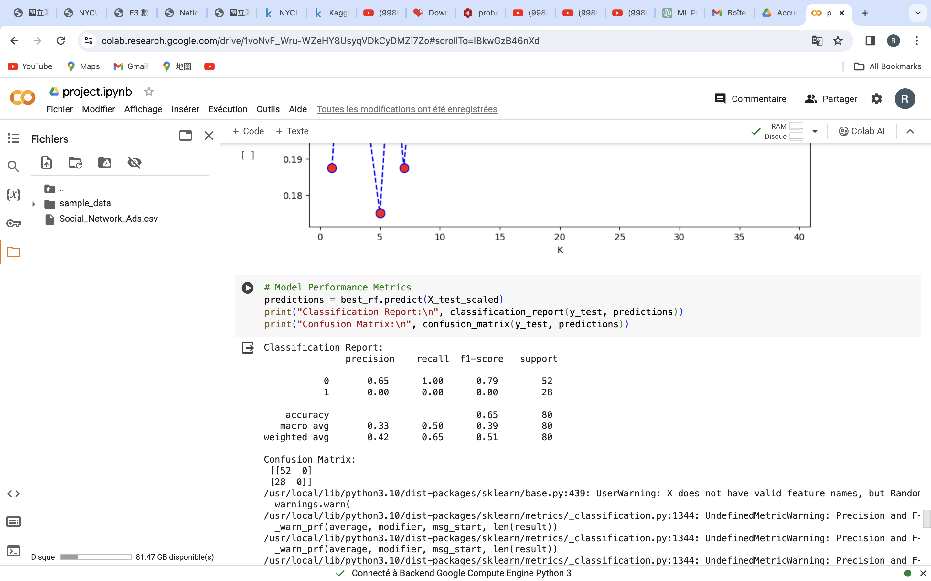
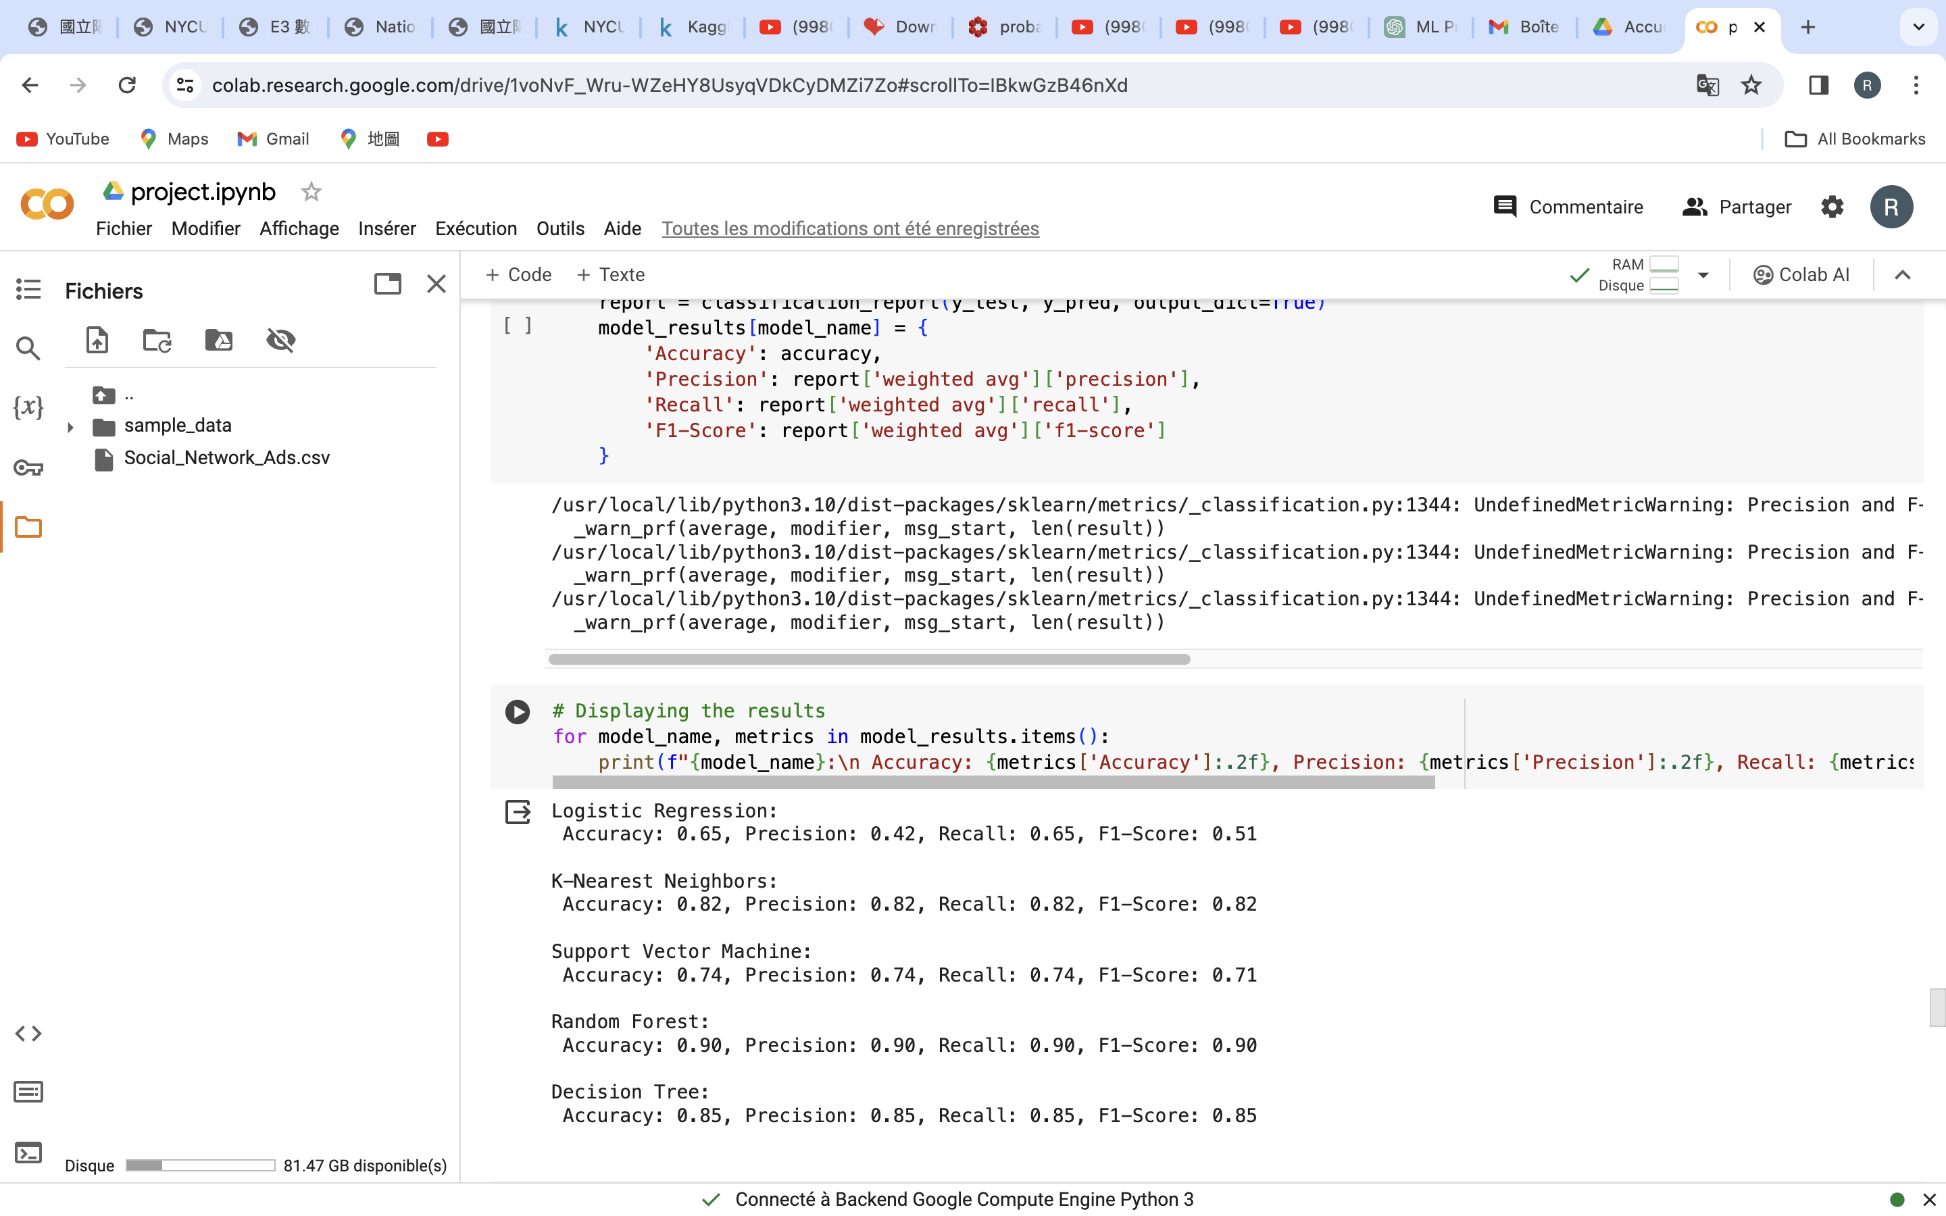
MODEL EVALUATION
Metrics Used:
Confusion Matrix,
Classification Report
Accuracy
Precision
recall and F
F1-score, are used to evaluate the models.

Slide 6
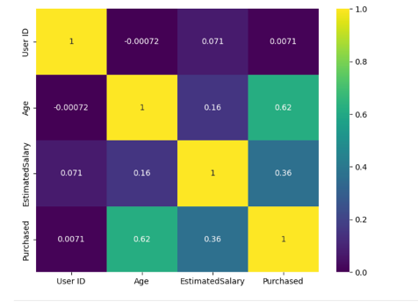
Exploratory TOOL
The correlation matrix indicates:
Age and Purchased have a moderate positive correlation, suggesting older users are more likely to make purchases.
Estimated Salary and Purchased are moderately correlated, indicating that users with higher salaries tend to purchase more.
Age and Estimated Salary show a weak positive correlation, slightly suggesting higher salaries with increasing age.
User ID has no meaningful correlation with any other variable.

Slide 7
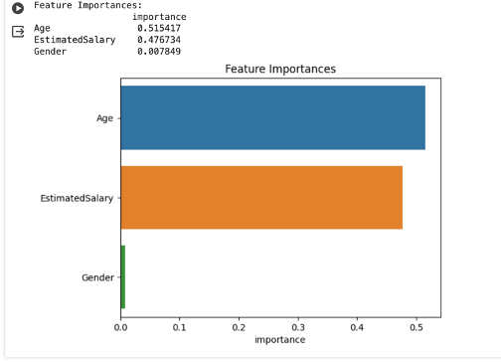
Feature importance
Findings
Age: This feature has the highest importance, with a score of approximately 0.515. This suggests that age is the most influential predictor in the model, indicating that the likelihood of the target variable (such as making a purchase) increases or decreases with age.
EstimatedSalary: The second most important feature, with a score of about 0.476. This indicates that estimated salary is almost as influential as age in the model's predictions. It implies a strong relationship between a user's salary and the target variable.
Gender: The least important feature, with a score around 0.0078. Its lower score compared to age and estimated salary suggests that gender has a much smaller effect on the model's predictions.

Slide 8
Conclusion
Age and estimated salary are key predictors of purchase behavior in the 'Social_Network_Ads' dataset, indicating that marketing efforts should prioritize these demographics. Gender's low impact suggests less focus on it for targeting strategies.

Slide 9
THANk you

