Slide 1
outline:
Introduction
Dataset
preprocessing
Dataset cleaning
Dataset normalization
Dataset reduction
knn algorithm
Accuracy and Visualization

Slide 2

Introduction
Study case:
build a program predicting if the patient could has breast cancer or not .
Apply K-Nearest Neighbors (KNN) method on the dataset
classification problem.
classify new data points based on similarity measures

Slide 3
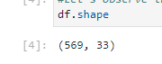
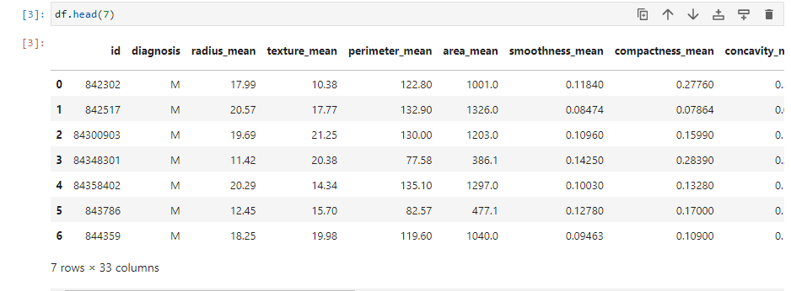
Dataset In Details
Data set contains: Features are computed from a digitized image of a fine needle aspirate (FNA) of a breast mass.
Diagnosis determines if the tumor is malignant or a benign tumor
Data set contains 569 rows × 33 columns

Slide 4
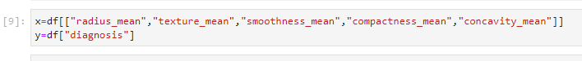
preprocessing
Split the dataset
x=df[["radius_mean","texture_mean","smoothness_mean","compactness_mean","concavity_mean"]]
y=df["diagnosis"]

Slide 5
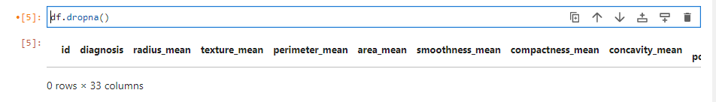
Data cleaning
Dropna() function is used to remove missing values.

Slide 6
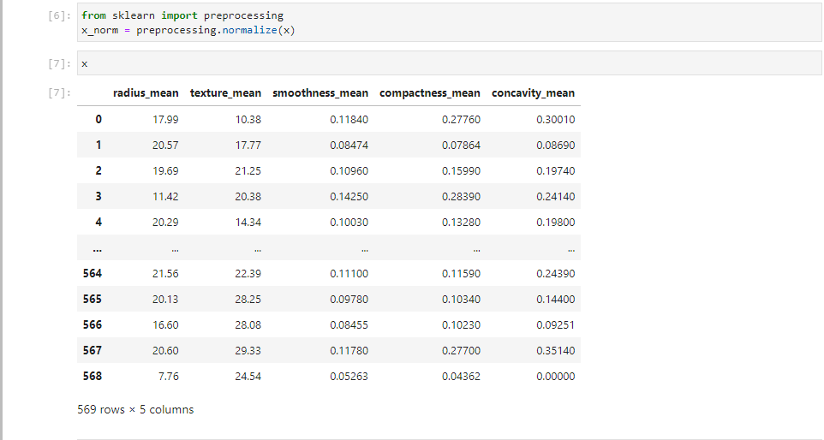
Data normalization
normalized the data values in the range of 0 and 1.

Slide 7
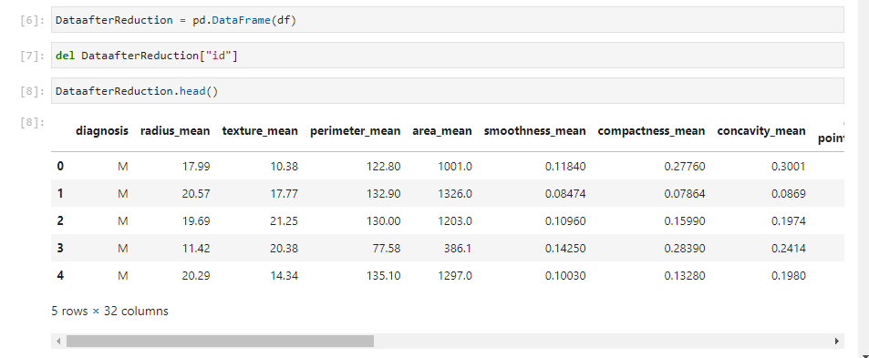
Data reduction
Delete column we do not need it

Slide 8
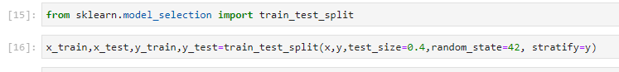
k-Nearest Neighbors classification
KNN Supervised learning (classification)
New data is classified based on the training set
Divide the dataset into training and test

Slide 9
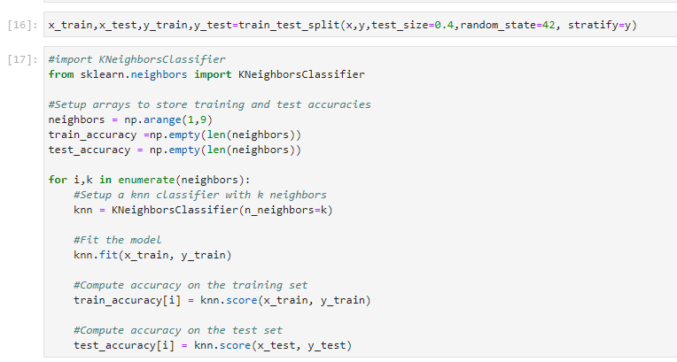
k-Nearest Neighbors classification
import the KNeighborsClassifier

Slide 10
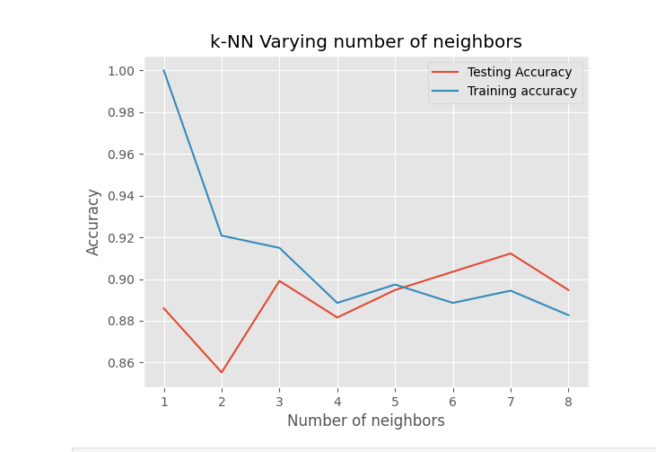
Decide the Number of Neighbors in KNN
maximum testing accuracy for k=7.

Slide 11
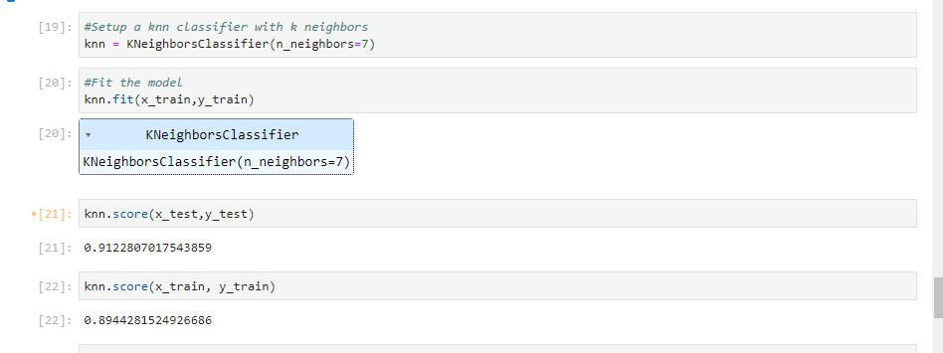
Accuracy
92% of accuracy and 89% of accuracy .

Slide 12
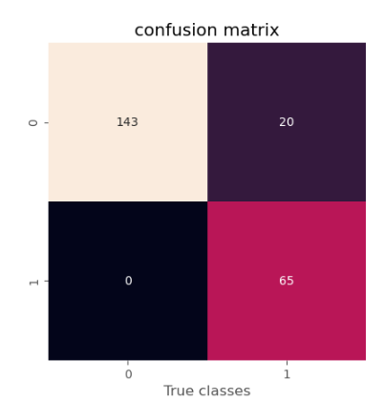
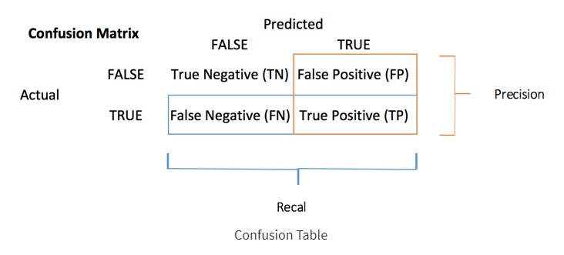
Visualization
Confusion Matrix
The confusion matrix gives a clear overview of the actual labels and the prediction of the model
The model predicted 163 patients were in the “benign (0)” stage (they do not have breast cancer) while only 143 were and it predicted that
0 patient were in “malignant (1)” when only 65 have breast cancer.

