Slide 1

Google Cloud Vision Cloud ${\text{AutoML}}^{BETA}$
Michael Wimmer, Monika Moser

Slide 2
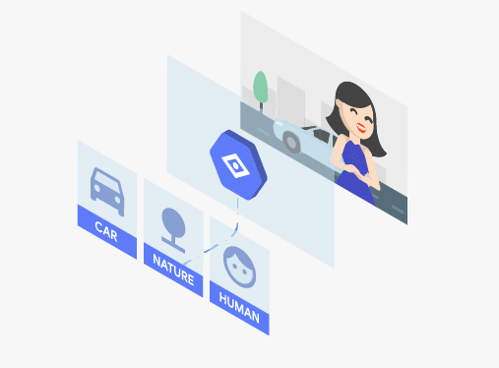
Cloud Vision API
pretrained API model
use through REST
moderated content
1.000 units a month free

Slide 3

Cloud Vision API
label detection
a weber identifier
optical character recognition
Handwriting recognition^{BETA}
logo recognition
Object locator^{BETA}
recognition of sights
face recognition
integrated ML Kit
Product search^{BETA}

Slide 4
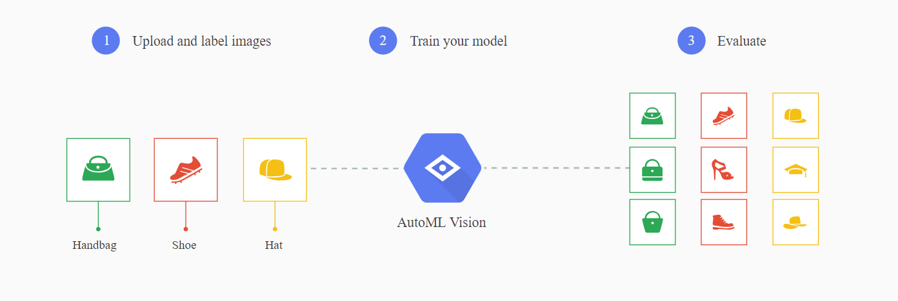
AutoML Vision
train customized models
higher model accuracy
high performance
label creation by humans
1.000 first forecasts are free

Slide 5
App Engine
fundamental part of Google Cloud Platform
PaaS and IaaS
Big Data Cloud storage
Python, Java, PHP, GO, …
Many storage options

Slide 6
Live Demo
label detection
objects, places, animal species, products, …
labels are in English (translate with Cloud Translation API)
GCP-project and authentication
returns JSON

Slide 7
Live Demo
pip install –upgrade google-cloud-vision
google-api.core
google-auth
google-cloud-vision
googleapis-common-protox (check version!!) latest version is beta – does not work

Slide 8
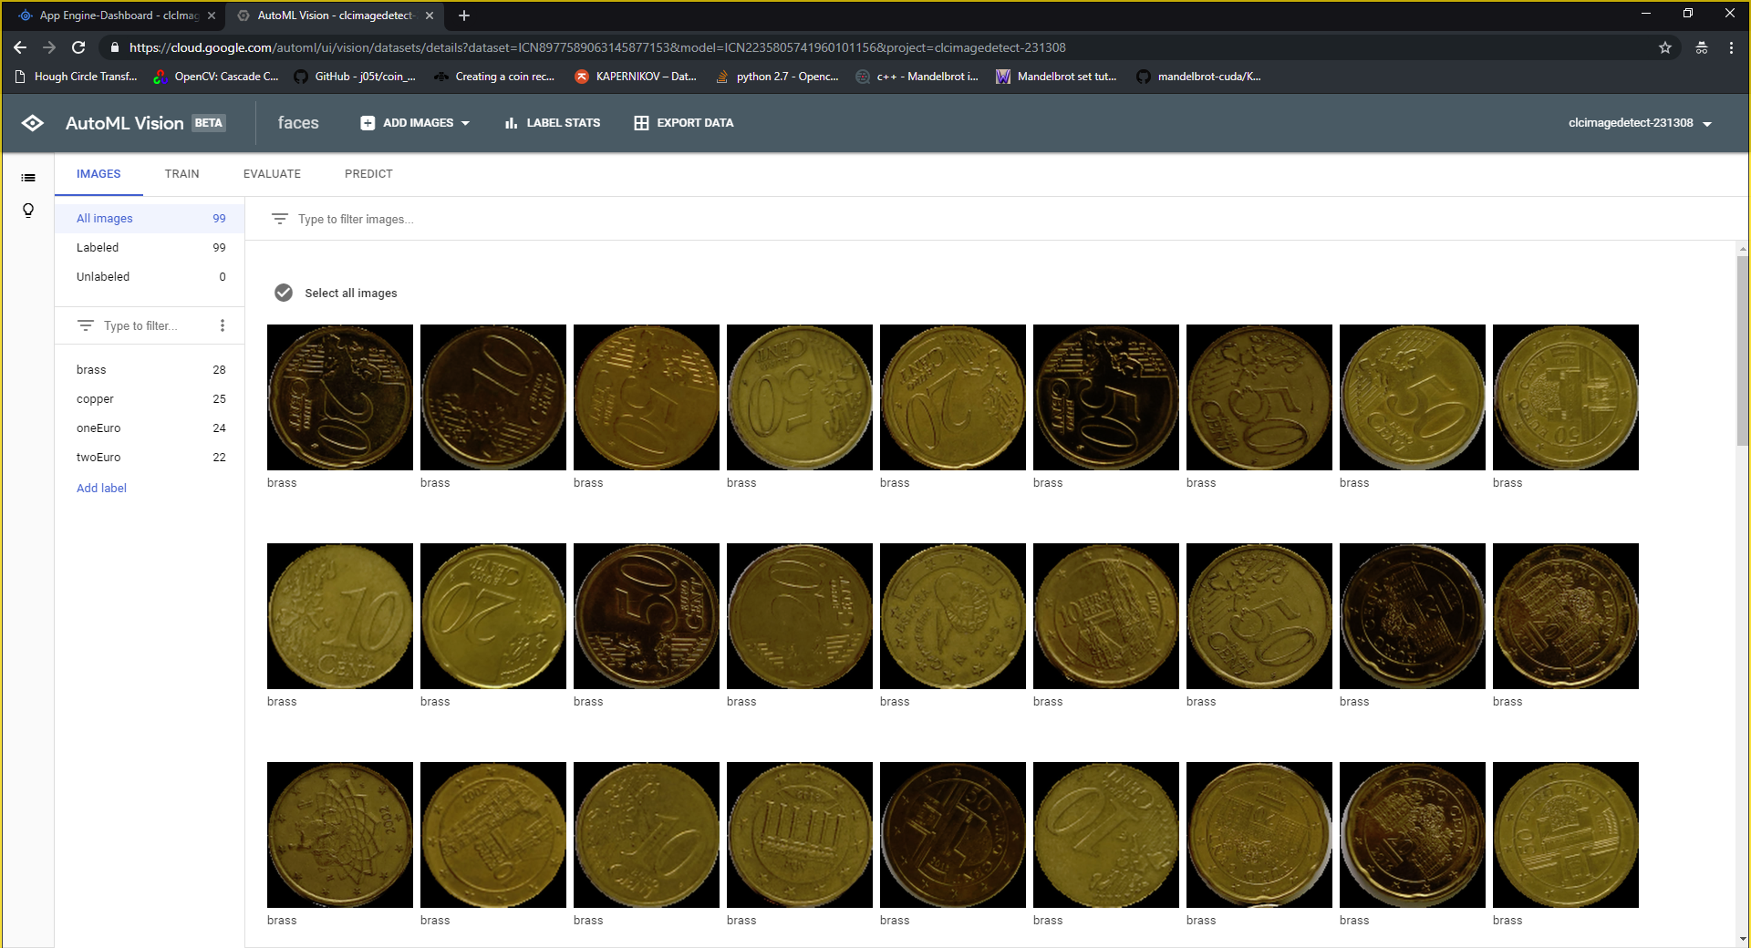

Slide 9
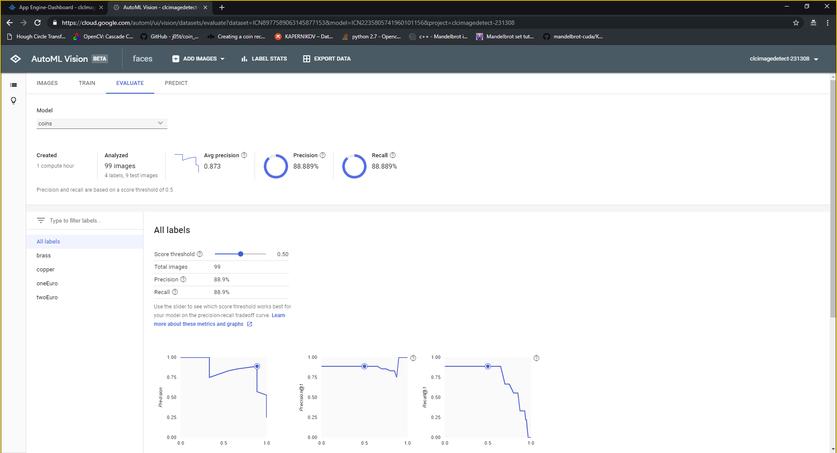

Slide 10
