Slide 1
01
Constraint-based modeling of drug-induced metabolic changes in a cancer cell line
Benedicto et al., 2025
권태민 · 32220304
Systems Biology Midterm
Format B · Presentation date 2026-10-14
Notes:
Cue: npj Systems Biology and Applications 11:111 (2025). AGS gastric cancer cells, three kinase inhibitors, two combinations. Public data GSE285616 and open-source MTEApy; I re-ran the analysis myself.

Slide 2
02
Paper: Benedicto, Flobak, Ponce-de-León, Valencia
npj Systems Biology and Applications 11:111 (2025)
Data: GEO GSE285616 · Code: MTEApy (open source)
Outline
Background
Cross-check · Fig. 5
Take-home
Method
My re-analysis
Questions
Result 1 · Fig. 3
Assessment
Backup · Fig. 1, Fig. 2
Result 2 · Fig. 4
Relevance
Backup · Table 1, terms
Notes:
Optional slide; skip if time is short.

Slide 3
The system
03
Background
AGS gastric adenocarcinoma cells
PI3K inhibitor PI-103 (PI3Ki)
MEK inhibitor PD0325901 (MEKi)
TAK1 inhibitor (5Z)-7-oxozeaenol (TAKi)
Two combinations: PI3Ki+MEKi, PI3Ki+TAKi
Control: DMSO; 4 replicates per condition
  Cancer cells rewire metabolism under PI3K, MEK and TAK1 signaling
  PI3Ki+MEKi and PI3Ki+TAKi inhibit AGS growth synergistically
  Gap: expression analysis gives broad labels, not metabolic detail
  Question: which metabolic tasks change, and which only in the combination?
Background
Notes:
Cue: AGS carries KRAS G12D and PIK3CA mutations, so MAPK and PI3K are both active. Synergy of the pairs was shown for growth in Flobak 2015. GSEA and DEG give broad labels such as amino acid metabolism.

Slide 4
04
Method
Method
3 Test and rule
10,000 permutations, p < 0.025
Weak synergy: beyond both single drugs
Strong synergy: only the combination
2 Metabolic map
Human-GEM and 187 tasks
AND = min, OR = absmax
Task score = mean log2FC
1 RNA-seq and DESeq2
6 conditions × 4 replicates
log2FC against DMSO control
Notes:
Cue: a task is a defined input to output conversion, e.g. aspartate to asparagine. TIDE averages the reactions of a pFBA reference pathway; TIDE-essential averages genes whose knockout makes the task infeasible. Permutation shuffles gene log2FC values.

Slide 5
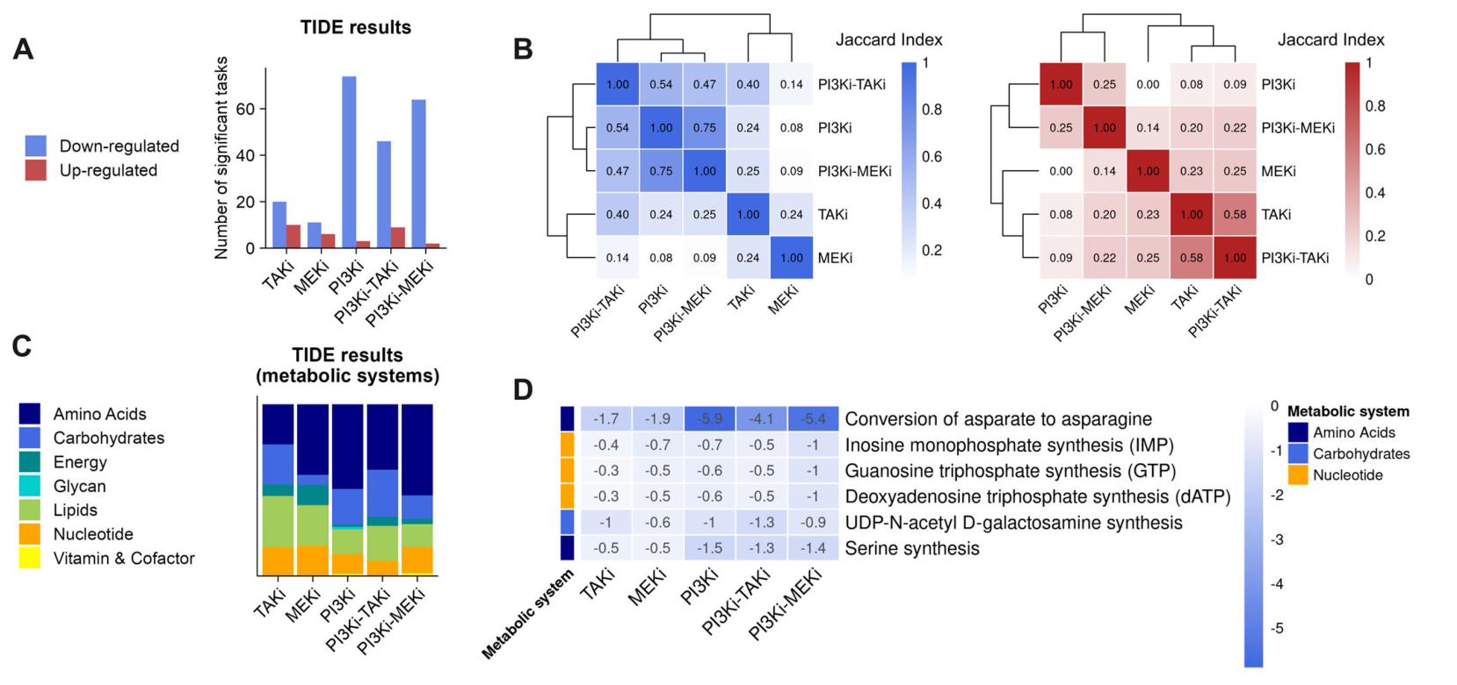
05
Result 1
Metabolic tasks are weakened, led by PI3K inhibition
77, 66 and 55 significant tasks in PI3Ki, PI3Ki+MEKi and PI3Ki+TAKi
About 88% of significant tasks are weakened, not strengthened
Asp → Asn synthesis: −5.9 in PI3Ki, weakened in all five conditions
Source: Fig. 3, Benedicto et al. 2025 (CC BY-NC-ND 4.0). A tasks · B overlap · C systems · D shared tasks
Result 1 · Fig. 3
Notes:
Cue: A = significant tasks per condition (down in blue). B = Jaccard overlap, PI3Ki and PI3Ki+MEKi 0.75, MEKi isolated. C = amino acids largest. D = tasks significant in all five; Asp to Asn is ASNS, a single-gene task. Task score = mean log2FC.

Slide 6
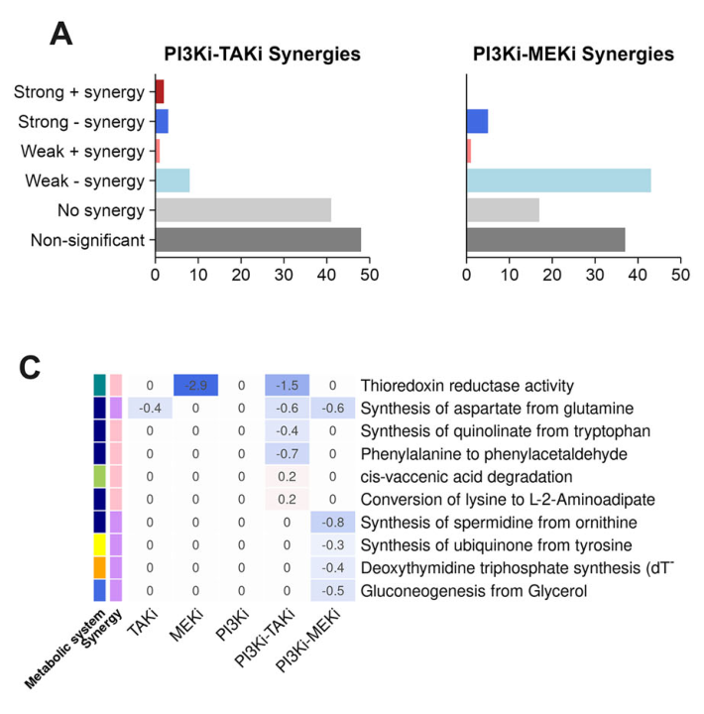
06
Result 2
Some tasks are weakened only by the combination
49 of 66 PI3Ki+MEKi tasks are classified synergistic (PI3Ki+TAKi: 14 of 55)
Weak synergy: the combination is more extreme than both single drugs
Strong synergy: only the combination is significant, e.g. spermidine synthesis, CoQ synthesis, thioredoxin reductase
Most calls are weak synergy (about 43 of 49)
Source: Fig. 4A and 4C, Benedicto et al. 2025 (CC BY-NC-ND 4.0)
Result 2 · Fig. 4
Notes:
Cue: parent and child logic. Weak: combination below the min of both singles. Strong: both singles not significant, combination significant. Strong-synergy scores are small, -0.3 to -0.8, versus -5.9 for Asp to Asn. Combination is half-dose of each drug.

Slide 7
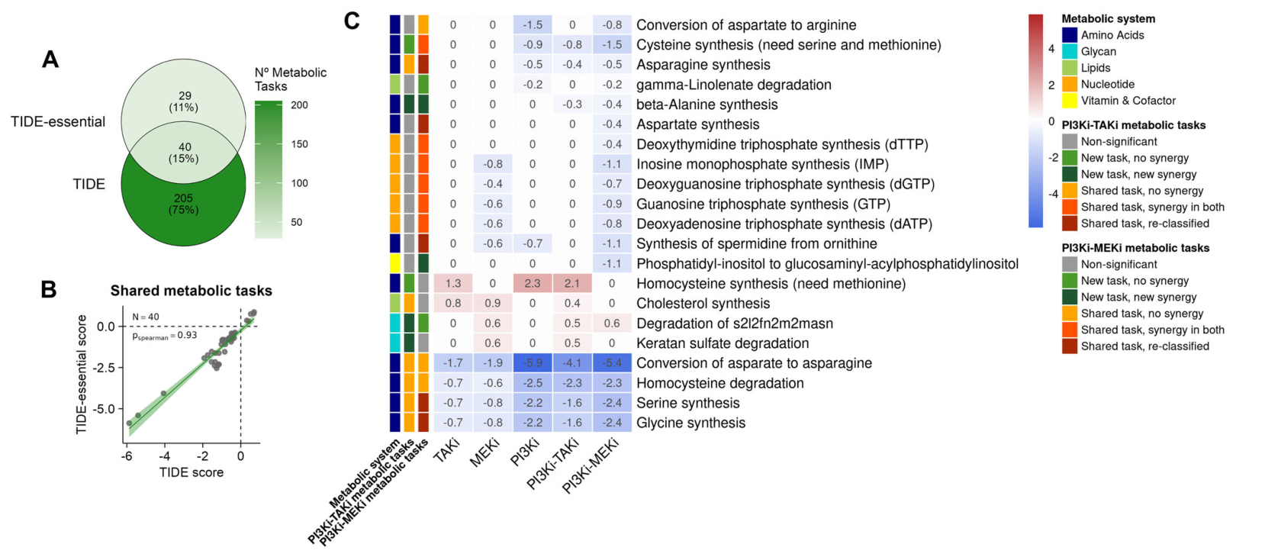
07
Cross-check
A second method: TIDE-essential
245 vs 69 significant task–condition pairs (TIDE vs TIDE-essential)
40 shared; Spearman ρ = 0.93 on these shared pairs
New in TIDE-essential: β-alanine synthesis, down in both combinations
Source: Fig. 5, Benedicto et al. 2025 (CC BY-NC-ND 4.0). A overlap · B score agreement · C TIDE-essential tasks
Cross-check · Fig. 5
Notes:
Cue: counts are task-condition pairs, not distinct tasks. rho = 0.93 is computed on pairs already significant in both methods. Single-gene tasks give identical scores. Complementary, not a validation.

Slide 8
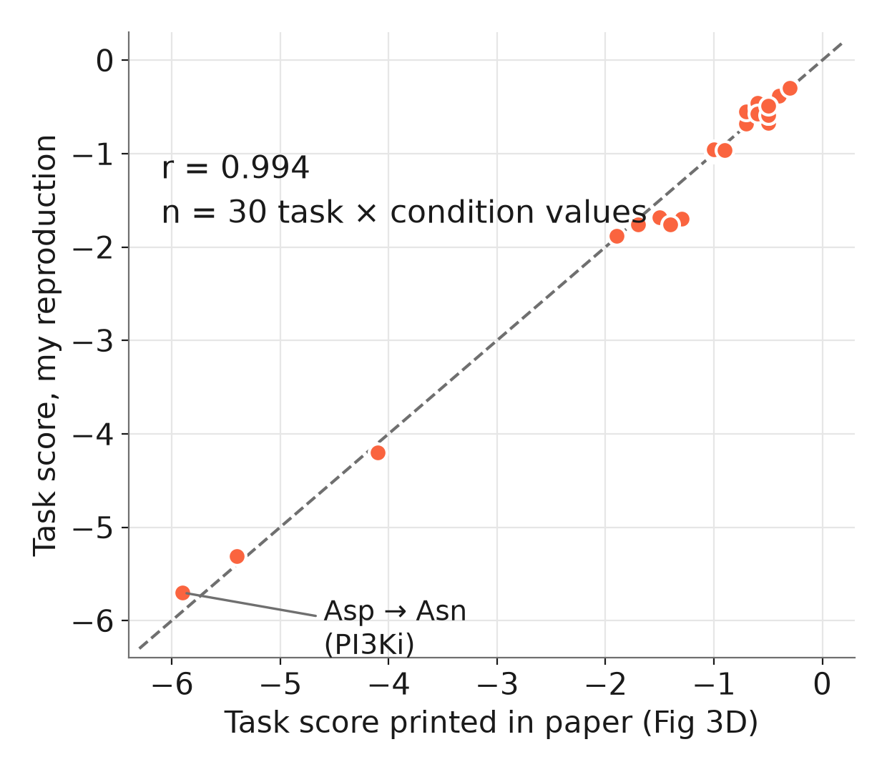
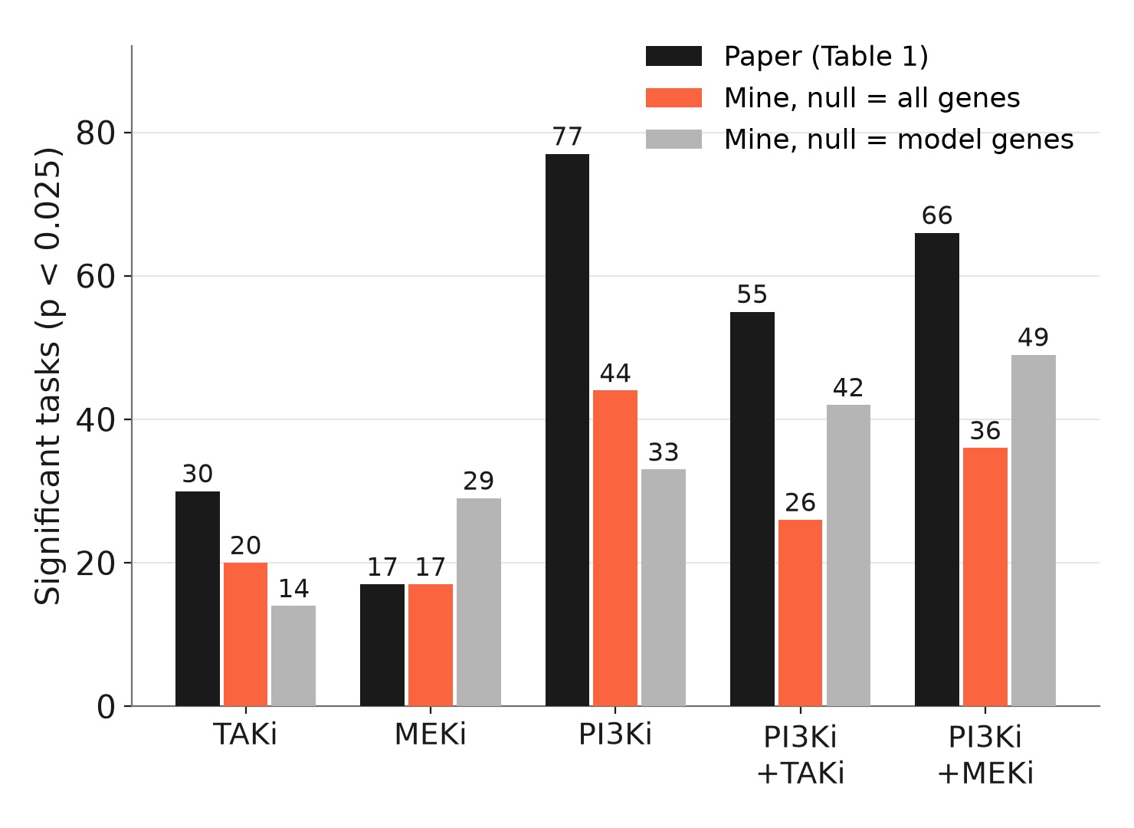
08
My re-analysis
Scores reproduce; counts depend on method choices
DEG counts within about 10% of Fig. 1A
Task scores agree: r = 0.994 (30 values)
TIDE vs TIDE-essential: ρ 0.91 on shared pairs, 0.61 on all pairs
Scores: six tasks × five conditions
Counts depend on the permutation null
Data: GEO GSE285616; code: MTEApy; pydeseq2 and 1,000 permutations (paper: R DESeq2, 10,000)
My re-analysis
Notes:
Cue: same counts from GEO, pydeseq2 with replicate + condition, apeglm, p < 0.025. Null = shuffle log2FC among model genes only or among all genes; the paper's ordering PI3Ki, PI3Ki+MEKi, PI3Ki+TAKi, TAKi, MEKi appears only with all genes. Trust direction and scores, not exact counts.

Slide 9
09
Assessment
Assessment
Robust | Sensitive | Not tested
Direction: tasks are weakened, most under PI3K inhibition Scores reproduce from public data Asp → Asn (ASNS) is the clearest signal | Task counts depend on the permutation null Weak synergy: margin over the best single drug is often below 0.1 log2FC Strong synergy flips near p = 0.025 | Multiple testing across 187 tasks Interaction term: combination vs single drugs Experimental validation; one cell line, one dose
Printed totals in Table 1 do not match their own columns (TAKi 25 vs 24 + 6; MEKi TIDE-essential 15 vs 9 + 7); corrected values are used.
Notes:
Cue: robust = what I could reproduce. Sensitive = what moved when I changed the null or looked at margins (median margin 0.06 to 0.10; 52 to 70 percent of weak calls below 0.1). Not tested = acknowledged by the authors or absent.

Slide 10



10
Cancer and
drug discovery
Combination therapy: a metabolic readout for why PI3K + MEK co-inhibition limits growth more than PI3K + TAK1
  Candidate vulnerabilities: ODC1 (polyamines), ASNS (asparagine), thioredoxin reductase; hypotheses only
Next step I would take: multiple-testing control, an interaction model, dose–response data
  Scalable readout: RNA-seq, a public model and open code can be applied to other lines, drugs and doses
Relevance
Notes:
Cue: AGS has KRAS G12D and PIK3CA mutations, so both arms are on. ODC1 is the target of DFMO; asparagine synthesis links to asparaginase therapy; thioredoxin to CHK1 inhibitor sensitivity (cited in the paper). All hypotheses, from background knowledge.

Slide 11
11
PI3K inhibition weakens biosynthetic tasks.
Combination-only changes are candidates, not proofs.
Scores reproduce from public data; counts and synergy labels depend on method choices.
Take-home
Notes:
Three points: (1) PI3K inhibition weakens most biosynthetic tasks, asparagine synthesis clearest. (2) Combination-only changes such as polyamine and CoQ synthesis are candidates. (3) Scores reproduce; counts and synergy labels depend on method choices.

Slide 12
12
Thank you
Questions?

Slide 13
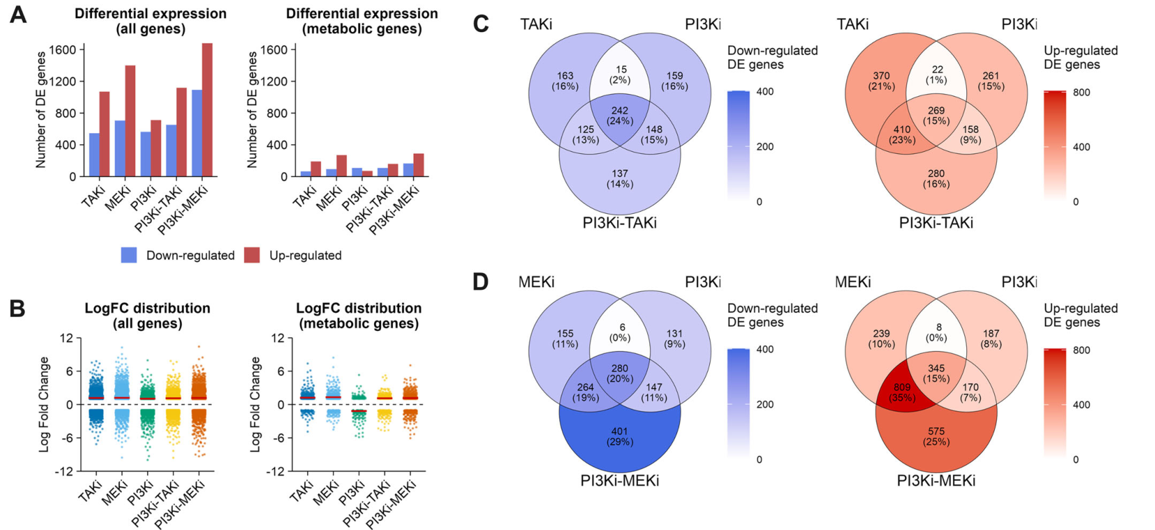
13
Backup
Gene-level response (Fig. 1)
Up-regulated genes outnumber down-regulated in every condition
PI3Ki+MEKi has the most DEGs
Combination-only DEGs: about 15% (PI3Ki+TAKi), about 25% (PI3Ki+MEKi)
Source: Fig. 1, Benedicto et al. 2025 (CC BY-NC-ND 4.0)
Backup · Fig. 1

Slide 14
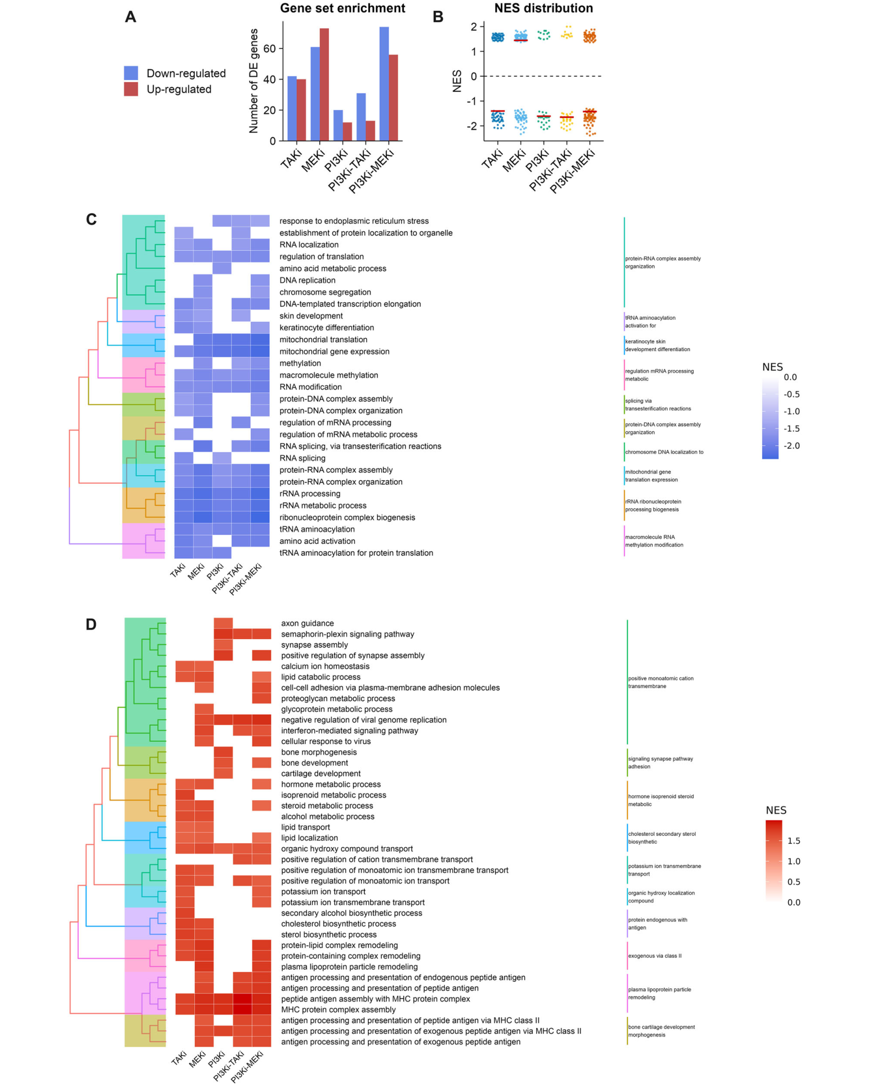
14
Backup
Gene-set response (Fig. 2)
About 54% of significant GO sets are down, 46% up; PI3Ki combinations lean down
Down in all conditions: rRNA processing, tRNA aminoacylation, mitochondrial translation
Up in all conditions: MHC antigen presentation
Labels stay broad: no pathway-level metabolic detail, hence the model-based step
My check: no single mitochondrial ribosomal gene reaches 2-fold, yet the set is strongly down (p about 1e-19)
Backup · Fig. 2
Source: Fig. 2, Benedicto et al. 2025 (CC BY-NC-ND 4.0)

Slide 15
15
Table 1, corrected
Backup · Table 1
Significant tasks | TAKi | MEKi | PI3Ki | PI3Ki+MEKi | PI3Ki+TAKi
TIDE only | 24 | 10 | 70 | 52 | 49
TIDE-essential only | 8 | 9 | 3 | 4 | 5
Shared | 6 | 7 | 7 | 14 | 6
Total TIDE | 30 * | 17 | 77 | 66 | 55
Total TIDE-essential | 14 | 16 * | 10 | 18 | 11
* The paper prints 25 and 15. Rows add up to 24 + 6 = 30 and 9 + 7 = 16, which matches the text and Fig. 5A (245 and 69 task–condition pairs).

Slide 16
16
Terms for questions
Backup · Terms
Term | Meaning
GPR rule | Complex = AND (take min); isozymes = OR (take largest |log2FC|)
pFBA | Flux balance analysis picking the smallest-total-flux pathway per task
FVA | Flux range per reaction; 149 of 187 tasks have alternative pathways
Permutation null | Shuffle gene log2FC 10,000 times; significant if tail fraction < 0.025
GI50 | Dose that halves growth; singles at GI50, combinations at half of each
Jaccard index | Set overlap: intersection divided by union (0 to 1)

