Slide 1
AZ-104 Microsoft Azure Administrator

Slide 2
Welcome
Thank you for joining us today
We’ve worked together with the Microsoft Partner Network and Microsoft IT Academies to bring you a world-class learning experience. At the end of class, please complete an evaluation of today’s experience. We value your feedback!
Microsoft Certified Trainers + Instructors
Your instructor is a premier technical and instructional expert who meets ongoing certification requirements
Customer Satisfaction Guarantee
Our partners offer a satisfaction guarantee, and we hold them accountable for it
Certification Exam Benefits
After training, consider pursuing a Microsoft Certification to help distinguish your technical expertise and experience. Ask your instructor about available exam promotions and discounts
We wish you a great learning experience and ongoing career success!

Slide 3
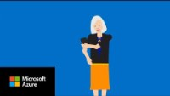

Slide 4
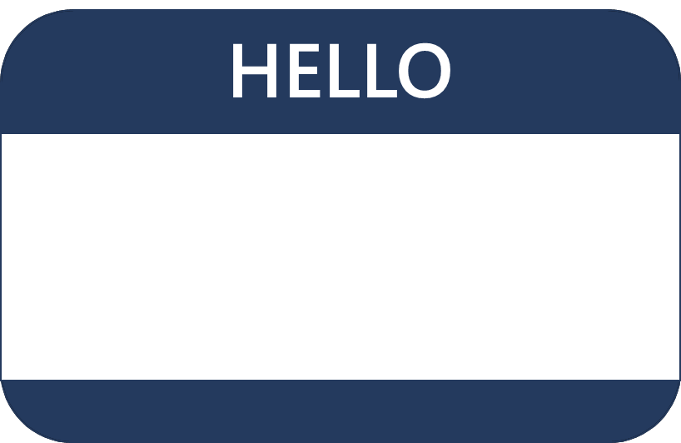
Hello! Student Introductions
Your name
Company affiliation
Title/function
Microsoft Azure experience
Your expectations for the course

Slide 5
Physical classroom experience
Class hours: 0900 - 1500
Messages: keep to a minimum
Building hours: TBD
Smoking: TBD
Parking: TBD
Internet access: wifi (details on whiteboard)
Restrooms: TBD
Garbage & recycling: in classroom
Meals: BYOM
Emergency contact and procedures
Phones: keep to a minimum
Notes:
Adjust this for a virtual audience. Consider chat, sharing, small group work, video, software, etc.

Slide 6
About this course: Prerequisites
Successful Azure Administrators start this role with experience on operating systems, virtualization, cloud infrastructure, storage structures, and networking
Understanding of on-premises virtualization technologies, including: VMs, virtual networking, and virtual hard disks
Understanding of network configuration, including TCP/IP, Domain Name System (DNS), virtual private networks (VPNs), firewalls, and encryption technologies
Understanding of Active Directory concepts, such as users, groups, and role-based access control
Understanding of resilience and disaster recovery, including backup and restore operations
Notes:
Be sure to ask your students about their level of experience. Have they used Azure? Do they prefer command line or GUI for administrative tasks.
Microsoft Learn has a series of Fundamental modules for Azure, networking, and security. More modules are added every day and can help students ramp up on Azure basics. https://docs.microsoft.com/en-us/learn/browse/?term=fundamentals
There is also an AZ-104: Prerequisites for Azure administrators learning path - https://docs.microsoft.com/en-us/learn/paths/az-104-administrator-prerequisites/.

Slide 7
Cloud Administrator role
Cloud Administrators manage the cloud services that span storage, networking and compute cloud capabilities, with a deep understanding of each service across the full IT lifecycle
They take end-user requests for new cloud applications and make recommendations on services to use for optimal performance and scale, as well as provision, capacity, monitor and adjust as appropriate. This role requires communicating and coordinating with vendors
Cloud Administrators use the Azure Portal and as they become more proficient, they use PowerShell and the Command Line Interface
Successful Cloud Administrators start this role with experience on operating systems, virtualization, cloud infrastructure, storage structures, and networking
Notes:
Each year Microsoft reviews each role to determine what tasks are included in a typical day. Ask students what areas are most important for their jobs. What are they most interested in?

Slide 8
Microsoft Certifications
Certifications give you a professional edge by providing globally recognized industry endorsed evidence of skills mastery, demonstrating your abilities and willingness to embrace new technologies
Exam AZ-900: Microsoft Azure Fundamentals
Microsoft Certified: Azure Administrator Associate
Microsoft Certified: Azure Solutions Architect Expert
Designed for candidates looking to demonstrate foundational level knowledge of cloud services and how those services are provided
Designed for Azure Administrators who implement, monitor, and maintain compute, storage, network, and security
Designed for Azure Solutions Architects who create solutions for compute, network, storage, and security
Notes:
AZ-104 Exam page - https://docs.microsoft.com/en-us/learn/certifications/exams/az-104

Slide 9
AZ-104 certification areas
Study Areas | Weights
Manage Azure identities and governance | 15 – 20%
Implement and manage storage | 15 – 20%
Deploy and manage Azure compute resources | 20 – 25%
Configure and manage virtual networking | 25 – 30%
Monitor and backup resources | 10 – 15%
Percentages indicate the relative weight of each area on the exam
The higher the percentage, the more questions you are likely to see in that area
Notes:
AZ-104 Exam page - https://docs.microsoft.com/en-us/learn/certifications/exams/az-104

Slide 10
About this course: Course Outline
01: Administer Identity
07: Administer Azure Storage
02: Administer Governance and Compliance
08: Administer Azure Virtual Machines
03: Administer Azure Resources
09: Administer PaaS Compute Options
04: Administer Virtual Networking
10: Administer Data Protection
05: Administer Intersite Connectivity
11: Administer Monitoring
06: Administer Network Traffic Management
Notes:
Review the Trainer Prep Guide for general information about how the course was structured. Some instructors prefer to start with Module 03.
Also, review the Change Log for anything that may have changed since the last time you taught the course.
Both documents are downloadable from the MCT Download Center.

Slide 11
Course schedule
Day 1
Welcome
Day 2
Day 3
Day 4
Identity
Virtual Networking
Azure Storage
Containers, AKS
Lunch
Lunch
Lunch
Lunch
Governance and Compliance
Intersite Connectivity
Azure Virtual Machines
Data Protection
Azure Administration
Network Traffic Management
App Service
Monitoring
Notes:
Adjust this slide to your teaching schedule. Consider using the last lab of the day as something to complete (homework) before the next training day. Also, consider using the Module Review questions to recap the day before or after breaks to refocus the class. Some instructors like to lecture in the morning then lab all afternoon. Other instructors like to complete labs with the lecture material.

Slide 12
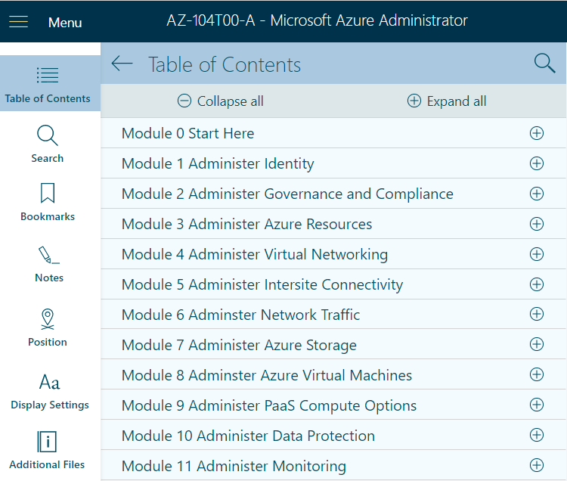
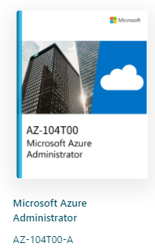
Student materials on Skillpipe (optional)
Notes:
Explain how students access Skillpipe. How to navigate and the features of the product. For example, you may be using notes or highlighting.

Slide 13






Student materials on Learn
https://aka.ms/AZ-104LearningPaths
Notes:
Learn Collection - https://aka.ms/AZ-104LearningPaths
A Learn Collection has been created for the course. Feel free to share the link with your students. This link provides direct access to the exam page, student content, the GitHub labs.
Discuss the self-paced Learning Paths available from the exam page or by searching. Explain the course provides very high-level information. The Summary and Resources page gives links to additional Learn content. To fully prepare for the exam students should go through this additional content as much as possible. For example, AD Join has one slide in the classroom, but there is an entire module in Learn on that.
Also explain each self-paced Learning Path has, at the end, a few modules with hands-on sandbox exercises. If student are struggling with the GitHub labs or just want more lab time, Learn sandboxes provides an alternative.

Slide 14
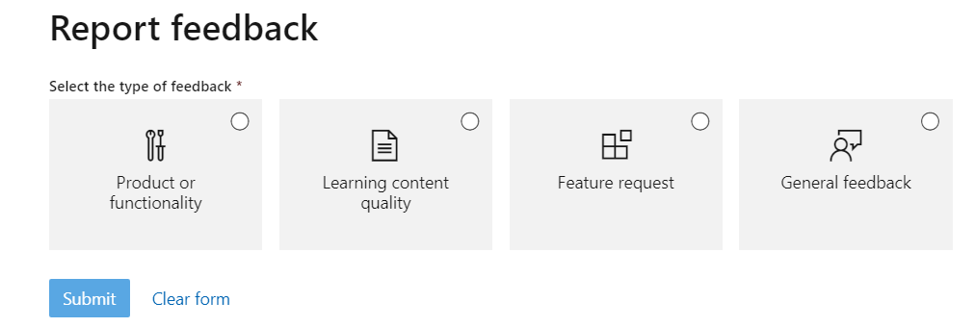
Student content feedback on Learn
Scroll to the bottom of the online page – be specific
Notes:
Feedback from Learn is logged and tracked. Corrections are made within just a few days. As you review the materials you can provide feedback. The best feedback is specific and actionable. For example, the virtual machine limits have changed and provide the documentation page.

Slide 15
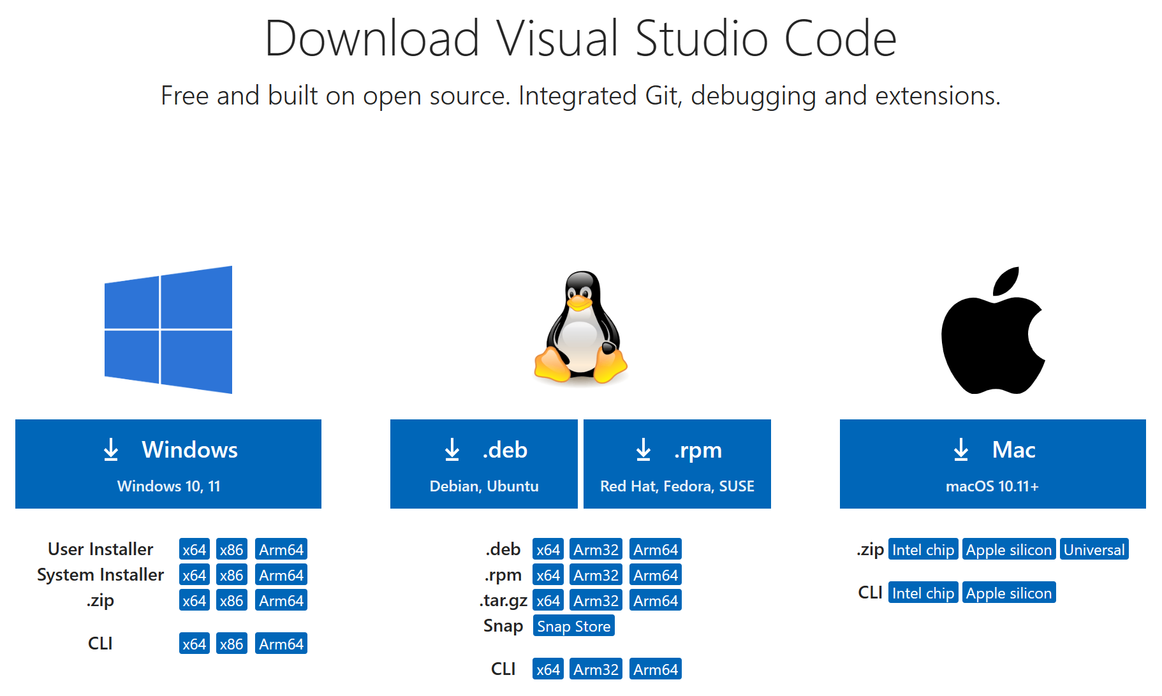
*optional – Download Visual Studio Code

Slide 16
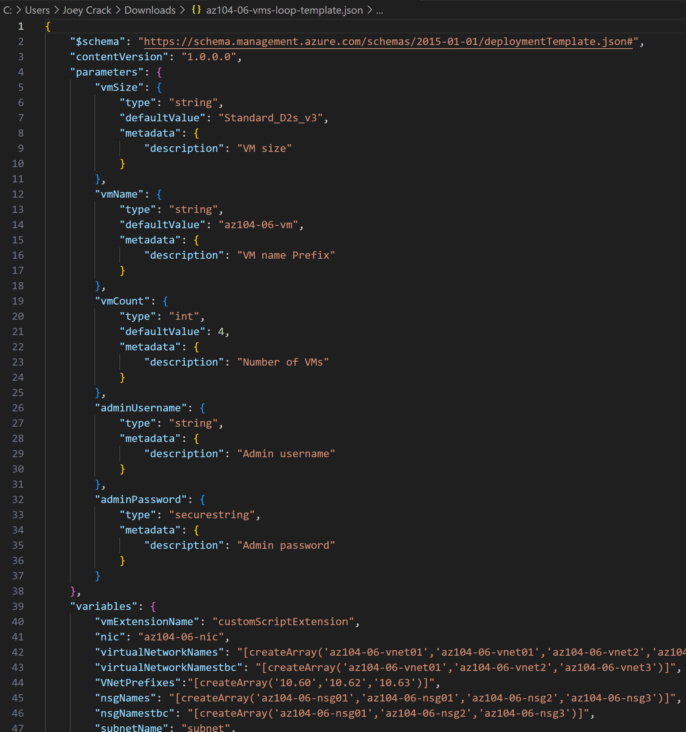
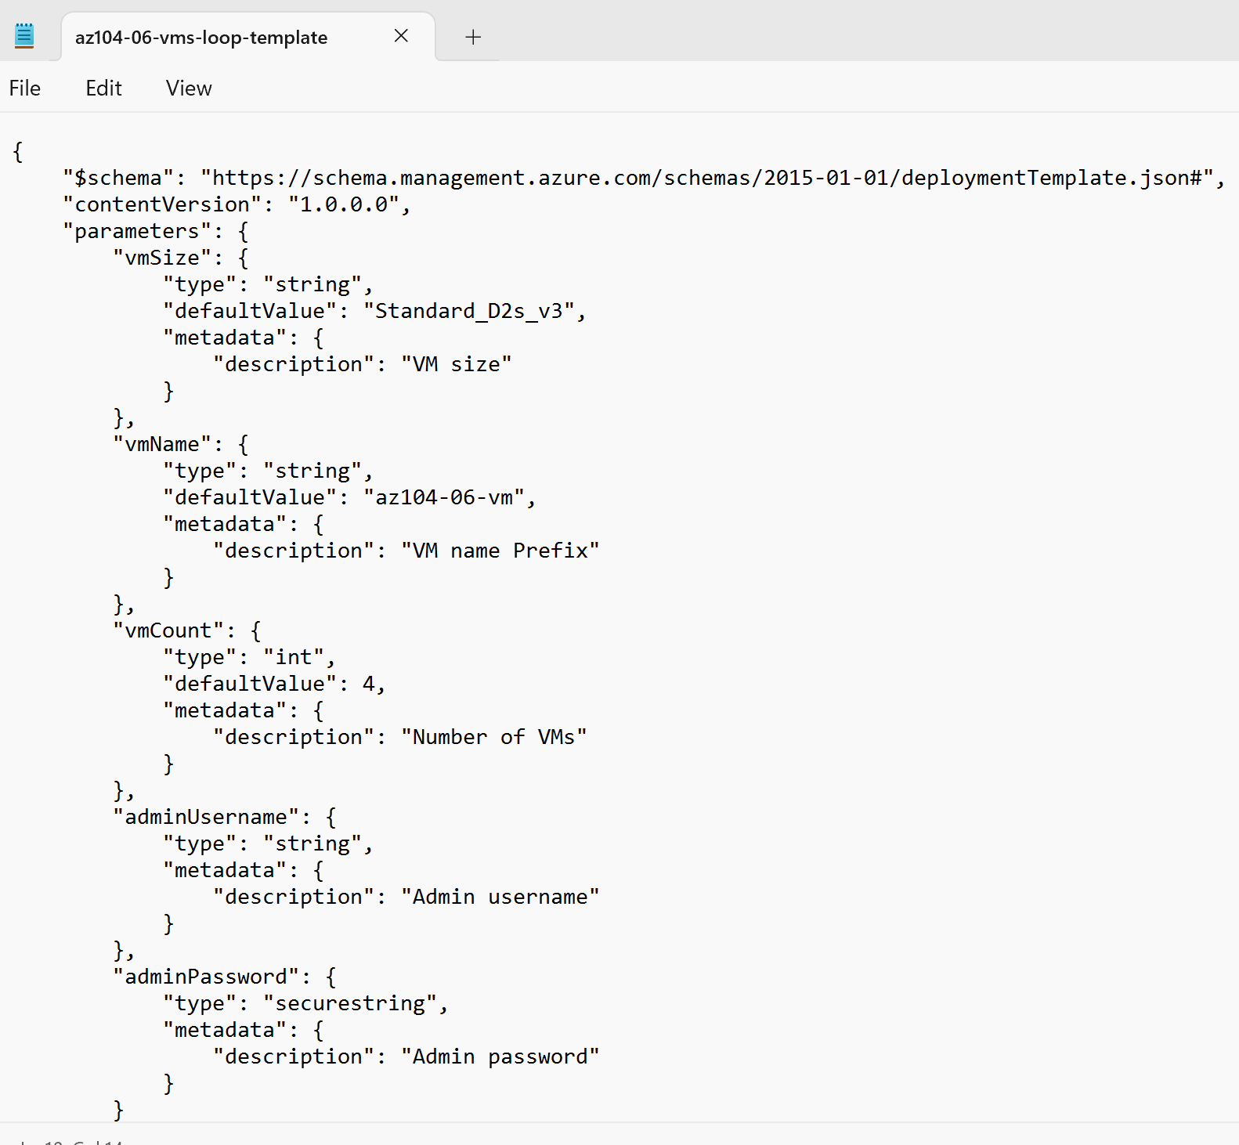
Comparison

Slide 17
Additional Resources
Microsoft Learn
Microsoft Azure Blog
Azure Documentation
Microsoft Learning Community Blog
Azure Forum
Summary and Resources page (Learn modules)
Notes:
Microsoft Learn - https://docs.microsoft.com/en-us/learn/browse/. There is a summary slide at the end of each lesson with applicable online training modules.
Azure Documentation - https://docs.microsoft.com/en-us/azure/. Stay informed on the latest products, tools, and features. Get information on pricing, partners, support, and solutions.
Azure forums https://social.msdn.microsoft.com/Forums/enUS/home?category=windowsazureplatform.
The Azure forums are very active. You can search the threads for a specific area of interest. You can also browse categories like Azure Storage, Pricing and Billing, Azure Virtual Machines, and Azure Migrate.
Azure Tuesdays with Core - https://channel9.msdn.com/Shows/Tuesdays-With-Corey/. Corey Sanders answers your questions about Microsoft Azure - Virtual Machines, Web Sites, Mobile Services, Dev/Test etc.
Azure Fridays - https://channel9.msdn.com/Shows/Azure-Friday. Join Scott Hanselman as he engages one-on-one with the engineers who build the services that power Microsoft Azure, as they demo capabilities, answer Scott's questions, and share their insights.
Channel 9 - https://channel9.msdn.com/. Channel 9 provides a wealth of informational videos, shows, and events.
Microsoft Azure Blog - https://azure.microsoft.com/en-us/blog/. Keep current on what's happening in Azure, including what's now in preview, generally available, news & updates, and more.
Microsoft Learning Community Blog - https://www.microsoft.com/en-us/learning/community-blog.aspx). Get the latest information about the certification tests and exam study groups.

Slide 18


Slide 19
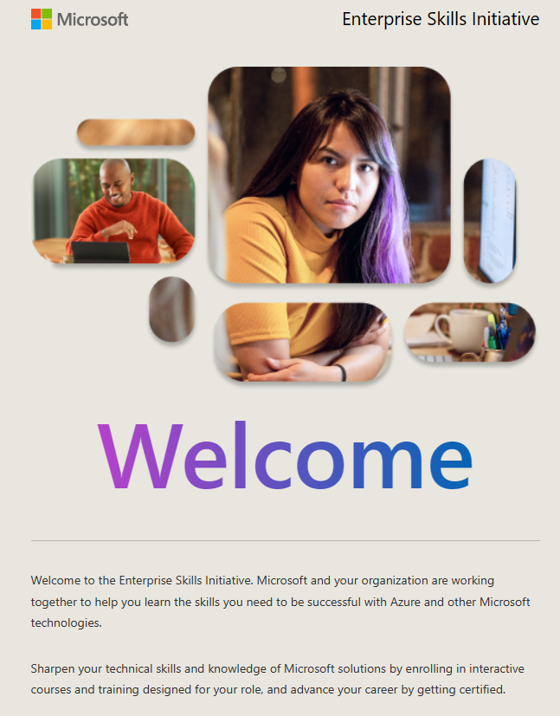
Enterprise Skills Initiative: https://esi.microsoft.com/

Slide 20

End of presentation

Slide 21
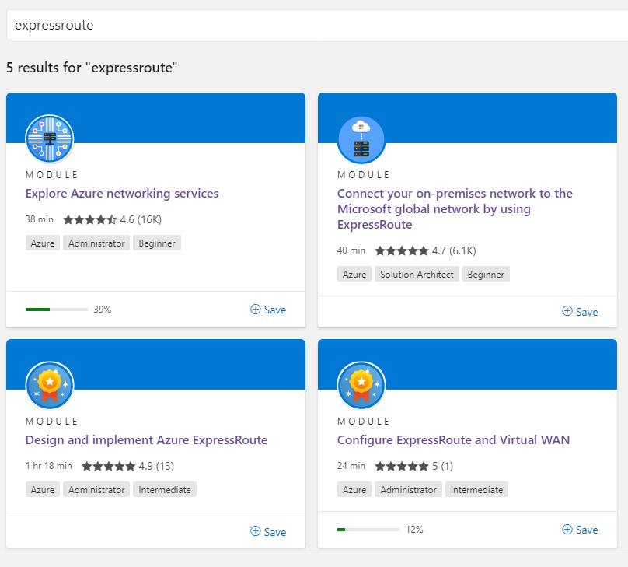
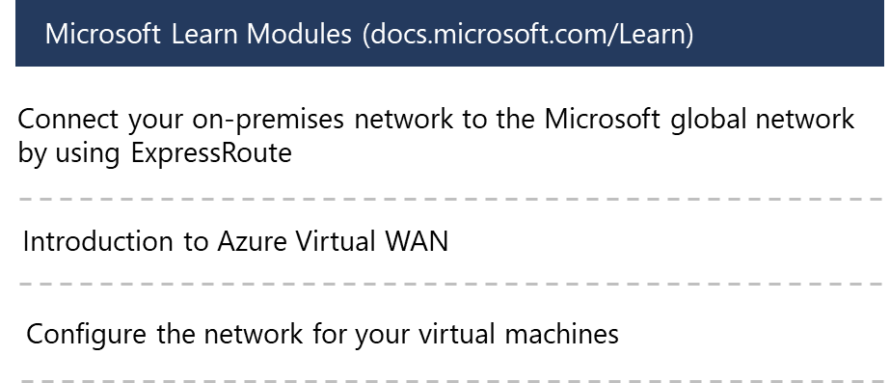
Complete your study on Learn (optional)
Learn More
Notes:
The course materials include a curated list of modules we think would be most helpful. These modules are listed on the last page, Summary and Resources. Students can search and find other modules. It is important to point out that additional study is needed for students to pass the exam. Many modules do include hands-on sandboxes that do not require an Azure subscription.

Slide 22
Student materials on Learn mapping (optional)
AZ-104 Exam Page
Identity
Governance and Compliance
Azure Administration
Virtual Networking
Intersite Connectivity
Network Traffic Management
7 – Azure Storage
Azure Virtual Machines
App Service, Containers, AKS
Data Protection
Monitoring
Notes:
The student materials are also in Learn (https://docs.microsoft.com/en-us/learn/browse/). You can search for AZ-104 and these six Learning Paths will appear. Another way to get to the Learning Paths is from the AZ-104 Exam Page (https://docs.microsoft.com/en-us/learn/certifications/exams/az-104). The exam page has the links and shows how the Skills Measured lines up.

