Slide 1
AZ-104 Administer Identity

Slide 2

Administer Identity Introduction
Configure Azure Active Directory (Entra)
Configure User and Group Accounts
Lab 01 - Manage Azure Active Directory Identities

Slide 3
Configure Azure Active Directory

Slide 4
Configure Azure Active Directory Introduction
Describe Azure Active Directory Benefits and Features
Describe Azure AD Concepts
Compare AD DS to Azure Active Directory
Select Azure AD Editions
Implement Azure AD Device Identities
Implement Self-Service Password Reset
Summary and Resources
Notes:
Manage Azure identities and governance (15-20%)
Manage Azure AD objects
Configure Azure AD join
Configure self-service password reset

Slide 5
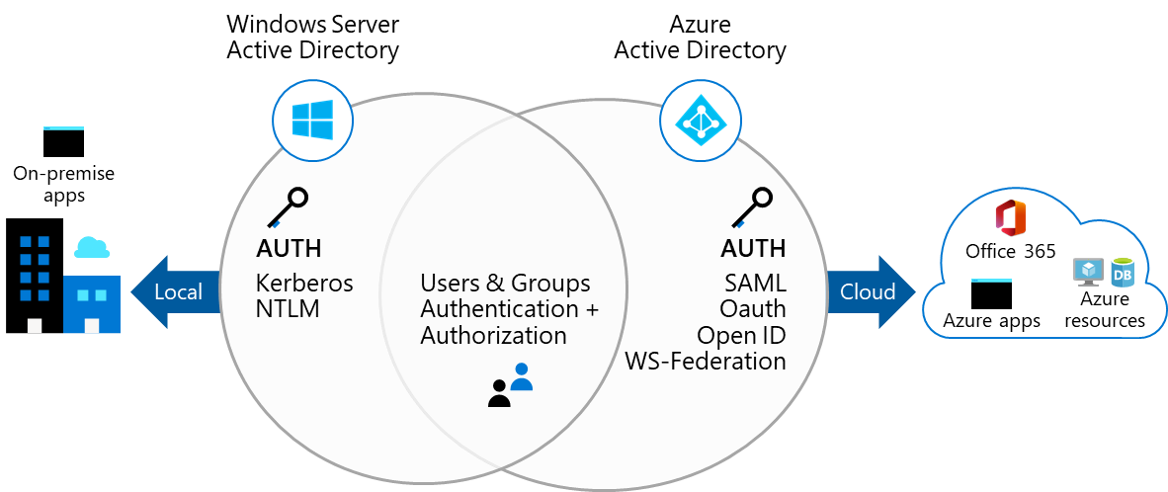
Describe Azure Active Directory Benefits and Features
A cloud-based suite of identity management capabilities that enables you to securely manage access to Azure services and resources for your users
Provides application management, authentication, device management, and hybrid identity
Notes:
Comparison and Tradeoffs
SAML, OAuth, OpenID, WS-Federation
Focus on Web and Cross-Domain: These are more focused on web applications and cross-domain authentication.
Complexity: Generally more complex to implement but offer more flexibility.
Security: Security can be robust but depends on proper implementation.
Kerberos and NTLM
Focus on Intranet: These are more focused on intranet and network-level authentication.
Simplicity: Generally simpler (especially NTLM), but may lack some flexibility.
Security: Kerberos is considered very secure, while NTLM is less so.

Slide 6
Describe Azure AD Concepts
Concept | Description
Identity | An object that can be authenticated
Account | An identity that has data associated with it
Azure AD account | An identity created through Azure AD or another Microsoft cloud service
Azure AD tenant/directory | A dedicated and trusted instance of Azure AD, a Tenant is automatically created when your organization signs up for a Microsoft cloud service subscription​ ​ Additional instances of Azure AD can be created​ Azure AD is the underlying product providing the identity service​ The term Tenant means a single instance of Azure AD representing a single organization​ The terms Tenant and Directory are often used interchangeably​
Azure subscription | Used to pay for Azure cloud services
Notes:
Azure AD Terminology - https://docs.microsoft.com/azure/active-directory/fundamentals/active-directory-whatis#terminology

Slide 7
Compare AD DS to Azure Active Directory
Azure AD is primarily an identity solution, and designed for HTTP and HTTPS communications
Queried using the REST API over HTTP and HTTPS. Instead of LDAP
Uses HTTP and HTTPS protocols such as SAML, WS-Federation, and OpenID Connect for authentication (and OAuth for authorization). Instead of Kerberos
Includes federation services, and many third-party services (such as Facebook)
Azure AD users and groups are created in a flat structure, and there are no Organizational Units (OUs) or Group Policy Objects (GPOs)
Notes:
Compare Active Directory to Azure Active Directory - https://docs.microsoft.com/azure/active-directory/fundamentals/active-directory-compare-azure-ad-to-ad
✔️ Azure AD is a managed service. You only manage the users, groups, and policies. Deploying AD DS with virtual machines using Azure means that you manage the deployment, configuration, virtual machines, patching, and other backend tasks. Do you see the difference? How are they similar?

Slide 8
Select Azure Active Directory Editions
Feature | Free | Microsoft 365 Apps | Premium P1 | Premium P2
Directory Objects | 500,000 objects | No object limit | No object limit | No object limit
Single Sign-On | Unlimited | Unlimited | Unlimited | Unlimited
Core Identity and Access | X | X | X | X
B2B Collaboration | X | X | X | X
Identity & Access for O365 |  | X | X | X
Premium Features |  |  | X | X
Hybrid Identities |  |  | X | X
Advanced Group Access |  |  | X | X
Conditional Access |  |  | X | X
Identity Protection |  |  |  | X
Identity Governance |  |  |  | X
Notes:
Azure AD Pricing Editions - https://azure.microsoft.com/pricing/details/active-directory/
✔️ Did you look through the pricing list to determine which features your organization needs and to compare edition capabilities?

Slide 9



Configure Azure AD Device Identities
Azure AD registered devices | Azure AD joined devices | Hybrid Azure AD joined devices
Supports Bring Your Own Device Registered devices sign-in using a Microsoft account Attached to an Azure AD account granting access to resources Control using Mobile Device Management (MDM) tools like Microsoft Intune OS – Windows 10⁺, iOS, Android, and MacOS | Intended for cloud-first or cloud-only organizations Organization-owned devices Joined only to Azure AD - organizational account required Can use Conditional Access policies OS – Windows 10⁺ devices | You have Win32 apps deployed to these devices using Active Directory machine authentication You want to continue to use Group Policy to manage the device You want to use existing image solutions to deploy devices OS - Windows 7⁺ devices
Notes:
This slide used to just be only about Azure AD Join.
Azure AD registered devices - https://docs.microsoft.com/azure/active-directory/devices/concept-azure-ad-register
Azure AD joined devices - https://docs.microsoft.com/azure/active-directory/devices/concept-azure-ad-join
Hybrid Azure AD joined devices - https://docs.microsoft.com/azure/active-directory/devices/concept-azure-ad-join-hybrid

Slide 10
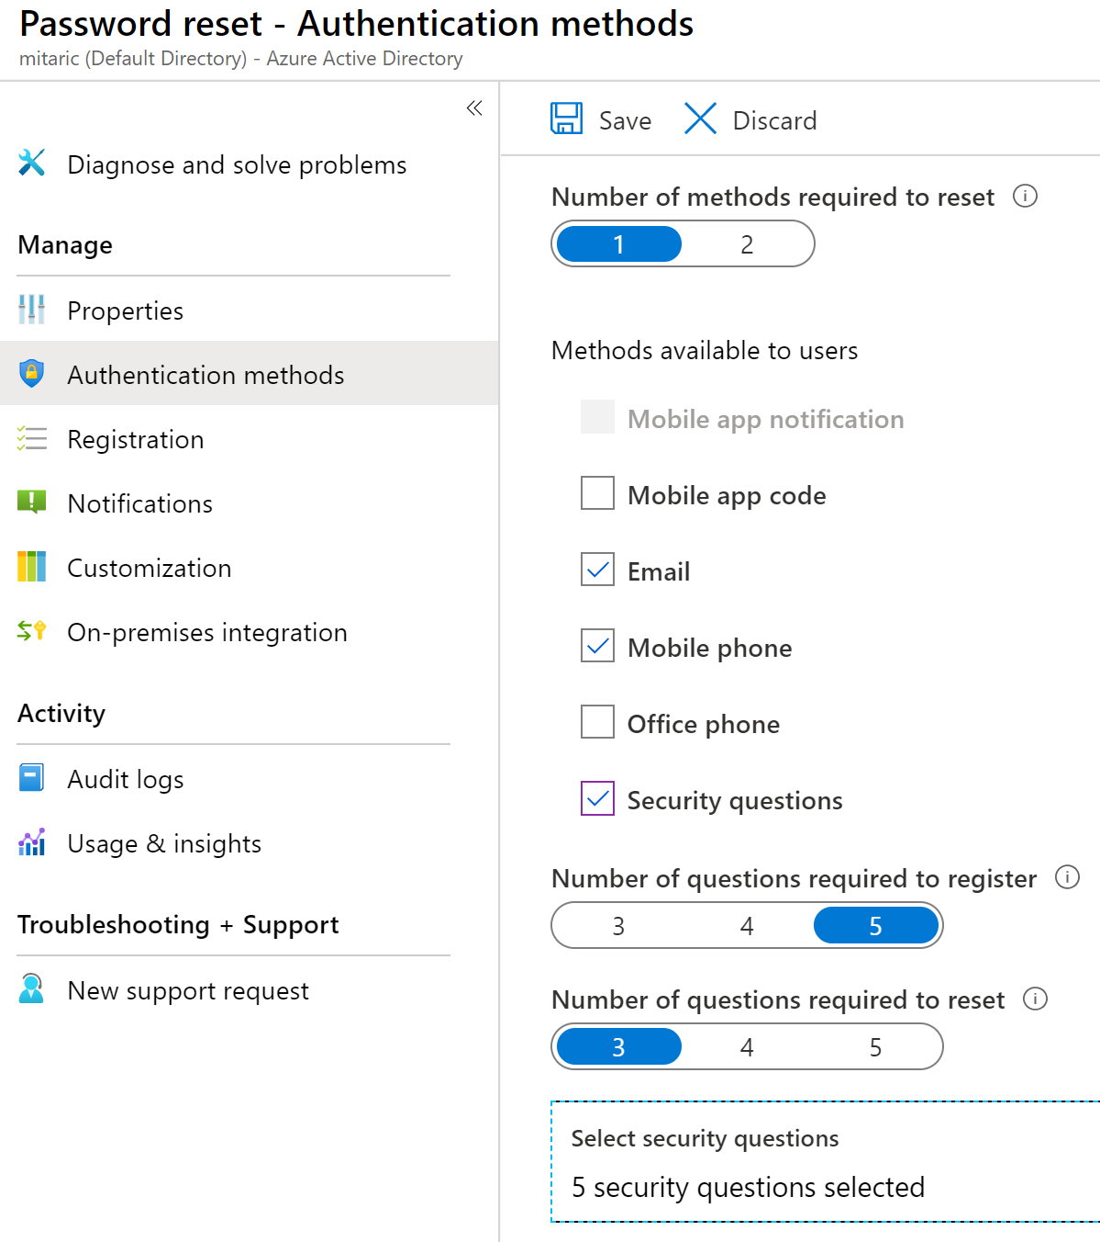
Implement Self-Service Password Reset
Determine who can use self-service password reset
1
2
Choose the number of authentication methods required and the methods available (email, phone, questions)
3
You can require users to register for SSPR (same process as MFA)
Notes:
Plan an Azure Active Directory self-service password reset deployment - https://docs.microsoft.com/azure/active-directory/authentication/howto-sspr-deployment

Slide 11
Summary and Resources – Configure Azure Active Directory
Knowledge Check
Microsoft Learn Modules (docs.microsoft.com/Learn)
Allow users to reset their password with Azure Active Directory self-service password reset (Sandbox)
Manage device identity with Azure AD join and Enterprise State Roaming
Implement and manage hybrid identity
A sandbox indicates a hands-on exercise.
Notes:
Learn - https://docs.microsoft.com/learn/browse/
Although Hybrid Identities is not on the exam, there is Learn content if a student is interested.
The Assessment Guide in the MCT DLC has open-ended questions.
Describe the following concepts: identity, account, Azure AD account, Azure AD Account, Azure AD tenant, and Azure subscription. How are these different?
Answer: Identity is an object that can be authenticated. An Account is an identity that has data associated with it. An Azure AD account is an identity created through Azure AD or another Microsoft cloud service. An Azure AD tenant is a dedicated and trusted instance of Azure AD, A Tenant is automatically created when your organization signs up for a Microsoft cloud service subscription​. An Azure subscription is used to pay for Azure cloud services.
How is Azure Active Directory different from Azure Active Directory Domain Services?
Answer: Azure AD is primarily an identity solution and designed for HTTP and HTTPS communications. Azure AD can be queried with a REST API, instead of LDAP. Azure AD uses federation services, and many third-party services (such as Facebook). Azure AD users and groups are created in a flat structure. Azure AD does not have Organizational Units (OUs) or Group Policy Objects (GPOs).
Describe the Self-Service Password Reset authentication methods can be configured for users.
Answer: Self-Service Password Reset authentication methods include mobile app notification, mobile app code, email, mobile phone, office phone, and security questions. A combination of authentication methods can be used.

Slide 12
Configure User and Group Accounts

Slide 13


Configure User and Group Accounts Introduction
Create User Accounts
Manage User Accounts
Create Bulk Accounts
Create Group Accounts
Assign Licenses to Users and Groups (extra topic)
Create Administrative Units
Demonstration – Users and Groups
Summary and Resources
Notes:
Manage Azure identities and governance (15-20%)
Manage Azure AD objects
Create users and groups
Manage user and group properties
Perform bulk user updates
Manage guest accounts

Slide 14
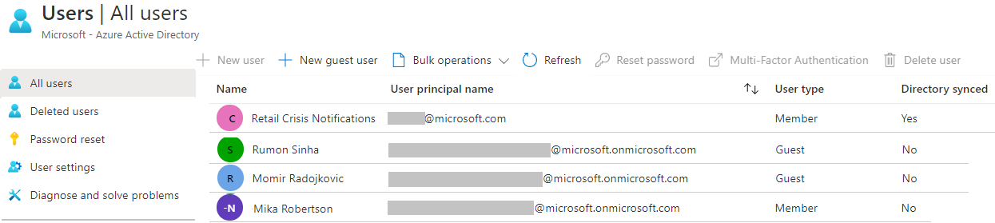
Create User Accounts
All users must have an account
The account is used for authentication and authorization
Each user account has additional properties
Notes:
✔️ Have you given any thought as to the type of users you will need?

Slide 15
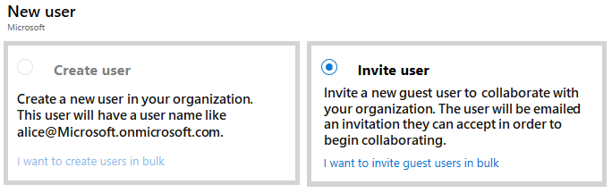
Manage User Accounts
Must be Global Administrator or User Administrator to manage users
User profile (picture, job, contact info) is optional
Deleted users can be restored for 30 days
Sign in and audit log information is available
Notes:
Add or delete users using Azure Active Directory - https://docs.microsoft.com/azure/active-directory/fundamentals/add-users-azure-active-directory

Slide 16
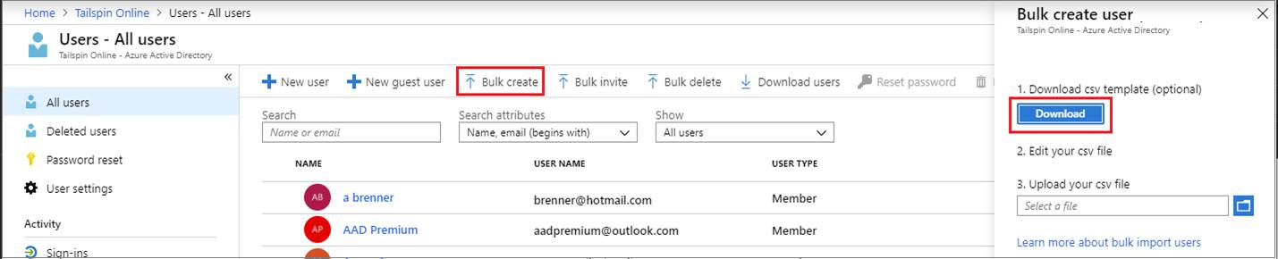
Perform bulk account updates
Azure AD supports bulk user and group member updates
Create the comma-separated values (CSV) template you can download from the Portal
Must be signed in as a Global administrator or User administrator
Notes:
The latest JTA (Jan 2022) now states, Perform bulk updates. Previously this was just bulk user accounts.
Bulk create users in Azure Active Directory - https://docs.microsoft.com/azure/active-directory/users-groups-roles/users-bulk-add
Bulk add group members in Azure Active Directory - https://docs.microsoft.com/azure/active-directory/enterprise-users/groups-bulk-import-members
✔️ Establish or implement a naming convention for usernames, display names and aliases. The password for the new users needs to conform to the password complexity rules you have set for your directory. User parameters include User Principal Name, Display Name, Given Name, Department, and Job Title.

Slide 17
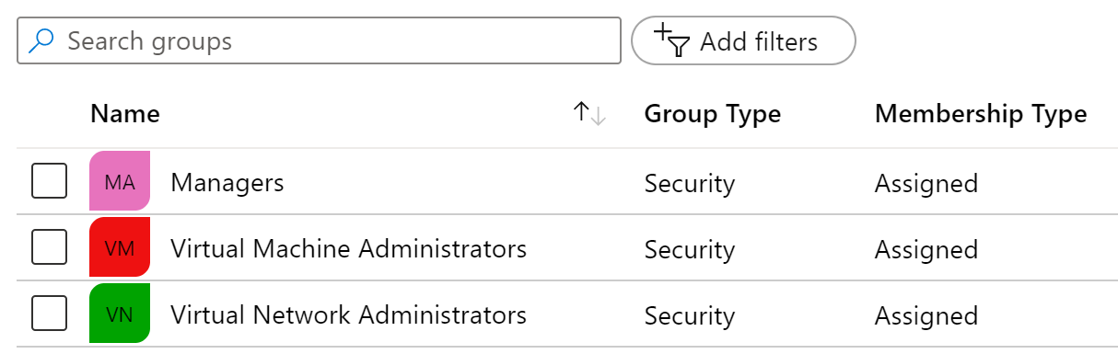
Create Group Accounts
Group Types
Security groups
Microsoft 365 groups
Assignment Types
Assigned
Dynamic User
Dynamic Device (Security groups only)
Notes:
Manage app and resource access using Azure Active Directory groups – https://docs.microsoft.com/azure/active-directory/fundamentals/active-directory-manage-groups
Quickstart: View your organization's groups and members in Azure Active Directory - https://docs.microsoft.com/azure/active-directory/fundamentals/active-directory-groups-view-azure-portal
✔️ Have you given any thought to which groups you need to create? How will you assign users to groups?

Slide 18
Assign Licenses to Users and Groups
Microsoft Azure is a cloud service that provides many built-in services for free.
Azure AD comes as a free service
Gain additional Azure AD functionality with a P1 or P2 license
View license plans and plan details
Set the Usage Location parameter
Assign licenses to users and groups
Change license plans for users and groups
Remove a license
Additional Services (like O365 are paid cloud services)
Microsoft paid cloud services require licenses
Licenses are assigned to those who need access to the services
Each user or group requires a separate paid license
Administrators use management portals and PowerShell cmdlets to manage licenses
Notes:
Assign or remove licenses in the Azure Active Directory portal - https://docs.microsoft.com/azure/active-directory/fundamentals/license-users-groups
Choose the best license for your business - https://www.microsoft.com/security/business/identity-access-management/azure-ad-pricing?rtc=1#office-SKUChooser-q6q98uk
Take a minute to show in the Portal the basic licensing tasks. This topic is not in the student content.

Slide 19
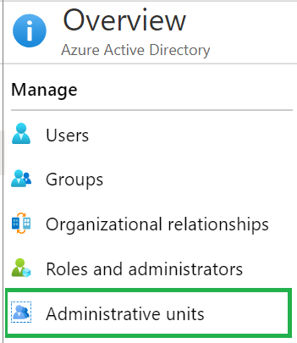
Create Administrative Units
Create an administrative unit
Populate the administrative unit with Azure AD users or groups
Create a role with appropriate permissions scoped to the administrative unit
Add IT members to the role
Azure AD Premium P1 or P2 for each Privileged Role Administrator or Global Administrator
Notes:
What Are Administrative Units?
Administrative Units are essentially containers within Azure AD that allow administrators to group users, groups, and devices. Once grouped, specific administrative roles can be assigned to these units, allowing for delegated administration.
Why Might They Be Beneficial for the Department of Defense?
Complex Organizational Structure: The DoD has a highly complex structure with various branches, units, and teams. AUs allow for a structured approach to managing this complexity.
Security Requirements: The DoD has stringent security requirements. AUs enable precise control over who has access to what, helping to maintain security.
Compliance: The DoD must adhere to various regulatory requirements. AUs can help in enforcing compliance by allowing specific policies to be applied to specific units.
Efficiency: By delegating administration, the DoD can allow different units to manage their own resources, leading to increased efficiency and responsiveness.
Integration with Azure Government: Utilizing AUs within Azure Government ensures that all the benefits are realized within a framework that's designed to meet the specific needs and regulations of governmental entities.

Slide 20
Demonstration – Users and Groups
Determine domain information
Explore user accounts
Explore group accounts
Explore PowerShell for group management
Notes:
✔ Always consider having students walk-through the demonstrations themselves. Also, consider the overlap with the formal labs and your best use of time.
Use the Demonstration in the MCT DLC, or one of the Quickstart tutorials.
Add or delete users using Azure Active Directory - https://docs.microsoft.com/azure/active-directory/fundamentals/add-users-azure-active-directory
Create a basic group and add members using Azure Active Directory - https://docs.microsoft.com/azure/active-directory/fundamentals/active-directory-groups-create-azure-portal

Slide 21
Summary and Resources – Configure User and Group Accounts
Knowledge Check
Microsoft Learn Modules (docs.microsoft.com/Learn)
Create Azure users and groups in Azure Active Directory (Sandbox)
Manage users and groups in Azure Active Directory
A sandbox indicates a hands-on exercise.
Notes:
Learn - https://docs.microsoft.com/learn/browse/
The Assessment Guide in the MCT DLC has open-ended questions.
List three features of a user account and two ways a user can be assigned to group.
Answer: All users must have a user account. The user account is used for authentication and authorization. Each user account can have additional properties (user profile), like phone number. You must be a Global Administrator or User Administrator to manage users. Users can be assigned to groups either directly or dynamically. Dynamic assignment lets you create complex attribute-based rules.

Slide 22
Lab 01 - Manage Azure Active Directory Identities
AZ-104-AzureGov/Instructions/Labs/LAB_01-Manage_Azure_AD_Identities.md at master · joeycrack93/AZ-104-AzureGov (github.com)

Slide 23
Lab 01 – Manage Azure Active Directory Identities
Lab scenario
In order to allow Contoso users to authenticate by using Azure AD, you have been tasked with provisioning users and group accounts. Membership of the groups should be updated automatically based on the user job titles. You also need to create a test Azure AD tenant with a test user account and grant that account limited permissions to resources in the Contoso Azure subscription.
Objectives
Task 1: Create and configure Azure AD users
Task 2: Create Azure AD groups with assigned and dynamic membership
Task 3: Create an Azure Active Directory (AD) tenant
Task 4: Manage Azure AD guest users
Next slide for an architecture diagram
Notes:
LAB 01 - Manage Azure Active Directory Identities - ESTIMATED DURATION 30 MIN
AZ-104 Lab Repository - https://microsoftlearning.github.io/AZ-104-MicrosoftAzureAdministrator/

Slide 24


Lab 01 – Architecture diagram
Task 1, Task 2
Task 3
Default Azure AD tenant
IT Cloud Administrators
Membership type: Dynamic User
IT System Administrators
Membership type: Dynamic User
New Azure AD tenant
Contoso Lab
Cloud user
Cloud user
az104-01a-aaduser1
Role: User administrator
Job title: Cloud Administrator
Department: IT
az104-01a-aaduser2
Job title: System Administrator
Department: IT
Cloud user
az104-01b-aaduser1
Job title: System Administrator
Department: IT
IT Lab Administrators
Membership type: Assigned
Task 4
Guest user
az104-01b-aaduser1
Job title: Lab Administrator
Department: IT

Slide 25

End of presentation

