Slide 1
AZ-104 Administer Governance and Compliance

Slide 2


Administer Governance and Compliance Introduction
Configure Subscriptions
Configure Azure Policy
Configure Role-Based Access Control
Lab 02a - Manage Subscriptions and RBAC
Lab 02b - Manage Governance via Azure Policy

Slide 3
Configure Subscriptions and Configure Azure Resource Manager Resources

Slide 4





Configure Subscriptions Introduction
Identify Regions
Implement Azure Subscriptions
Identify Subscription Usage
Obtain a Subscription
Create Resource Groups
Determine Resource Limits
Create an Azure Resource Hierarchy
Apply Resource Tagging
Manage Costs
Summary and Resources
Notes:
Manage Azure identities and governance (15-20%)
Manage subscriptions and governance
• Manage subscriptions
• Configure Cost Management

Slide 5
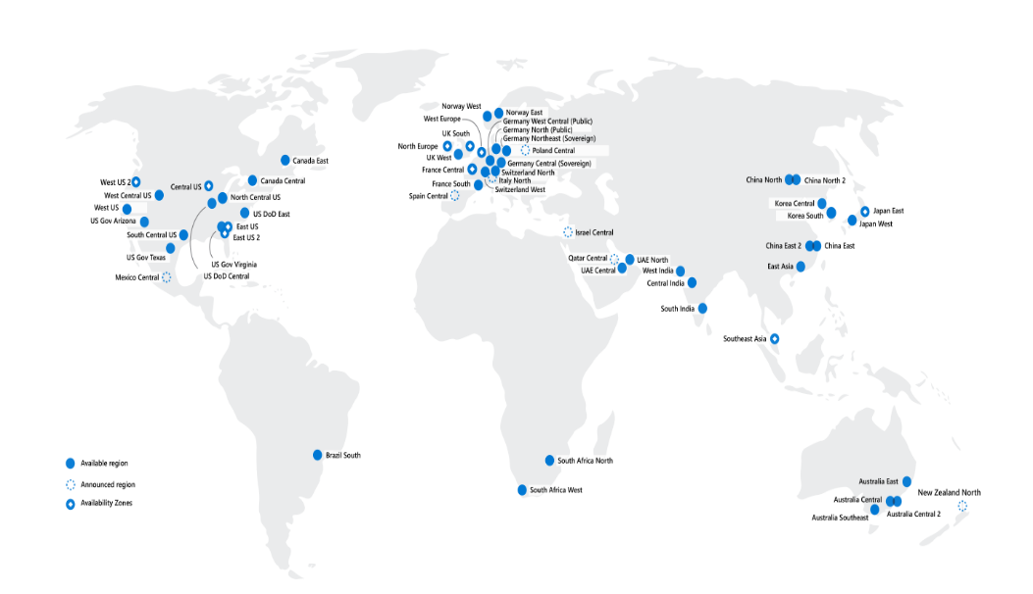
Identify Regions
A region represents a collection of datacenters
Provides flexibility and scale
Preserves data residency
Select regions close to your users
Be aware of region deployment availability
There are global services that are region independent
Worldwide there are 60+ regions representing 140 countries
Regions are paired for high availability
Notes:
A list of regions and their locations is available at https://azure.microsoft.com/global-infrastructure/locations/
May want to mention availability zones which is coming up in another lesson.

Slide 6
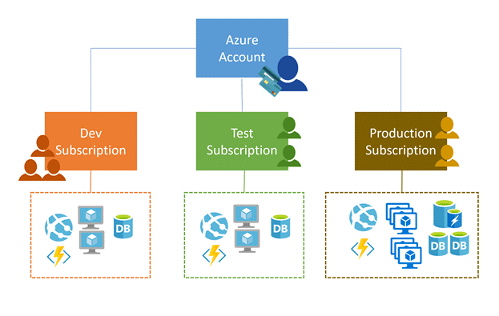
Implement Azure Subscriptions
Only identities in Azure AD, or in a directory that is trusted by Azure AD, can create a subscription
Logical unit of Azure services that is linked to an Azure account
Security and billing boundary
Notes:
Create an additional Azure subscription - https://docs.microsoft.com/azure/cost-management-billing/manage/create-subscription
Change your Azure subscription to a different offer - https://docs.microsoft.com/azure/cost-management-billing/manage/switch-azure-offer
✔️ Do you know how many subscriptions your organization has?
Clarification on the last bullet - Only Identities in Azure Active Directory (Azure AD) or in a directory that is trusted by Azure AD (such as a work or school organization) can create a Subscription. For example, Account Owner role can be used to create a Subscription in an Enterprise Agreement.

Slide 7
Identify Subscription Usage
Subscription | Usage
Free | Includes a $200 credit for the first 30 days, free limited access for 12 months
Pay-As-You-Go | Charges you monthly
CSP | Agreement with possible discounts through a Microsoft Cloud Solutions Provider Partner – typically for small to medium businesses
Enterprise | One agreement, with discounts for new licenses and Software Assurance – targeted at enterprise-scale organizations
Student | Includes $100 for 12 months – must verify student access
Notes:
Credit card information is used for identity verification only. You won’t be charged for any services until you upgrade.

Slide 8
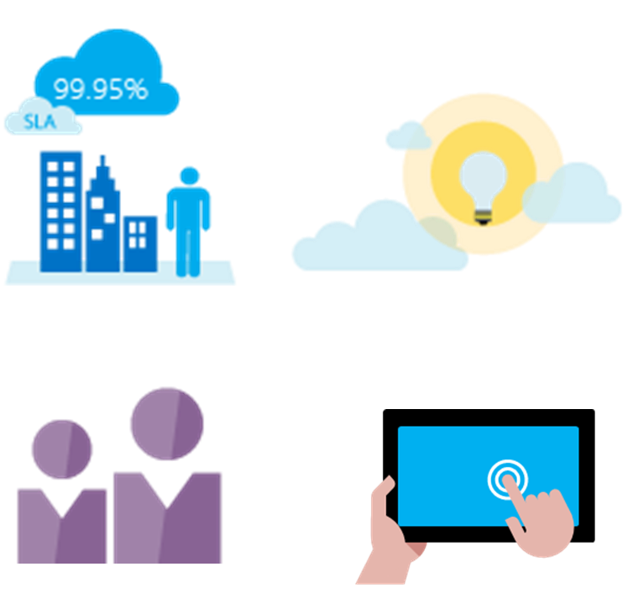
Obtain a Subscription
Enterprise Agreement customers make an upfront monetary commitment and consume services throughout the year
Resellers provide a simple, flexible way to purchase cloud services
Partners can design and implement your Azure cloud solution
Personal free account – Start right away
Notes:
Subscription decision guide - https://docs.microsoft.com/azure/cloud-adoption-framework/decision-guides/subscriptions/
✔️ Which subscription model are you most interested in?

Slide 9
Create Resource Groups
Resources can only exist in one resource group
Resources grouped (Web + DB, VM, Storage) in one group
Groups can have resources of many different types (services) and from many different regions
OR
Groups cannot be renamed or nested
Web and DB resource group
Virtual machine resource group
Storage resource group
Resource locks can prevent changes to the resources
You can move resources between groups
Notes:
Manage Azure Resource Manager resource groups by using the Azure portal - https://docs.microsoft.com/azure/azure-resource-manager/management/manage-resource-groups-portal

Slide 10
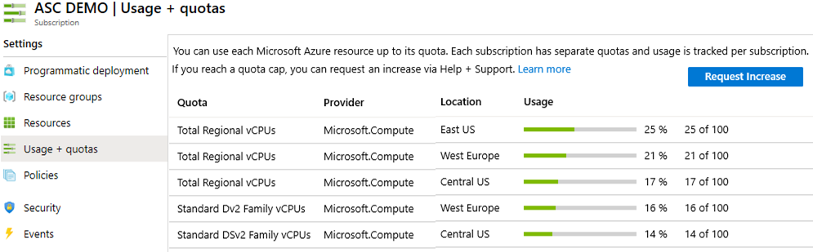
Determine Resource Limits
Resources have a default limit also known as quota
Helpful to track current usage, and plan for future use
You can open a free support case to increase limits to published maximums
Notes:
Azure subscription and service limits, quotas, and constraints - https://docs.microsoft.com/azure/azure-resource-manager/management/azure-subscription-service-limits

Slide 11
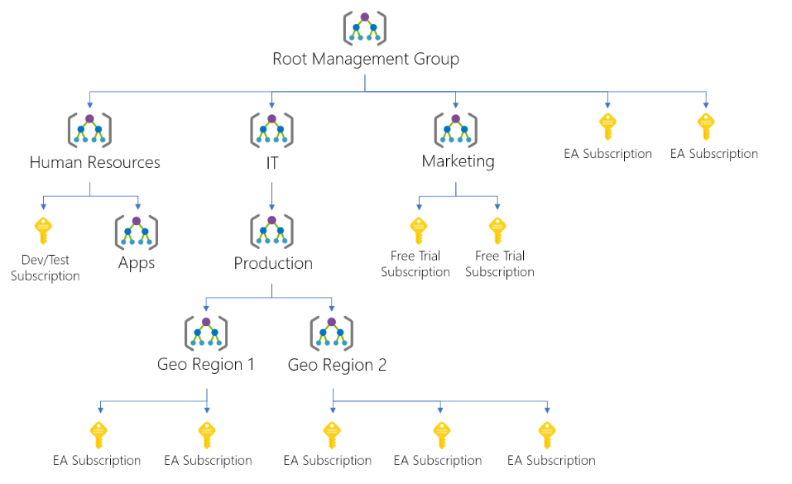
Create an Azure Resource Hierarchy
Management groups provides a level of scope above subscriptions
Target policies and spend budgets across subscriptions and inheritance down the hierarchies
Implement compliance and cost reporting by organization (business/teams)
Notes:
Create management groups for resource organization and management - https://docs.microsoft.com/azure/governance/management-groups/create
Manage your resources with management groups - https://docs.microsoft.com/azure/governance/management-groups/manage

Slide 12
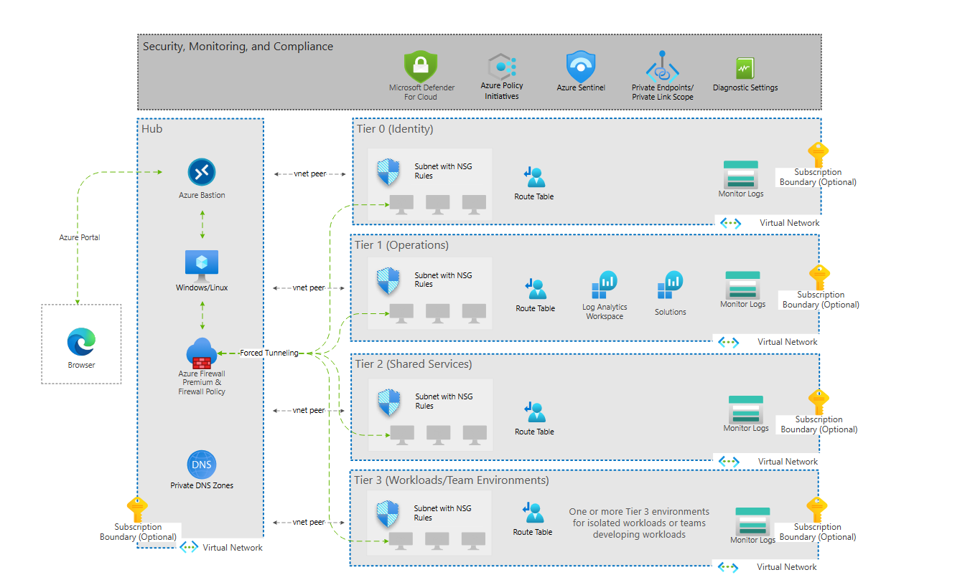
“Mission Landing Zone” example
Notes:
Create management groups for resource organization and management - https://docs.microsoft.com/azure/governance/management-groups/create
Manage your resources with management groups - https://docs.microsoft.com/azure/governance/management-groups/manage

Slide 13
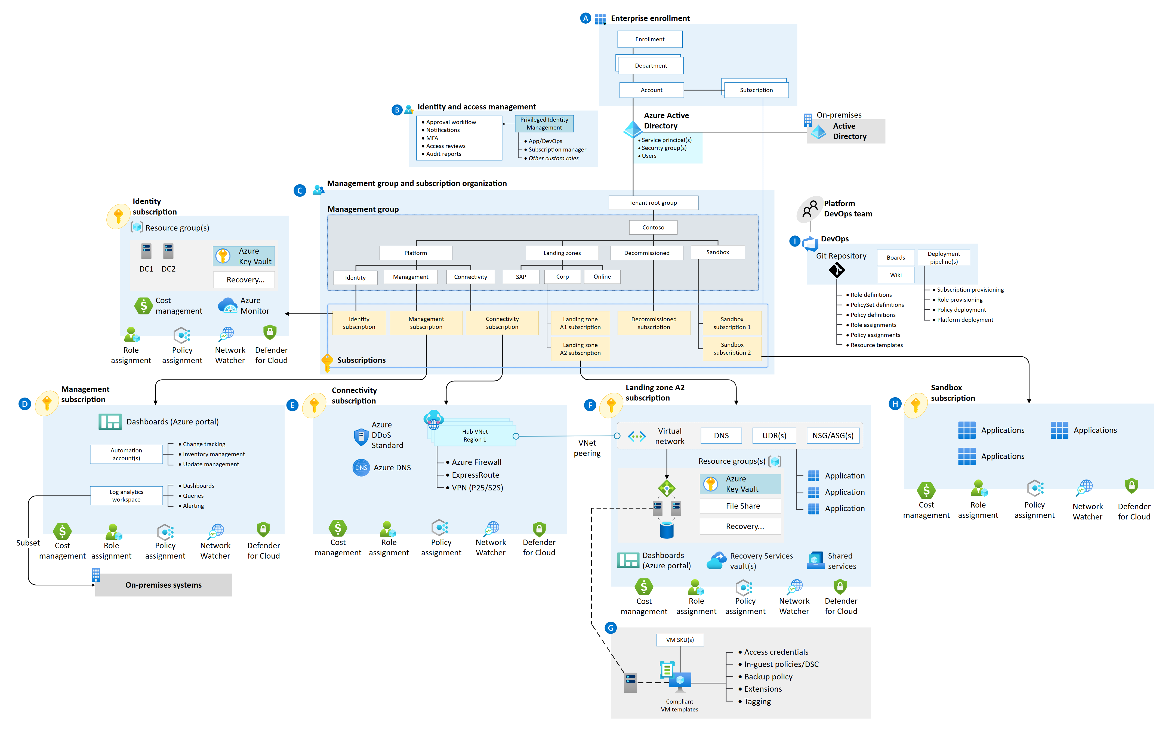
Cloud Adoption Framework – Generic Landing Zone

Slide 14
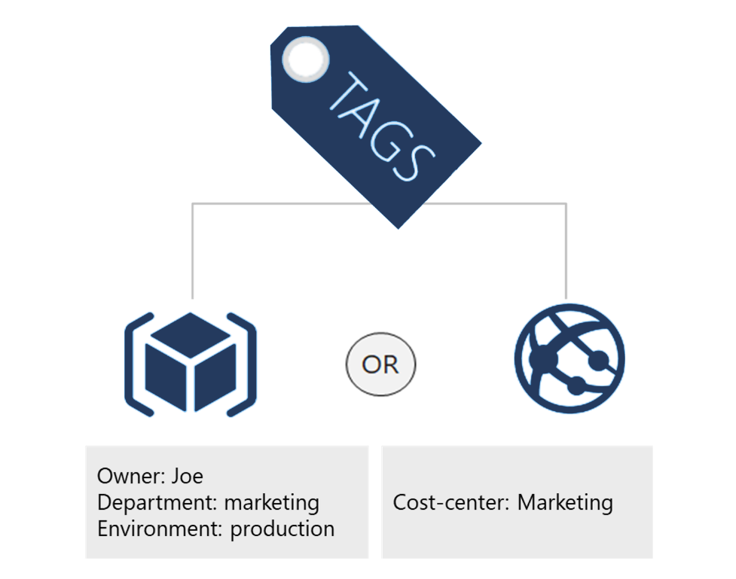
Apply Resource Tagging
Provides metadata for your Azure resources
Logically organizes resources into a taxonomy
Consists of a name-value pair
Very useful for rolling up billing information
Notes:
Resource naming and tagging decision guide - https://docs.microsoft.com/azure/cloud-adoption-framework/decision-guides/resource-tagging
✔️ If you need to create a lot of tags you will want to do that programmatically. You can use PowerShell or the CLI.

Slide 15
Manage Costs
Costs are resource-specific
Usage costs may vary between locations
Costs for inbound and outbound data transfers differ
Pre-pay with Azure reserved instances
Use your on-premises licenses with Azure Hybrid Benefit
Optimize with alerts, budgets, and recommendations
Notes:
Azure usage charges - https://docs.microsoft.com/azure/billing/billing-understand-your-invoice
There are six primary factors affecting costs:
Resource Type: Costs are resource-specific, so the usage that a meter tracks and the number of meters associated with a resource depend on the resource type.
Services: Azure usage rates and billing periods can differ between Enterprise, Web Direct, and CSP customers.
Location: The Azure infrastructure is globally distributed, and usage costs might vary between locations that offer Azure products, services, and resources.
Bandwidth: Some inbound data transfers are free, such as data going into Azure datacenters. For outbound data transfers, such as data going out of Azure datacenters, pricing is based on Zones.
Azure Reservations: Azure Reservations allow you to prepay for one-year or three-years of virtual machine or SQL Database compute capacity. Pre-paying will allow you to get a discount on the resources you use. Azure reservations can significantly reduce your virtual machine or SQL database compute costs — up to 72 percent on pay-as-you-go prices with one-year or three-year upfront commitment. Reservations provide a billing discount and don't affect the runtime state of your virtual machines or SQL databases.
Azure Hybrid Benefit: If you already have Windows Server or SQL Server licenses in your on-premises deployments, you can use the Azure Hybrid Benefit program to save in Azure. With the Windows Server benefit, each license covers the cost of the OS (up to two virtual machines), and you only pay for base compute costs. You can use existing SQL Server licenses to save up to 55 percent on vCore-based SQL Database options. Options include SQL Server in Azure Virtual Machines and SQL Server Integration Services.

Slide 16
Summary and Resources - Configure Subscriptions
Knowledge Check Questions
Microsoft Learn Modules (docs.microsoft.com/Learn)
Introduction to analyzing costs and creating budgets with Azure Cost Management
Plan and manage your Azure costs (Sandbox)
Control and organize Azure resources with Azure Resource Manager
A sandbox indicates a hands-on exercise.
Notes:
Learn - https://docs.microsoft.com/learn/browse/
The Assessment Guide in the MCT DLC has open-ended questions.
What is resource tagging and why would you use it?
Answer: Resource tags provide metadata for your Azure resources. Tags are name-value pairs that help logically organize resources into a taxonomy. Tags can be used to roll up billing information, for example the costs on a new project. Tags can also be used by Azure policy to determine when a policy should be applied.
Name several ways you can reduce costs in Azure
Answer: Azure Reservations helps you save money by pre-paying for services. Azure Hybrid Benefits uses Windows Server and SQL Server on-premises licenses with Software Assurance. Azure Credits provides a monthly benefit that allows you to experiment with, develop, and test new solutions on Azure. Regional pricing can be explored to find the most cost-effective location. You can implement Cost Management to conduct a cost analysis, create a budget, and review cost recommendations.

Slide 17
Configure Azure Policy

Slide 18
Configure Azure Policy Introduction
Implement Azure Policy
Create Azure Policies
Demonstration – Azure Policies
Create Policy Definitions
Create and Scope the Initiative Definition
Determine Compliance
Summary and Resources
Notes:
Manage Azure identities and governance (15-20%)
Manage subscriptions and governance
Configure Azure policies
Apply tags
Configure management groups

Slide 19
Implement Azure Policies
A service to create, assign, and manage policies
Usage Cases
Allowed resource types – Specify the resource types that your organization can deploy
Allowed virtual machine SKUs – Specify a set of virtual machine SKUs that your organization can deploy
Allowed locations – Restrict the locations your organization can specify when deploying resources
Require tag and its value – Enforces a required tag and its value
Azure Backup should be enabled for Virtual Machines – Audit if Azure Backup service is enabled for all Virtual machines
Runs evaluations and scans for non-compliant resources
Advantages:
Enforcement and compliance
Apply policies at scale
Remediation
Notes:
What is Azure Policy? - https://docs.microsoft.com/azure/governance/policy/overview
Quickstart: Create a policy assignment to identify non-compliant resources - https://docs.microsoft.com/azure/governance/policy/assign-policy-portal

Slide 20
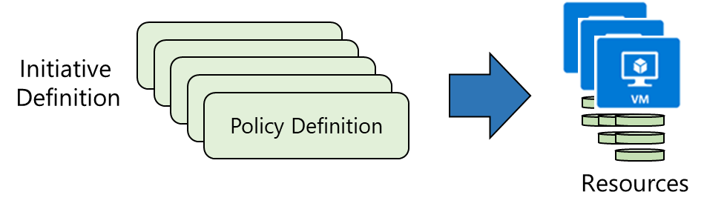
Create Azure Policies
Create Policy Definitions
Create Initiative Definitions
Scope the Initiative Definition
Determine Compliance
Notes:
Walk-through the Tutorial: Create and manage policies to enforce compliance - https://docs.microsoft.com/azure/governance/policy/tutorials/create-and-manage
Or do the Demonstration (in the MCT DLC).
Or just walk through the slides.
Apply and monitor infrastructure standards with Azure Policy (Learn) - https://docs.microsoft.com/learn/modules/intro-to-governance/
The next topics step you through creating an Azure policy.
✔ Even if you have only a few Policy Definitions, we recommend creating an Initiative Definition.

Slide 21
Demonstration – Azure Policy
Assign a policy
Create and assign an initiative definition
Check for compliance
Check for remediation tasks
Remove your policy and initiative
Notes:
✔ Always consider having students walk-through the demonstrations themselves. Also, consider the overlap with the formal labs and your best use of time.

Slide 22
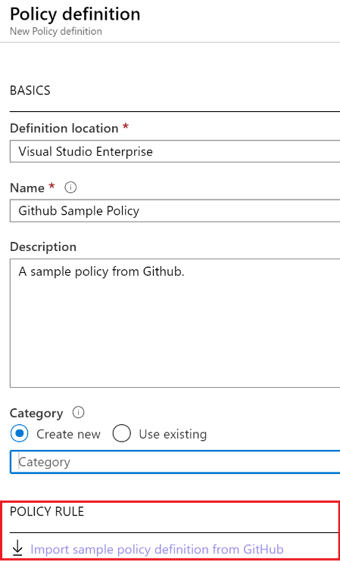
1. Create Policy Definitions
Many policy definitions are available
You can import policies from GitHub
Policy Definitions have a specific JSON format
You can create custom policy definitions
Notes:
Azure Policy built-in policy definitions - https://docs.microsoft.com/azure/governance/policy/samples/built-in-policies
✔️ Policy Definitions have a specific JSON format. As an Azure Administrator you will not need to create files in this format, but you may want to review, so you are familiar. Review the available definitions in the portal and in GitHub.

Slide 23
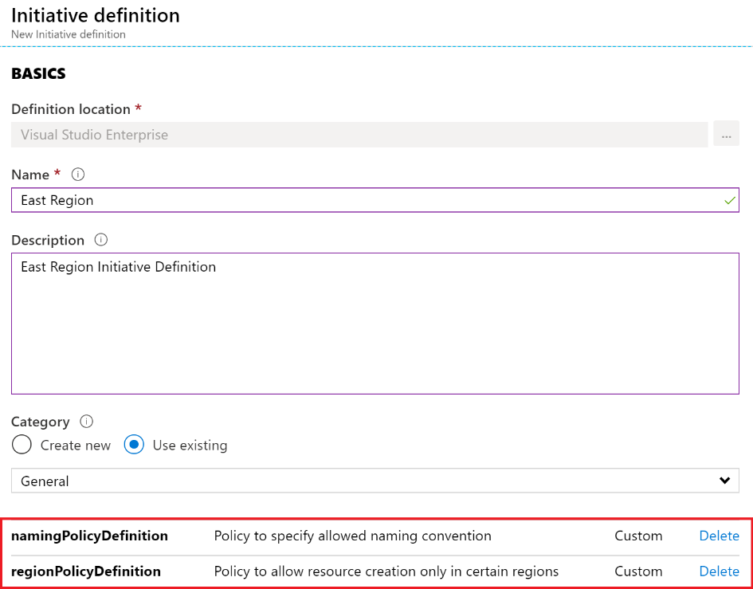
2. Create Initiative Definitions
Group policy definitions
Include one or more policies
Requires planning
Notes:
Azure Policy built-in initiative definitions - https://docs.microsoft.com/azure/governance/policy/samples/built-in-initiatives
✔️ Can you see how this will require some planning to organize your policies?

Slide 24
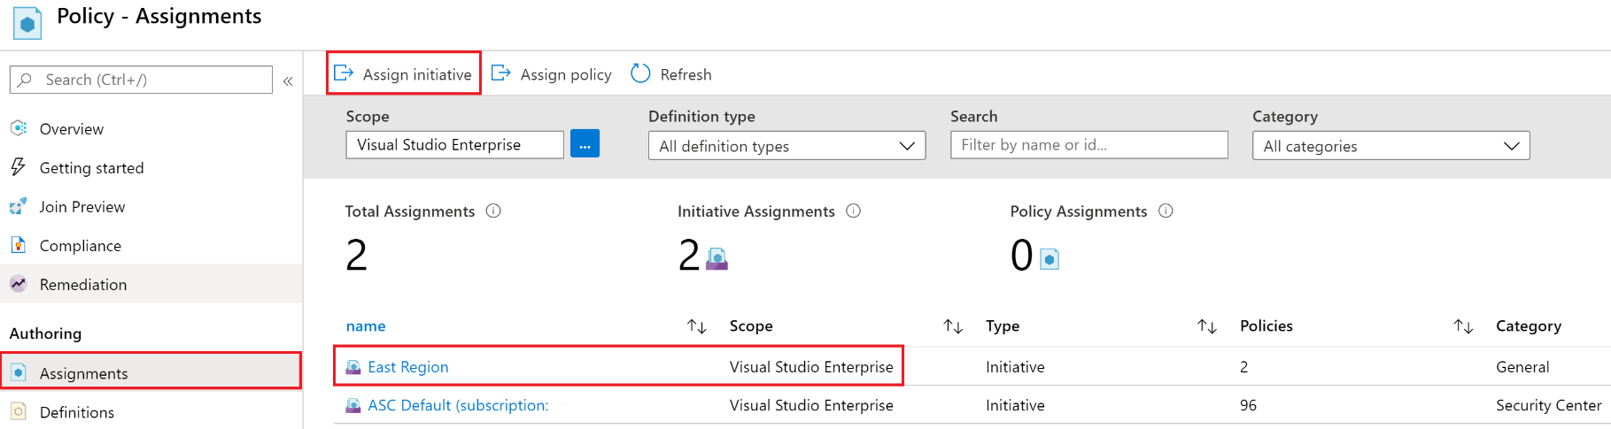
3. Scope the Initiative Definition
Assign the definition to a scope
The scope enforces the policy
Select the subscription, and optionally the resource group

Slide 25
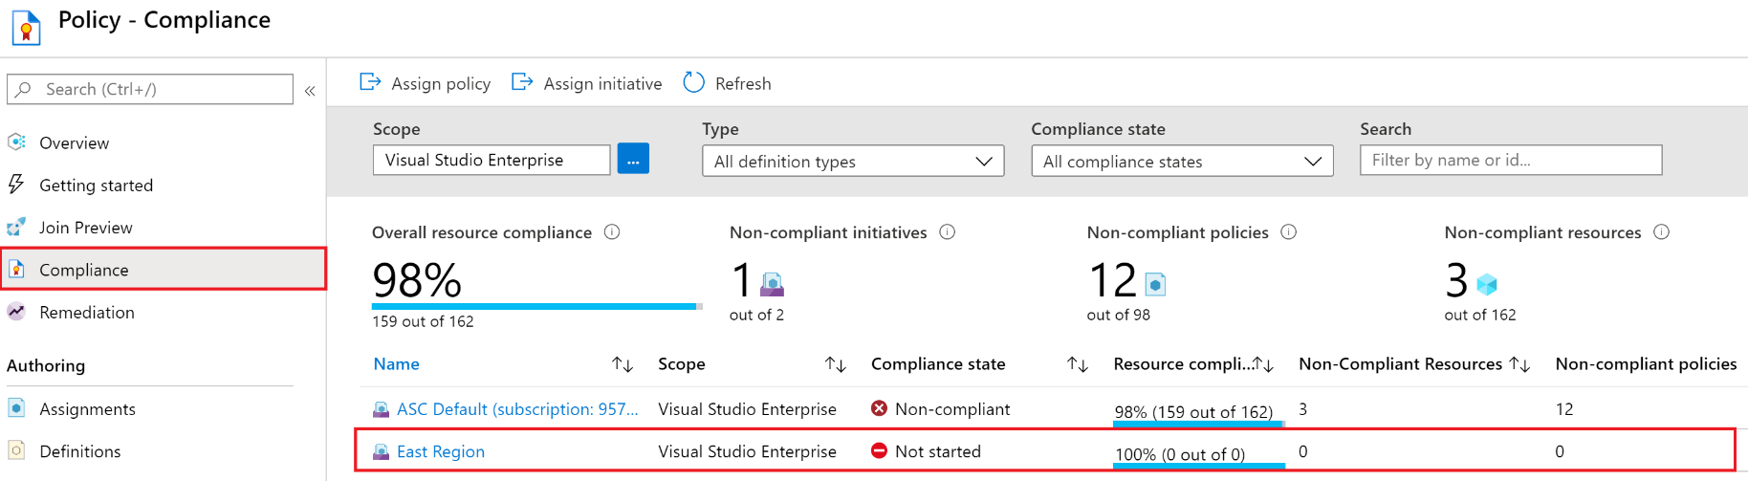
4. Determine Compliance
Non-compliant initiatives, policies and resources
Evaluates and reports about once an hour
Automatic remediations is available
Notes:
✔️ Policy evaluation happens about once an hour, which means that if you make changes to your policy definition and create a policy assignment then it will be re-evaluated over your resources within the hour.

Slide 26
Summary and Resources – Configure Azure Policy
Knowledge Check Questions
Microsoft Learn Modules (docs.microsoft.com/Learn)
Introduction to Azure Policy
Build a cloud governance strategy on Azure
Notes:
Learn - https://docs.microsoft.com/learn/browse/
The Assessment Guide in the MCT DLC has open-ended questions.
Describe the steps for creating an Azure policy. What are the advantages of Azure policy?
Answer: Azure Policy is a service in Azure which allows you create polices which enforce and control the properties of a resource. The advantages include enforcement and compliance, applying policies at scale, and remediating non-compliant resources. The creation steps are - create a policy definition, create a policy initiative, scope the initiative, and determine compliance. A policy example is when company wants to implement geographic compliance requirements to limit locations where services can be deployed.

Slide 27
Configure Role-Based Access Control

Slide 28
Configure Role-Based Access Control Introduction
Compare Azure RBAC Roles to Azure AD Roles
Create a Role Definition
Create a Role Assignment
Apply RBAC Authentication
Demonstration – Azure RBAC
Summary and Resources
Notes:
Manage Azure identities and governance (15-20%)
Manage role-based access control (RBAC)
Create a custom role
Provide access to Azure resources by assigning roles (subscriptions, resource groups. resources)
Interpret access assignments

Slide 29

Compare Azure RBAC Roles to Azure AD Roles
RBAC roles provide fine-grained access management
Azure RBAC roles | Azure AD roles
Manage access to Azure resources | Manage access to Azure AD objects
Scope can be specified at multiple levels | Scope is at the tenant level
Role information can be accessed in the Azure portal, Azure CLI, Azure PowerShell, Azure Resource Manager templates, REST API | Role information can be accessed in Azure portal, Microsoft 365 admin portal, Microsoft Graph, Azure Active Directory PowerShell for Graph
There are many built-in roles, or you can create your own custom role

Slide 30
Create a Role Definition
Collection of permissions that lists the operations that can be performed
Contributor
Owner
Contributor
Reader
…
Backup Operator
Security Reader
User Access Administrator
Virtual Machine Contributor
"Actions": [
"*"
],
"NotActions" : [
"Authorization/*/Delete",
"Authorization/*/Write",
"Authorization/elevateAccess/Action"
],
"DataActions" : [],
"NotDataActions": [],
"AssignableScopes" : [
"/"
]
Built-in
Reader Support Tickets
Virtual Machine Operator
Custom
Notes:
List role definitions in Azure RBAC - https://docs.microsoft.com/azure/role-based-access-control/role-definitions-list
Create custom roles for Azure resources with role-based access control - https://docs.microsoft.com/learn/modules/create-custom-azure-roles-with-rbac/

Slide 31




Create a Role Assignment
Process of binding a role definition to a user, group, or service principal at a scope for the purpose of granting access
1
Security principal
User
Group
Service principal
2
Role definition
Role assignment
3
Scope
Owner
Contributor
Reader
…
Backup Operator
Security Reader
Contributor
"Actions": [
"*"
],
"NotActions": [
"Auth/*/Delete",
"Auth/*/Write",
"Auth/elevate"
]
Management group
Marketing group
Subscription
Resource group
Pharma-sales Resource group
Reader Support Tickets
Virtual Machine Operator
Contributor
Resource
Notes:
Add or remove role assignments using Azure RBAC and the Azure portal - https://docs.microsoft.com/azure/role-based-access-control/role-assignments-portal
Explain that the role assignment completes the process of implementing RBAC and combining service principals, a role definition, and a scope.

Slide 32





Apply RBAC Authentication
Azure AD
Admin roles
Azure Active
Directory tenant
Global admin
Application admin
Application developer
Billing admin …
Global admin/User access admin (elevated access)
Root
Azure RBAC
roles
Root management group
Owner
Contributor
Reader
User access admin
…
Management group
Subscription
Azure RBAC
roles
Resource group
Azure account
Owner
Contributor
Reader
User access admin
…
Resource
Notes:
Manage access to an Azure subscription by using Azure role-based access control - https://docs.microsoft.com/learn/modules/manage-subscription-access-azure-rbac/3-elevate-your-access-user-access-admin

Slide 33
Demonstration – Azure RBAC
Locate the Access Control blade
Review role permissions
Add a role assignment
Explore PowerShell commands
Notes:
✔ Always consider having students walk-through the demonstrations themselves. Also, consider the overlap with the formal labs and your best use of time.
Use the Demonstration in the MCT DLC or one of the tutorials.
Tutorial: Grant a user access to Azure resources using the Azure portal - https://docs.microsoft.com/azure/role-based-access-control/quickstart-assign-role-user-portal
Quickstart: Check access for a user to Azure resources - https://docs.microsoft.com/azure/role-based-access-control/check-access

Slide 34
Summary and Resources – Configure RBAC
Knowledge Check
Microsoft Learn Modules (docs.microsoft.com/Learn)
Create custom roles for Azure resources with Azure role-based access control
Manage access to an Azure subscription by using Azure role-based access control
Secure your Azure resources with Azure role-based access control (Sandbox)
A sandbox indicates a hands-on exercise.
Notes:
Learn - https://docs.microsoft.com/learn/browse/
The Assessment Guide in the MCT DLC has open-ended questions.
List three RBAC roles and the associated permissions for each role.
Answer: Owner who has full access to all resources and can delegate access to others. Contributor who can creates and manages all types of Azure resources but cannot grant access to others. Reader who can only view Azure resources. User access administrator who manages user access to Azure resources. Other roles are possible.
What is the purpose of role-based access control (RBAC) and why would you use it?
Answer: RBAC provides fine-grained access management of resources in Azure. RBAC can be used to segregate duties within a team. RBAC can also grant just the amount of access users need to perform their jobs​. RBAC is an allow model granting access only as assigned.

Slide 35
Lab 02a - Manage Subscriptions and RBAC Lab 02b - Manage Governance via Azure Policy

Slide 36
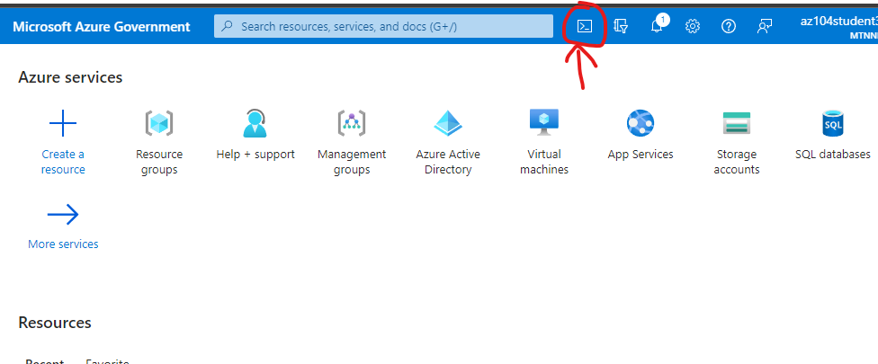
Set up Cloud Shell
Open Cloud Shell
Select the icon highlighted in the picture

Slide 37
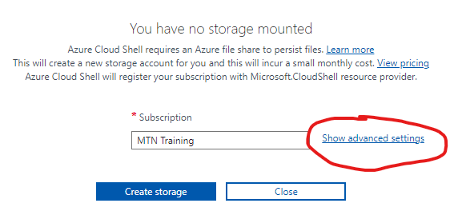
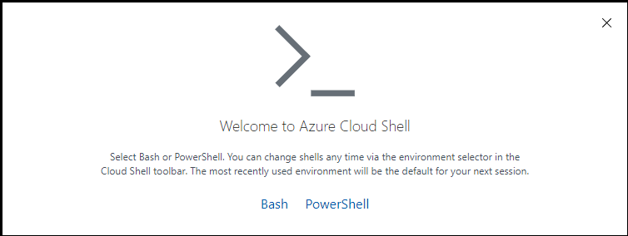
Set up Cloud Shell
Select either Bash or PowerShell.
Verify your subscription, then select “show advanced settings”

Slide 38
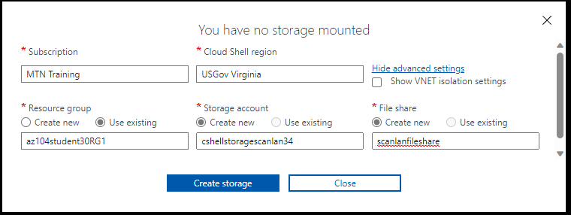
Set up Cloud Shell
Advanced settings
Region: USGov Virginia
Resource group: use existing – change this to your student RG
Storage account: create new, must be globally unique name
File share: create new, doesn’t have to be unique name

Slide 39
Lab 02a – Manage Subscriptions and Azure RBAC
Lab scenario
To improve the management of Azure resources in Contoso, you have been tasked with implementing the following functionality:
Using management groups for the Contoso’s Azure subscriptions
Granting user permissions for submitting support requests. This user would only be able to create support request tickets and view resource groups
Objectives
Task 1: Implement Management Groups
Task 2: Create custom RBAC roles
Task 3: Assign RBAC roles
Next slide for an architecture diagram
Notes:
LAB 02a - Manage Subscriptions and RBAC - ESTIMATED DURATION 30 MIN
Lab Repository - https://microsoftlearning.github.io/AZ-104-MicrosoftAzureAdministrator/

Slide 40




Lab 02a – Architecture diagram
Task 1
Tenant Root Group
Default Azure AD tenant
az104-02-rg1
Task 2
Task 3
az104-02a-customRoleDefinition.json
{
"Name": "Support Request Contributor (Custom)",
"IsCustom": true,
"Description": "Allows to create support requests",
"Actions": [
"Microsoft.Resources/subscriptions/resourceGroups/read",
"Microsoft.Support/*"
],
"NotActions": [
],
"AssignableScopes": [
"/providers/Microsoft.Management/managementGroups/az104-02-mg1",
"/subscriptions/SUBSCRIPTION_ID"
]
}
Azure pass subscription
az104-02-aaduser1
customRoleDefinition

Slide 41
Lab 02b – Manage Governance via Azure Policy
Lab scenario
To improve management of Azure resources in Contoso, you have been tasked with implementing the following functionality:
Tagging resource groups that include only infrastructure resources
Ensuring that only properly tagged infrastructure resources can be added to infrastructure resource groups
Remediating any non-compliant resources
Objectives
Task 1: Create and assign tags via the Azure portal
Task 2: Enforce tagging via an Azure Policy
Task 3: Apply tagging via an Azure Policy
Next slide for an architecture diagram
Notes:
LAB 02b - Manage Governance via Azure Policy - ESTIMATED DURATION 30 MIN
Lab Repository - https://microsoftlearning.github.io/AZ-104-MicrosoftAzureAdministrator/

Slide 42


Lab 02b – Architecture diagram
Task 1
Name: Role
Value: Infra
Task 2
Cloud Shell Storage
Resource Group
Azure policy
Require a tag and its value on resources
Cloud Shell Storage Account
Task 3
Azure policy
Inherit a tag from the resource group if missing
New Storage Account

Slide 43

End of presentation

Slide 44
Implement Cost Management
Conduct cost analysis
Create a budget
Review recommendations
Export the data
Notes:
What is Azure Cost Management and Billing? - https://docs.microsoft.com/azure/cost-management-billing/cost-management-billing-overview
Quickstart: Explore and analyze costs with cost analysis - https://docs.microsoft.com/azure/cost-management-billing/costs/quick-acm-cost-analysis
Analyze costs and create budgets with Azure Cost Management - https://docs.microsoft.com/learn/modules/analyze-costs-create-budgets-azure-cost-management/

Slide 45
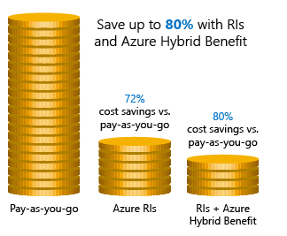
Apply Cost Savings
Azure Reservations – Helps you save money by pre-paying for services
Azure Hybrid Benefits – Use Windows Server and SQL Server on-premises licenses with Software Assurance
Azure Credits – Monthly credit benefit that allows you to experiment with, develop, and test new solutions on Azure
Regions – Choose low-cost locations and regions
Notes:
Cost savings - https://docs.microsoft.com/learn/modules/predict-costs-and-optimize-spending/4-save-on-infrastructure-costs

Slide 46
Implement Role-Based Access Control
Provides fine-grained access management of resources in Azure​
Concepts​
Built on Azure Resource Manager
Segregate duties within your team ​
Grant only the amount of access to users that they need to perform their jobs​
Security principal. Object that represents something that is requesting access to resources​
Role definition. Collection of permissions that lists the operations that can be performed​
Scope. Boundary for the level of access that is requested​
Assignment. Attaching a role definition to a security principal at a particular scope​:
Users can grant access described in a role definition by creating an assignment​
Deny assignments are currently read-only and are set by Azure Blueprints and Azure Managed Apps
Notes:
What is role-based access control (RBAC) for Azure resources? - https://docs.microsoft.com/azure/role-based-access-control/overview

Slide 47
Determine Azure RBAC Roles
RBAC role in Azure | Permissions | Notes
Owner | Has full access to all resources and can delegate access to others | The Service Administrator and Co-Administrators are assigned the Owner role at the subscription scope. This applies to all resource types
Contributor | Creates and manages all types of Azure resources but cannot grant access to others | This applies to all resource types
Reader | Views Azure resources | This applies to all resource types
User Access Administrator | Manages user access to Azure resources | This applies to managing access, rather than to managing resources
Notes:
Custom roles for Azure resources - https://docs.microsoft.com/azure/role-based-access-control/custom-roles

