Slide 1
AZ-104 Administer Azure Virtual Machines

Slide 2
Administer Azure Virtual Machines Overview
Configure Virtual Machines
Configure Virtual Machine Availability
Configure Virtual Machine Extensions
Lab 08 – Manage Virtual Machines
Notes:
Module overview

Slide 3
Configure Virtual Machines

Slide 4
Configure Virtual Machines Introduction
Review Cloud Services Responsibilities
Plan Virtual Machines
Determine Virtual Machine Sizing
Determine Virtual Machine Storage
Demonstration - Creating a VM in the Portal
Connect to Virtual Machines
Connect to Windows Virtual Machines
Connect to Linux Virtual Machines
Demonstration – Connect to Linux VMs (optional)
Summary and Resources
Notes:
Deploy and manage Azure compute resources (25-30%)
Create and configure VMs
VM sizes
Add data disks

Slide 5
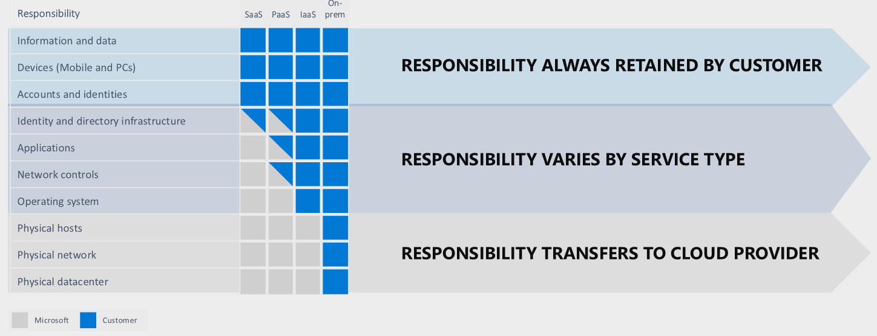
Review Cloud Services Responsibilities
Test and development, website hosting, storage, backup, recovery, high-performance computing, big data analysis, and extended data center
Notes:
Infrastructure as a Service - https://azure.microsoft.com/en-us/overview/what-is-iaas/
Choose an Azure compute service for your application - https://docs.microsoft.com/en-us/azure/architecture/guide/technology-choices/compute-decision-tree

Slide 6
Plan Virtual Machines
Start with the network
Name the virtual machine
Choose a location
Each region has different hardware and service capabilities
Locate Virtual Machines as close as possible to your users and to ensure compliance and legal obligations
Consider pricing
60+ Azure regions
Available in 140 countries

Slide 7
Determine Virtual Machine Sizing
Type | Description
General purpose | Balanced CPU-to-memory ratio.
Compute optimized | High CPU-to-memory ratio.
Memory optimized | High memory-to-CPU ratio.
Storage optimized | High disk throughput and I/O.
GPU | Specialized virtual machines targeted for heavy graphic rendering and video editing..
High performance compute | Our fastest and most powerful CPU virtual machines
✔️ Share VM images in a compute gallery
Notes:
Virtual Machine series - https://azure.microsoft.com/en-us/pricing/details/virtual-machines/series/
Sizes for Windows virtual machines in Azure - https://docs.microsoft.com/en-us/azure/virtual-machines/windows/sizes?toc=%2Fazure%2Fvirtual-machines%2Fwindows%2Ftoc.json#size-tables
Sizes for Linux virtual machines in Azure - https://docs.microsoft.com/en-us/azure/virtual-machines/linux/sizes?toc=%2fazure%2fvirtual-machines%2flinux%2ftoc.json
Resize a Windows VM - https://docs.microsoft.com/en-us/azure/virtual-machines/windows/resize-vm
Balanced CPU-to-memory ratio. Ideal for testing and development, small to medium databases, and low to medium traffic web servers.
High CPU-to-memory ratio. Good for medium traffic web servers, network appliances, batch processes, and application servers.
High memory-to-CPU ratio. Great for relational database servers, medium to large caches, and in-memory analytics.
High disk throughput and IO ideal for Big Data, SQL, NoSQL databases, data warehousing and large transactional databases.
Specialized virtual machines targeted for heavy graphic rendering and video editing, as well as model training and inferencing (ND) with deep learning. Available with single or multiple GPUs.
Our fastest and most powerful CPU virtual machines with optional high-throughput network interfaces (RDMA).

Slide 8



Determine Virtual Machine Storage
Each Azure VM has two or more disks:
OS disk
Temporary disk (contents can be lost)
Data disks (optional)
Azure VM (Windows)
OS and data disks reside in Azure Storage accounts:
Azure-based storage service
Standard (HDD, SSD) or Premium (SSD), or Ultra (SSD)
C:\
OS disk
D:\
Temporary disk
F:\
Data disk
When creating an Azure VM, you can choose between:
Managed disks (recommended)
Unmanaged disks
Azure blob
Notes:
Introduction to Azure managed disks - https://docs.microsoft.com/en-us/azure/virtual-machines/managed-disks-overview
Introduction to Azure managed disks - https://docs.microsoft.com/en-us/azure/virtual-machines/windows/managed-disks-overview
Convert a Windows virtual machine from unmanaged disks to managed disks - https://docs.microsoft.com/en-us/azure/virtual-machines/windows/convert-unmanaged-to-managed-disks

Slide 9
Demonstration – Creating a VM in the Portal
Create the virtual machine
Connect to the virtual machine
Install the Web Server role
View the IIS welcome page
Notes:
✔ Always consider having students walk-through the demonstrations themselves. Also, consider the overlap with the formal labs and your best use of time.

Slide 10
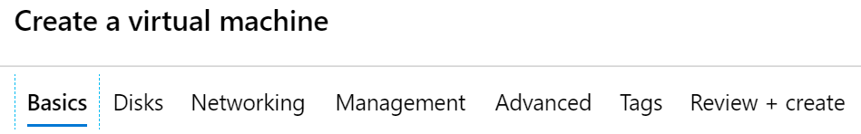
Create Virtual Machines in the Portal
Basic (required) – Project details, Administrator account, Inbound port rules
Disks – OS disk type, data disks
Networking – Virtual networks, load balancing
Management – Monitoring, Auto-shutdown, Backup
Advanced – Add additional configuration, agents, scripts or applications
Notes:
If you are unable to demonstrate creating a virtual machine in the portal, you can use this slide to discuss.
QuickStart: Create a Windows virtual machine in the Azure portal - https://docs.microsoft.com/en-us/azure/virtual-machines/windows/quick-create-portal
QuickStart: Create a Linux virtual machine in the Azure portal - https://docs.microsoft.com/en-us/azure/virtual-machines/linux/quick-create-portal

Slide 11
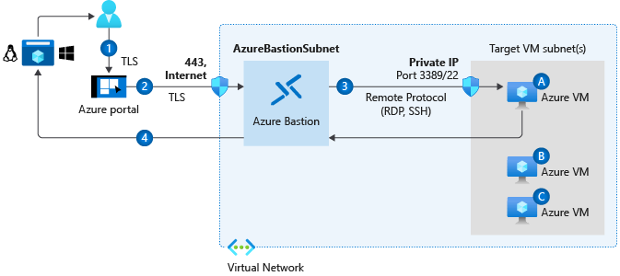
Connect to Virtual Machines
Bastion Subnet for RDP/SSH through the Portal over SSL
Remote Desktop Protocol for Windows-based Virtual Machines
Secure Shell Protocol for Linux based Virtual Machines
Notes:
How to connect and sign on to an Azure virtual machine running Windows - https://docs.microsoft.com/en-us/azure/virtual-machines/windows/connect-logon
How to use SSH keys with Windows on Azure - https://docs.microsoft.com/en-us/azure/virtual-machines/linux/ssh-from-windows
What is Azure Bastion? - https://docs.microsoft.com/en-us/azure/bastion/bastion-overview

Slide 12
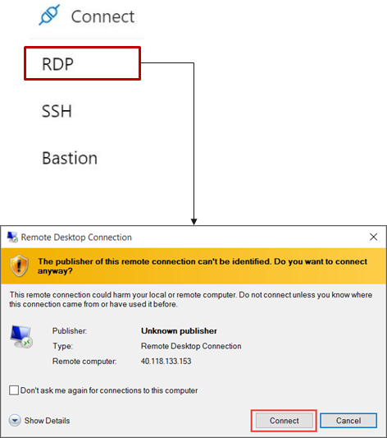
Connect to Windows Virtual Machines
Remote Desktop Protocol (RDP) creates a GUI session and accepts inbound traffic on TCP port 3389
WinRM creates a command-line session so you can run scripts
Notes:
How to connect and sign on to an Azure virtual machine running Windows - https://docs.microsoft.com/en-us/azure/virtual-machines/windows/connect-logon

Slide 13
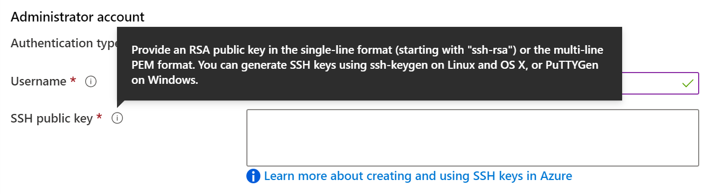
Connect to Linux Virtual Machines
Authenticate with a SSH public key or password
SSH is an encrypted connection protocol that allows secure logins over unsecured connections
There are public and private keys
Notes:
How to use SSH keys with Windows on Azure - https://docs.microsoft.com/en-us/azure/virtual-machines/linux/ssh-from-windows
How to create a Linux virtual machine with Azure Resource Manager templates - https://docs.microsoft.com/en-us/azure/virtual-machines/linux/create-ssh-secured-vm-from-template
✔️ Azure currently requires at least a 2048-bit key length and the SSH-RSA format for public and private keys.

Slide 14
Demonstration – Connect to Linux VMs (optional)
Create the SSH keys
Create the Linux machine and assign the public SSH key
Access the server using SSH
Notes:
✔ Always consider having students walk-through the demonstrations themselves. Also, consider the overlap with the formal labs and your best use of time.

Slide 15
Summary and Resources - Configure Virtual Machines
Knowledge Check Questions
Microsoft Learn Modules (docs.microsoft.com/Learn)
Introduction to Azure virtual machines (Sandbox)
Choose the right disk storage for your virtual machine workload
Create a Linux virtual machine in Azure (Sandbox)
Create a Windows virtual machine in Azure (Sandbox)
Connect to virtual machines through the Azure portal by using Azure Bastion
A sandbox indicates a hands-on exercise.
Notes:
Learn - https://docs.microsoft.com/en-us/learn/browse
The Assessment Guide in the MCT DLC has open-ended questions.
Describe at least three things you would need to consider before creating an Azure virtual machine.
Answer: Locating the virtual machine in a region that is close to your users. Selecting the best virtual machine size for your application. Determining how cost will be determined and estimating the monthly cost. Deciding on disk storage including standard, premium, or ultra. Selecting an operating system and version. How you will monitor and update the virtual machine. If any additional scripts, configuration, or agents are required.
Describe two ways to connect and sign-in to a virtual machine.
Answer: Bastion is the recommended way to connect to a virtual machine. For example, to install required software. Bastion lets you access the virtual machine through the Azure portal over SSL. You can also directly connect to a Windows server with the Remoted Desktop Protocol. For Linux machines you can use Secure Shell Protocol (SSH).

Slide 16
Configure Virtual Machine Availability

Slide 17
Configure Azure Virtual Machine Availability Introduction
Plan for Maintenance and Downtime
Setup Availability Sets
Review Update and Fault Domains
Review Availability Zones
Compare Vertical to Horizontal Scaling
Create Scale Sets (2 student topics)
Configure Autoscale (2 student topics)
Demonstration – Virtual Machine Scaling
Summary and Resources
Notes:
Deploy and manage Azure compute resources (25-30%)
Configure VMs for high availability and scalability
Configure high availability
Deploy and configure scale sets

Slide 18
Plan for Maintenance and Downtime
Unplanned Hardware Maintenance
Unexpected Downtime
Planned Maintenance
When the platform predicts a failure, it will issue an unplanned hardware maintenance event
Action: Live migration
Unexpected Downtime is when a virtual machine fails unexpectedly
Action: Automatically migrate (heal)
Planned Maintenance events are periodic updates made to the Azure platform
Action: No action
Notes:
Microsoft Azure Well-Architected Framework (Reliability) - https://docs.microsoft.com/en-us/learn/modules/azure-well-architected-reliability/
✔️ To reduce the impact of downtime due to one or more of these events, we recommend placing multiple virtual machines into an availability set (next topic).

Slide 19
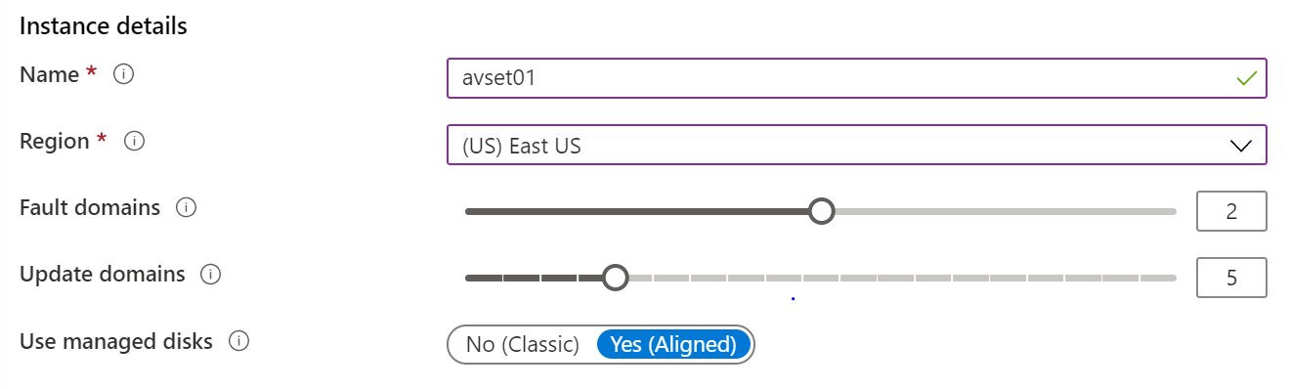
Setup Availability Sets
Two or more instances in Availability Sets = 99.95% SLA
Configure multiple Virtual Machines in an Availability Set
Configure each application tier into separate Availability Sets
Combine a Load Balancer with Availability Sets
Use managed disks with the Virtual Machines
Notes:
Availability options for virtual machines in Azure - https://docs.microsoft.com/en-us/azure/virtual-machines/windows/availability
Configure multiple virtual machines in an availability set for redundancy - https://docs.microsoft.com/en-us/azure/virtual-machines/windows/manage-availability#:~:text=Availability%20sets%20are%20another%20datacenter,meets%20the%2099.95%25%20Azure%20SLA.
✔️ You can create a virtual machine and an availability set at the same time. A VM can only be added to an availability set when it is created. To change the availability set, you need to delete and then recreate the virtual machine.

Slide 20
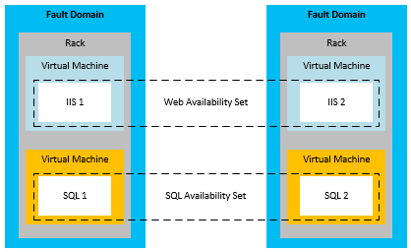
Review Update and Fault Domains
Update domains allows Azure to perform incremental or rolling upgrades across a deployment. During planned maintenance, only one update domain is rebooted at a time
Fault Domains are a group of Virtual Machines that share a common set of hardware, switches, that share a single point of failure. VMs in an availability set are placed in at least two fault domains
Notes:
✔️ Placing your Virtual Machines into an availability set does not protect your application from operating system or application-specific failures, it does limit the impact of potential physical hardware failures, network outages, or power interruptions. Can you see why this important and how this is implemented?

Slide 21
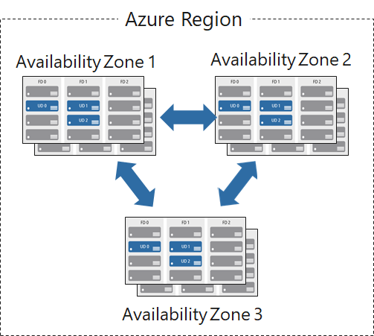
Review Availability Zones
Unique physical locations in a region
Includes datacenters with independent power, cooling, and networking
Protects from datacenter failures
Combines update and fault domains
Provides 99.99% SLA​
Notes:
Regions and Availability Zones in Azure - https://docs.microsoft.com/en-us/azure/availability-zones/az-overview

Slide 22
Compare Vertical to Horizontal Scaling
Vertical scaling (scale up and scale down) is the process of increasing or decreasing power to a single instance of a workload; usually manual​
Horizontal scaling (scale out and scale in) is the process of increasing or decreasing the number of instances of a workload; frequently automated
Notes:
Autoscaling - https://docs.microsoft.com/en-us/azure/architecture/best-practices/auto-scaling

Slide 23
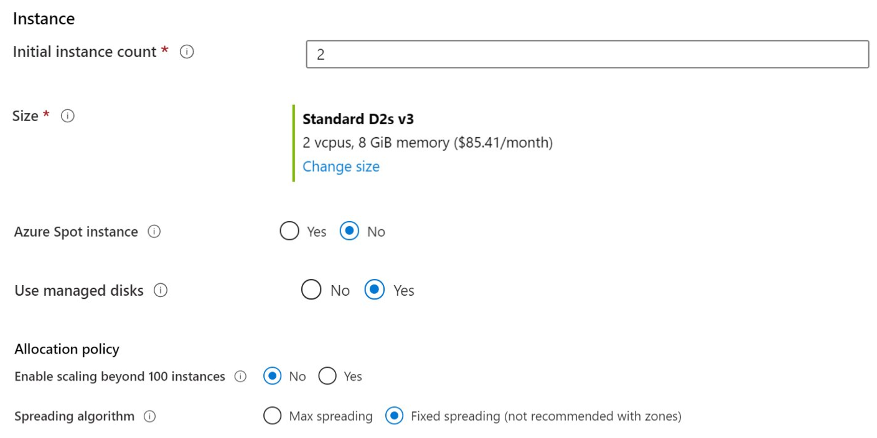
Create Scale Sets
Instance count. Number of VMs in the scale set (0 to 1000)
Instance size. The size of each virtual machine in the scale set
Azure Spot Instance. Unused capacity at a discounted rate
Use managed disks
Enable scaling beyond 100 instances
Notes:
QuickStart: Create a virtual machine scale set in the Azure portal - https://docs.microsoft.com/en-us/azure/virtual-machine-scale-sets/quick-create-portal

Slide 24
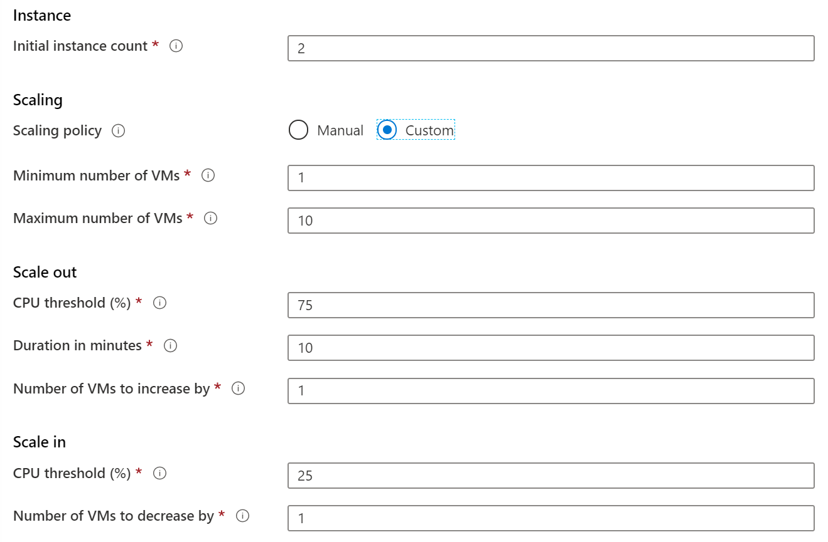
Configure Autoscale
Define a minimum, maximum, and default number of VM instances
Create more advanced scale sets with scale out and scale in parameters
Notes:
Best Practices for Autoscale - https://docs.microsoft.com/en-us/azure/monitoring-and-diagnostics/insights-autoscale-best-practices

Slide 25


Demonstration – Virtual Machine Scaling
Create a scale out rule
Create a scale in rule
Notes:
✔ Always consider having students walk-through the demonstrations themselves. Also, consider the overlap with the formal labs and your best use of time.

Slide 26
Summary and Resources – Configure Virtual Machine Availability
Knowledge Check Questions
Microsoft Learn Modules (docs.microsoft.com/Learn)
Build a scalable application with virtual machine scale sets
Implement scale and high availability with Windows Server VM
Notes:
Learn - https://docs.microsoft.com/en-us/learn/browse
The Assessment Guide in the MCT DLC has open-ended questions.
What is the difference between virtual and horizontal scaling?
Answer: Vertical scaling (scale up and scale down) is the process of increasing or decreasing power to a single instance of a workload. For example, selecting a virtual machine with more memory or faster CPU performance. Horizontal scaling (scale out and scale in) is the process of increasing or decreasing the number of instances of a workload. For example, adding additional virtual machines as the workload increases. Vertical scaling is usually a manual process. Horizontal scaling is usually automated.
What is a virtual machine scale set and when would you want to deploy them?
Answer: Azure virtual machine scale sets let you create and manage a group of load-balanced VMs. Scale sets provide redundancy and improved performance, applications are typically distributed across multiple instances. Each instance is identical, no pre-provisioning is required. As demand goes up more VMs are added. As demand goes down instances are removed. Scaling can be manual, automated, or a combination of both. To control costs, you control the instance count.

Slide 27
Configure Virtual Machine Extensions

Slide 28
Configure Virtual Machine Extensions Introduction
Implement Virtual Machine Extensions
Implement Custom Script Extensions
Implement Desired State Configuration
Demonstration – Custom Script Extension (optional)
Summary and Resources
Notes:
Lesson overview

Slide 29
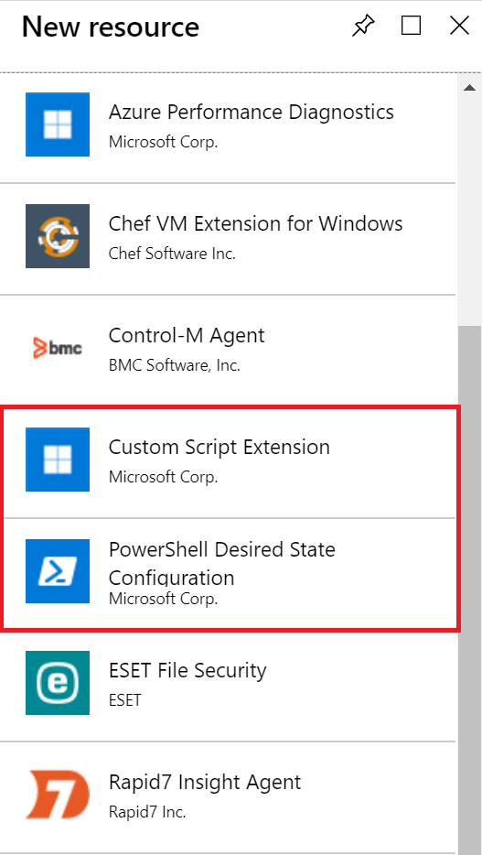
Implement Virtual Machine Extensions
Extensions are small applications that provide post-deployment VM configuration and automation tasks
Managed with Azure CLI, PowerShell, Azure Resource Manager templates, and the Azure portal
Bundled with a new VM deployment or run against any existing system
Different for Windows and Linux machines
Notes:
Virtual machine extensions and features for Windows - https://docs.microsoft.com/en-us/azure/virtual-machines/extensions/features-windows?toc=%2Fazure%2Fvirtual-machines%2Fwindows%2Ftoc.json
Virtual machine extensions and features for Linux - https://docs.microsoft.com/en-us/azure/virtual-machines/extensions/features-linux

Slide 30
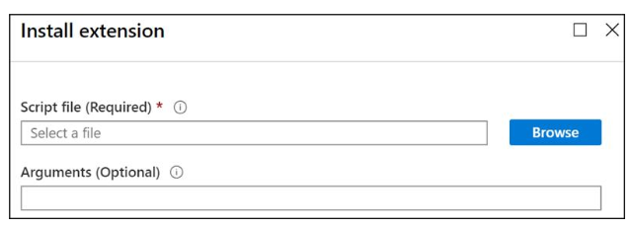
Implement Custom Script Extensions
Extension scripts can be simple or complex
Extensions have 90 minutes to run
Double check dependencies to ensure availability
Account for any errors that might occur
Protect/encrypt sensitive information
Notes:
Custom Script Extension for Windows - https://docs.microsoft.com/en-us/azure/virtual-machines/extensions/custom-script-windows
Use the Azure Custom Script Extension Version 2 with Linux virtual machines - https://docs.microsoft.com/en-us/azure/virtual-machines/extensions/custom-script-linux
Protect your virtual machine settings with Azure Automation State Configuration (Learn) - https://docs.microsoft.com/learn/modules/protect-vm-settings-with-dsc/
✔ Can you think of any custom script extensions that you might want to create? For PowerShell use the Set-AzVmCustomScriptExtension command.

Slide 31
Implement Desired State Configuration
configuration IISInstall
{
Node “localhost”
{
WindowsFeature IIS
{
Ensure = “Present”
Name = “Web-Server”
}
}
}
Configuration block(s) have a name
Node blocks define the computers or VMs that you are configuring
Resource block(s) configure the resource and its properties
There are many built-in configuration resources
Notes:
Introduction to the Azure Desired State Configuration extension handler - https://docs.microsoft.com/en-us/azure/virtual-machines/extensions/dsc-overview

Slide 32
Demonstration – Custom Script Extension
Verify the Web Server feature is available on a virtual machine
Create a PowerShell script file to install the Web Server
Configure an Extension in the Portal to run the script
Verify the Web Server feature was installed
Notes:
✔ Always consider having students walk-through the demonstrations themselves. Also, consider the overlap with the formal labs and your best use of time.

Slide 33
Summary and Resources - Configure Virtual Machine Extensions
Knowledge Check Questions
Microsoft Learn Modules (docs.microsoft.com/Learn)
Automate the configuration of Windows Server IaaS Virtual Machines
Protect your virtual machine settings with Azure Automation State Configuration (Sandbox)
A sandbox indicates a hands-on exercise.
Notes:
Learn - https://docs.microsoft.com/en-us/learn/browse
The Assessment Guide in the MCT DLC has open-ended questions.
What is a virtual machine extension and when would you use it?
Answer: Azure VM extensions are small applications that provide post-deployment configuration and automation tasks on Azure VMs. For example, if a virtual machine requires software installation, anti-virus protection, or to run a script inside of it, a VM extension can be used. Azure VM extensions can be run with the Azure CLI, PowerShell, Azure Resource Manager templates, and the Azure portal.

Slide 34
Lab 08 – Manage Virtual Machines

Slide 35
Lab 08 – Manage Virtual Machines
Lab scenario
You are tasked with identifying different options for deploying and configuring Azure Virtual Machines
Objectives
Task 1: Deploy zone-resilient Virtual Machines in the Azure portal and with templates
Task 2: Configure Azure Virtual Machines by using virtual machine extensions
Task 3: Scale compute and storage for Azure Virtual Machines
Task 4: Deploy zone-resilient scale sets by using the Azure portal
Task 5: Configure Azure virtual machine scale sets by using extensions
Task 6: Scale compute and storage for Azure virtual machine scale sets
Next slide for an architecture diagram
Notes:
LAB 08 - Manage Virtual Machines - ESTIMATED DURATION 50 MIN
Lab Repository - https://microsoftlearning.github.io/AZ-104-MicrosoftAzureAdministrator/

Slide 36









Lab 08 – Architecture diagram
Task 1
Task 2
Task 3, Task 4, Task 5, Task 6, Task 7
az104-08-rg01
az104-08-rg02
az104-06-vnet01 10.80.0.0/20
az104-08-rg02-vnet 10.82.0.0/20
Subnet0 10.80.0.0/24
Subnet0 10.82.0.0/24
az10408rg01diag938
az104-08-vm0
10.80.0.4
az104-08-vm1
10.80.0.5
az10408vmss0
az10408vmss0-lb
Zone1
Zone2
scripts
az10408vmss0-nsg
az10408vmss0-ip
az104-08-install_IIS.ps1

Slide 37

End of presentation

Slide 38
Planning Checklist
Start with the network
Understand the pricing model
Name the VM
Consider storage for the VM
Decide the location for the VM
Select an operating system
Determine the size of the VM
Notes:
Azure Virtual Machine Documentation - https://docs.microsoft.com/en-us/azure/virtual-machines/

Slide 39
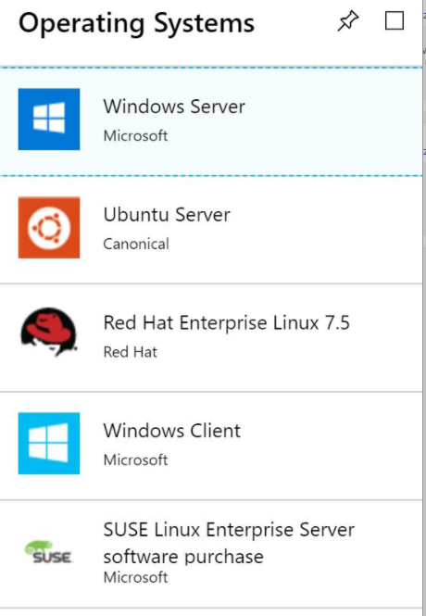
Supported Operating Systems
Windows Server includes many common products, requires a license, doesn’t support OS upgrades
Linux distributions are supported, upgrade of the OS is supported
Notes:
Microsoft server software support for Microsoft Azure Virtual Machines - https://support.microsoft.com/en-us/help/2721672/microsoft-server-software-support-for-microsoft-azure-virtual-machines
Linux on distributions endorsed by Azure - https://docs.microsoft.com/en-us/azure/virtual-machines/linux/endorsed-distros#supported-distributions–versions.

Slide 40
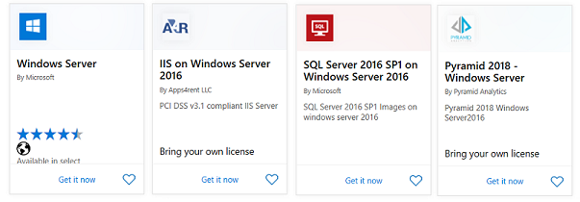
Windows Virtual Machines
Unique hybrid capabilities
Advanced multi-layer security
Faster innovation for applications
Unprecedented hyper-converged infrastructure
Notes:
Windows Virtual Machines Documentation - https://docs.microsoft.com/en-us/azure/virtual-machines/windows/
Create a Windows virtual machine from a Resource Manager template - https://docs.microsoft.com/en-us/azure/virtual-machines/windows/ps-template
Create a VM from a VHD by using the Azure portal - https://docs.microsoft.com/en-us/azure/virtual-machines/windows/create-vm-specialized-portal
Deploy Azure virtual machines from VHD templates (Learn) - https://docs.microsoft.com/en-us/azure/virtual-machines/windows/create-vm-specialized-portal

Slide 41
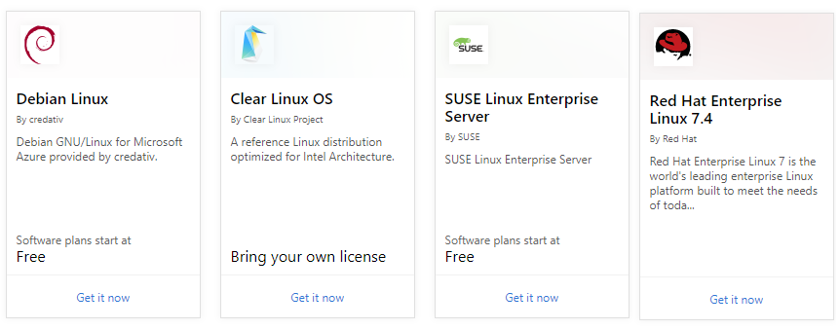
Linux Virtual Machines
Hundreds of community-built images in the Azure Marketplace
Linux has the same deployment options as for Windows VMs
Manage Linux VMs with many popular open-source DevOps tools
Notes:
How to use SSH keys with Windows on Azure - https://docs.microsoft.com/en-us/azure/virtual-machines/linux/ssh-from-windows
Linux Virtual Machines (Documentation) - https://docs.microsoft.com/en-us/azure/virtual-machines/linux/

Slide 42
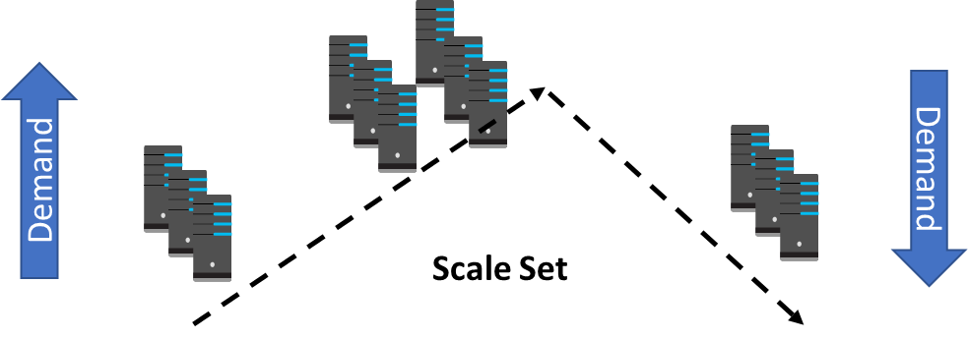
Implement Scale Sets
Scale sets deploy a set of identical VMs
No pre-provisioning of VMs is required
As demand goes up VMs are added
As demand goes down VM are removed
The process can be manual, automated, or a combination of both
Notes:
What are virtual machine scale sets? - https://docs.microsoft.com/en-us/azure/virtual-machine-scale-sets/overview

Slide 43
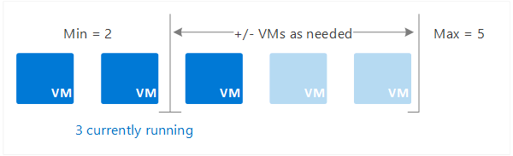
Implement Autoscale
Define rules to automatically adjust capacity
Scale out (increase) the number of VMs in the set
Scale in (reduce) the number of VMs in the set
Schedule events to increase or decrease at a fixed time
Reduces monitoring and optimizes performance
Notes:
✔️ Autoscale minimizes the number of unnecessary VM instances that run your application when demand is low, while customers continue to receive an acceptable level of performance as demand grows and additional VM instances are automatically added.

